Slide 1
Operating System Support for Data Acquisition in Sensor Networks
L.F. Wanner, Arliones Stevert Hoeller Junior,
A.B. de Oliveira and A. A. Fröhlich
arliones@lisha.ufsc.br
  http://www.lisha.ufsc.br/~arliones
  September 12, 2006

Slide 2
Introduction
Sensors
  Key role in embedded systems
Sensing subsystem
  Modular hardware design == device heterogeneity
  Architectural differences
    Cannot be trivially abstracted
    Should not be forwarded to the application

Slide 3
EPOS Sensing Subsystem (1)
Embedded Parallel Operating System
Software/hardware interface for Sensor devices
  Uniform abstraction for families of sensing devices
  Classes of sensing devices based on their finality
  Common substrate for each class.

Slide 4
EPOS Sensing Subsystem (2)
Individual devices implement the interface
Thin software layer for adaptation
  Conversions to common physical units
  Applying calibration factors
A simple thermistor is exported to an application in the exact same fashion as a complex digital temperature sensor.
Self-description
  Similar to the IEEE 1451 standard sensors transducer electronic data sheet.

Slide 5
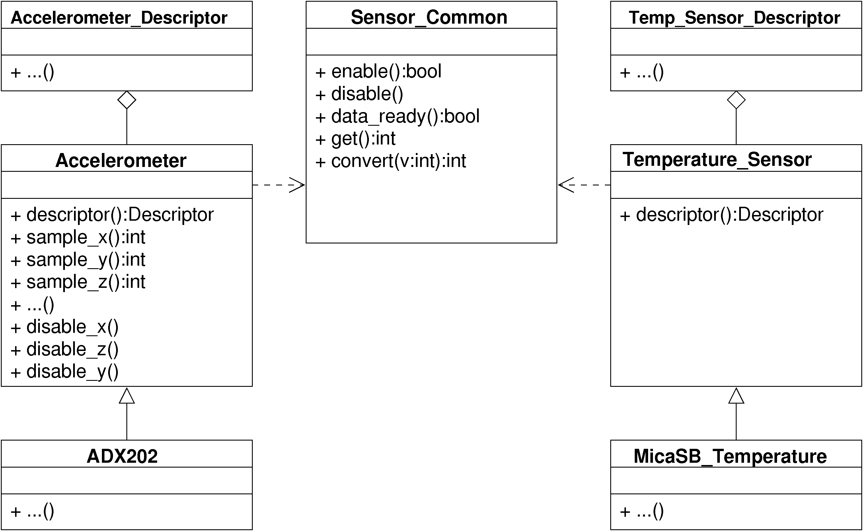
Overview

Slide 6
Sample application
Basic sensing application configuration.
  Null_Sensor
  Accelerometer
  ADXL202
struct Msg {
int x,y;
};
int main()
{
Msg msg;
NIC nic;
Null_Sensor sensor;
while(1) {
msg.x = sensor.sample_x();
msg.y = sensor.sample_y();
nic.send(NIC::BROADCAST, 0,
&msg, sizeof(msg));
}
}

Slide 7
Results

Slide 8
Conclusions
High level sensing subsystem
Uniform abstraction of families of sensing devices
Self-description similar to IEEE 1451
Very small overhead

