Slide 1
Configurable Medium Access Control for Wireless Sensor Networks
  Lucas F. Wanner, Augusto B. de Oliveira, Antônio Augusto Fröhlich
  http://www.lisha.ufsc.br/
  IESS 2007
  June 2007

Slide 2
Outline
Overview of WSN
MACs for WSN
Communication on WSN
C-MAC
  Proposal
  Implementation
  Evaluation
Conclusions

Slide 3



Communication on WSN
There is no “single best” MAC protocol
  Aloha, B-MAC, S-MAC, T-MAC, WiseMAC, LMAC, ...
Configurable communication
  Different communication patterns for different applications
  Energy efficiency is the main concern
Fire!!!
Duck.

Slide 4



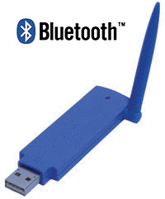
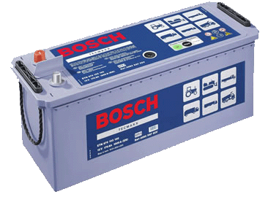

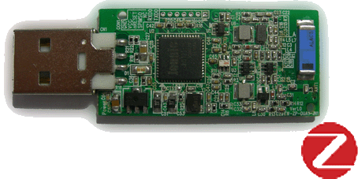

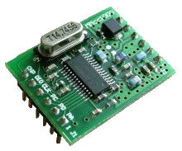

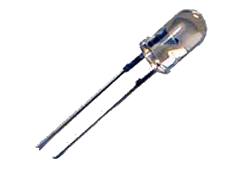
Wireless Communication HW
MAN
LAN
Power Consumption
PAN
Data Rate

Slide 5
Wireless Sensor Networks
Low-power hardware
Limited resources
Software-defined MAC
  Control access to the shared medium
  Avoid interferences between transmissions
  Define packet format
  Perform local/global synchronization
X

Slide 6

MACs for WSN
Nodes powered by batteries
  Turn off the radio whenever possible!
Main sources of power overhead
  Idle listening (nodes must listen for potential messages)
  Collisions
X
X

Slide 7
MACs for WSN
Main sources of power overhead (cont.)
  Overhearing (the radio channel is a shared medium)
  Traffic fluctuations (higher competition for the medium)
  Protocol overhead
Message Packet
X

Slide 8
Communication on WSN
No “single best” MAC protocol
  Different applications, different communication needs
Configurable communication could
  Provide an unified communication interface
  Provide a configuration framework
  Enable applications to reach energy/communication efficiency

Slide 9
C-MAC
Configurable Medium Access Control for Wireless Sensor Networks
  Different MAC services
  Different strategies
  Configuration architecture
Framework to build functional MAC protocols
  Pre-defined configuration points
  Protocol: compile-time (configurable traits)
  Parameters: run-time

Slide 10
C-MAC
Fundamental configuration points
  Communication parameters
    Frequency, power, modulation
  Duty cycle
    Defines organization, or lack thereof
  Collision avoidance mechanism
    None
    Global synchronization
  Collision detection mechanism
    Confirmation
  Collision handling mechanism
    Retransmission
    Chanel sampling
    RTS/CTS
    None
    None

Slide 11
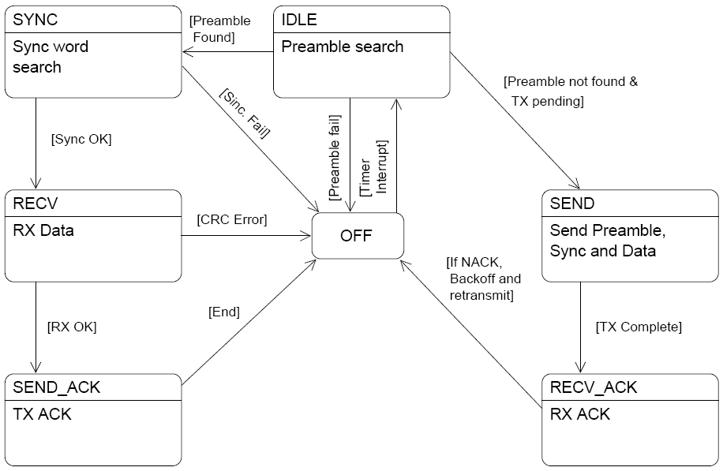
C-MAC: State Machine Overview

Slide 12
C-MAC: Evaluation
Comparative Tests
  C-MAC + EPOS
  B-MAC + TinyOS
Communication Parameters
  Best reported results

Slide 13
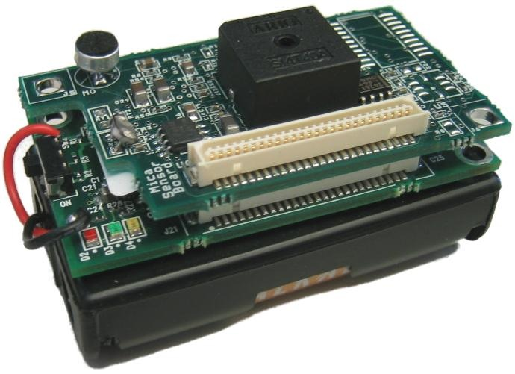
C-MAC: Evaluation

Slide 14
C-MAC: Evaluation

Slide 15
C-MAC: Evaluation

Slide 16
C-MAC: Evaluation
Footprint

Slide 17
Conclusions
“Ideal” MAC for sensor networks
  Compromise between power efficiency and communication flexibility / performance
  Current protocol designs have little space for application-determined configuration
C-MAC
  MAC “framework”
  Configuration architecture
  Competitive performance

Slide 18
Perspectives
Adaptability
  Dynamic changes in protocol behavior
    Reactive adaptation of parameters (e.g. duty cycle)
    Coordinated protocol alterations (aided by a meta-protocol)
Cross-layer optimizations
  Protocol and service integration
    Routing, transport, localization
    First step: C-MAC + HECOPS Localization Protocol
  Generalized configuration architecture
Large-scale evaluations

