Slide 1
Application-driven
Embedded System Design
Prof. Dr. Antônio Augusto Fröhlich
Giovani Gracioli
UFSC/LISHA
giovani@lisha.ufsc.br
http://www.lisha.ufsc.br/
Nov 11, 2011
Escola de Sistemas Embarcados
Teresina - Piauí

Slide 2
Overview
Embedded System
Embedded System-on-a-Chip
Ordinary Embedded System Design
Application-driven Embedded System Design
EPOS – Embedded Parallel Operating System
Case Study - EPOSMote
Final remarks

Slide 3
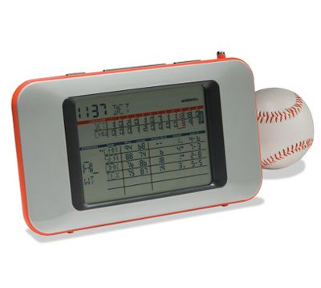

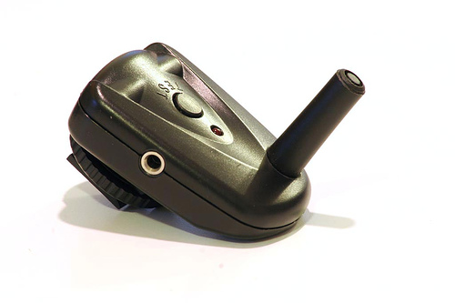
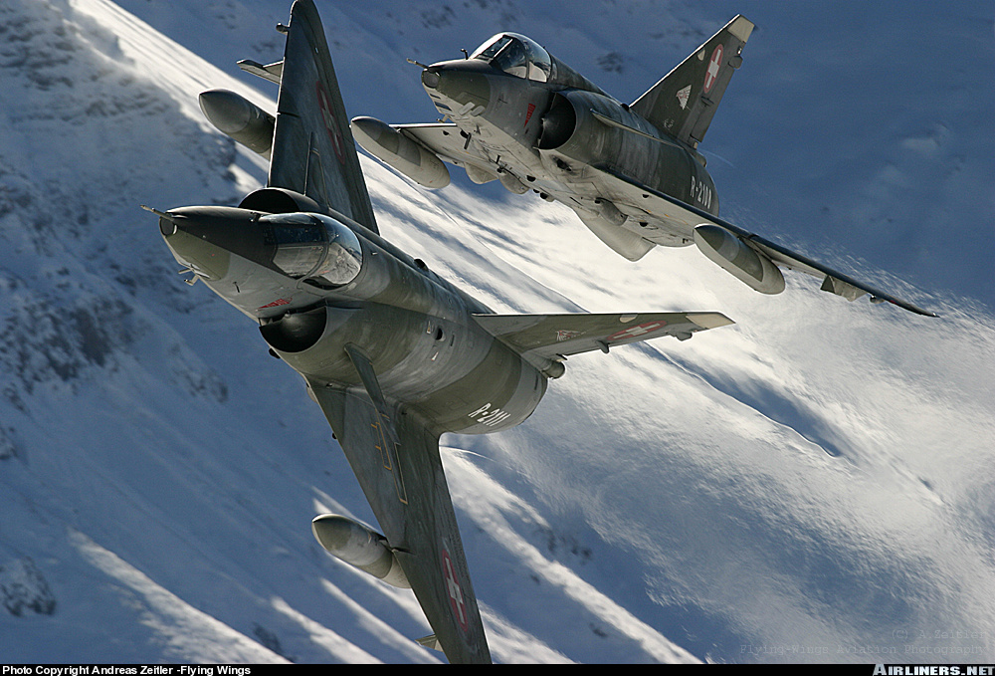
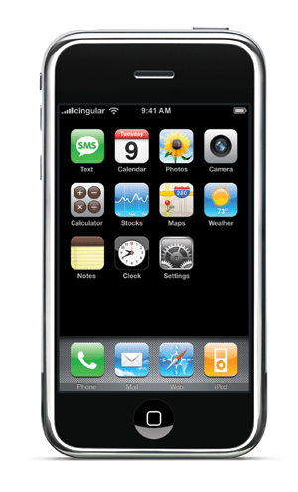
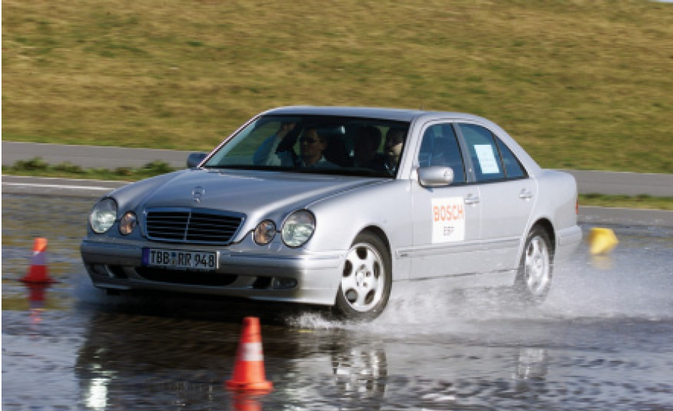
Embedded Systems: embedded!
“Hardware and software which forms a component of some larger system and which is expected to function without human intervention.”
[Foldoc]

Slide 4
Really Embedded!
Where are the processors?
(Tennenhouse, CACM 43(5):44)
Huge market
  Increased 14% (2009)
  Embedded software increased 16% (2009)
embedded
80%
8-bit
63%
robots
6%
vehicles
12%
interactive
2%
4-bit
22%
>= 32-bit
3%
16-bit
12%

Slide 5
Embedded X All-purpose
Embedded
  Dedicated
  Single, previously known application
  Small set of application-specific services and features
  Integrated hardware and software design
  Example
    EPOS SoC
All-purpose
  Generic
  Any, many applications
  Comprehensive set of services and features
  Independently designed computer, operating system, and middleware
  Examples
    PC + LINUX + JRE
    IPhone + MacOS + ???

Slide 6
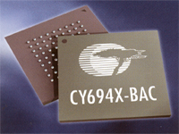
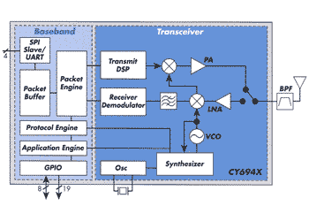
Extreme Integration
Advances in microelectronics are enabling developers to integrate complex hardware designs in a single silicon pastille
Embedded System-On-a-Chip
Variety of projects
  30% of time spent in the design
  70% testing
High degree of
complexity
Time-to-market

Slide 7
Embedded System Design
R E U S E ! ! !
“The ability of retarget previously designed components on a chip for a new design in order to reduce time to market”

Slide 8
Component Evolution
OO++
procedures
modules
classes
VB Java
models
1960
1970
1980
1990
2000
circuits
ICs
ISA
HDL IPs
platform

Slide 9
Contemporary Design Approaches
Platform-based design
“In essence, a platform is a frozen architecture. Once the architecture is frozen, you may standardize the interfaces and give the engineers some choice of building blocks.”
[Smith 2004]
Model-driven Engineering
"A promising approach to address the inability of third-generation languages to alleviate the complexity of platforms and express domain concepts effectively."
[Scmidt 2006]

Slide 10
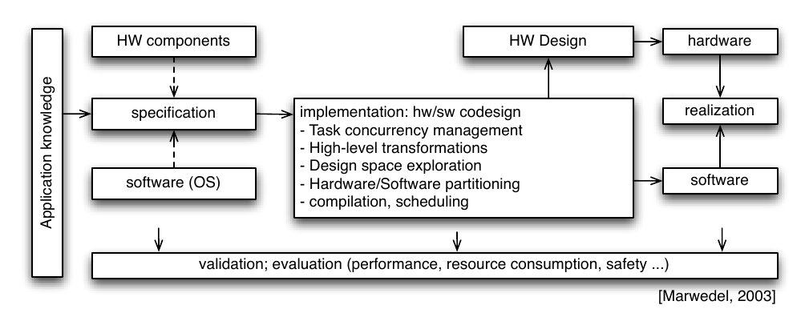
Contemporary Design Flow

Slide 11
Contemporary Development Tools
Hardware
  Focus on IP reuse and glue-logic generation
  Run-time support is mostly considered part of application's duties
  Examples
    SOPC Builder from ALTERA
    CORAL from IBM
    EDK from XILINX
Software
  Focus on models, refactoring, and transformations based on middleware
  Hardware and OS have existed since the creation of the world
  Examples
    UML and MDE tools
    JAVA and PHP RTSS
    Builders

Slide 12
A few words abut the OS...
The more complex the application is, the greater is the probability it will need some sort of run-time support system
  Core OS services (scheduling, memory management, communication, etc)
  Peripherals abstraction (sensors, actuators, etc)
  Power management
  Dynamically reconfiguration
  ...
Ordinary operating systems cannot go with the dynamism of SoCs

Slide 13
and about Hardware Soft IPs
HDLs such as VHDL, Verilog, and System C are closer to software programming language than to older hardware development strategies
There might soon be no reason to treat them differently from software components
Both domains can to learn from each other
  Software can improve on handling parallelism, coordination, and timing
  Hardware can improve on factorization, composition, and separation of concerns
Embedded system developers could thus concentrate on what really matters: applications

Slide 14
The Embedded System Challenge
We must give each embedded application an adequate execution platform ...
  that properly fulfills its requirements (no workarounds, no middleware, etc)
  that is delivered as required (application-specific API)
  it doesn't matter what is HW and what is SW
without having to design a new system for each application ...
and without requiring application developers to undergo complicated configuration procedures
Notes:
- Each dedicated application deserves its own RTS
- Neither less nor more than what is necessary to support the application

Slide 15
A Plausible Solution
Apply domain engineering techniques
to produce embedded system components (SW / HW / hybrid) that can be (automatically) tailored according with the needs of specific applications
A new methodology emerged
  Application-driven Embedded System Design
Family-based design
Object-oriented design
Feature-based modeling
Application-oriented design
Aspect-oriented programming
Generic programming
Static metaprogramming
Generative programming

Slide 16
Application-oriented
Domain Decomposition
Families of
Abstractions
Frameworks
Domain
interface
adapt
asp
feature
family
aspect
adapt
scen.
member
member
member
adapt
asp
member

Slide 17
Application-oriented
Domain Decomposition
Abstractions model domain entities
Commonality analysis
  Build families of abstractions
Variability analysis
  Shape family members (subclassing or not)
  Isolate scenario aspects
Factorization
  Configurable features
Inter-family relationships
  System-wide properties
  Reusable architectures

Slide 18
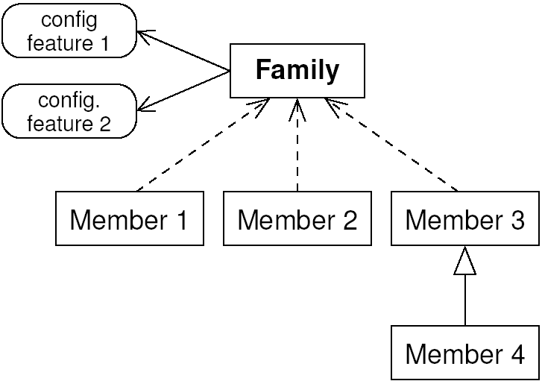
Scenario-Independent Abstractions
Can be reused in a variety of scenarios
Yield components
  Application-ready ADTs
  Correspondence with domain entities
Families
  Class hierarchy
  Cooperating classes
  Common packages
    Base class or utility classes
    Configurable features
Notes:
Interfaces
Fundamental
ADTs
Can include constructors
Class realize a single interface
Families
Subtyping
Subclassing

Slide 19
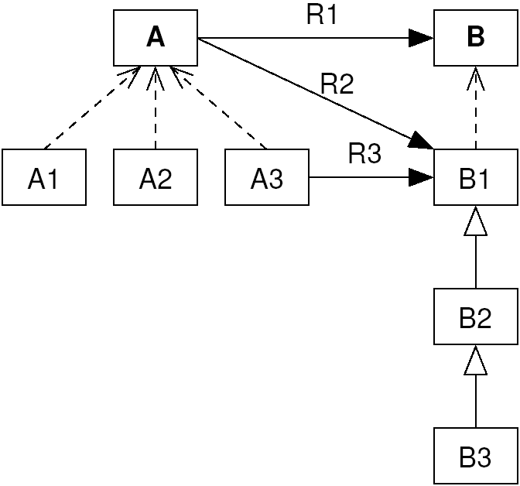
Inter-Family Relationships
Shape framework composition rules
Well captured with feature-based models
Avoid
  Restrictive rules
  Loose rules
  Relations for the sake of reuse
    Factorization

Slide 20
Scenario Aspects
Properties that transcend the scope of single abstractions
  Scenario dependencies
  Non-functional properties
Can be organized as families too
Applied to abstractions by
  Weavers
  Scenario adapters
aspect
aspect
Scenario
Scenario Adapter
Client
Abstraction

Slide 21
Configurable Features
Configurable features differ from aspects in that
  They are specific to a single family of abstractions (do not crosscut families)
  They are not transparent to abstractions
    but encapsulate generic programming implementations of algorithms and data structures associated to the feature that can be reused by abstractions when the feature is turned on
Example: family of networks
  Features as multicast, in-order delivery, and error detection

Slide 22
Inflated Interfaces
Export families of abstractions to applications as if they were a single abstraction
  Well-known to application programmers
  Comprehensive
  Promote requirement analysis
Support automatic generation
  Interface references can be extracted from specifications and trigger the search for adequate components
Rely on feature models

Slide 23
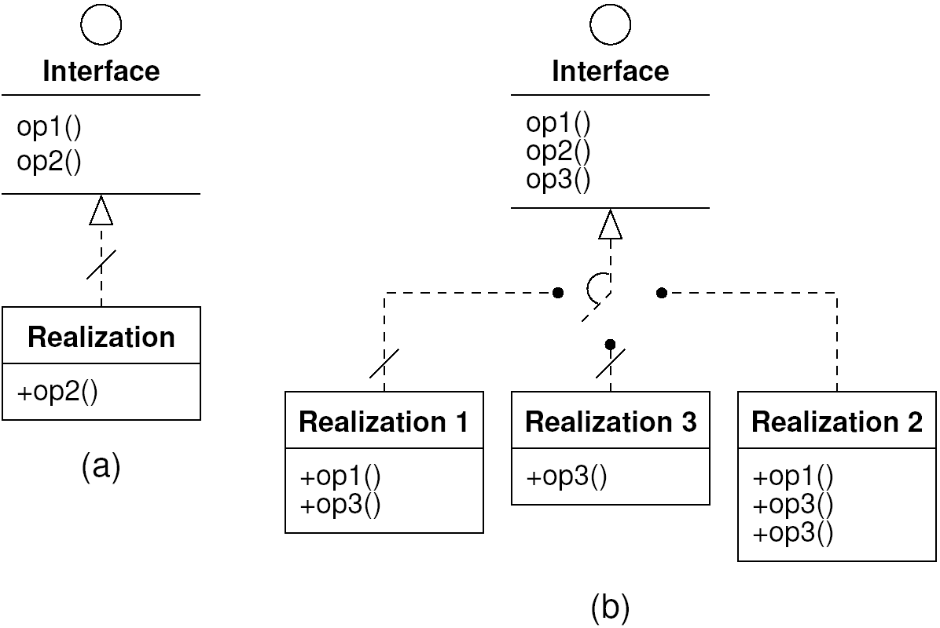
Partial and Selective Realization

Slide 24
Component Frameworks
Also known as “black-box frameworks”
  Based on the idea of components and defined interfaces (in opposition to inheritance and overriding used in white-box frameworks)
  The reuse of a component does not imply on reusing the whole framework along with it
Defined as compositions of scenario adapters (placeholders for components) and a configuration knowledge base that specifies components' requirements and dependencies

Slide 25
Application-oriented
Embedded System
application
interfaces
scenario adapters
system micro-components
(hardware / software)
system abstractions

Slide 26
The EPOS System
Embedded Parallel Operating System
  A collection of SW/HW components
  A meta-programmed framework
  A set of tools to assist the selection, configuration and adaptation of components
10 years old
50 man/year work (10 % committed)
Mostly academic
  CS courses on OS and Embedded Systems
But also industrial
  Telecom
  Multimedia

Slide 27
EPOS Tool Chain
application's
source code
specified interfaces
framework
Analyzer
Info
Configurator
tailored EPOS
SW
HW
Generator
HW
SW
scenario
aspects
frameworks
elements (glue logic)
components, mediators and IPs

Slide 28
EPOS Framework Metaprogram

Slide 29







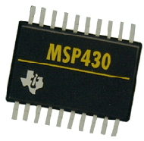
EPOS Scales ...
Power
Cost

Slide 30
... sustaining Real
Design Space Exploration ...
Power
Cost

Slide 31

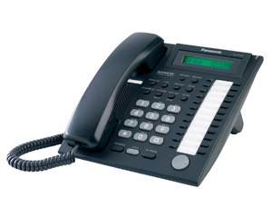
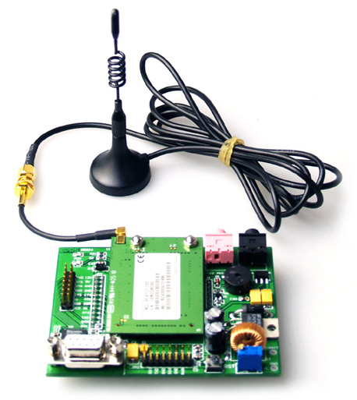
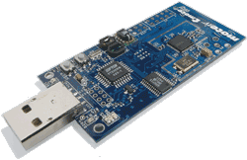
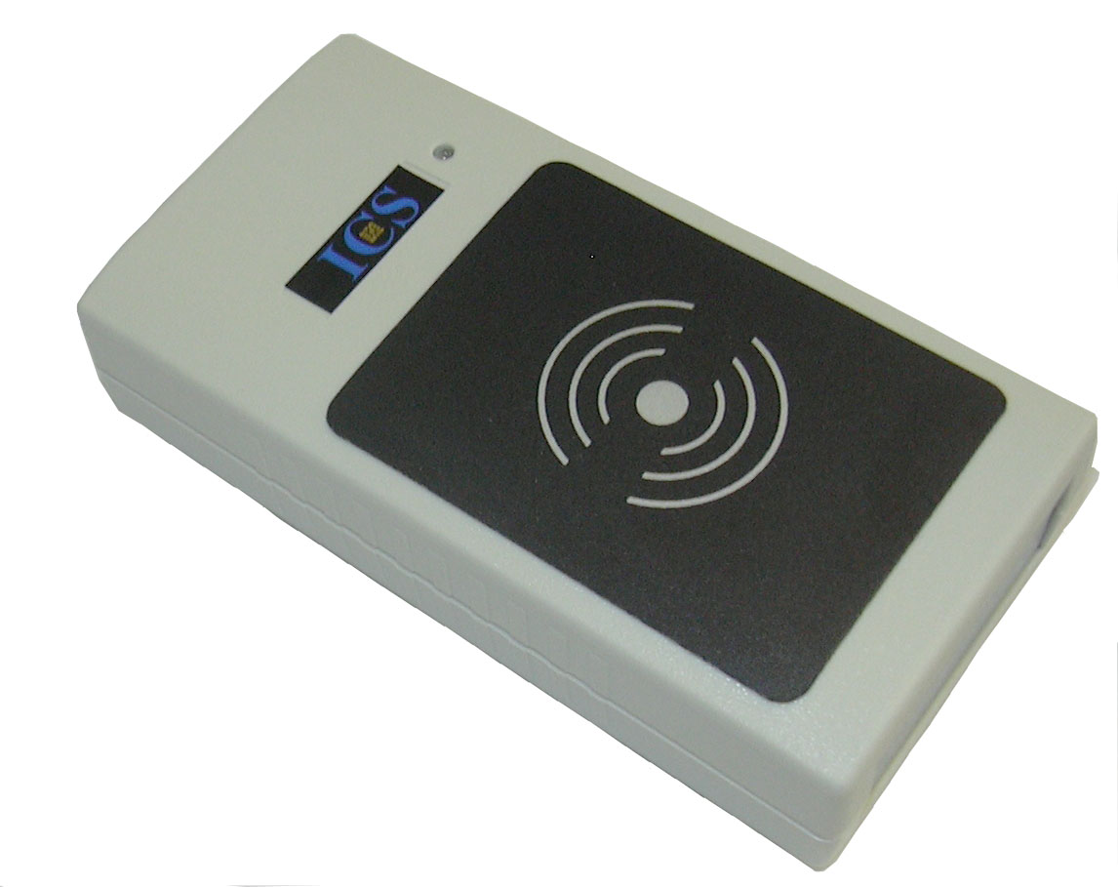
for the sake of Applications
multimedia
Power
VoIP
telemetry
sensor networks
coontrol
Cost

Slide 32
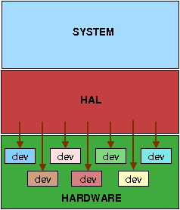
Hardware Abstraction Layers

Slide 33
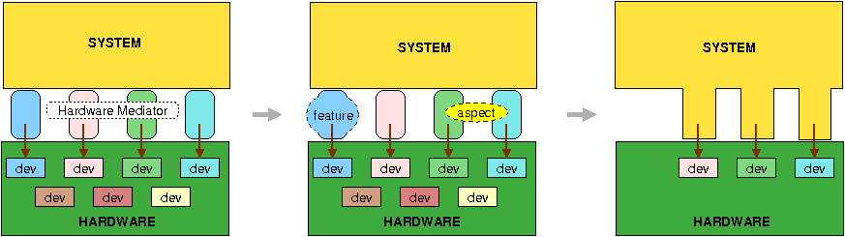
Hardware Mediators
Sustain an interface contract between system abstractions and the machine
Mostly metaprogrammed

Slide 34
EPOS Sample Instance
Single task
Multiple threading
Cooperative scheduling (co-routines)
Dynamic memory allocation

Slide 35
EPOS X eCos: footprint
eCos - Embedded Cygnus Operating System
  Customizable run-time support system by RedHat
  Manual configuration
  HAL-based
Evaluated instance of eCos
  Same configuration as EPOS

Slide 36
EPOS X eCos: performance
IA-32-based platform
  Time taken for a consecutive number of context-switching operations and memory allocations

Slide 37
Power Management in EPOS
Application-driven
Hierarchical
  At high-level abstractions, propagated to mediators
  Formalized with Petry Nets
Semantic modes
  OFF
  SUSPEND (hibernation and reconfiguration)
  STAND BY (short-time resume)
  LIGHT (fully functional, low power)
  FULL (performance)
Autonomous manager integrated within the real-time scheduler

Slide 38
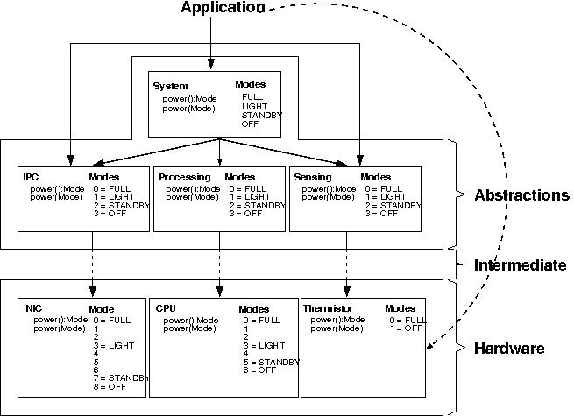
PM Event Propagation

Slide 39
Software Update in EPOS
Host
Base Station
Node
Data
preparation
Dissemination
Reconfiguration
Application
Binary
Update data
Packages
OS

Slide 40
Dynamic Reconfiguration in EPOS
Application
Application
EPOS
EPOS
Med C1
Med C2
Med C1
Med C2
Med C3
FPGA
FPGA
Soft
Core
C1
Soft
Core
C1
C3
C2
C2

Slide 41
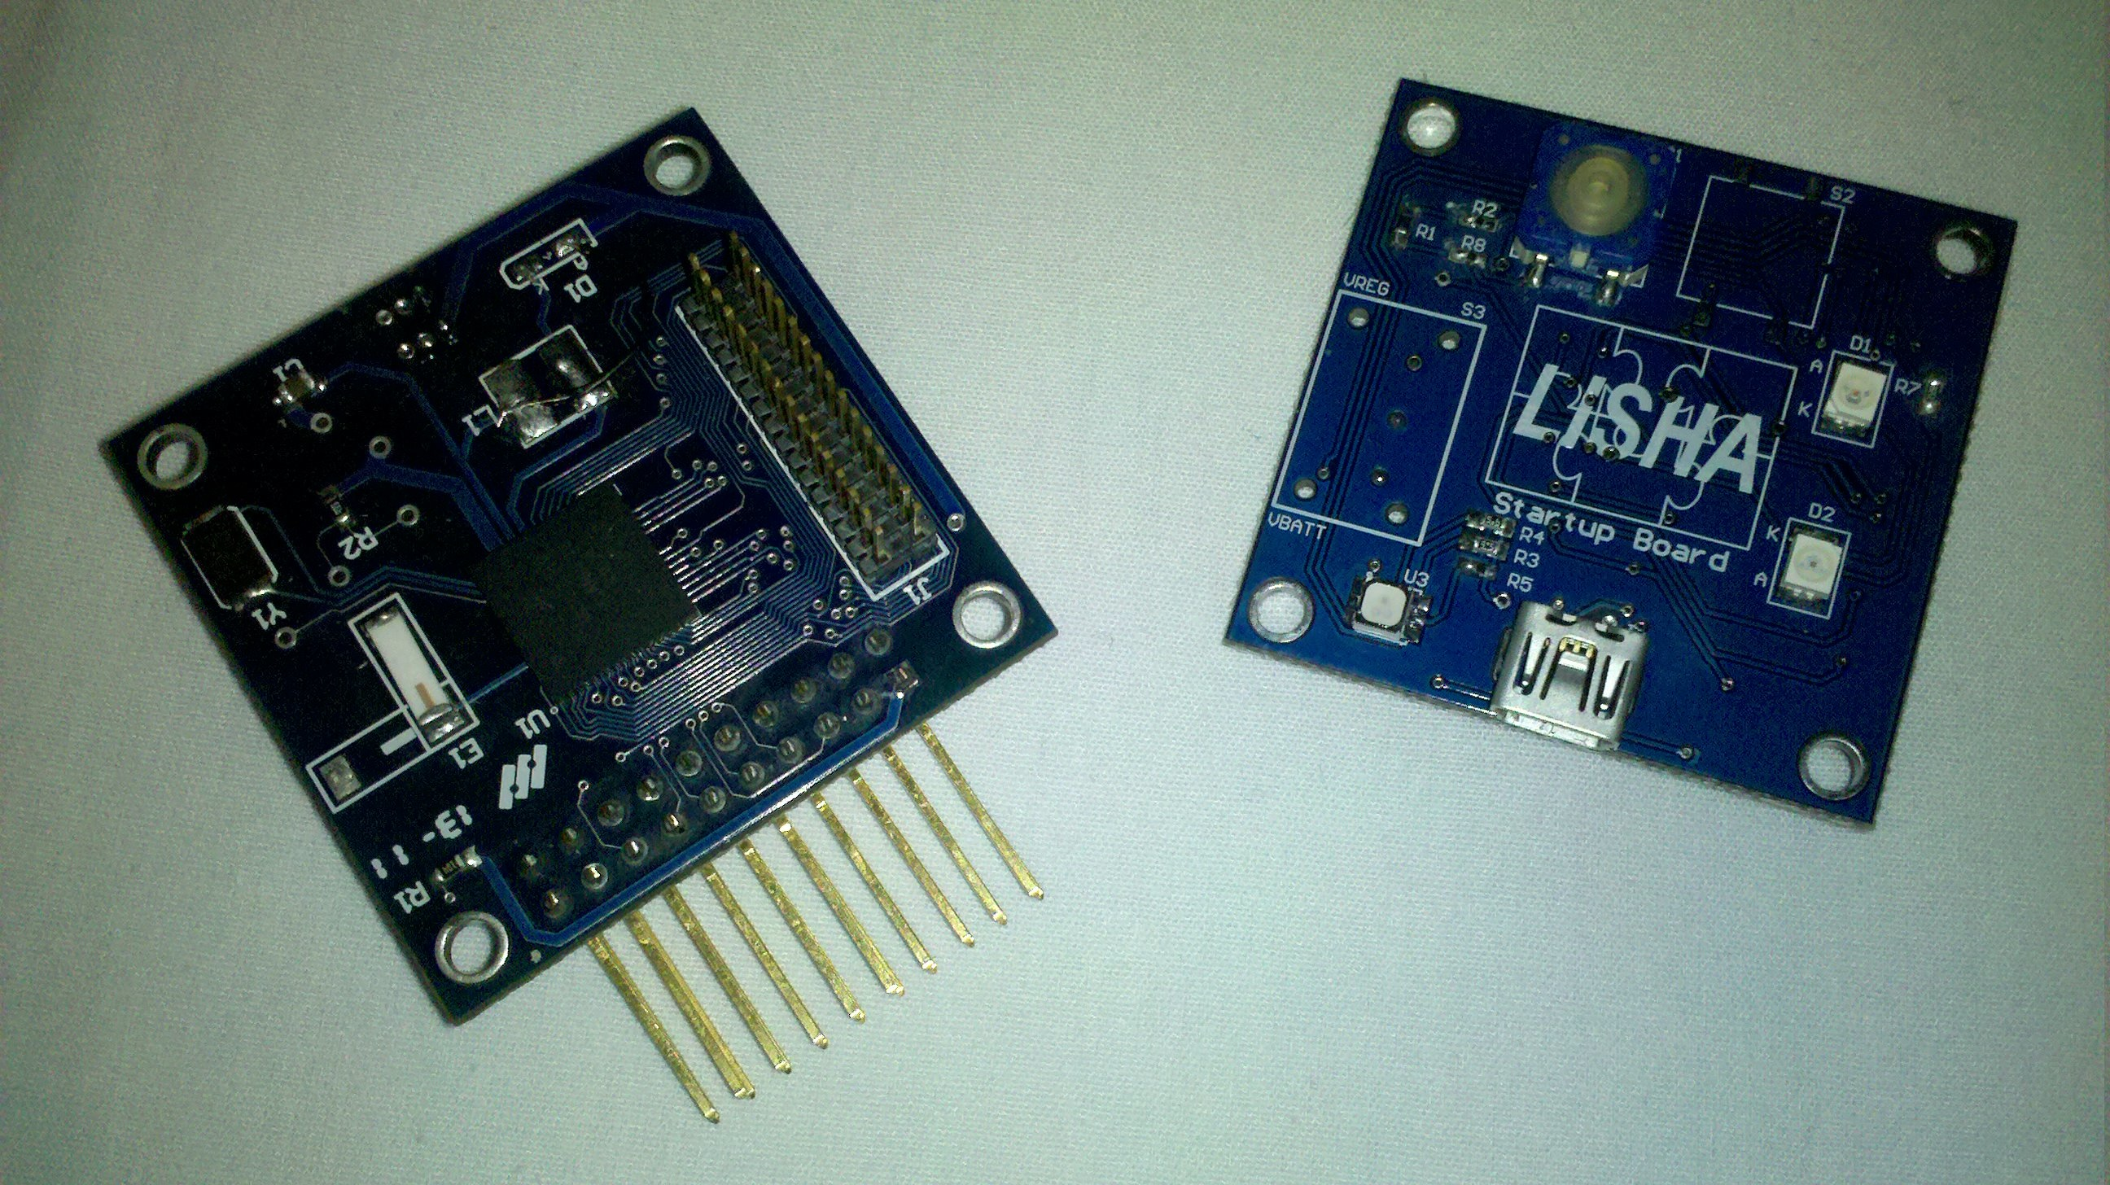

Case Study – EPOSMote I and II
MeshNetics ZigBit
8-bits ATMega1281
AT86RF230
  IEEE 802.15.4
Sensor SHT-11
  Temperature and humidity
Modular design
3 modules
  Base: CPU + radio
  I/O: sensors
  Power: battery
Freescale MC13224V
32-bits ARM7 TDMI
Integrated radio
  IEEE 802.15.4

Slide 42
Final Remarks
ADESD
  Complements traditional ES methodologies with a domain engineering strategy
  Extends the notion of platform to multiple architectures (hardware mediators)
EPOS SoCs
  Automatically generated by tools according with application requirements
    Properly designed IPs
    Hardware mediators for the target machine
  Limited by current HDL (aspects, metaprograms, etc)

Slide 43
Application-driven
Embedded System Design
Giovani Gracioli
giovani@lisha.ufsc.br
http://www.lisha.ufsc.br/Giovani

