Slide 1

Ant-based Dynamic Hop Optimization Protocol: a Routing Algorithm for Mobile Wireless Sensor Networks
Alexandre Massayuki Okazaki
Prof. Dr. Antônio Augusto Fröhlich
{alexandre,guto}@lisha.ufsc.br
Software/Hardware Integration Lab (LISHA)
Federal University of Santa Catarina (UFSC)

Slide 2
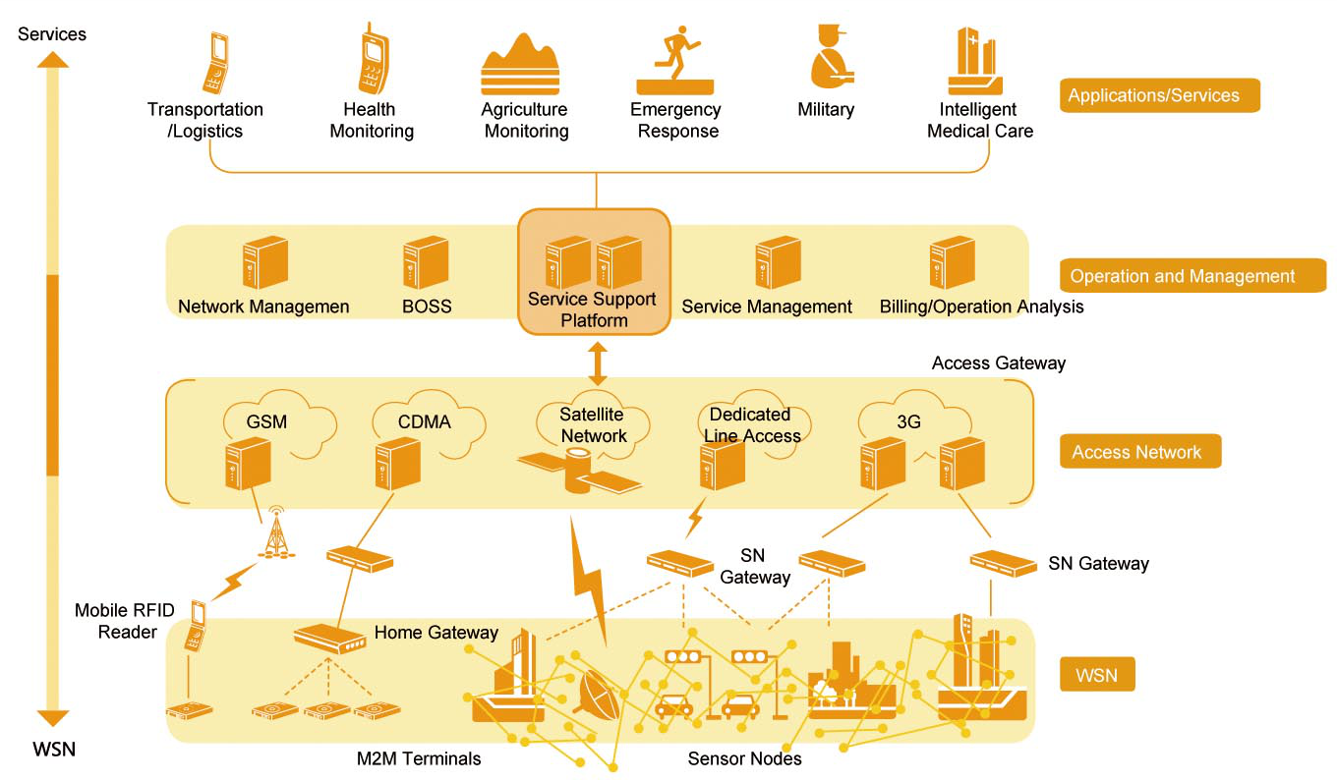
Internet of Things: Challenge

Slide 3

Smart Object Communication
Intermittent
Scalable
Self-configuring
Real-time
Power-aware
Mobility

Slide 4
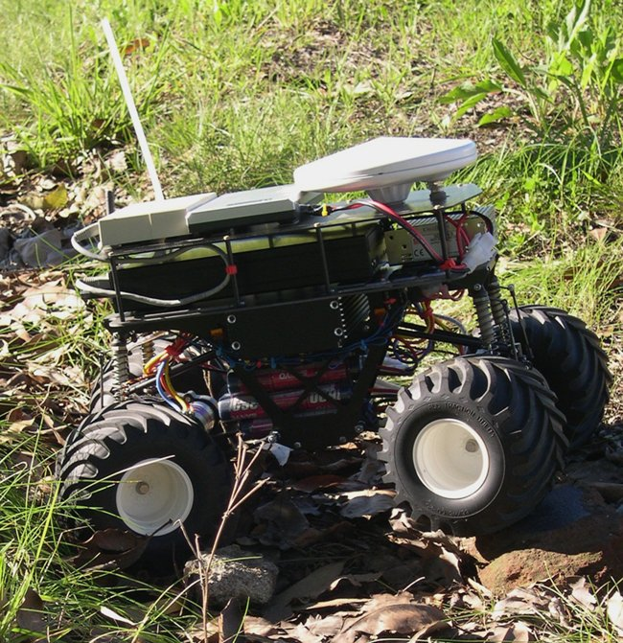
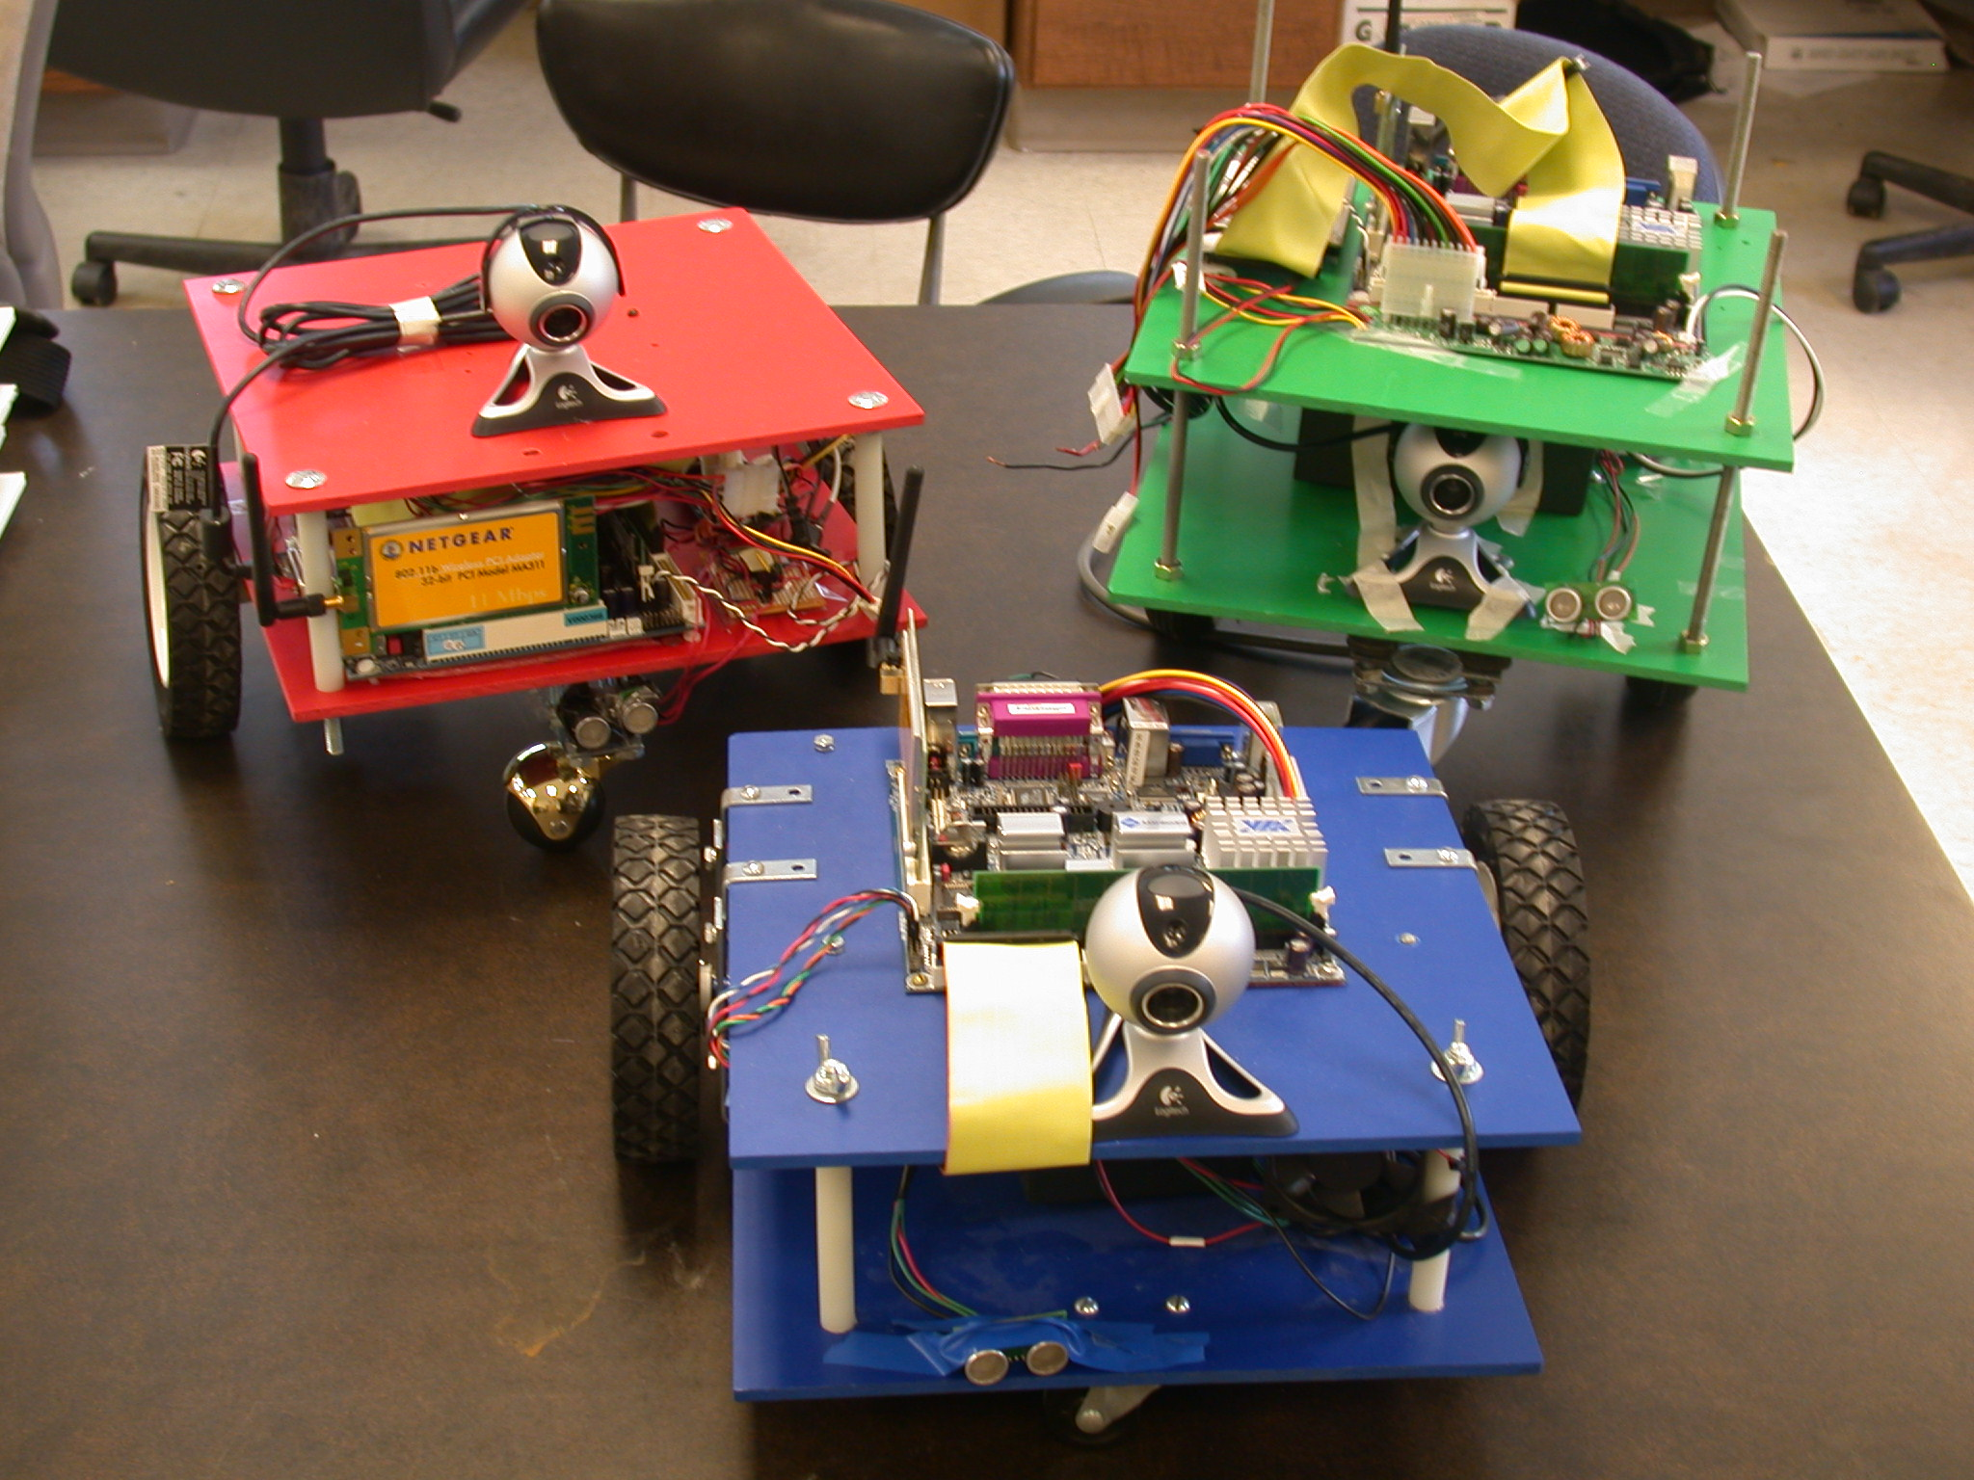
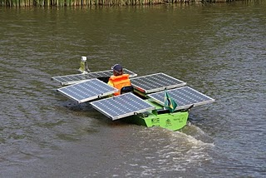
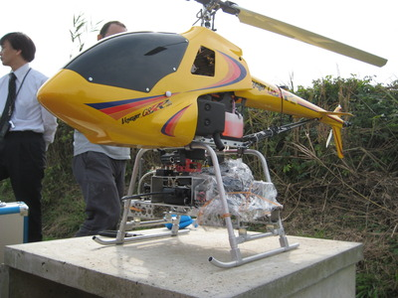
Mobility
Mobile Ad hoc NETworks (MANETs)
    Networks envisioned to be composed of mobile nodes
    But its requirements have evolved to a point where solutions for MANETs no longer apply to Wireless Sensor Networks (WSNs), e.g., energy and bandwidth
Therefore, geographic routing protocols and self-organizing protocols have been highlighted in Mobile WSNs
Notes:
Pior slide na minha opnião, e não sei como melhorar.
Estava pensando em apresentar o ADHOP e já falar das motivações e aplicações possíveis (Barco solar).
Não encontrei figuras boas de SmartBuilding (prédio solar).

Slide 5

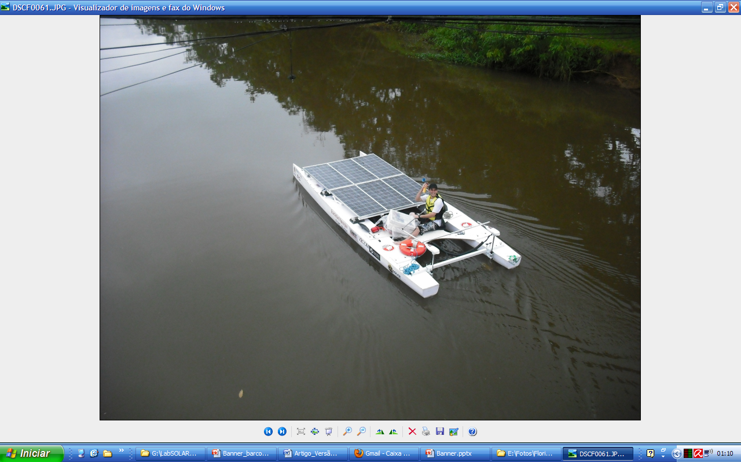

eBoat at the
Brazilian Solar Challenge

Slide 6

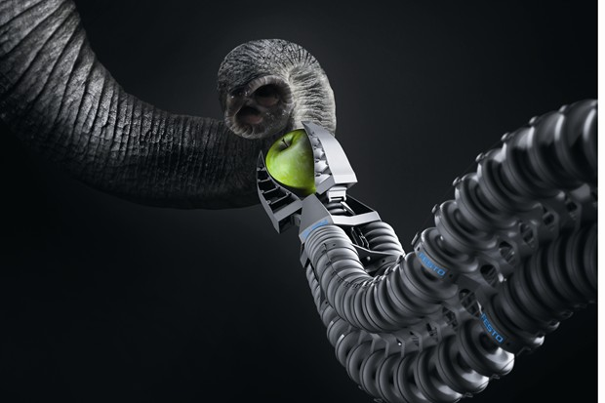


Robotic Animals - Esslingen, Germany

Slide 7
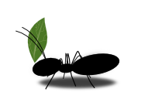
Ant Colony Optimization (ACO)
ACO improves the ability to adapt to dynamic topologies
Improving the algorithm in terms of
  route discovery
  route maintenance
And reducing the routing complexity in WSNs
  simple routing operations
  simple routing tables

Slide 8
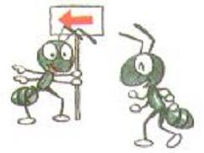
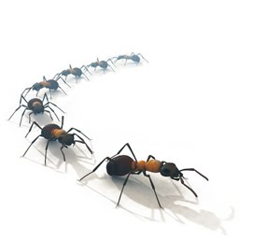
Ants
Ants in routing protocols usually act
  route discovery
  route maintenance
pheromone
use simple operations to route data over the network

Slide 9

Sensing Pheromone Trail
Notes:
Trail pheromones are common in social insects. For example, ants mark their paths with these pheromones, which are volatile hydrocarbons.
Certain ants lay down an initial trail of pheromones as they return to the nest with food. This trail attracts other ants and serves as a guide. As long as the food source remains, the pheromone trail will be continuously renewed. The pheromone must be continuously renewed because it evaporates quickly. When the supply begins to dwindle, the trail making ceases.

Slide 10

Choosing a Route to the Food
Notes:
No entanto, há casos em a formiga terá de escolher entre 2 ou mais caminhos.
A escolha sempre é feita pela quantidade de feromônio sentida pela formiga. Ela escolhe a rota com maior quantidade.

Slide 11
Routing Protocols for
Mobile WSNs
Ant-based Dynamic Zone Routing Protocol (AD-ZRP) is a routing algorithm based on the HOPNET algorithm
  Developed in Software and Hardware Integration Lab (LISHA), AD-ZRP aims at routing in Mobile WSNs
Noticing the AD-ZRP behavior, and improving some of its characteristics, we present ADHOP
  It is a self-organizing and reactive algorithm developed to support several routing heuristics and improve the dissemination of pheromone on the network

Slide 12
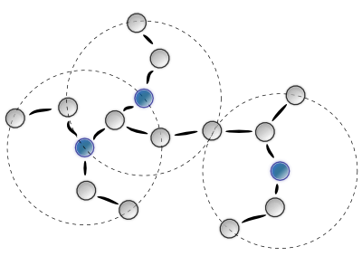
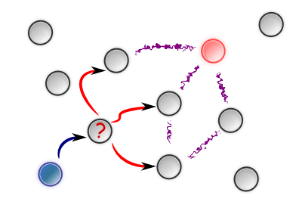
AD-ZRP ADHOP
Ant-based Dynamic Zone Routing Protocol
Too much overhead for WSNs
Ant-based Dynamic Hop Optimization Protocol
Notes:
Explicar o motivo da mudança de nomes. Como o conceito de zonas era aplicada defina de maneira errado no AD-ZRP.

Slide 13
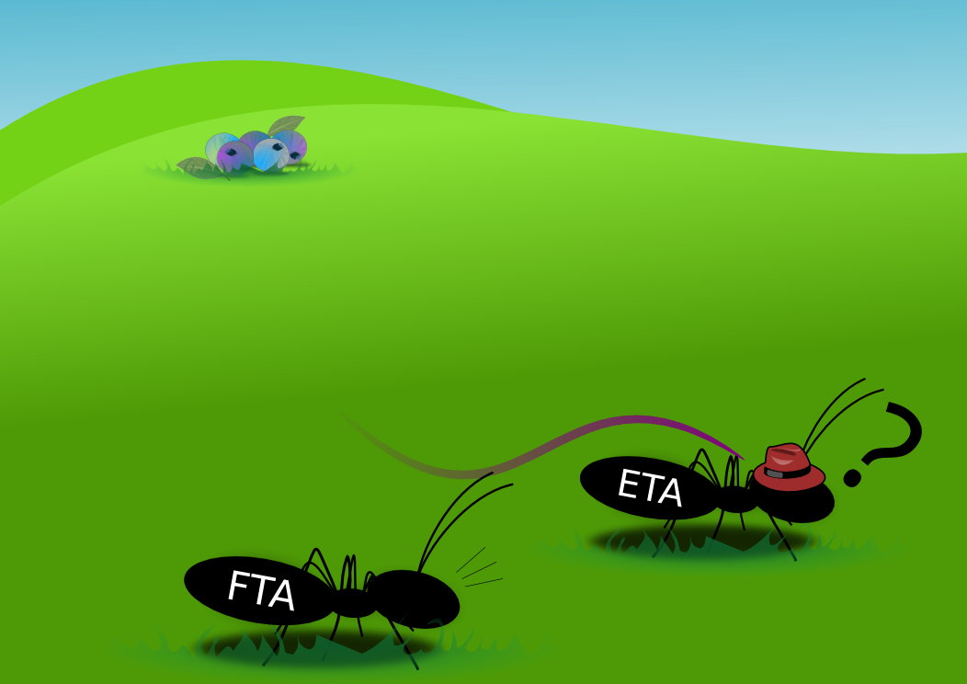
ADHOP Ants
Two types of Ants
  Exploratory Transport Ant (ETA)
  Forward Transport Ant (FTA)
Notes:
Apenas destacando os tipos de formigas do ADHOP.
ETA: responsável por descobrir rotas a nodos desconhecidos.
FTA: responsável por seguir as rotas descobertas, e reforçar o feromônio no caminho.
Ambas formigas realizam a entrega de dados.

Slide 14
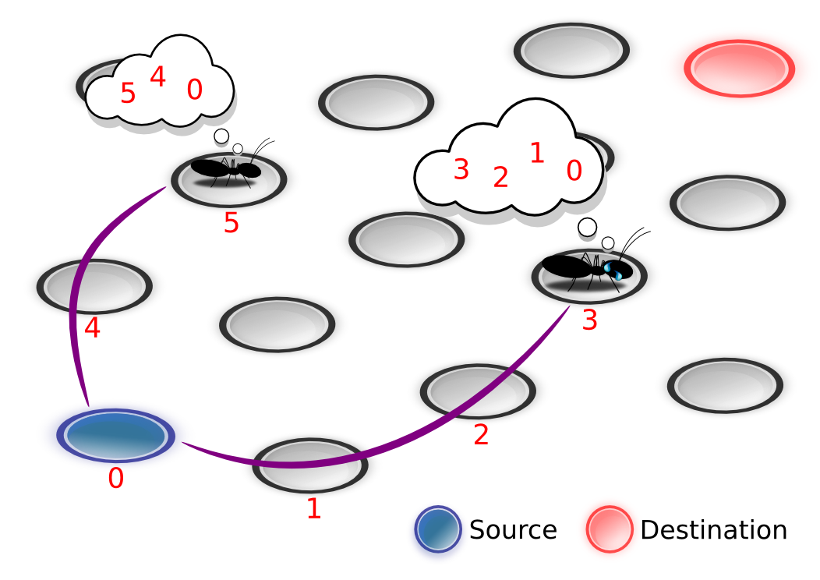
In Traditional ACO ...
Notes:
Destacar que na maiorias dos protocolos baseados em ACO, as formigas possuem memória (dos nodos em passa). Característica nada benéfica em RSSF, caso a quantidade de saltos seja muito alta.

Slide 15
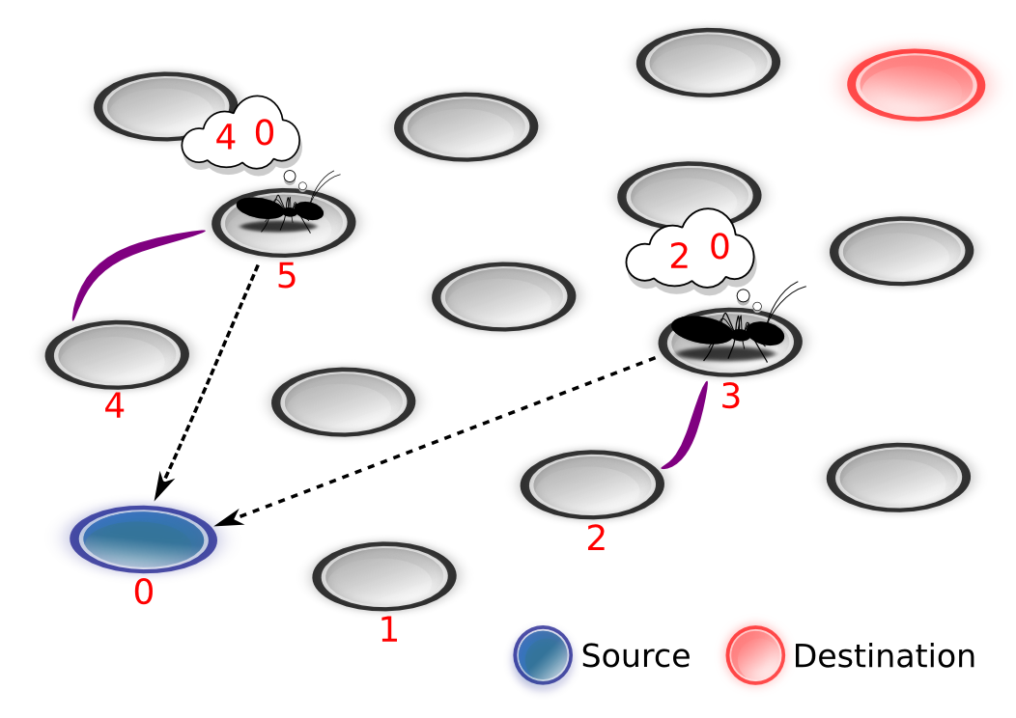
In ADHOP ...
Notes:
Diferentemente, ADHOP apenas mantém infomações sobre o “last hop”, destination e source.
Routes do not need to be stored entirely. The ants handle the dynamic changes along the routes, reducing time, processing, and memory consumption.

Slide 16
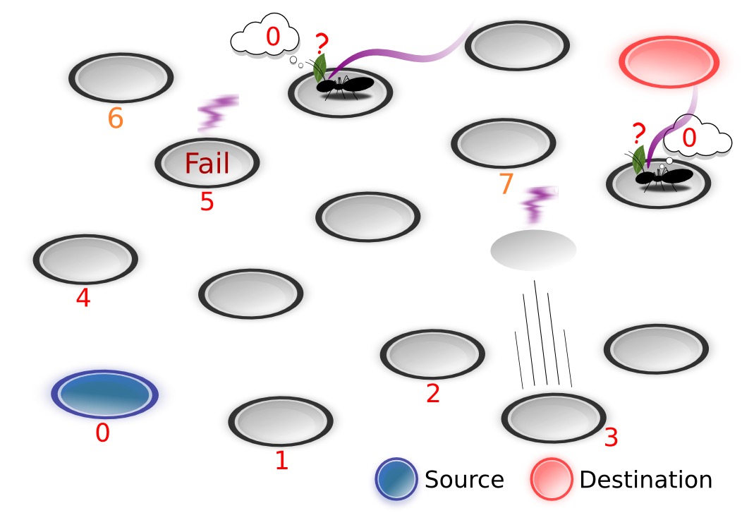
Coming back ...
Notes:
Devido à evaporação de feromônio, e ao seu depósito frequente nas melhores rotas. As formigas tendem a sentir mudanças na topologia de rede, seja por falhas ou mobilidade.
Em ambos os casos há a perda do link entre nodos.

Slide 17
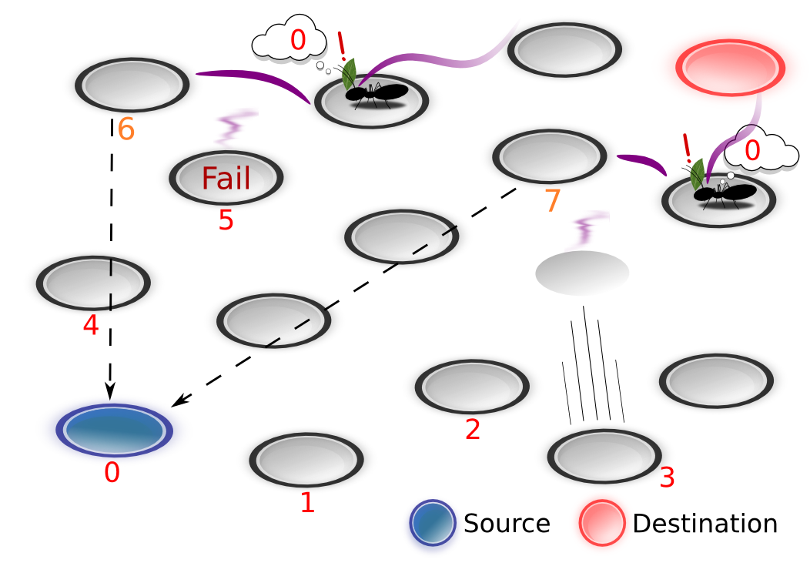
Coming back ...
Notes:
No ADHOP, uma formiga escolhe o próximo hop de acordo com a quantidade de feromônio que um nodo vizinho possui em relação ao nodo alvo (destination ou source, depende se está voltando ou não).
Tais situações (de perda de links) podem ser evitadas de modo transparente pela evaporação de feromônio, eu por uma mesagem da camada MAC.

Slide 18
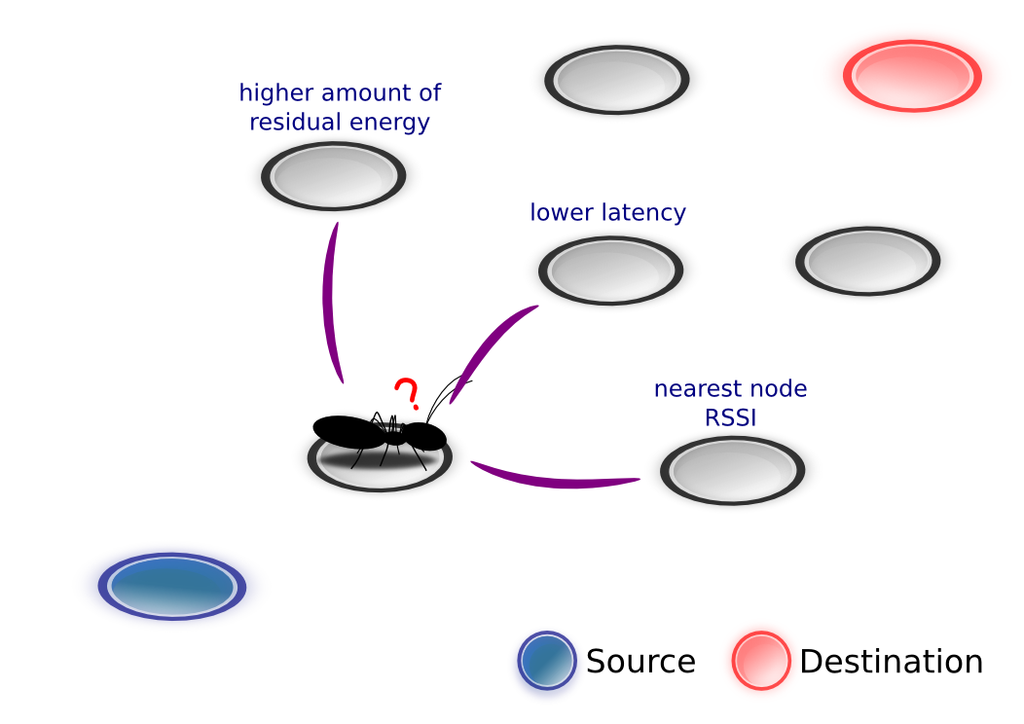
Routing Heuristics
Deposit and evaporation of pheromone
Notes:
Devido à estrutura do ADHOP é fácil definir heurísticas para o roteamento, utilizando uma ou mais heurística no depósito ou na evaporação de feromônio.

Slide 19


Implementation in OpenEPOS http://epos.lisha.ufsc.br/
OpenEPOS software
  RT scheduling, sensing, energy management and communication
OpenEPOS hardware
  EPOSMote I
    AVR + ZigBee
  EPOSMote II
    AVR + ZigBee / PLC
    ARM + ZigBee / PLC
EPOS gateway devices
  GSM / GPRS / Wi-Fi
  eSDR

Slide 20
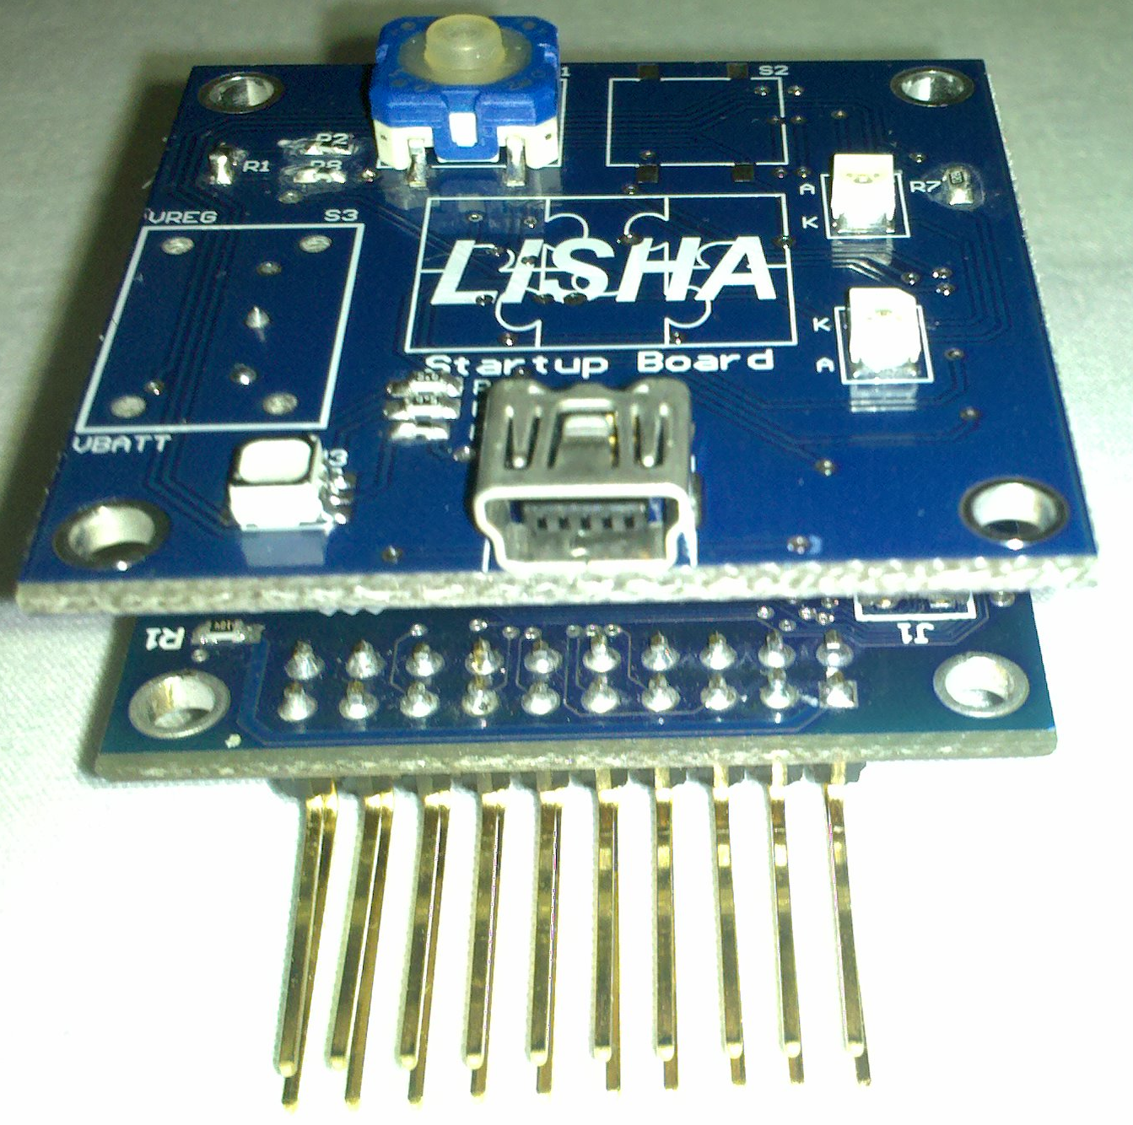
EPOSMote X MicaZ http://epos.lisha.ufsc.br/
 | MicaZ | EPOSMote I | EPOSMote II
Core | PCB | ZigBit | MC13224V
Processor | 8-bits ATMega128L | 8-bits ATMega128v | 32-bits ARM7 TDMI
RAM | 4 kB | 8 kB | 96 kB
Flash | 128 kB | 128 kB | 128 kB
Transmission Power | 0 dBm | +3 dBm | +4 dBm
Max Tx Current | 17.4 mA | 18 mA | 29 mA
Max Rx Current | 19.7 mA | 19 mA | 22 mA
Sleep Current | 15 uA | 6 uA | 0.85 uA
Size (mm) | 58 x 32 x 7 | 24 x 13,5 x 2 | 9,5 x 9,5 x 1,2

Slide 21
Simulation 1
GloMoSim (same as HOPNET)
  20 to 200 nodes randomly moving at 10 m/s on a 700 meters x 400 meters area with high data loss (Random Way Mobility Model)
  20 CBR UDP/IP data sources on IEEE 802.11
  15 dBm transmission power at 2 Mbps
  900 seconds with
Not exactly a WSN scenario, but it enables ADHOP to be compared to HOPNET

Slide 22
Data Packet Delivery Ratio
Notes:
Each simulation scenario was run for a total of 900 seconds in an environment that is conducive to high data loss.
The nodes were placed randomly in a rectangular area of 700 meters x 400 meters, and each one moved at a maximum speed of 10 meters per second, according to the Random Way Mobility Model.
The data traffic was generated by 20 Constant Bit Rate sources.
UDP supported the network at the Transport layer.
Internet Protocol (IP) protocol operated at the Network layer.
The protocol used for Data Link layer and MAC sublayer was the standard IEEE 802.11.
The radio transmission power was set to 15 dBm and the bit rate was 2 megabits per second.
This base scenario was used for the experiments on GloMoSim by varying specific parameters, such as number of nodes and zone radius.
The number of nodes ranged from 20 to 200, and the zone radius ranged from 2 to 5.

Slide 23
Broken Routes
Notes:
Because of the low connectivity of small and sparse networks, the data packets cannot be transmitted and the packet loss tends to be low.
Nevertheless, as the number of nodes in the network increases, the amount of broken routes tends to decrease slightly.
Because of the ability of ants to determine the best route between several options to obtain reliable links between nodes along the routes.
Since the routing in ADHOP is solely performed by pheromone, the nodes become more attentive as the topology changes.
It also allows us to use more efficient ways to retrieve a route or discover another.
This way, we can notice that our proposal produces better results of broken routes than HOPNET.

Slide 24
Broken Routes (100 Nodes)
Notes:
If we consider congestion in the simulations of 100 nodes due to mobility and placement of the nodes, then the packet loss due to broken routes tends to be slightly lower in low mobility scenarios.
The Figure shows the results of broken routes by varying the maximum speed of nodes from 1 to 15 meters per second.
We notice from the figure that HOPNET tends to produce significantly better results in networks of low mobility; however, ADHOP shows better results than HOPNET, even in scenarios of high congestion where speed is 10 meters per second.

Slide 25
Link Failures
Notes:
The Figure shows the results of dropped packets ratio due to link failures.
Different from broken routes, link failures refers to the error messages that originate from MAC sublayer.
In MAC, if a node does not receive CTS or ACK after several attempts, a link failure message is sent to the routing protocol in order to conduct a repair procedure.
We see from the figure that the amount of link failures is superior in small and sparse networks due to low connectivity between nodes.
We also notice that HOPNET produces better results of link failures than ADHOP.
Since our approach is a reactive routing protocol, the links between neighbor nodes tend to be more susceptible to failure.
Because HOPNET has more reliable pheromone information than ADHOP due to proactive routing.
However, our proposal provides better results in situations of congestion and high mobility due to dynamic hops which provide better adaptability to dynamic topologies.
Accordingly, the routes reactively discovered are no longer stored as sequences of nodes, and the nodes moving to beyond the zone will not lose the communication due to the zone radius.

Slide 26
Routing Overhead
Notes:
The Figure shows the comparison between AODV, HOPNET, and ADHOP for routing overhead.
In HOPNET, the control packets (ants) are periodically sent out within a zone to maintain the routes in the zone, others are sent out to perform interzone route discovery and repair procedures.
In ADHOP, the data is sent along with the ants thereby decreasing the amount of control packets in the network.
We notice from the figure that ADHOP gives lower routing overhead than HOPNET and AODV due to a reduction of ants in the network.
Accordingly, our approach tends to produce low routing overhead for sparse networks due to low connectivity.
However, it also produces high link failures, as explained in the previous figure.
Differently, HOPNET produces high routing overhead for sparse networks.
On this account, it tends to send many more control packets to obtain reliable routes.
And as the number of nodes increases, the routing overhead also tends to increase.
In another way, since the data is sent along with the ants and the routing is reactive, the routing overhead of our proposal tends to stay almost constant for large and dense networks.

Slide 27
Simulation 2
OMNet++ (WSN scenario-driven)
  20 to 100 nodes randomly moving at 5 m/s on a 1000 meters x 1000 meters area with high data loss (Mass Mobility Model)
  20 UDP/IP data sources on IEEE 802.15.4
  1 mW transmission power
  Sensitivity -85 dBm
  Thermal Noise -110 dBm
  300 seconds with
IEEE 802.15.4 MTU (127 bytes)
  Data/UDP/IP/ADHOP/IEEE 802.15.4 == 102 bytes

Slide 28
Routing Overhead

Slide 29
Link Failures

Slide 30
Broken Routes

Slide 31
Data Packet Delivery Ratio

Slide 32
Final Remarks
ADHOP proves to be an efficient routing algorithm for mobile networks in terms of rate of data delivery
  And due to its simplicity proves to be a good routing algorithm for wireless sensor networks
Being a reactive algorithm, ADHOP lacks precision in the choice of near neighbors
  However, it has a very low routing overhead
    And thus lower power consumption
Better integration with C-MAC will yield an even lower overhead routing protocol

