Slide 1
- AEP -
Automatic Exchange of Embedded
Software Parameters
Rita de Cássia Cazu Soldi
rita@lisha.ufsc.br
Antônio Augusto Medeiros Fröhlich
guto@lisha.ufsc.br

Slide 2
Agenda
Introduction
  The problem of testing
Embedded systems environment
  Support for testing and debugging
Automatic exchange of embedded system software parameters
  General algorithm and implementation details
Results
  Classification of configurations, execution time and size of additional information
Conclusion and Future work

Slide 3
Introduction
Embedded system
  Combination of software and hardware designed to perform a specific task
  Popular and intrinsic to humans daily life
Software testing
  Analyse and detect the differences between existing and required conditions
  Non-trivial and time-consuming
  Embedded software testing should also consider
  software/hardware integration
  Once a test fail, debugging can locate/identify bugs and then correct the software.

Slide 4
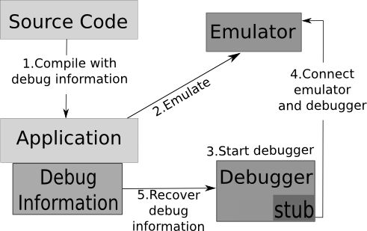
Embedded systems debugging environment

Slide 5
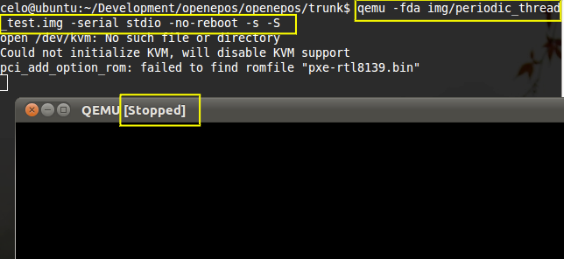
Embedded systems debugging environment

Slide 6
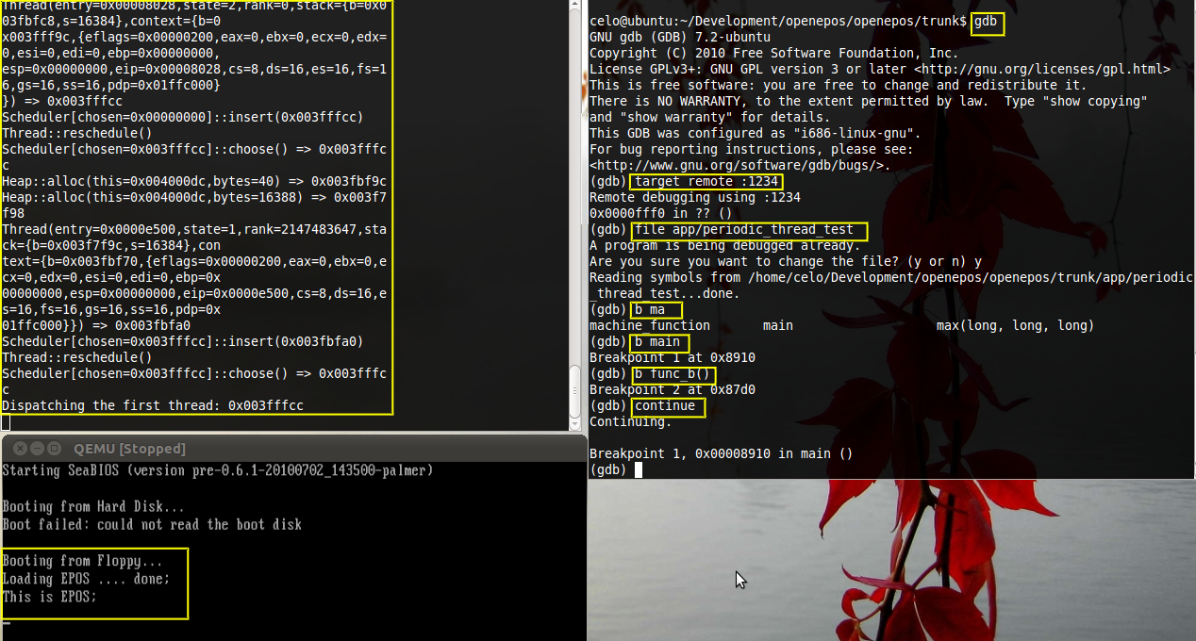
Embedded systems debugging environment

Slide 7
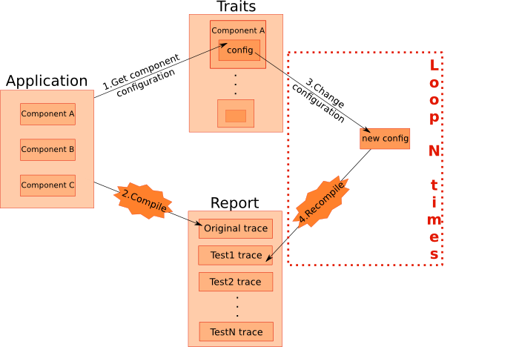
Automatic exchange of software parameters

Slide 8
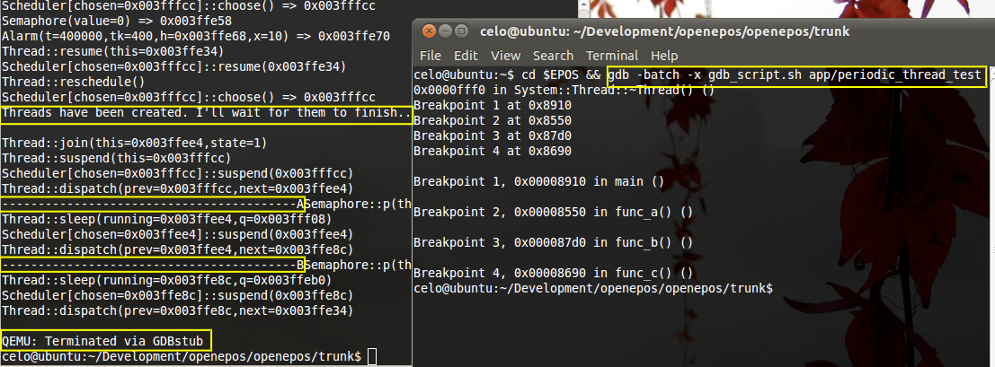
Automatic exchange of software parameters

Slide 9
AEP - Automatic exchange of embedded system software parameters
Requirements
  Application-Oriented System Design
  Feature Based Model
  Parametric Model
Granularity of configuration
  Random (worst-case)
  Partially random
  Determined
Definition of exchange success
  No compilation errors
  Is there a register on the exchange on the report
  No difference between traces logs

Slide 10
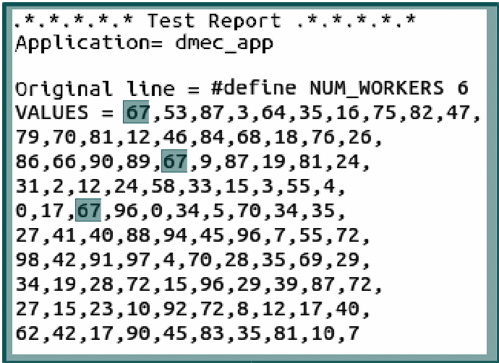
AEP - Automatic exchange of embedded system software parameters

Slide 11
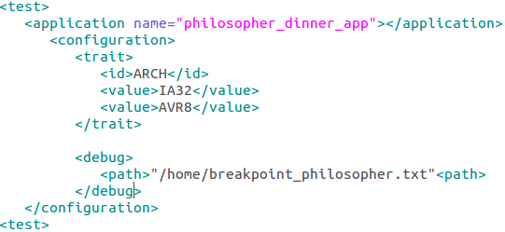
AEP - Automatic exchange of embedded system software parameters

Slide 12
AEP - Automatic exchange of embedded system software parameters
XML configuration file:
  Application
    Name
  Exchange of parameters
    Traits
    Values
    Interval
    Number of tries
  Debugging
    File with debugging commands
    Compare traces

Slide 13
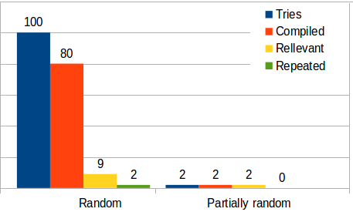
Results
Philosopher's Dinner
Classification generated configurations

Slide 14
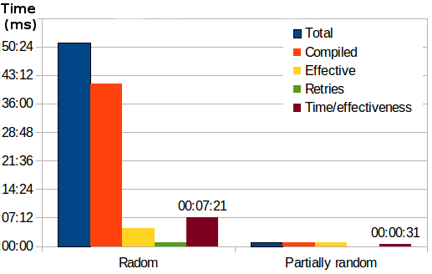
Results
Philosopher's Dinner
Classification of execution time

Slide 15
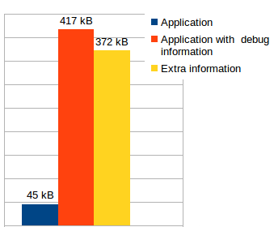
Results
Philosopher's Dinner
Size of information

Slide 16
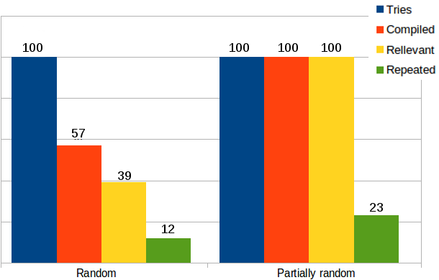
Results
DMEC
Classification generated configurations

Slide 17
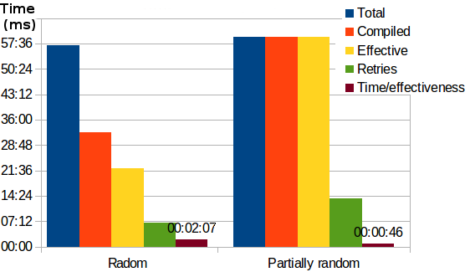
Results
DMEC
Classification of execution time

Slide 18
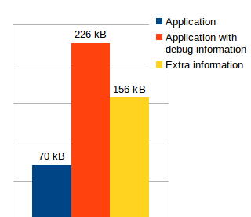
Results
DMEC
Size of information

Slide 19
Conclusion and Future work
This work show that it is possible to create an stable development environment for embedded systems
The activity of verify this become simpler, since the testing and debugging can share the same environment
  If necessary a manual debugging, the AEP report can provide useful information
As future work, there are some improvements, such as:
  Extract input data directly from application
  Support new types of testing
  Deepen the level of information in the report, also returning an analysis of data collected from the application

