Slide 1
- AEP - Automatic Exchange of Embedded Software Parameters
Rita de Cássia Cazu Soldi
rita@lisha.ufsc.br
Antônio Augusto Medeiros Fröhlich
guto@lisha.ufsc.br

Slide 2
Agenda
Introduction
The problem of testing
Embedded systems environment
Support for testing and debugging
Automatic exchange of embedded system software parameters
General algorithm and implementation details
Results
Classification of configurations, execution time and size of additional information
Conclusion and Future work

Slide 3
Introduction
Embedded system
Combination of software and hardware designed to perform a specific task
Popular and intrinsic to humans daily life
Software testing
Analyse and detect the differences between existing and required conditions
Non-trivial and time-consuming
Embedded software testing should also consider
software/hardware integration
Once a test fail, debugging can locate/identify bugs and then correct the software.

Slide 4
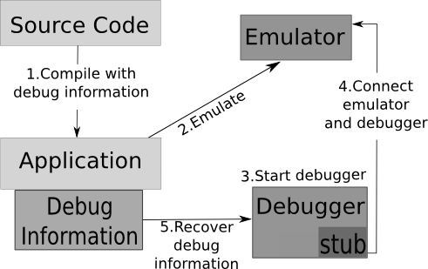
Embedded systems debugging environment

Slide 5
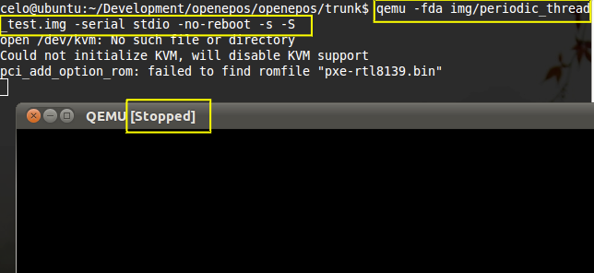
Embedded systems debugging environment

Slide 6
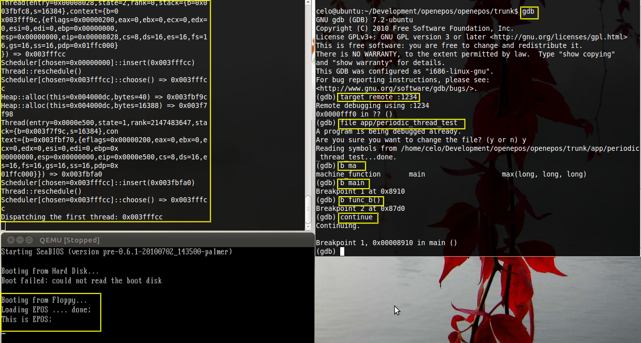
Embedded systems debugging environment

Slide 7
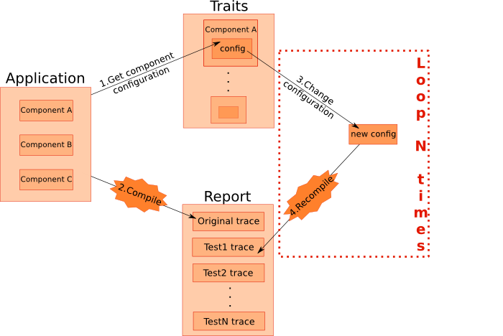
Automatic exchange of software parameters

Slide 8
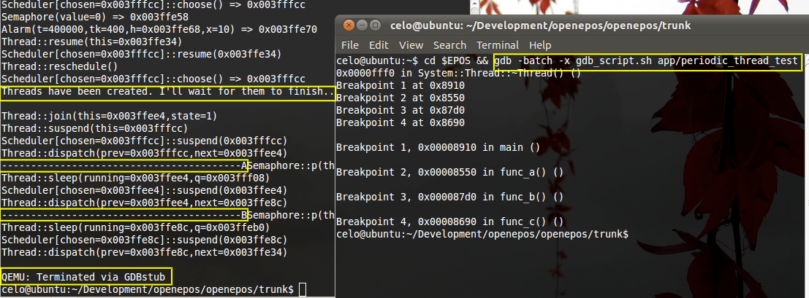
Automatic exchange of software parameters

Slide 9
AEP - Automatic exchange of embedded system software parameters
Requirements
Application-Oriented System Design
Feature Based Model
Parametric Model
Granularity of configuration
Random (worst-case)
Partially random
Determined
Definition of exchange success
No compilation errors
Is there a register on the exchange on the report
No difference between traces logs

Slide 10
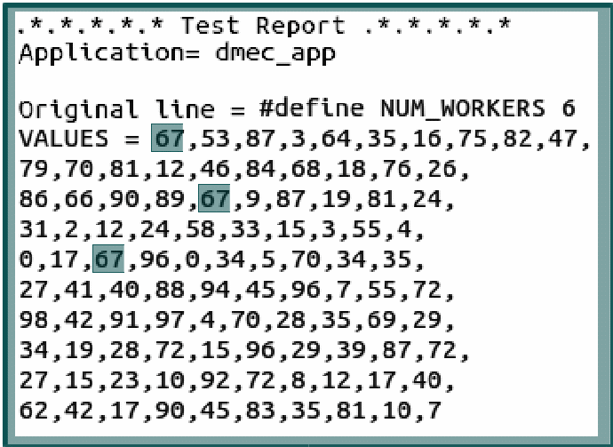
AEP - Automatic exchange of embedded system software parameters

Slide 11
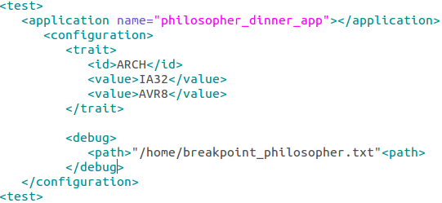
AEP - Automatic exchange of embedded system software parameters

Slide 12
AEP - Automatic exchange of embedded system software parameters
XML configuration file:
Application
Name
Exchange of parameters
Traits
Values
Interval
Number of tries
Debugging
File with debugging commands
Compare traces

Slide 13
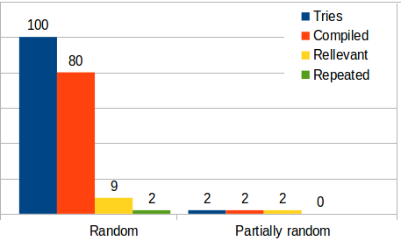
Results
Philosopher's Dinner
Classification generated configurations

Slide 14
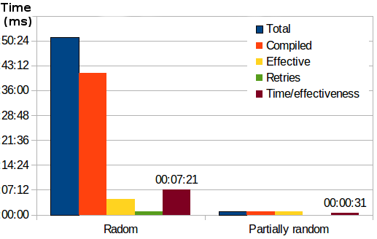
Results
Philosopher's Dinner
Classification of execution time

Slide 15
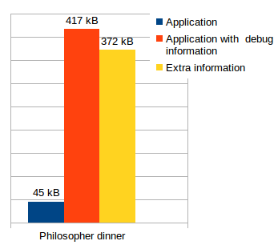
Results
Philosopher's Dinner
Size of information

Slide 16
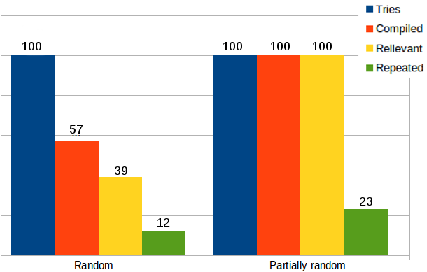
Results
DMEC
Classification generated configurations

Slide 17
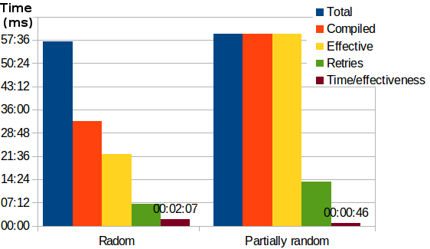
Results
DMEC
Classification of execution time

Slide 18
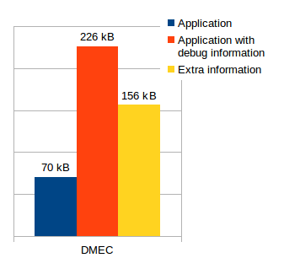
Results
DMEC
Size of information

Slide 19
Conclusion and Future work
This work show that it is possible to create an stable development environment for embedded systems
The activity of verify this become simpler, since the testing and debugging can share the same environment
If necessary a manual debugging, the AEP report can provide useful information
As future work, there are some improvements, such as:
Extract input data directly from application
Support new types of testing
Deepen the level of information in the report, also returning an analysis of data collected from the application

