Slide 1
Apple Inc. Financial Performance Dashboard
2009 – 2024
ElevateLabs Internship Task: 3 Dashboard in Tableau

Slide 2
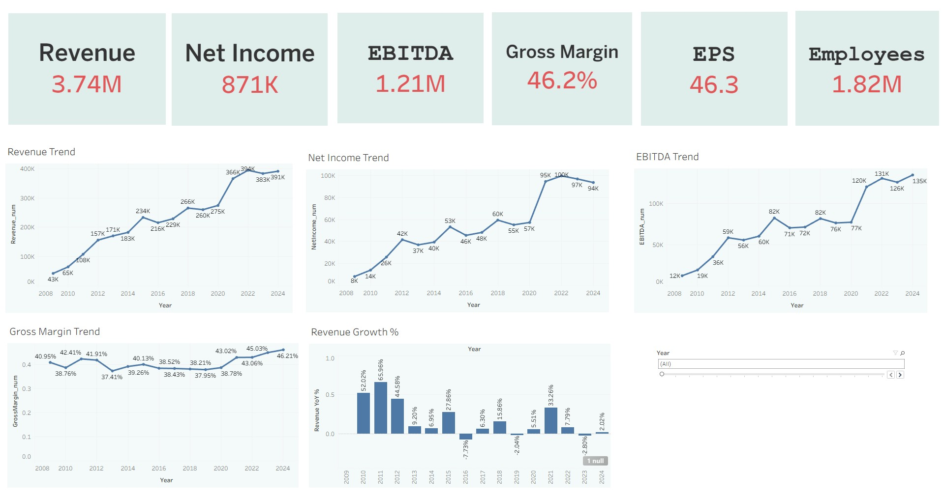
Dashboard Overview

Slide 3
Key Insights
- Revenue peaked at $391B in 2024 (+2% YoY).
- Net Income declined slightly by -3% YoY.
- EBITDA reached $135B in 2024, the highest in history.
- Gross Margin remained strong at 46.2%.
- Revenue growth has slowed in recent years compared to 2020 surge.

Slide 4
Recommendations
- Focus on maintaining profitability as revenue growth slows.
- Control costs to sustain high Gross Margins.
- Monitor Net Income trends to avoid long-term decline.
- Leverage strong EBITDA for future investments.
- Keep Debt-to-Assets ratio in check for financial stability.

