Slide 1
Simple Sales Dashboard Design
Create a basic interactive dashboard that shows sales performance by product, region, and month.

Slide 2
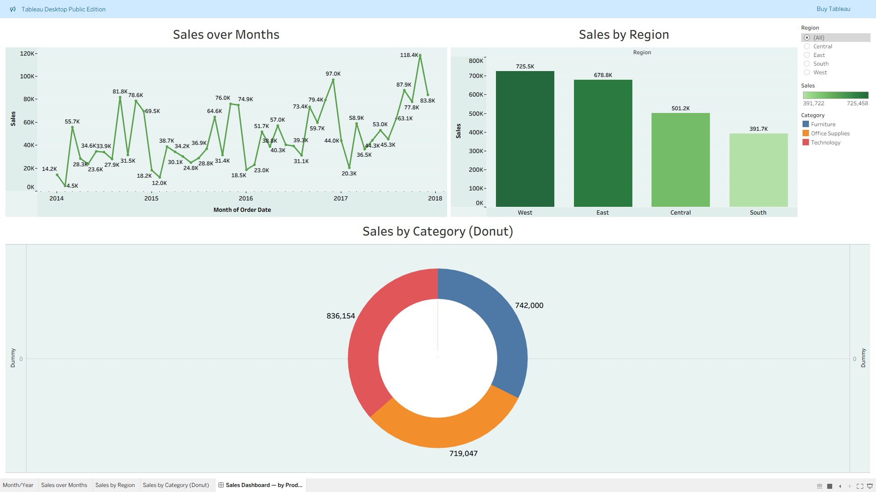
Key Insights-
1. Sales showed a steady upward trend with peaks in Q3 (Jul–Sep).
2. The West region recorded the highest total sales, outperforming others by ~20%.

Slide 3
Key Insights-
3. Technology category contributed the largest share of sales (~40%).
4. Sales dipped in February across all regions, suggesting an opportunity for targeted promotions.

Slide 4
Conclusion
• Sales growth is driven mainly by the West region and Technology products.
• Strategic focus on seasonal lows and underperforming categories could further improve results. Github_Repo :- https://github.com/MohammedAdnanQureshi/elevatelabs_Task_8

