Slide 1
Secure data hiding in image using steganography
CAPSTONE PROJECT
Presented By:
Student Name : SHAIKH AFFAN INAYAT
College Name & Department : M.H. SABOO SIDDIK C.O.E. / CSE(AIML)

Slide 2
OUTLINE
Problem Statement
Technology used
Wow factor
End users
Result
Conclusion
Git-hub Link
Future scope

Slide 3
Problem Statement
The rapid growth of digital communication has increased the need for secure data transmission. Traditional encryption methods protect data but can attract unwanted attention. Steganography provides a solution by concealing information within images, making it imperceptible to unauthorized users. This project aims to develop a secure data hiding technique using image steganography, ensuring confidentiality and robustness against detection. The focus will be on optimizing data embedding efficiency while maintaining image quality and resistance to steganalysis.

Slide 4
Technology used
The given code uses Python along with the OpenCV (cv2) library for image processing and basic steganography. The technology stack includes:
Python – The programming language used.
OpenCV (cv2) – For reading and writing images.
OS module – To interact with the operating system (e.g., opening the encrypted image).
Basic ASCII Mapping – A simple character-to-value encoding system.

Slide 5
Wow factors
Invisible Data Embedding The secret message is hidden inside an image without noticeable changes, making it undetectable to the human eye.
No Extra Files Needed The image itself acts as the carrier of hidden information—no additional encrypted files, just a simple image.
Basic Encryption with Passcode The embedded message can only be retrieved with the correct passcode, adding an extra security layer.
Simple Yet Effective The method is lightweight and fast, requiring only basic image modifications to store secret data.
Works on Any Image Format Can be applied to JPEG, PNG, BMP, and more, making it flexible for different use cases.

Slide 6
End users
Cybersecurity Professionals – Use steganography to securely transmit sensitive information without drawing attention.
Journalists & Whistleblowers – Hide confidential messages within images to avoid surveillance and censorship.
Military & Intelligence Agencies – Securely communicate classified information without detection.
Forensic Experts – Embed hidden clues or watermarks within images for digital evidence tracking.
Corporate Sector – Protect sensitive business data by embedding it in media files to prevent leaks.
General Users & Privacy Enthusiasts – Individuals who want to keep their personal data hidden from unauthorized access.

Slide 7
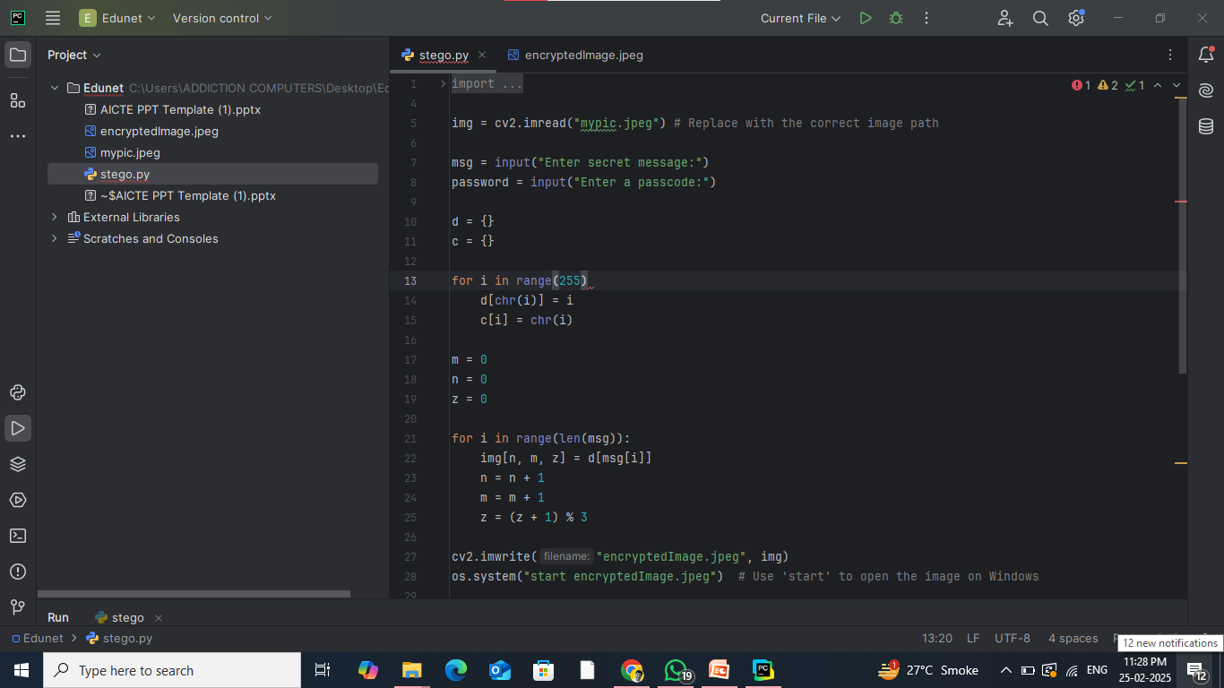

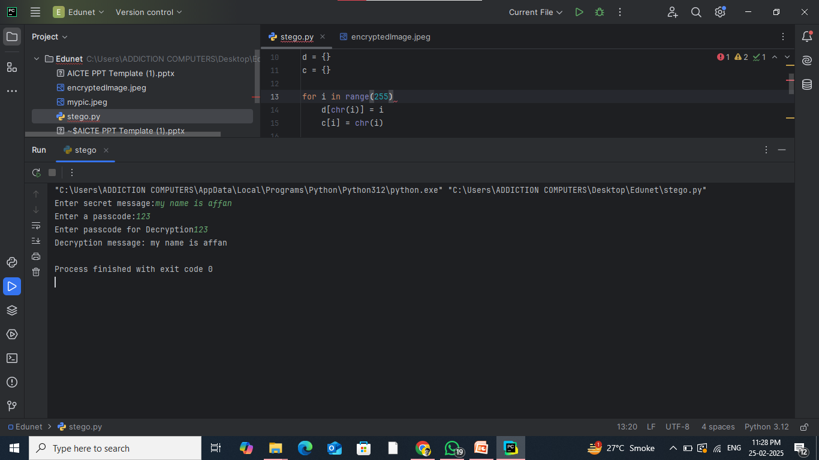
Results
Code
Screenshots of the outcome (min 3)
Encryption
Decryption

Slide 8
Conclusion
Steganography provides an effective method for securely hiding data within images, ensuring confidentiality while maintaining the original file's appearance. This technique is useful for secure communication, data protection, and avoiding detection by unauthorized parties. While the basic implementation is simple and efficient, enhancing security through advanced steganographic techniques, such as random pixel embedding or encryption, can further improve robustness against steganalysis. As digital communication continues to evolve, steganography remains a valuable tool for protecting sensitive information in various fields, from cybersecurity to forensic investigations.

Slide 9
GitHub Link
https://github.com/MohammedAffanShaikh/Steganography.git

Slide 10
Future scope(optional)
Advanced Steganographic Techniques – Implementing methods like LSB with random pixel selection, Discrete Cosine Transform (DCT), or Deep Learning-based steganography can enhance security and reduce detectability.
Improved Robustness – Developing resistance against steganalysis techniques to prevent detection by adversaries.
Higher Data Capacity – Optimizing data embedding algorithms to store more information while maintaining image quality.
Multi-layered Security – Combining steganography with encryption and blockchain technology for enhanced data protection.
Real-time Steganography – Implementing live data hiding and extraction in video streaming or cloud-based applications for secure communication.

Slide 11
THANK YOU

