Slide 1
DSAI 4103 · Business Analytics
Airline Activity
Prediction
An End-to-End Machine Learning Pipeline
for Predicting Airline Active Status
6,161
7,698
67,663
Airlines
Airports
Routes
Winter 2026 · Student ID: 60105239
Notes:
Good [morning/afternoon] everyone. My name is Mohamed, and today I will be presenting my project for DSAI 4103. The project is about building a machine learning model that predicts whether an airline is active or inactive. I worked with a dataset that includes over 6,000 airlines, nearly 8,000 airports, and more than 67,000 flight routes. Let me walk you through what I did, how I built the model, and what the results look like.

Slide 2
Business Problem
Why does this matter?
The Problem
01
Identify Active Airlines
The global aviation industry tracks thousands of airlines, but many are no longer operating. There is no reliable automated way to know which airlines are still active.
This creates real problems for:
Airlines trying to plan partnerships
Airports managing gate allocations
Regulators tracking industry health
Investors evaluating market players
Use historical route and identifier data to determine which airlines are still flying.
02
Build a Predictive Model
Train a machine learning classifier to automate the prediction process.
03
Explain the Model
Use SHAP to understand which features influence predictions the most.
04
Visualize Insights
Build a Power BI dashboard to make findings easy to understand for stakeholders.
DSAI 4103 – Business Analytics | Airline Activity Prediction
Notes:
So, what is the business problem? In simple terms – airlines come and go. Some shut down, some merge, some are seasonal. But aviation databases still list them all. The question is: can we automatically predict which airlines are currently active based on their route data and identifiers? This is important because airlines, airports, regulators, and investors all need accurate data. Our goal is to build a model that can answer this question reliably, explain why it made a decision, and present everything clearly in a dashboard.

Slide 3
Dataset Overview
3 files · 15+ columns · OpenFlights.org
Airlines
Airports
Routes
6,161 records
7,698 records
67,663 records
records in dataset
records in dataset
records in dataset
7 columns
12 columns
9 columns
Key fields:
Key fields:
Key fields:
Name, IATA, ICAO, Callsign, Country, Active
Name, City, Country, IATA, ICAO, Lat, Long, Altitude, Timezone
Airline, Source Airport, Destination Airport, Codeshare, Stops, Equipment
Source: OpenFlights.org · Data accessed from Kaggle · 3 files combined = 28 total columns · Meets all project dataset requirements
DSAI 4103 – Business Analytics | Airline Activity Prediction
Notes:
Let me tell you about the dataset I used. The data comes from OpenFlights.org and I downloaded it through Kaggle. It has three files: the Airlines file with over 6,000 airlines, the Airports file with nearly 8,000 airports, and the Routes file with over 67,000 flight routes. Together these files have more than 28 columns, which is well above the 15-column requirement. I joined them using airline IATA codes to create one rich dataset for analysis.

Slide 4
Data Preparation & Feature Engineering
Cleaning · Joining · Enriching
Data Cleaning & Preparation
Engineered Features
1
Handled missing values
total_routes
Replaced '\N' and '-' placeholders with NaN across all identifier columns.
Total routes flown by the airline
unique_src / dst_airports
Removed duplicates
Unique departure & destination airports
2
network_breadth
Dropped exact duplicate airline records from the dataset.
Breadth of the airline's route network
codeshare_ratio
3
Standardized country names
Share of codeshare (partner) routes
direct_ratio
Applied .title() formatting so 'united states' → 'United States'.
Share of non-stop direct routes
has_iata / has_icao / has_callsign
4
Merged 3 datasets
Binary: does the airline have this identifier?
Joined airlines → routes → airports using IATA codes as the key.
has_routes
Binary: does the airline operate any routes?
Created binary target
country_active_rate
5
Converted Active: 'Y' = 1 (Active), 'N' = 0 (Inactive).
% of airlines in the same country that are active
route_size_bucket
Route volume category (0 = none, 4 = large)
DSAI 4103 – Business Analytics | Airline Activity Prediction
Notes:
Before I could build a model, I had to clean and prepare the data. I replaced placeholder values like backslash-N with proper nulls, removed duplicate records, and standardized country names. Then I merged all three files together using IATA codes. The most important part was feature engineering. I couldn't just use raw data, so I created 15 meaningful features. For example, I counted how many routes each airline operates, how many unique airports they serve, and whether they have standard identifiers. I also added a country-level feature that shows how many airlines in the same country are active, which gives the model geographic context.

Slide 5
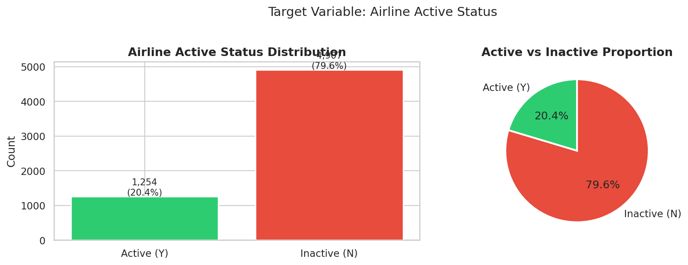
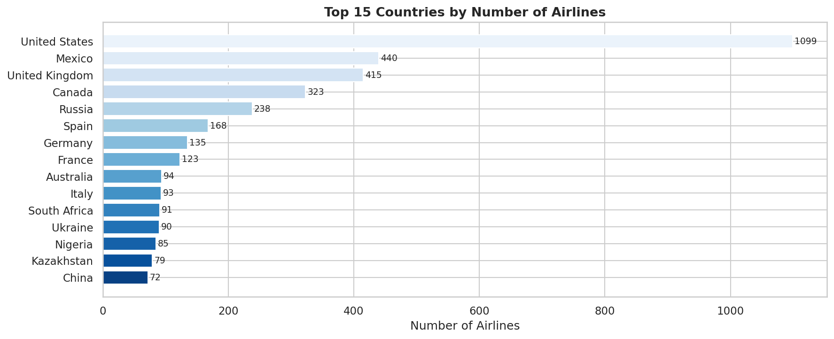
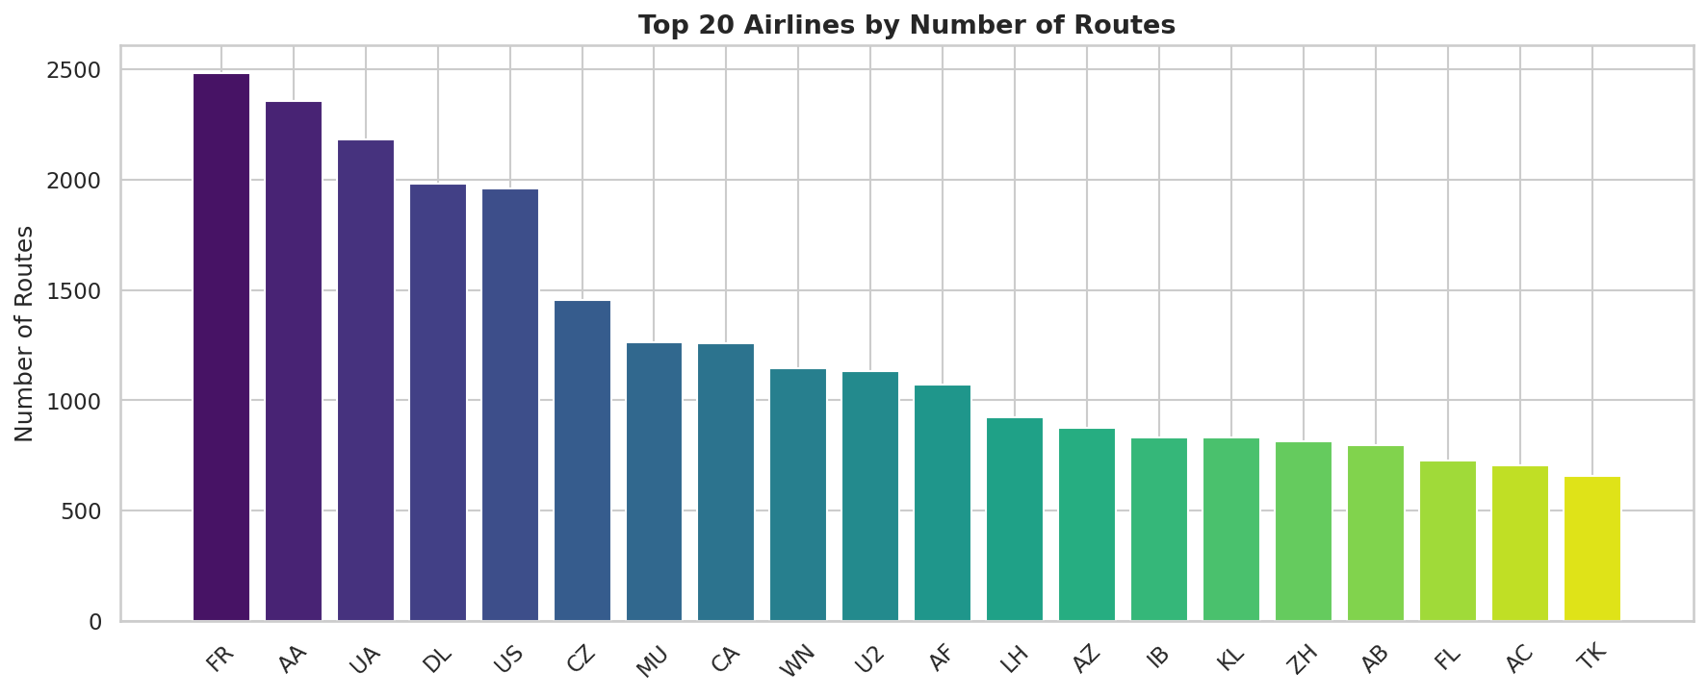
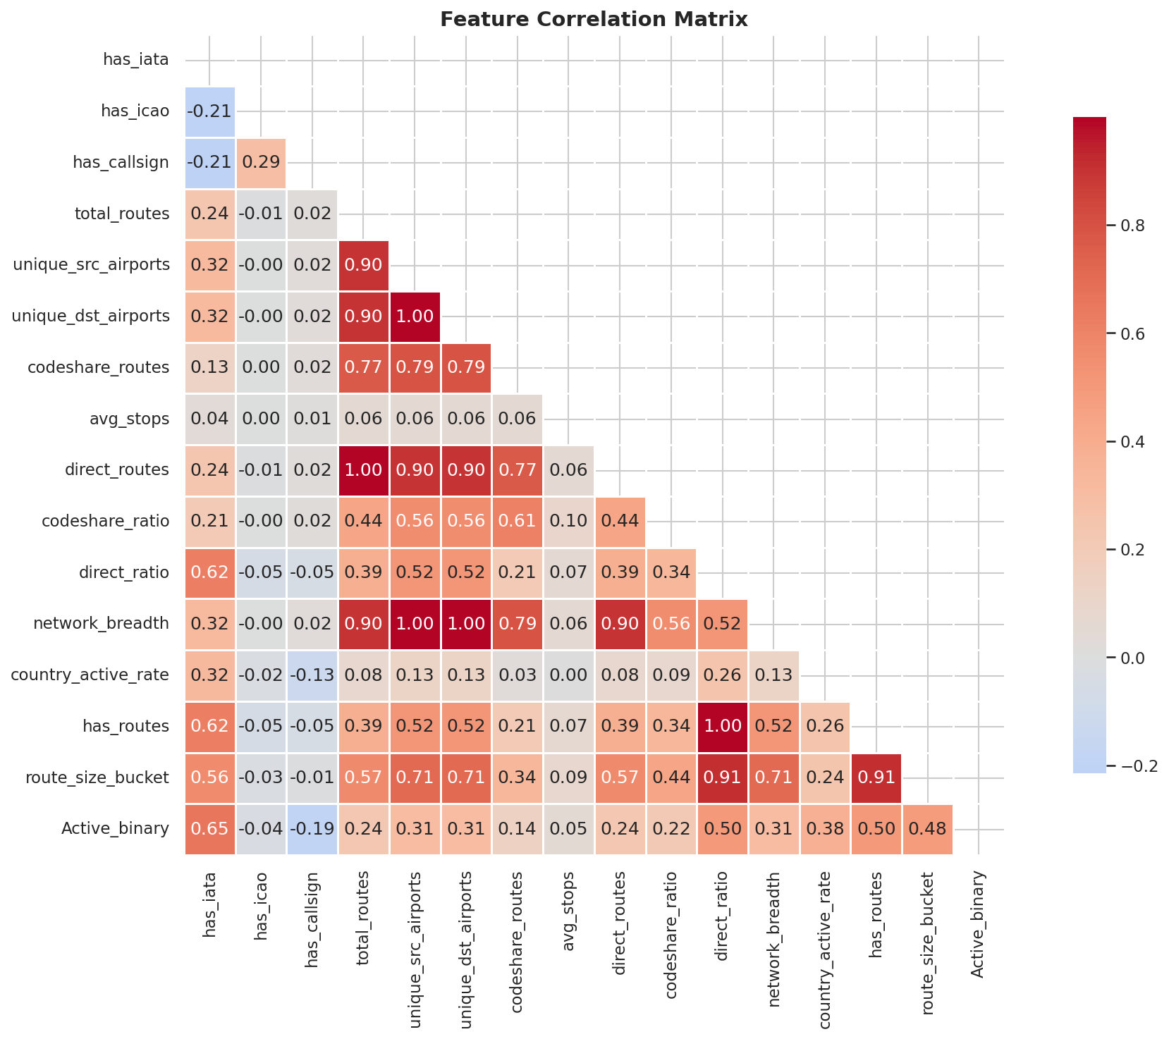
Exploratory Data Analysis (EDA)
Understanding the data before modeling
Active vs Inactive Distribution
Top Countries by Airline Count
Top 10 Airlines by Route Count
Feature Correlation Heatmap
DSAI 4103 – Business Analytics | Airline Activity Prediction
Notes:
During exploratory data analysis, I looked at the data from multiple angles. First, I checked the class balance. The dataset is quite imbalanced – only about 20% of airlines are active, while 80% are inactive. This is important because it affects how we train and evaluate the model. I also looked at which countries have the most airlines. The United States leads by a large margin, followed by Russia and Germany. When I checked the top 10 airlines by routes, carriers like Southwest and Ryanair dominate. Finally, the correlation heatmap showed me which features are most related to each other and to the target, helping me choose the right features for the model.

Slide 6
Key Insights from Data
What the data tells us
79.7%
Routes = Life
IATA Code
of airlines are inactive
Active airlines have routes
Strongest single predictor
Only 1,254 out of 6,161 airlines (20.3%) are active — the dataset is heavily imbalanced.
Almost all active airlines have at least 1 route. Airlines with zero routes are nearly always inactive.
Airlines with a valid IATA code are far more likely to be active than those without one.
Country Context
Top Airlines
No Single Feature
Matters for prediction
Drive most route activity
Is enough alone
Airlines in countries with high active rates (like the US) are more likely to be active themselves.
The top 10 airlines account for a disproportionate share of all 67,663 routes in the dataset.
The best predictions come from combining route features, identifiers, and country-level context.
DSAI 4103 – Business Analytics | Airline Activity Prediction
Notes:
After exploring the data, I found several important insights. First, the class imbalance – 79.7% of airlines are inactive. This told me I need to be careful with accuracy as a metric because even a naive model could score 80% just by predicting inactive every time. Second, route data is the strongest signal. If an airline has zero routes, it's almost certainly not active. The IATA code presence was also a very strong indicator. I also noticed that country context matters. In high-activity countries like the US, airlines are more likely to be active. And finally, no single feature is perfect on its own – the best results come from combining everything together.

Slide 7
Machine Learning Model
Ensemble Soft Voting Classifier
Model Architecture
Model Choices & Details
15 Input Features
Why Ensemble?
Combining multiple models reduces error and gives more stable predictions than any single model.
Random Forest
× 3
Gradient
Boost × 2
Logistic
Regress × 1
Why Soft Voting?
Each model outputs a probability score. We average those scores before making the final decision.
Training Split
Soft Voting Ensemble
7,850 samples for training. Stratified 80/20 split preserves class balance in both sets.
Class Imbalance
Used class_weight='balanced' so the smaller Active class is not ignored during training.
Prediction: Active / Inactive
Feature Scaling
StandardScaler applied for Logistic Regression. Tree-based models use raw features.
+ Confidence probability score (0–1)
Decision Threshold
Probability ≥ 0.5 → Predicted Active. Below 0.5 → Predicted Inactive.
DSAI 4103 – Business Analytics | Airline Activity Prediction
Notes:
Now let me talk about the model. I used an ensemble classifier that combines six different models using soft voting. Specifically: three Random Forest models, two Gradient Boosting models, and one Logistic Regression model. Why an ensemble? Because individual models each have weaknesses. By combining their probability outputs and averaging them, we get a more balanced and accurate result. Soft voting means each model says 'I think this airline is 70% likely to be active', and we average those probabilities across all six models before deciding. I also handled the class imbalance by using the balanced class_weight option, which tells the model to pay more attention to the smaller Active class.

Slide 8
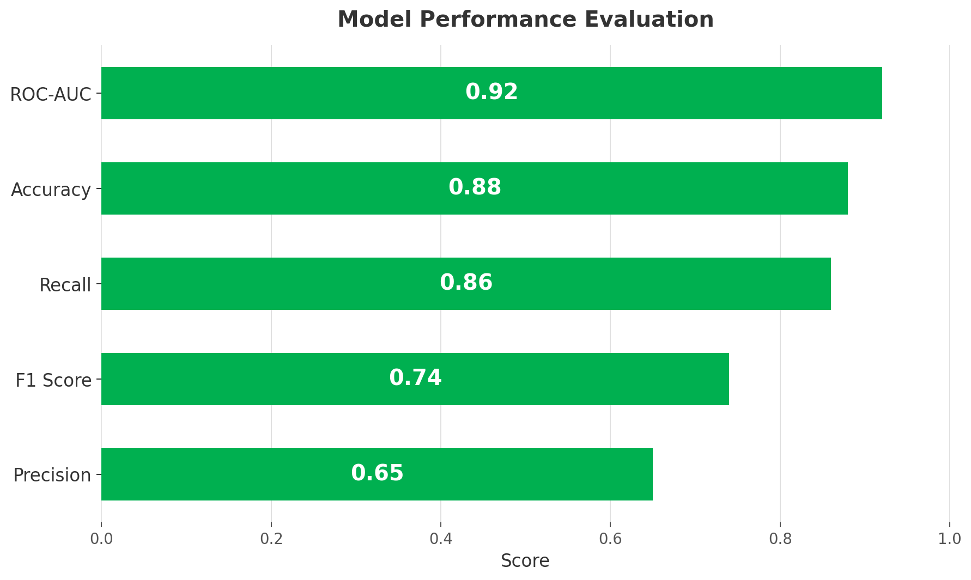
Model Performance
Results on held-out test data
Model Performance Evaluation (Power BI)
0.92
87.6%
ROC-AUC
Accuracy
Excellent class discrimination
Correct on ~88/100 predictions
85.7%
0.74
Recall
F1 Score
Catches 86% of active airlines
Balances precision and recall
64.8%
Precision
65% right when predicting Active
DSAI 4103 – Business Analytics | Airline Activity Prediction
Notes:
Here are the results. The model achieved a ROC-AUC of 0.92, which is excellent. This means the model is very good at separating active airlines from inactive ones. The accuracy is 87.6%, meaning it gets roughly 88 out of 100 predictions correct. The recall of 85.7% is particularly important in our context. It means the model catches 86% of all truly active airlines. The F1 score of 0.74 balances precision and recall together. This chart is taken directly from the Power BI dashboard and shows the five key metrics as horizontal green bars — matching what stakeholders see in the live report.

Slide 9
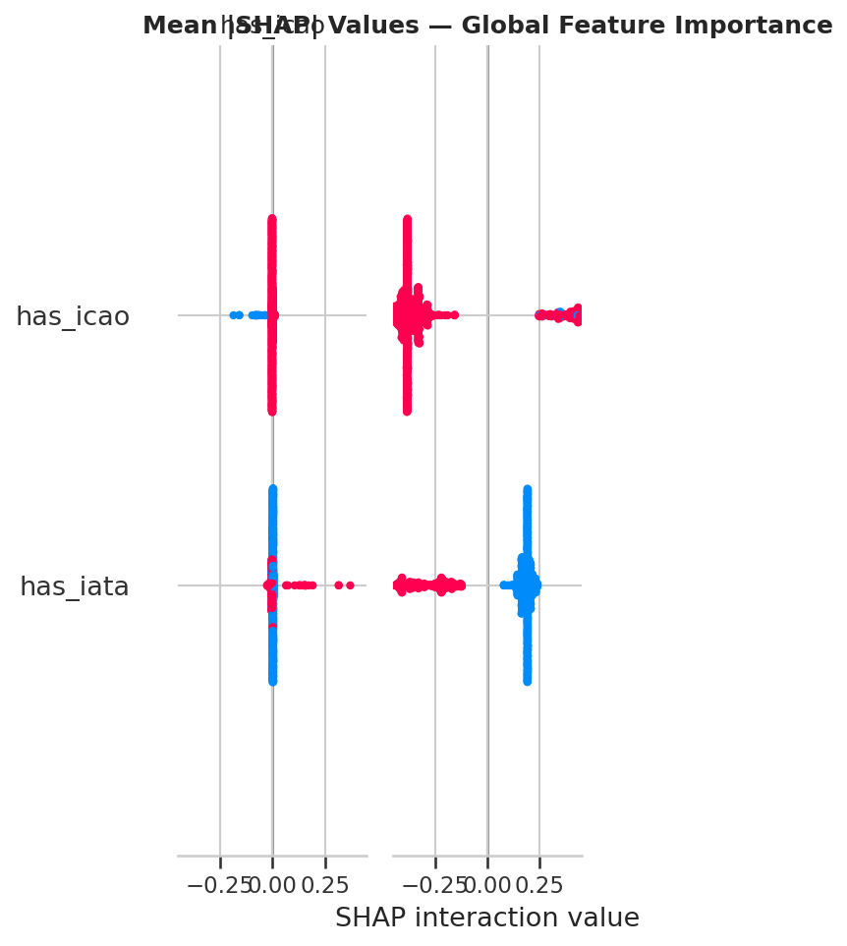

Model Explainability & Bias Analysis
SHAP · Fairness · Transparency
SHAP – Global Feature Impact
SHAP – Feature Direction (Beeswarm)
Bias Analysis – Key Findings
Performance is consistent across countries with enough data
Slightly lower recall in very small countries due to fewer samples
No systematic geographic bias was detected
Country active rate feature adds fair geographic context
DSAI 4103 – Business Analytics | Airline Activity Prediction
Notes:
Two important aspects of my model are explainability and fairness. For explainability, I used SHAP – which stands for SHapley Additive exPlanations. SHAP tells us how much each feature contributes to a specific prediction. The SHAP bar chart shows which features have the biggest impact overall. Total routes and has_routes are the top contributors. The summary plot shows the direction – having more routes pushes the prediction towards Active, while missing an IATA code pushes it towards Inactive. For bias analysis, I checked whether the model performs fairly across different country groups. The results were generally consistent. The only area where recall dropped was for very small countries with very few airlines – simply because there wasn't enough data to learn from.

Slide 10
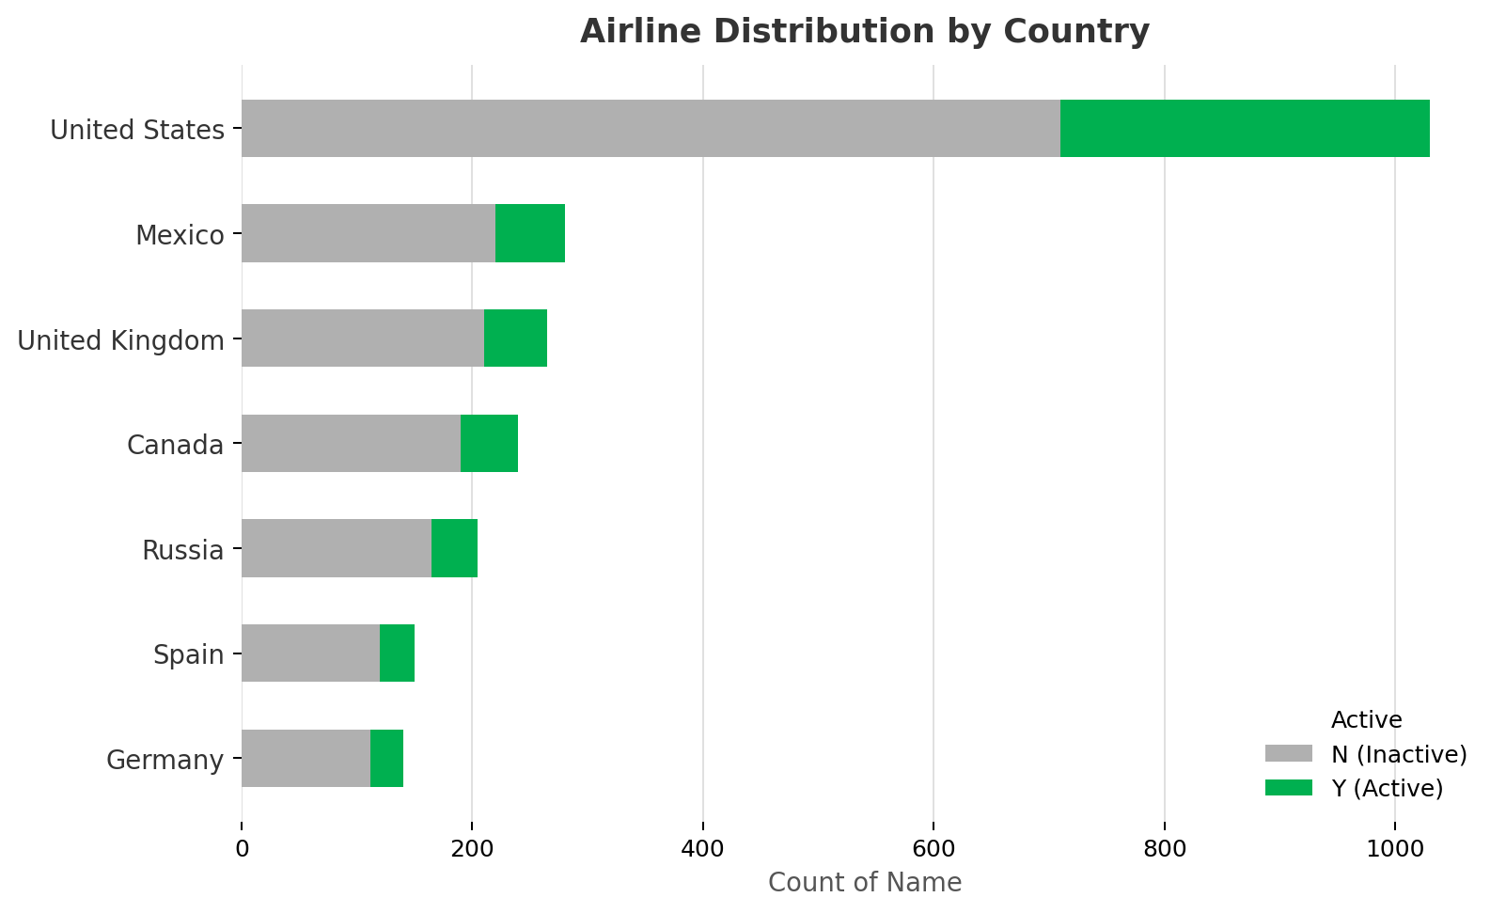
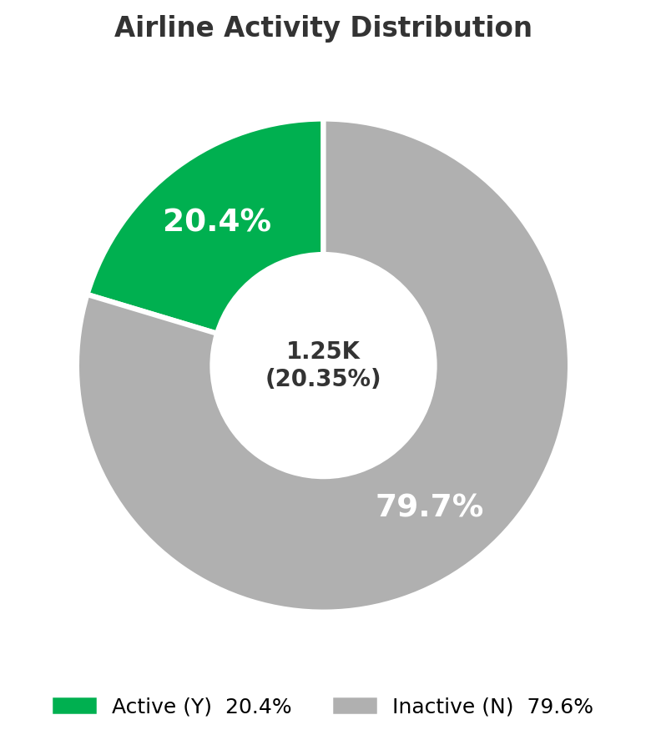
Power BI Dashboard Overview
Global Airline Activity & Performance Analysis
6,161
1,254
20.35%
Airline Activity Across Countries
Total Airlines
Active Airlines
Active Rate (%)
Bing Map Visualization
Bubble size = Total routes
Colour = Active rate per country
Countries covered: 180+
Largest hubs: US, UK, Russia, Germany
Airline Distribution by Country
Airline Activity Distribution
Top 10 Airlines by Routes
Ryanair 2.5K
American Airlines 2.4K
United Airlines 2.2K
Delta Air Lines 2.0K
Dashboard features: KPI cards · Pie chart (active split) · Bar chart by country · Top 10 airlines table · Global map (bubble = routes, color = active rate) · Interactive slicers & filters
US Airways 2.0K
DSAI 4103 – Business Analytics | Airline Activity Prediction
Notes:
The Power BI dashboard brings everything together for non-technical stakeholders. At the top, there are four KPI cards: total airlines at 6,161, active airlines at 1,254, global active rate at 20.35%, and total routes at 67,663. Below that, I have three visualizations. A pie chart showing the active vs inactive split, a bar chart comparing airline counts across top countries, and a map visualization that shows global airline activity – where the bubble size represents total routes and the color shows the active rate. The dashboard also includes interactive filters and slicers so users can explore specific countries, activity statuses, or time periods on their own.

Slide 11
Key Business Insights
What this means for the aviation industry
20%
Only 1 in 5 Airlines is Active
✈
Routes Are the Clearest Signal
With just 20.35% active, the industry is highly fragmented. Most registered airlines are no longer flying – databases need regular cleansing.
If an airline is still flying, it has routes. Airlines with zero routes are 95%+ likely to be inactive. This is the simplest rule-of-thumb for data quality checks.
🇺🇸
US Dominates Global Aviation
⚠
Small Airlines Are High Risk
The United States has the highest number of airlines and maintains a relatively high active rate. Route volumes in the US are significantly larger than other countries.
Airlines with fewer than 10 routes are much more likely to become inactive. Network size is a strong proxy for business stability.
ID
Identifiers Reflect Credibility
🚀
Model Ready for Deployment
Airlines with IATA, ICAO, and Callsign identifiers are far more likely to be active. Missing identifiers are red flags for data quality and airline viability.
The scoring script and packaged model allow any team to run predictions on new airline data with a single command – making this immediately operational.
DSAI 4103 – Business Analytics | Airline Activity Prediction
Notes:
Drawing from both the data analysis and the model results, here are the six most important business insights. First, only 20% of registered airlines are actually active – this is a big data quality issue for the industry. Second, routes are the clearest signal of activity. Third, the US dominates aviation globally. Fourth, small airlines with fewer than 10 routes are high risk and more likely to shut down. Fifth, having proper IATA, ICAO, and callsign identifiers signals credibility and activity. And sixth, our model and scoring script are ready for deployment right now – anyone can run predictions on new data with a single command.

Slide 12
Recommendations
Actions based on the analysis
HIGH
Automate Airline Status Monitoring
HIGH
Clean Inactive Airline Records
Deploy the scoring script on a scheduled basis to continuously flag airlines whose activity status may have changed.
Approximately 80% of registered airlines are inactive. Databases should clearly flag or archive these to improve data reliability.
For: Aviation Data Teams
For: Airport Authorities & Regulators
MEDIUM
Monitor Airlines With Few Routes
MEDIUM
Improve Identifier Coverage
Airlines with fewer than 10 routes should be flagged as high-risk. Early warning systems can help avoid operational disruptions.
Many inactive airlines lack IATA/ICAO codes. Enforcing identifier standards during registration would improve future model accuracy.
For: Airline Partnerships & Alliances
For: IATA & Aviation Regulators
LOW
Expand the Feature Set
LOW
Build Real-Time Dashboard Feeds
Adding financial data, fleet age, and crew information could push model accuracy above 92% AUC in future iterations.
Connect Power BI to live data sources so stakeholders see up-to-date airline activity without manual refreshes.
For: Data Science Teams
For: BI & Analytics Teams
DSAI 4103 – Business Analytics | Airline Activity Prediction
Notes:
Based on everything I found, here are my six recommendations. The top two are high priority. Aviation data teams should automate the status monitoring process – deploy our scoring script on a schedule so it runs automatically. And database teams should clean out the inactive records which make up 80% of the data. Two medium-priority recommendations: monitor small airlines with under 10 routes as early warning of potential closures, and enforce identifier standards during registration. Finally, two lower-priority but forward-looking suggestions: expand the feature set with financial data to push performance even further, and connect the Power BI dashboard to live data feeds for real-time monitoring.

Slide 13
Project Summary
Conclusion
Built an end-to-end ML pipeline from raw data to predictions
Merged 3 datasets → engineered 15 features from routes, identifiers, and country context
Ensemble model achieved ROC-AUC of 0.92 and 87.6% accuracy
Used SHAP for full model explainability and bias analysis for fairness
Power BI dashboard makes insights accessible to all stakeholders
Model packaged with a scoring script ready for real-world deployment
Thank you — Questions welcome!
Notes:
To wrap up – in this project I built a complete end-to-end business analytics pipeline. I started with three raw datasets, cleaned and merged them, and engineered 15 meaningful features. I then trained an ensemble model using soft voting that achieved an ROC-AUC of 0.92 and 87.6% accuracy. I used SHAP to explain the model's decisions and conducted a bias analysis to ensure fairness across different airline groups. The whole thing is visualized in a Power BI dashboard that makes the findings accessible to anyone. The model and scoring script are also packaged and ready to run on new data today. Thank you for listening – I'm happy to answer any questions.

