Slide 1

Forecasting Oil Price and Consumption Using Time Series
Mohammed AlKhamis

Slide 2
Agenda
Background
Data
Steps and Outcomes
Time Series Models
Models used
Forecast outcome
Conclusion
References
Challenges and
Future Work
What is the question
What are the assumptions

Slide 3
Background
Question:
Would Paris agreement reduce oil price and consumption?
Assumptions:
Oil consumption:
Gradual decrease.
Oil price:
Increase in price.

Slide 4
Data – Oil price
Structure:
Source:
https://www.macrotrends.net/1369/crude-oil-price-history-chart
Feature | Description
Years | January 1949 to November 2021
Oil price | In US $

Slide 5
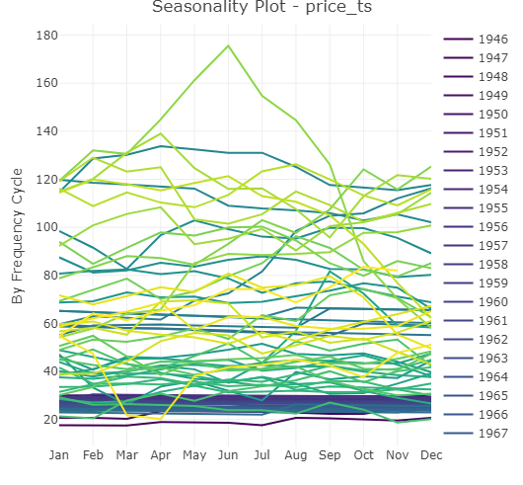
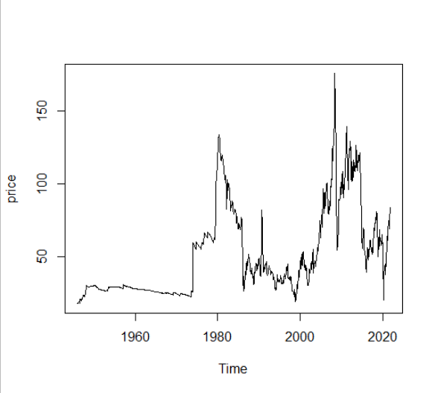
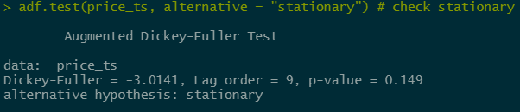
Explore the Time Series
2008 crisis
Convert the data frame to time series
Explore the time series
Check for seasonality
Check for stationary
Iran Revolution and Iraq war
COVID-19
Gulf war
Arab embargo

Slide 6
Time Series Models
Model | Residual SD
AR (Auto Regression) | 4.6669
ARIMA | 4.6829
Seasonal naive | 6.9603
ETS (Exponential Smoothing model) | 0.089

Slide 7
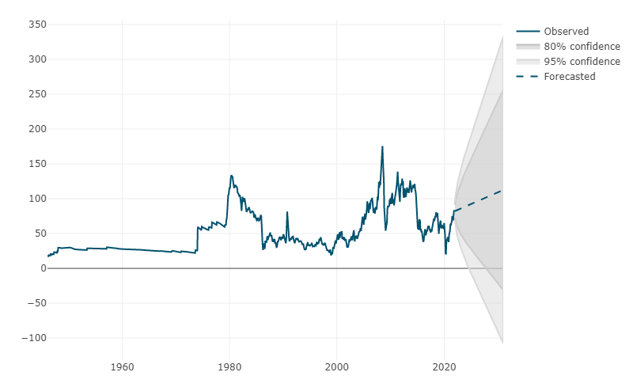
Forecasting 10 Years
It goes from 82$ in Dec 2021
To 112.6$ in Dec 2030

Slide 8
Data – Oil Consumption
Structure:
Source:
https://www.bp.com/en/global/corporate/energy-economics/statistical-review-of-world-energy.html
Feature | Description
Years | 1965 to 2020
Country | All countries (categorized by the region)
Total consumption | In MBD (Million Barrel per Day)

Slide 9
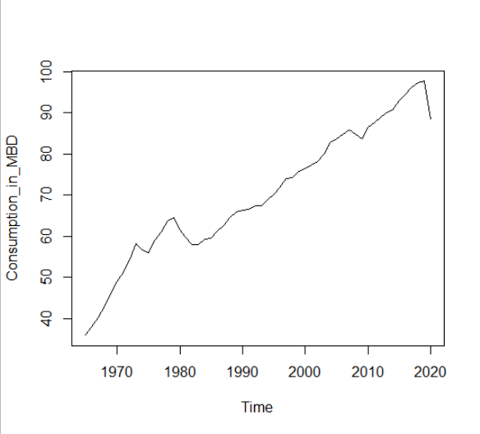
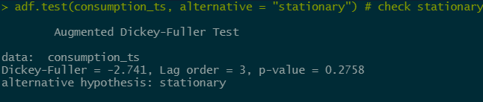
Explore the Time Series
Convert the data frame to time series
Explore the time series
Check for seasonality
Check for stationary
COVID-19
2008 Crisis
OPEC
Demand Reduction
Arab
Embargo

Slide 10
Time Series Models
Model | Residual SD
AR (Auto Regression) | 1.9165
ARIMA | 1.8439
Seasonal naive | 1.9801
ETS (Exponential Smoothing model) | 0.0257

Slide 11
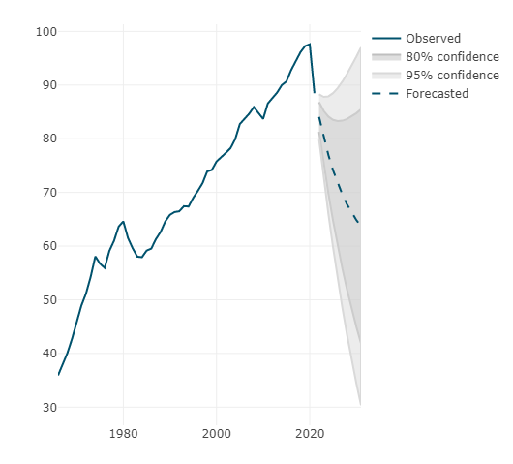
Forecasting 10 Years

Slide 12

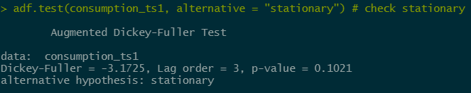
Explore the Time Series
Convert the data frame to time series
Explore the time series
Check for seasonality
Check for stationary

Slide 13
Time Series Models
Model | Residual SD
AR (Auto Regression) | 1.2907
ARIMA | 1.2465
Seasonal naive | 1.5193
ETS (Exponential Smoothing model) | 1.3983

Slide 14
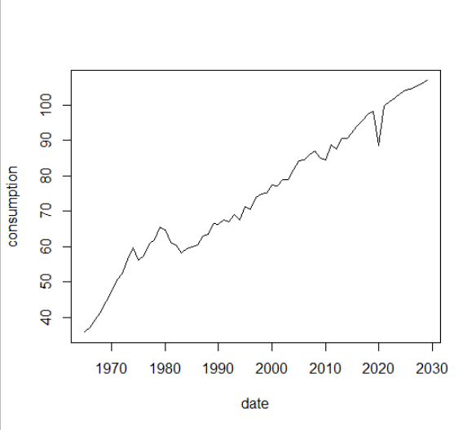
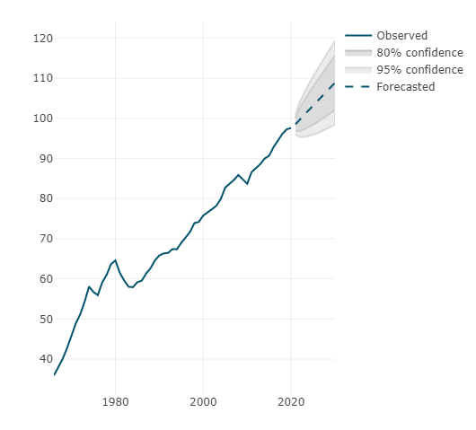
Forecasting 10 Years

Slide 15
Challenges and Future Work

Slide 16
Conclusion

Slide 17
References
Data sets:
https://www.bp.com/en/global/corporate/energy-economics/statistical-review-of-world-energy.html
https://www.macrotrends.net/1369/crude-oil-price-history-chart
Time series:
Course content
https://www.youtube.com/watch?v=_Gb14xNRaxc
https://www.youtube.com/watch?v=dBNy_A6Zpcc
https://www.youtube.com/watch?v=OyrheHnQLPg&t=24s
Energy Articles:
https://www.reuters.com/business/energy/opec-sees-oil-demand-rebounding-then-plateauing-after-2035-2021-09-28/
https://economictimes.indiatimes.com/industry/energy/oil-gas/indias-oil-demand-to-rise-50-by-2030-against-global-expansion-of-7-report/articleshow/86987508.cms
https://ec.europa.eu/clima/eu-action/international-action-climate-change/climate-negotiations/paris-agreement_en
https://climateactiontracker.org/countries/saudi-arabia/#:~:text=Saudi%20Arabia's%20Paris%20Agreement%20pledge,Vision%202030%20from%20October%202021.

Slide 18
Thank You
Is there any questions?

