Slide 1
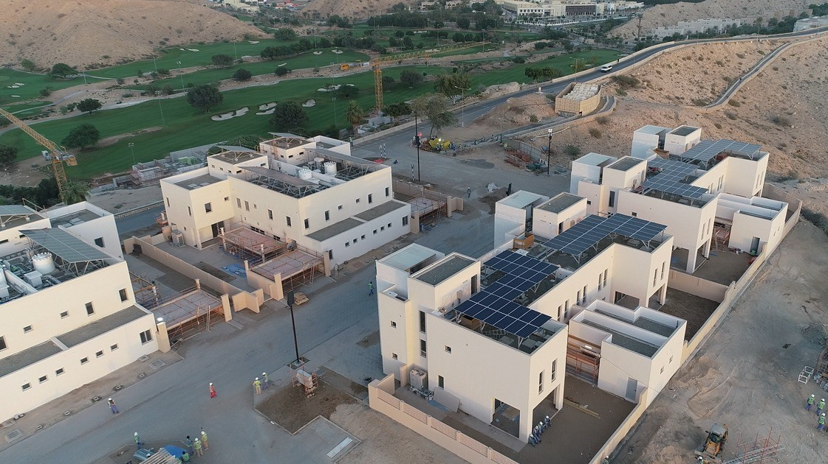

Techno-Commercial Offer for
EPC of Solar PV System
by
www.htc.om

Slide 2

HTC INTRODucTION
Introduction to HTC
01
General pv Plant schematic
Overall Schematic of Grid-Connected Solar PV Systems
02
PV Layout, shadow analysis, & mounting structure
Location for Solar PV Installation. Shadow Analysis, & Mounting Structure
03
04
Component specification
Energy analysis & Electrical connection
PVSyst Simulation Figures
Proposed Electrical Point of Connection
05
Methodology
Stage-wise Methodology
06
COMMERCIAL OFFER
Commercial Offer for EPC Project
07
HTC//TCO/01
Suite 1 | Building 169 | Way 6105 | Bawsher | P.O. Box 2240 | P.C. 133 | Oman
solar@htc.om | Phone/Fax: +968 22020959 | C.R. No. 1/66562/6 | Tax Card No. 8058978 | VAT No. OM1100020352

Slide 3
ABOUT US

Slide 4


Enriching Lives with innovation to delight

Slide 5



MARKET
In the areas of our operations we are experts ahead of the curve and are recognised as the “go-to” solution providers
OPERATIONS
Operational excellence and perpetual process innovation are cornerstones for delivering value to our stakeholders
PEOPLE
Talented inspired effective people performing who are living our WOW culture is the engine of our enterprise
IMPACT
Enriching lives with innovation to delight, is the vision we continuously work to achieve and the legacy we wish to deliver

Slide 6
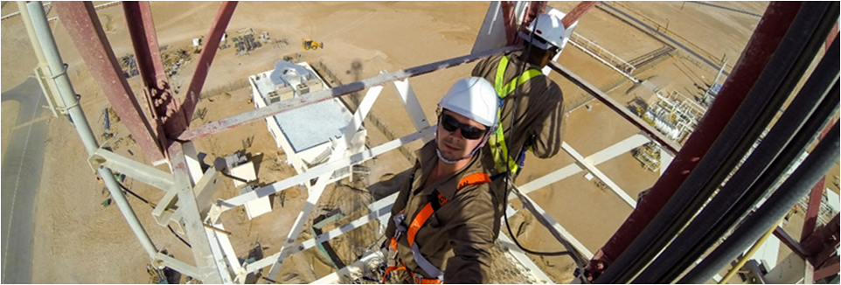

LEADING PRIVATE NETWORKS AND CARRIER GRADE SOLUTIONS
Since inception in 2006 HTC made its’ mark in the Telecom sector in Oman. HTC delivered Oman’s
first Private Network registered with the TRA, Oman’s first wireless mesh network, Oman’s first TRA registered FSO (free space optics link), Oman’s first MMW (millimeter wave) link, and Oman’s first L1 encrypted DWDM network. HTC partnered with telecom providers and selected by oil & gas concession holders to deliver over 4,000 last mile installations

Slide 7
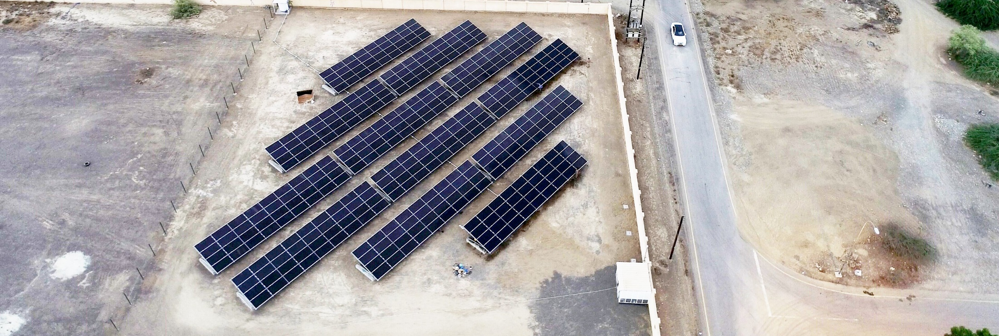
LET’S KNOW ABOUT US
LEADING EPC IN GRID-CONNECTED PV
In 2016 HTC diversified into Energy starting with grid-connected PV plants. HTC delivered
Oman’s first AER-compliant grid-connected plant. This was followed by Oman’s first East-West
ballasted system which withstood 173 km/hr cyclone, Oman’s first bifacial PV plant, and subsequently
Oman’s first tracker PV plant HTC’s currently leads the distributed solar PV market with over 90MW* contracted HTC’s clients include Shell, PDO, BP, Engie, ACWA, OAMC and ROP.
* Includes different subsets of EPC and paid for consultation

Slide 8
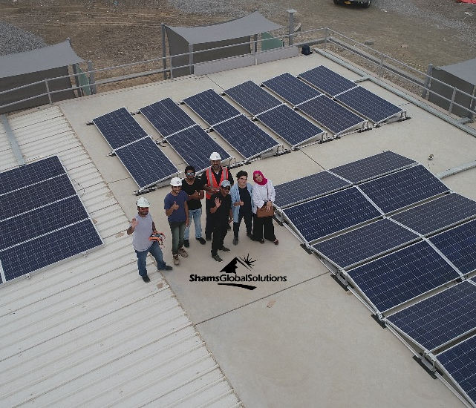
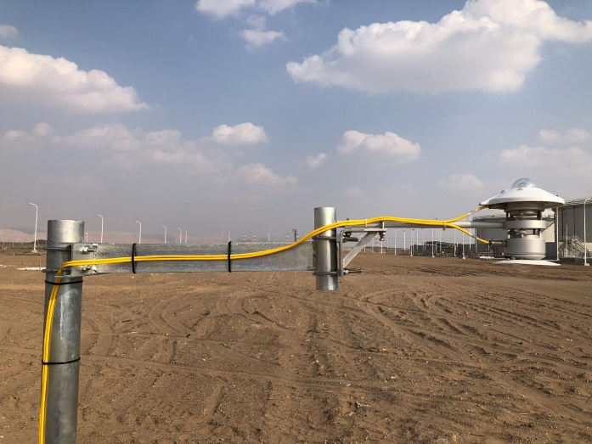
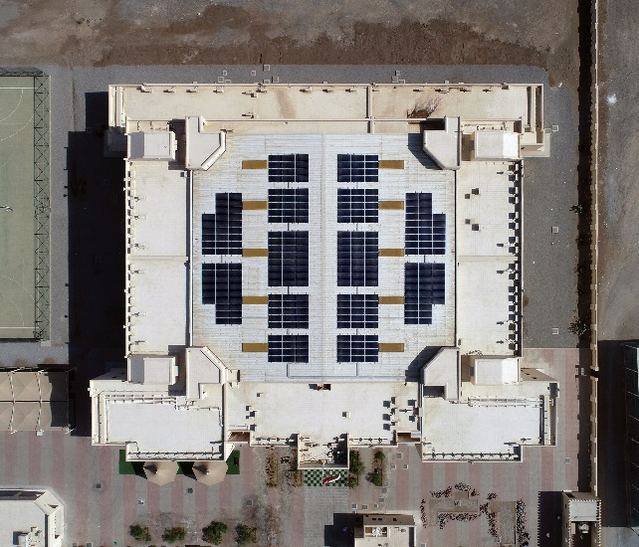







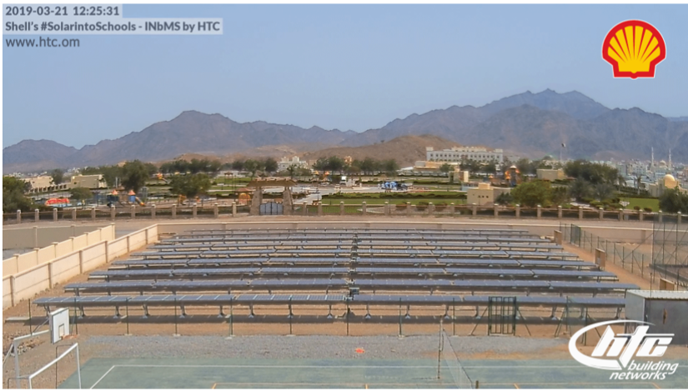

HTC Projects’ References

Slide 9
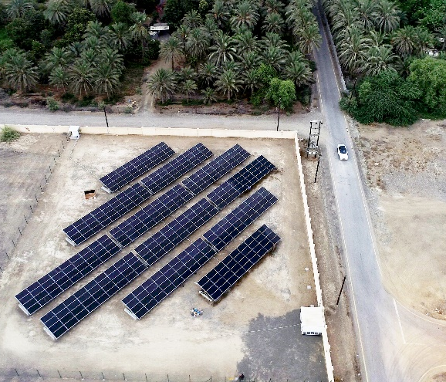
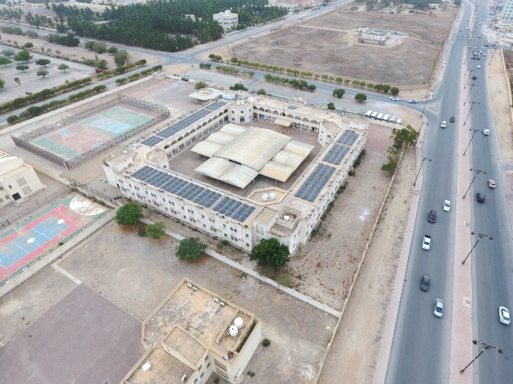
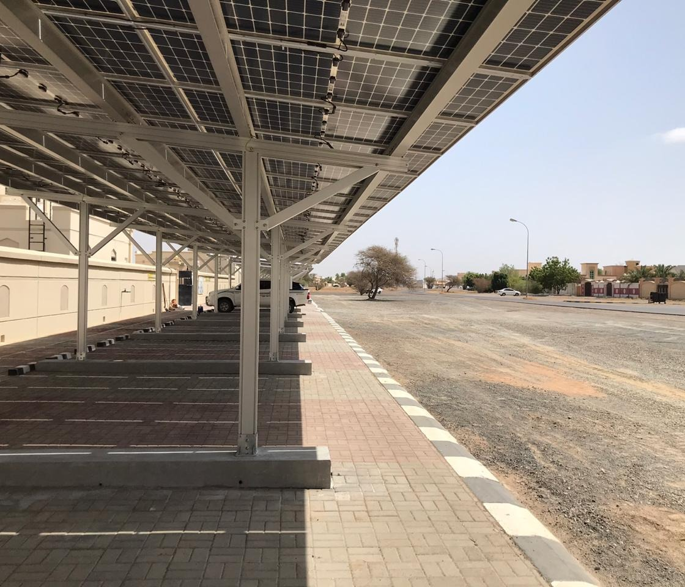
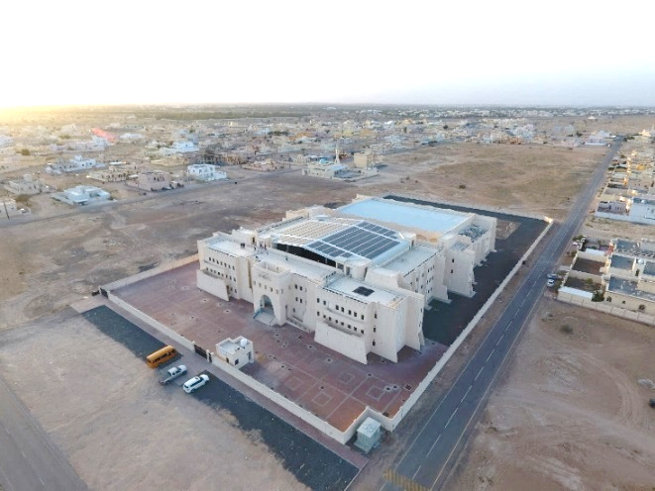
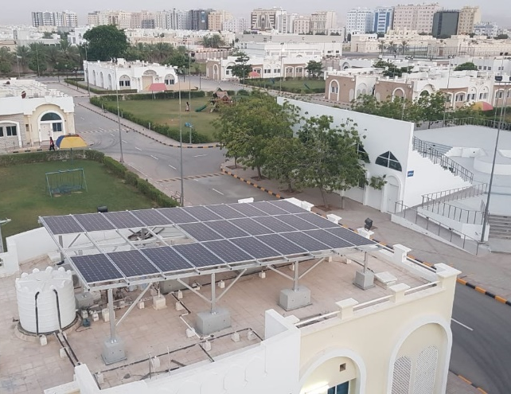
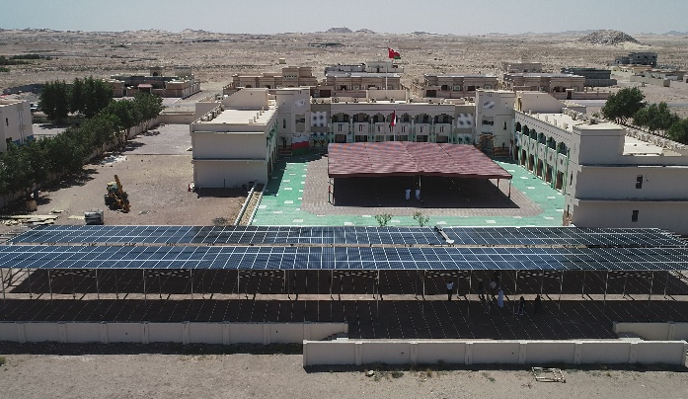
HTC Projects’ References
SAMPLE C&I PROJECTS

Slide 10
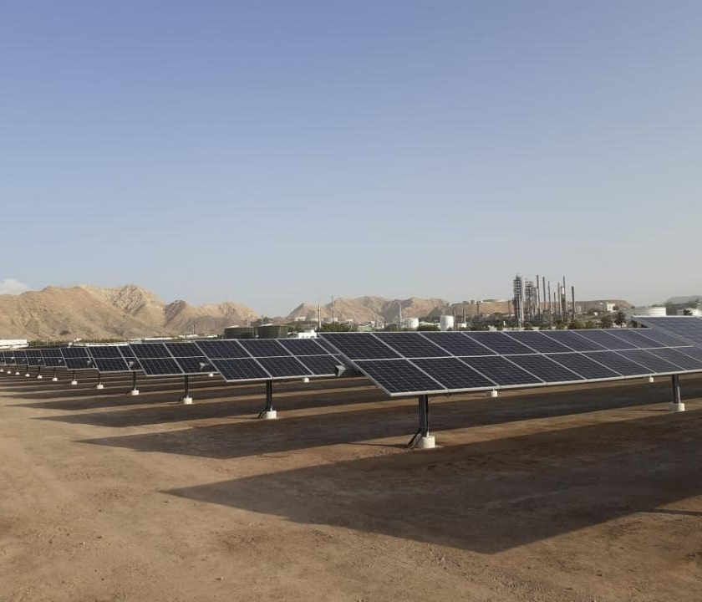
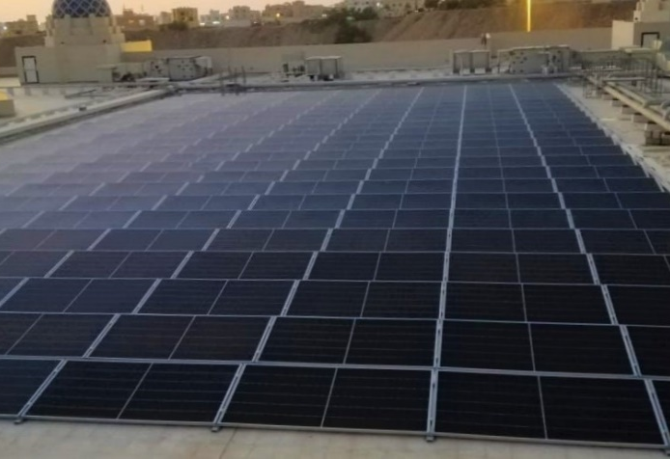
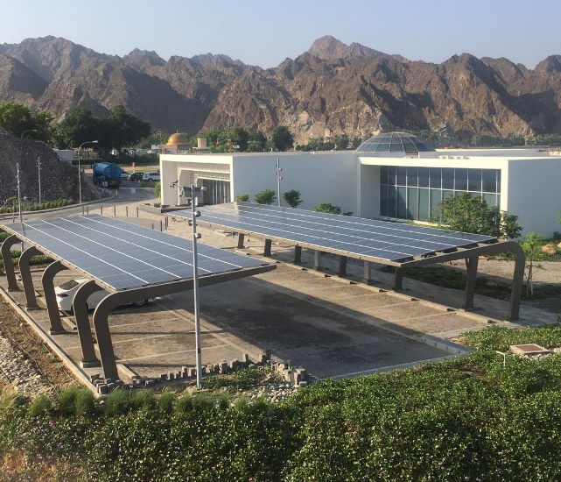
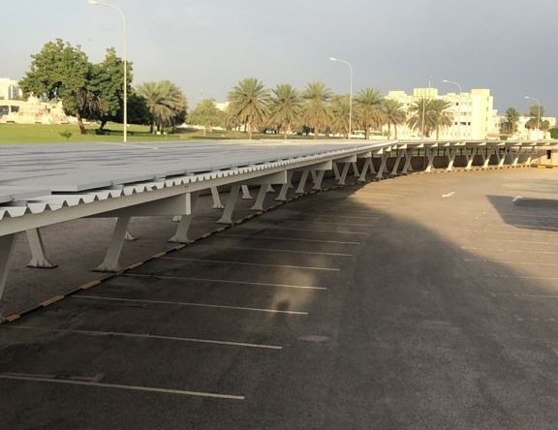
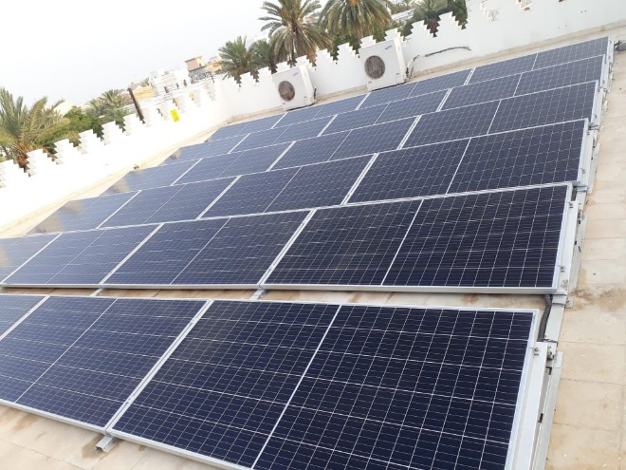
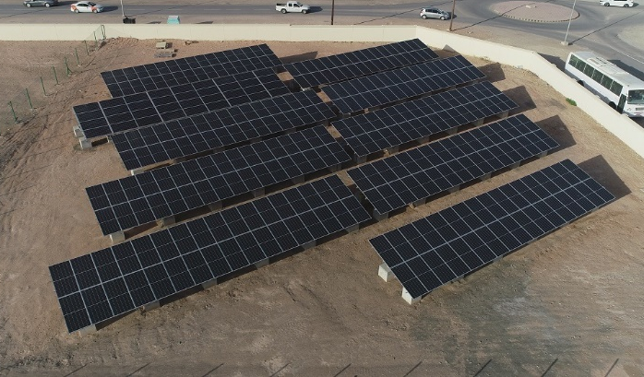
HTC Projects’ References
HTC Projects’ References
SAMPLE C&I PROJECTS

Slide 11
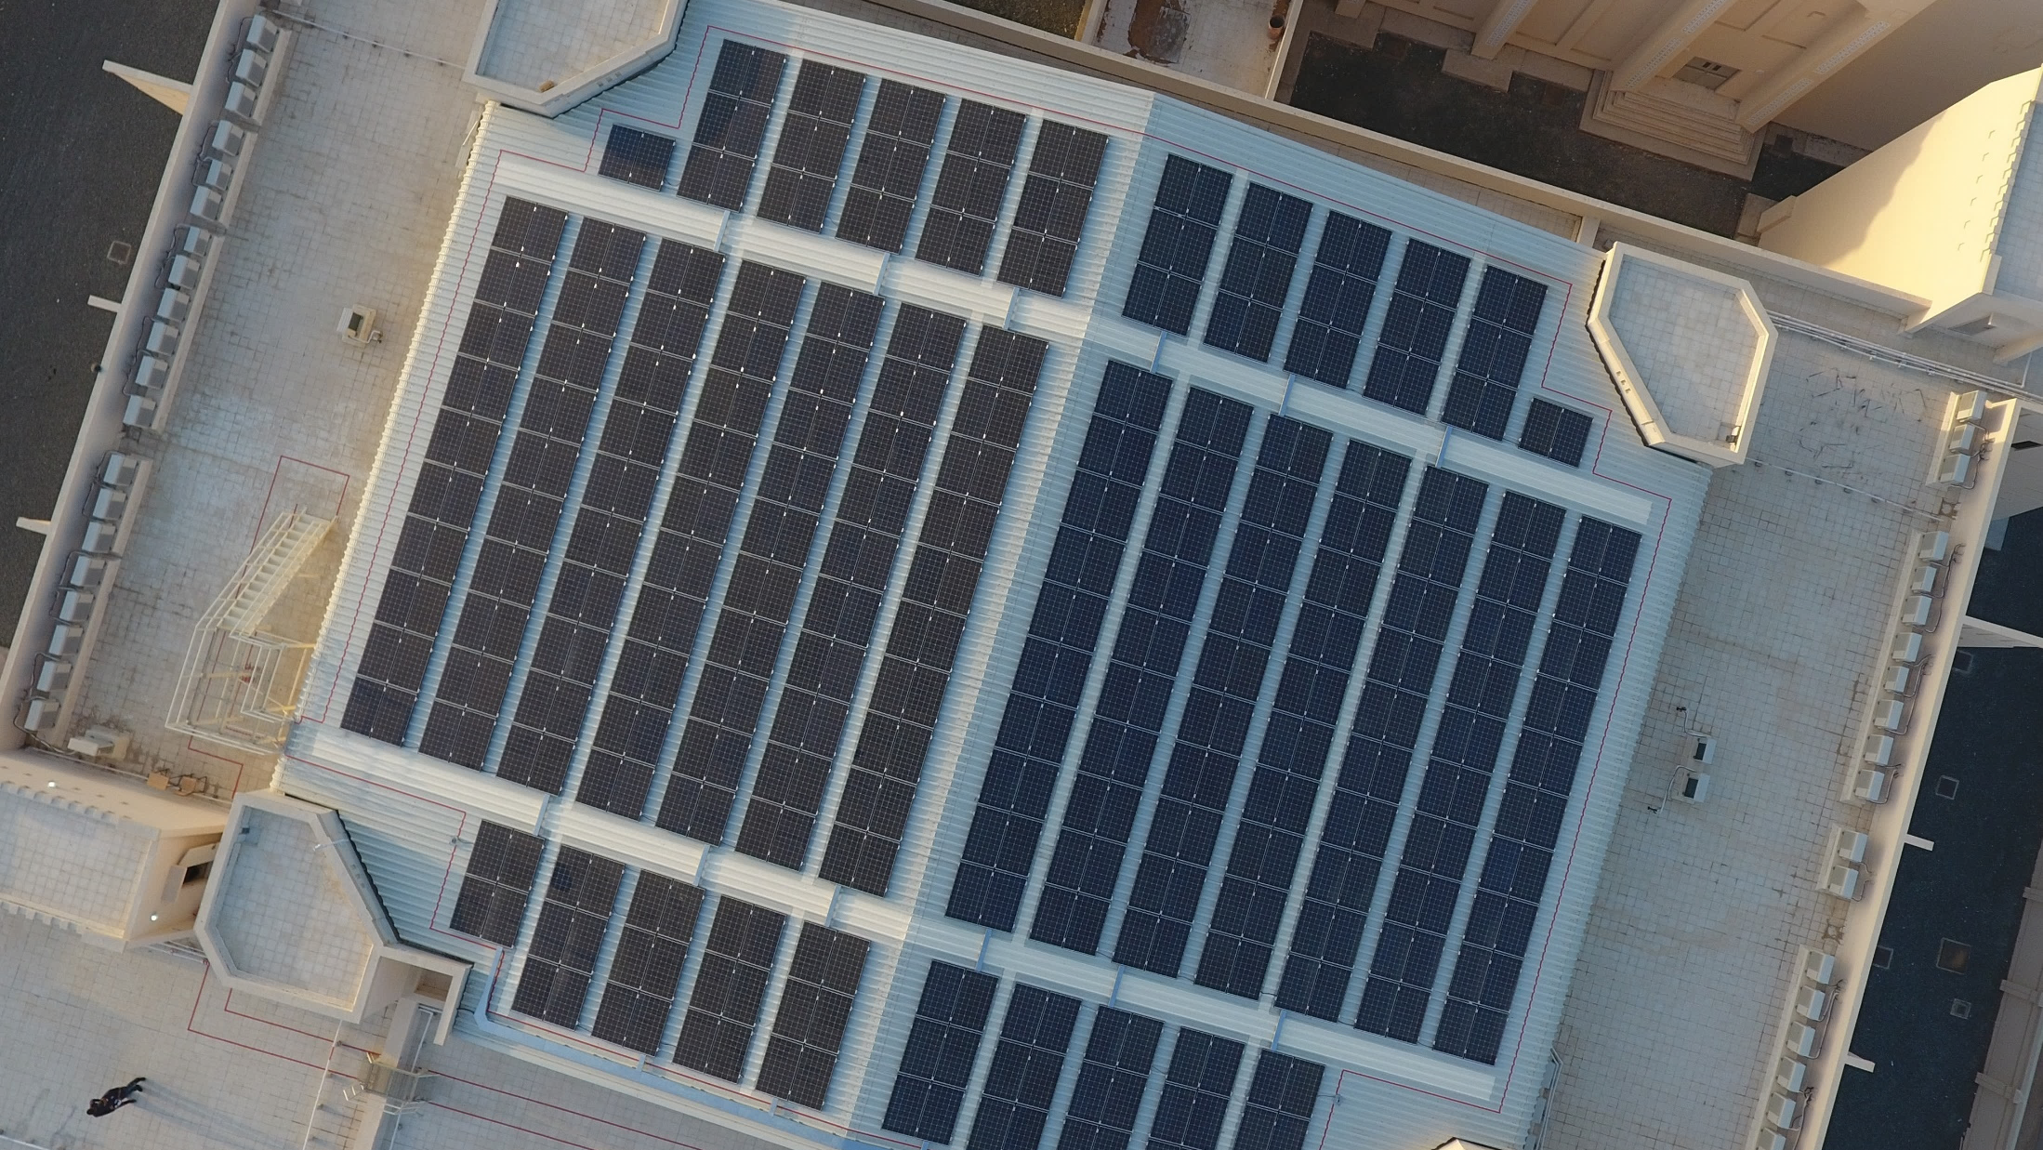
General pv Plant schematic
Overall Schematic of Grid-Connected Solar PV Systems

Slide 12


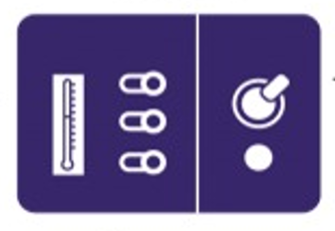




General PV Plant Schematic (Energy Flow)
Energy generation is measured by a meter in the LV panel, which also houses all the necessary monitoring and protection systems. The energy powers building loads, with any surplus exported to NEDC’s Grid.
PV Array
kWp
NEDC Grid
Solar LV Panel
Existing LV Panel
Inverters
kWac
Solar Meter
Net Meter
Solar PV panels generate DC electricity, which the inverter converts to AC energy. As most of the appliances utilize AC Energy
Solar Energy Flow
PV Monitoring System Load
Premises Loads
Grid Energy Flow

Slide 13
PV Layout, shadow analysis, & mounting structure Location for Solar PV Installation.
Shadow Analysis, & Mounting Structure

Slide 14
PV Layout, Shadow Analysis, & Mounting Structure
Proposed Location for Solar PV Installation
This solar PV design has been planned to optimize roof space utilization while strategically mitigating shading losses from existing structures. Additionally, careful consideration has been given to ensuring adequate clearance around panel structures, facilitating easy access for inspection, maintenance, and operational activities.
This approach not only enhances system efficiency and longevity but also prioritizes the safety of personnel during ongoing operations and maintenance (O&M).
Proposed PV Array Structures

Slide 15
PV Layout, Shadow Analysis, & Mounting Structure
Design Summary
Basic PV Plant Information
Type of Installation | Installation
Total no. of PV modules installed | modules
PV Module Type | N-type Bifacial
PV Module Rating (W_{p})
PV Module Make | Jinko Solar
Total Installed DC Capacity (kW_{p})
PV Inverter Make | Sungrow / Huawei
Total Installed AC Capacity (kW_{AC})
DC/AC Ratio | %

Slide 16

PV Layout, Shadow Analysis, & Mounting Structure
Shadow Analysis
As demonstrated in the simulation results, all solar panels experience minimal to no shading losses during peak sun hours, ensuring optimal energy generation.
This is visually confirmed in the bottom-left section of the report, where all panels are highlighted in green, indicating unobstructed sunlight exposure.
The uniform shading analysis further validates the effectiveness of the design in maximizing solar potential while mitigating performance losses.

Slide 17


PV Layout, Shadow Analysis, & Mounting Structure
Solar PV Installation Overview
Installation Type:
Design Wind load: 160km/hr
Tilt / Orientation:
Shade Analysis: Designed for shade-free up to 8 hours (Solar Hours)
Structure Material: Aluminium
Height: m

Slide 18
Component Specifications

Slide 19
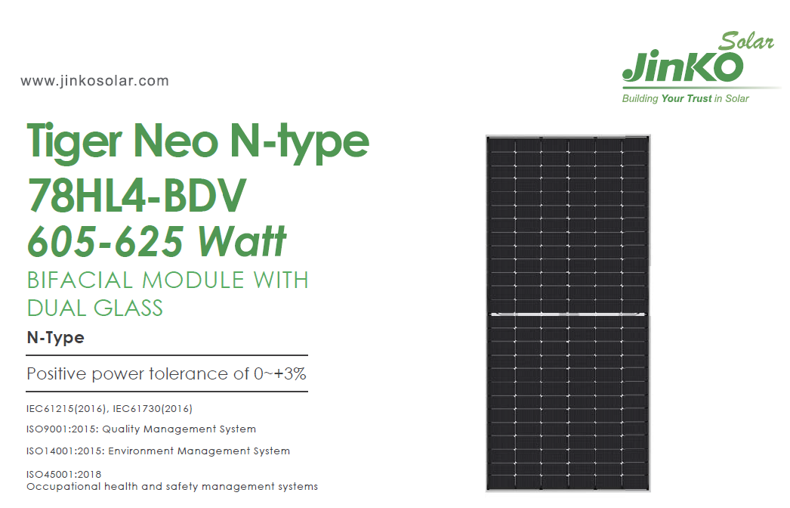
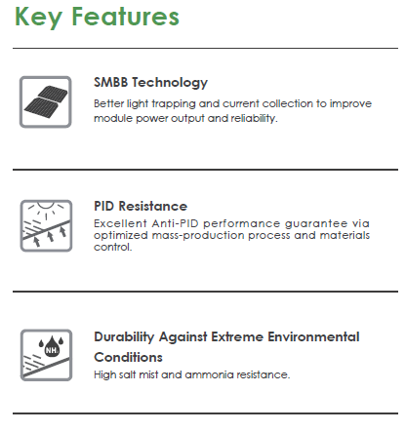
Component Specification
PV Module Specification from Manufacturer’s Datasheet

Slide 20
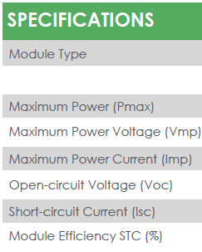
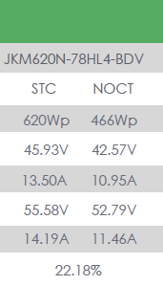
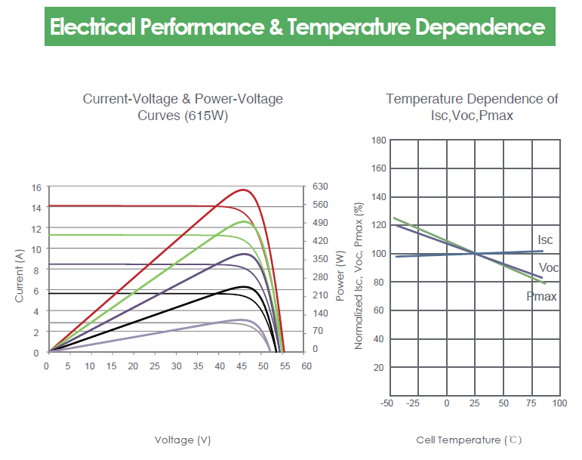
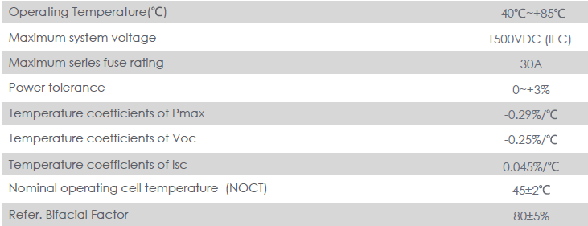
Component Specification
PV Module Specification from Manufacturer’s Datasheet

Slide 21
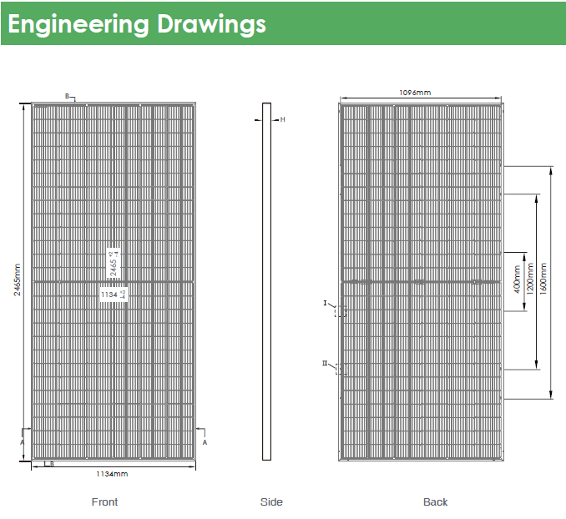
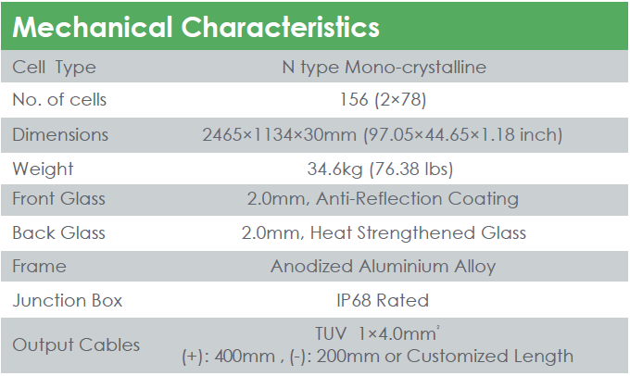
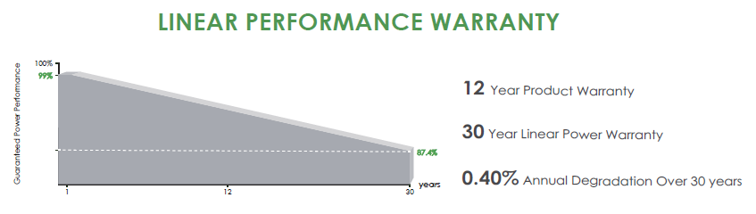
Component Specification
PV Module Specification from Manufacturer’s Datasheet

Slide 22
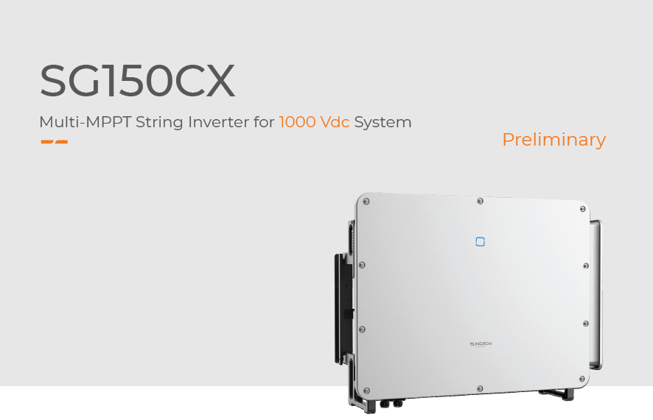
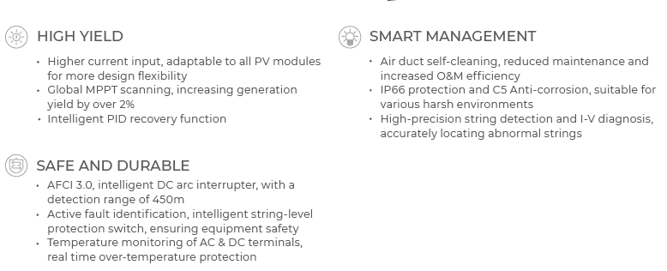
Component Specification
Solar PV Inverter Specification from Manufacturer’s Datasheet

Slide 23
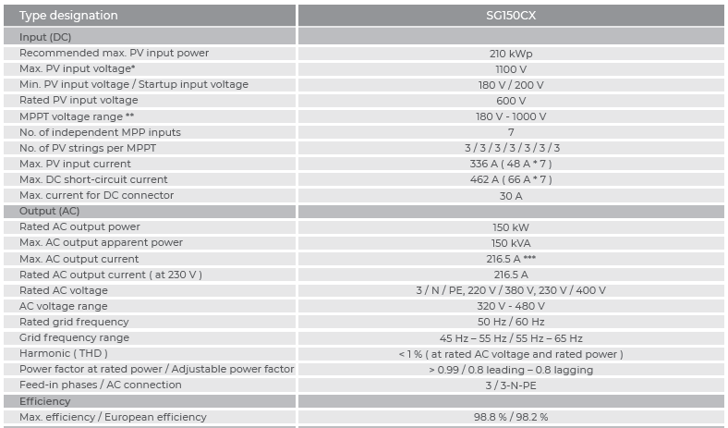
Component Specification
150kW Sungrow (SG150CX) Solar PV Inverter Specification from Manufacturer’s Datasheet

Slide 24
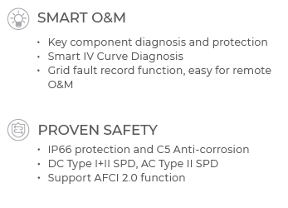

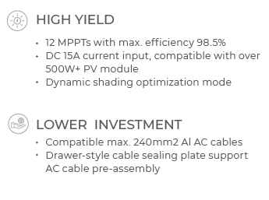
Component Specification
Solar PV Inverter Specification from Manufacturer’s Datasheet

Slide 25
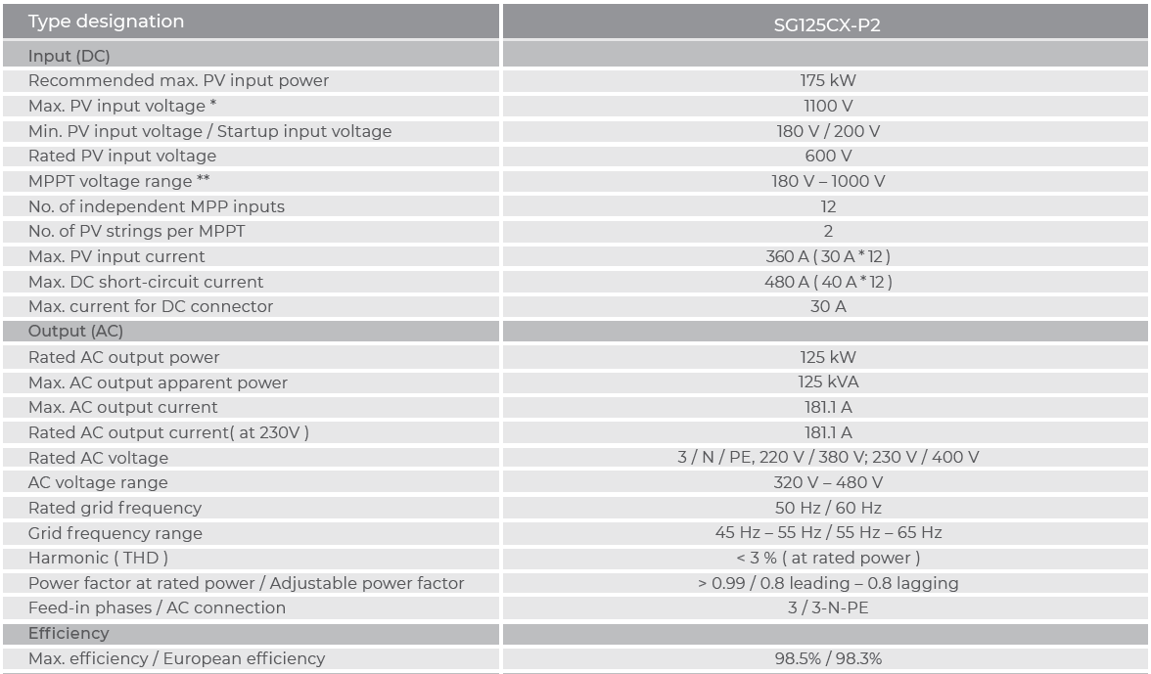
Component Specification
125kW Sungrow (SG125CX) Solar PV Inverter Specification from Manufacturer’s Datasheet

Slide 26
Energy analysis & Electrical connection
PVSyst Simulation Figures
Proposed Electrical Point of Connection

Slide 27
Design Engineering & Energy Analysis Considerations
Engineering Approach and Justification
Design Engineering Consideration
The selection of 710Wp module from AstroEnergy is considered as it is the highest available Utility grade Solar PV module Available in the Industrial and commercial Application.
HTC has considered inverters of 125kW (125kW CX-P2) from Sungrow.
Please note, Design is subject to be changed based on the PV module and Inverter availability.
All chosen components, as well as any alternatives proposed by HTC, are from Tier 1 suppliers. This is considered on par with industry standards.
All design considerations have been developed in full compliance with the regulations of APSR, NEDC, and the relevant municipal authority for this project location.
Energy Yield Consideration
After Validating Shading scene in Helioscope, which resulted in no major shading losses over the design PV area, an energy simulation was run on PVSyst which also showed no major losses in other aspects of the design.
For year-on-year energy analysis, multi-year climatic uncertainty along-with equipment downtime uncertainty considered.

Slide 28
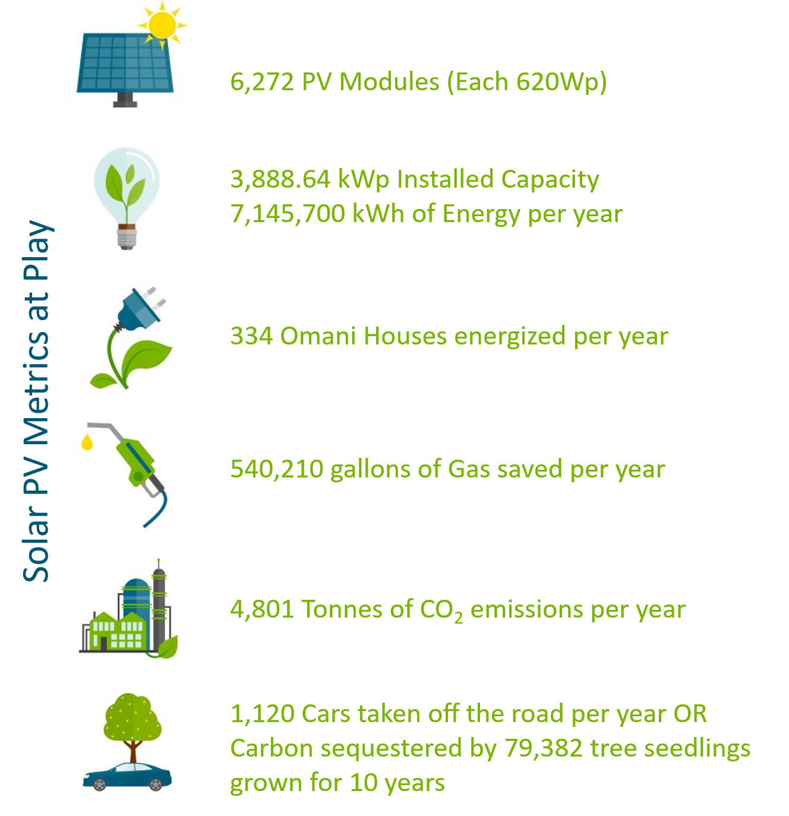
Carbon Footprint Reduction
Green House Gas Equivalents for PV System atop Chiller Building

Slide 29
Energy Analysis
Expected Energy Generation
Month | Annual Energy Yield from Metal Roof PV System (kWh)
Jan | 482,800
Feb | 500,100
Mar | 604,700
Apr | 662,300
May | 714,400
Jun | 687,800
Jul | 684,100
Aug | 661,300
Sep | 624,300
Oct | 587,700
Nov | 487,900
Dec | 448,300
Total | 7,145,700

Slide 30
Energy Analysis
Year-On-Year Degradation Analysis – For 25 Years
Year | E_Grid (MWh) | % Energy Loss
1 | 7,145.70 | 0.0%
2 | 7,099.25 | 0.6%
3 | 7,053.11 | 1.3%
4 | 7,007.26 | 1.9%
5 | 6,961.72 | 2.6%
6 | 6,916.46 | 3.2%
7 | 6,871.51 | 3.8%
8 | 6,826.84 | 4.5%
9 | 6,782.47 | 5.1%
10 | 6,738.38 | 5.7%
11 | 6,694.58 | 6.3%
12 | 6,651.07 | 6.9%
13 | 6,607.84 | 7.5%
14 | 6,564.88 | 8.1%
15 | 6,522.21 | 8.7%
16 | 6,479.82 | 9.3%
17 | 6,437.70 | 9.9%
18 | 6,395.85 | 10.5%
19 | 6,354.28 | 11.1%
20 | 6,312.98 | 11.7%
Year | E_Grid (MWh) | % Energy Loss
21 | 6,271.94 | 12.2%
22 | 6,231.18 | 12.8%
23 | 6,190.67 | 13.4%
24 | 6,150.43 | 13.9%
25 | 6,110.46 | 14.5%
For the Year-on-Year Energy Estimation, the yearly degradation factor has been considered as 0.65% yearly on annual energy yield.

Slide 31
Energy Analysis
Year-On-Year Degradation Analysis – For 25 Years

Slide 32
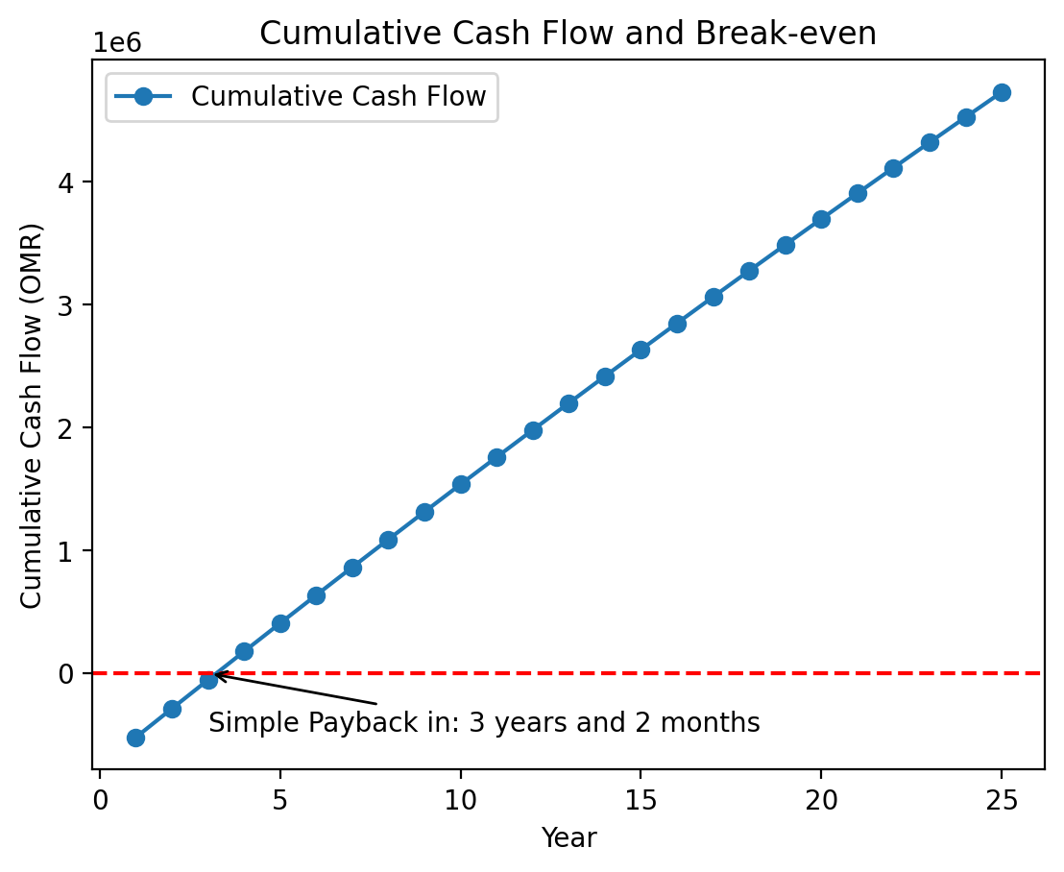
Energy Analysis
Financial Analysis Over 25 Years for Cost of System
The graph represents the cost of the energy produced by the system over 25 years if it was taken from the grid at the tariff of 33bz/kwh.
This tariff considered is based on the annual flat tariff from APSR.
Considering no escalation in grid electricity prices, the payback period is approximately 3 Years & 02 Months.
Considering an annual savings due to the value of electricity generated of 235,808.100 OMR, The ROI of the project comes to 28.9%.

Slide 33
Methodology & PROJECT SCHEDULE
Stage-wise Methodology and High-level Project Schedule

Slide 34
Execution Schedule
High Level Project Schedule (+2 Weeks Contingency)
# | Activity | Month 1 |  |  |  | Month 2 |  |  |  | Month 3 |  |  |  | Month 4 |  |  |  | Month 5
 |  | W1 | W2 | W3 | W4 | W5 | W6 | W7 | W8 | W9 | W10 | W11 | W12 | W13 | W14 | W15 | W16 | W17 | W18 | W19 | W20
1 | Award & Orientation
2 | Design Concept Submission and Documentation Approval
3 | Statutory & Regulatory Approvals
4 | Procurement, Clearances & Delivery to site
5 | Mobilization to Site/Site Preparation
6 | All Installation (Mechanical and Electrical)
Months 1-5, Cont. Months 6-10 Next Slide

Slide 35
Execution Schedule
High Level Project Schedule (+2 Weeks Contingency)
# | Activity | Month 6 |  |  |  | Month 7 |  |  |  | Month 8 |  |  |  | Month 9 |  |  |  | Month 10
 |  | W21 | W22 | W23 | W24 | W25 | W26 | W27 | W28 | W29 | W30 | W31 | W32 | W33 | W34 | W35 | W36 | W37 | W38 | W39 | W40
6 | All Installation (Mechanical and Electrical)
7 | Testing, Inspections and Commissioning
8 | Hand Over

Slide 36
Execution Methodology
Project Execution Methodology
This section provides a comprehensive brief of the activities (phases) to be carried throughout the project lifecycle, upon award. Many of these phases occur simultaneously.
# | Activity | Steps
1 | Award & Orientation | This initial phase will be a session to cover the following aspects: Interaction with Client’s Technical Team to discuss the technical and regulatory considerations for the design options proposed. Walk Client through proposed design and provide a techno-commercial comparison for the various options.
2 | Design Concept Submission and Documentation Approval | This phase includes the following steps, in order: Submission of the design option finalized by Client Work on the detailed engineering for all aspects such as Structure (Civil), Single Line Diagrams, Cable Scheduling, Earthing Calculations, Lightening Protection (Electrical) etc. Finalization of Manufacturers/Vendors of all equipment and approval from Client HSE Documentation submission and approval from Client Detailed Project Plan and Work Schedules submission and approval from Client

Slide 37
Execution Methodology
Project Execution Methodology
# | Activity | Steps
3 | Statutory & Regulatory Approvals | This phase is based on the APSR Connection Guidelines for Small-scale Grid connected Solar PV Plants. This is a 3-Stage process: 1. Initial Enquiry (with NEDC) a. Contractor Enrolment b. Project Preparation c. Application for Connection for Solar PV d. Connection Budgetary Cost Estimation e. Affection Plan Approval by Municipality 2. Design Approval (with NEDC) a. Application for Design Approval b. Define Connection Offer c. PV Plant Construction starts (on Build-Permit receipt) 3. Inspection & Energization (with NEDC) a. Notification for Mechanical Completion b. PV Construction Finalization c. Notification for Electrical Inspection and Testing: i. Testing without Interconnection ii. Testing with Interconnection d. Performance Tests e. Secondary Injection Test

Slide 38
Execution Methodology
Project Execution Methodology
# | Activity | Steps
4 | Procurement, Clearances & Delivery to site | This phase begins as soon as the vendors are finalized and approved by Clients and involves: Order Placement Shipment Delivery and Clearances at the respective local ports Storage facilities made available, if required. Delivery to site
5 | Mobilization to site/Site Preparation | This phase begins with the arrival of the major equipment on site while others can follow in due course: Off-site HSE Induction On-site HSE Induction Site familiarization On-site office set-up (if required) Placement of sign boards and barricading (physical/visual) Clear marking of working and storage zones Storage of Equipment on site

Slide 39
Execution Methodology
Project Execution Methodology
# | Activity | Steps
6 | All Installation (Civil and Electrical) | This phase comprises the Installation of all components of the Solar PV Plant, such as: Installation and assembly of PV mounting structure Installation and assembly of PV Modules Installation of PV Inverters and support structures, if required. Stringing of PV Modules Installation of Cable Trays Laying of DC and AC Cables Cable Dressing and Tagging Installation of AC Combiner Box (ACCB) Termination of DC cables in inverters and AC cables in respective electrical panels Installation of Energy Meters Grounding of mounting structure, PV modules, inverters, all electrical panels Installation and Commissioning of Monitoring Solution

Slide 40
Execution Methodology
Project Execution Methodology
# | Activity | Steps
7 | Testing, Inspections and Commissioning | This phase includes the Tests and Approvals as per APSR Guidelines, for Tests before and after Inter-connection/Energization, such as: Ground continuity (Insulation Resistance) Tests (for each PV string) Open Circuit Voltage Tests (for each PV string) Short Circuit Current Tests (for each PV string) Performance Test Secondary Injection Test
8 | Hand Over | This final phase includes the submission of all Deliverables as requested by Client, in specific: As-built Drawings and Single Line Diagrams (SLDs) Complete Design Report (DR) System Commissioning Reports (CR) PV System Inspection Report PV Array Test Reports (results of polarity, insulation, grounding, voltage and current tests) Performance Test Reports Spare-parts lists, if any O&M manuals and guidelines Training Documents

Slide 41
Commercial Offer

Slide 42
Commercial Offer
Engineering, Procurement & Construction (EPC – All Inclusive)
System | DC Installed Capacity (kWp) | AC Installed Capacity (kWac) | OMR/kWp | Total (OMR)
Metal Sheet Installation
Prices are not inclusive of VAT

Slide 43
Key Technical Assumptions/Considerations
Engineering, Procurement & Construction (EPC – All Inclusive)
Item | Assumption/Exclusion
Electrical Point of Connections/Grid Interconnection of Solar PV Plants | Total PV Capacity has been estimated based on maximum shade-free (up to 8 hours) for PV installation. Electrical Point of Connections (PoC) have been assumed with the following considerations: LV (415V) level Proximity to PV Installation Availability of physical space in the LV panels (Inverters/AC Combiner Panels) installation Suitable rating of Busbar and availability of spares (switchgear/compartments) with minimum requirements for existing panel modification Proposed PV capacity to be within ~50% of TCL (Total Connected Load) of existing LV panel at the PoC – per APSR mandate Available route for DC/AC Cables into LV panel and easy access for Equipment & Personnel PoC to be finalized by Client. Offered price is subject to revision upon finalization of PoC. Modification of PoCs is assumed to be the responsibility of the client and can be arranged with HTC accordingly.

Slide 44
Key Technical Assumptions/Considerations
Engineering, Procurement & Construction (EPC – All Inclusive)
Item | Assumption/Exclusion
Mechanical & Electrical Balance of Systems (BoS) | All Mechanical & Electrical BoS (Cables, Cable Management Systems, Cable Termination Accessories, Switchgears, Cable Tags, HSE Signs, Enclosures, Consumables etc.) proposed from APSR/DisCo-approved makes and guidelines.
DC/AC Voltage Drop & Power Loss | The average DC/AC Cables’ loss considered in design is approx. 2% on each - compliant with APSR regulations (Oman Electrical Standards allow up to 4%).
Earthing System | DC/AC Earthing Systems and Accessories are considered with connection into the existing Earthing Network
Lightning Protection System | Not included in offer.
Monitoring System | Included in the offer. Internet is to be provided by the Client.
Operations & Maintenance | It includes monthly visit for Water-based Cleaning, Remote Monitoring & Trouble-shooting Support and On-call visit, as required. Client to ensure water supply on site.

Slide 45
Key Technical Assumptions/Considerations
Engineering, Procurement & Construction (EPC – All Inclusive)
Item | Assumption/Exclusion
Energy Meters to be installed | The Energy Meters installed will be as follows for each Point of Connection: M1 Meter (Net Meter): Digital Meter to be re-calibrated (for bi-directional/2-way reading) in the existing Panel at Point of Connection. Property of DisCo – cannot be read/monitored by Client M2 Meter (Solar Meter): 2-way Digital Meter (DisCo approved make and checked/calibrated) procured and installed by Contractor on the Solar Feeder at PoC. Property of DisCo – cannot be read/monitored by Client
Authority/Stakeholder Approvals | All authority/stakeholder approvals will be in HTC’s scope (for NEDC)
Proposal Type and Validity | This is a non-binding Techno-Commercial Proposal. Validity – 60 Days from Issue Date
Warranties | Standard Manufacturers’ Warranties applicable and offered. PV Modules – 12 years (Product) and 30 years (Performance) PV Inverters –5 years Mounting Structure – 10 years Balance of System (Electrical) – 1 year PV Module Linear Power/Performance – 25 years Overall System & Workmanship Warranty – 1 year (Defect Liabilities Period/DLP)

Slide 46
THANK YOU
htc-om
HTC_OM

