Slide 1
Data Meeting
21 November, 2025
Geometry-Driven Strand Bias at Replication Origins

Slide 2
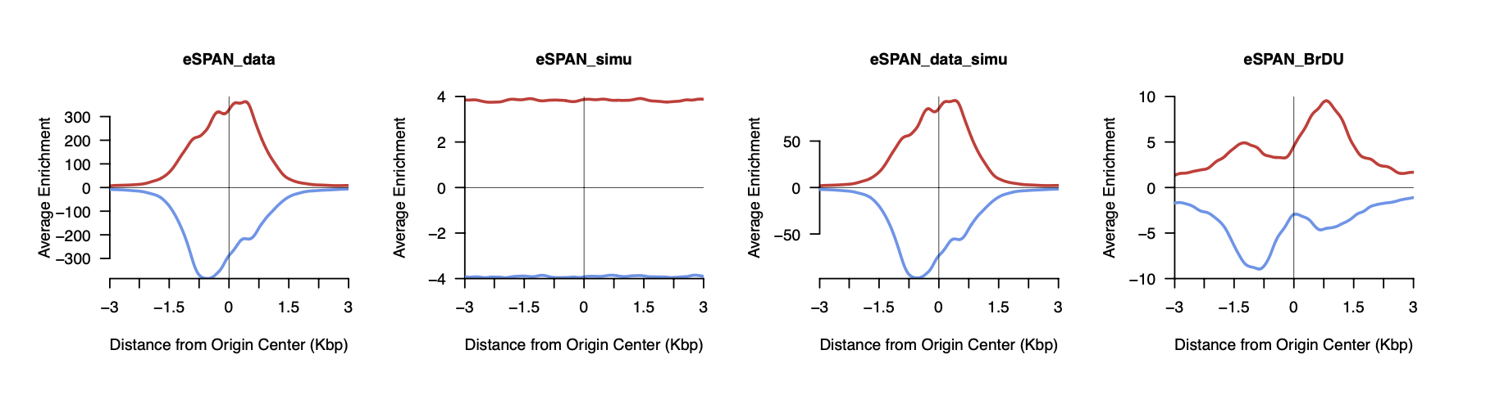
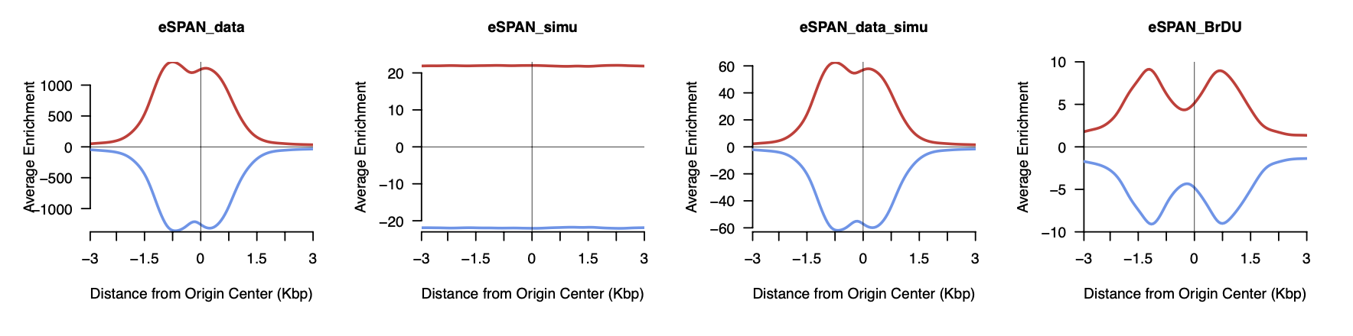
Pol2 eSPAN – average read enrichments at origins
5’ end of mate1… 5’ end of the fragment
Midpoint of the fragment

Slide 3
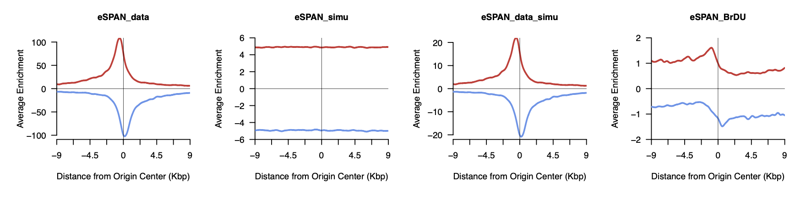
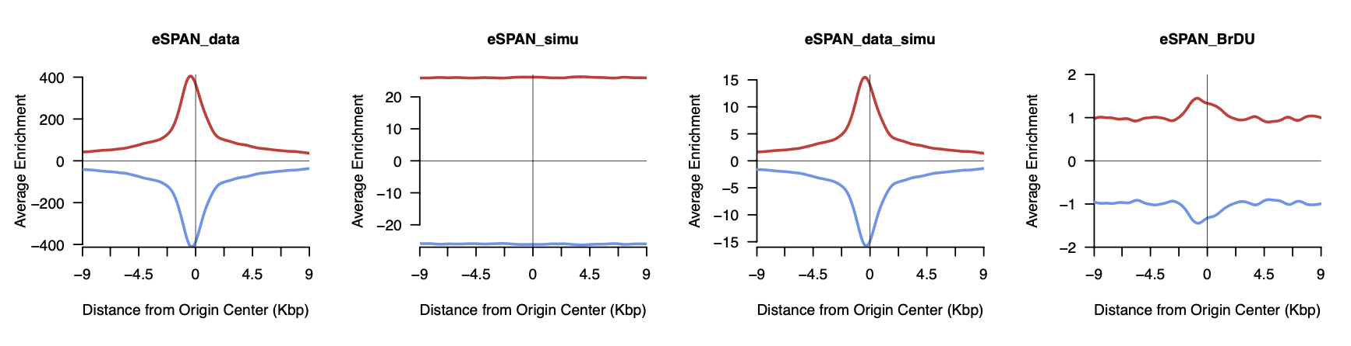
Pol3 eSPAN – average read enrichments at origins
5’ end of mate1… 5’ end of the fragment
Midpoint of the fragment

Slide 4
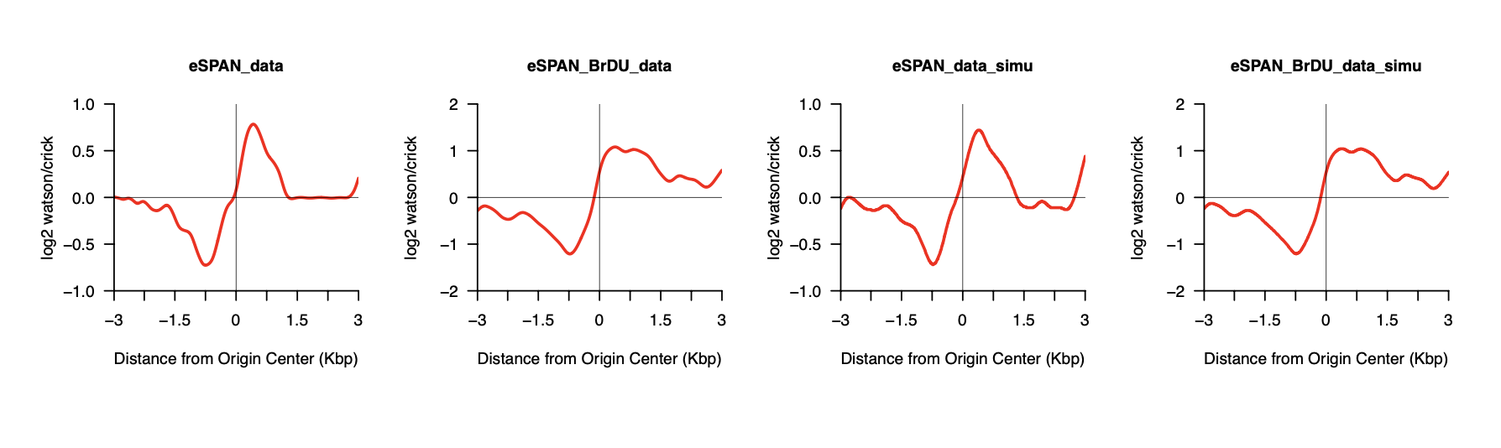
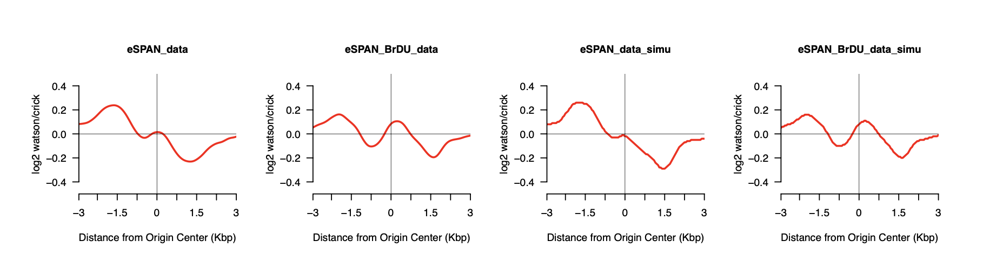
Pol2 eSPAN – flip in watson/crick bias pattern
5’ end of mate1… 5’ end of the fragment
Midpoint of the fragment

Slide 5
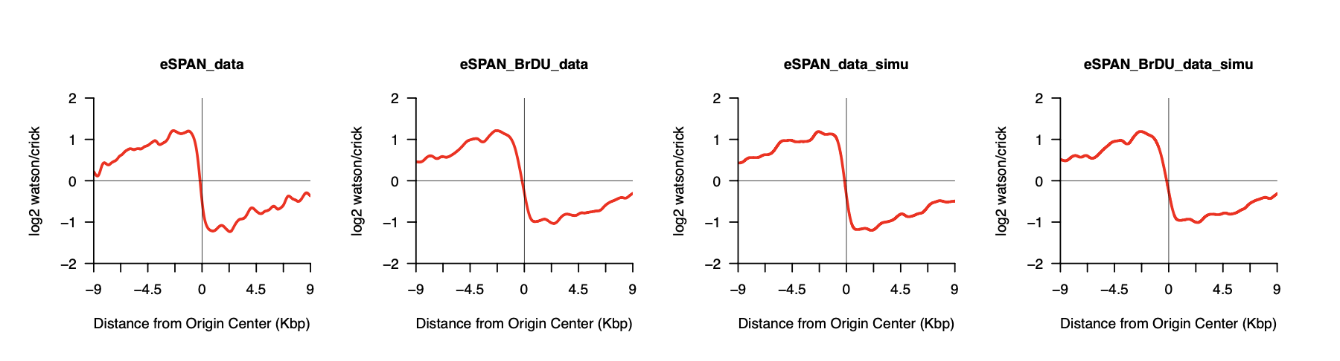
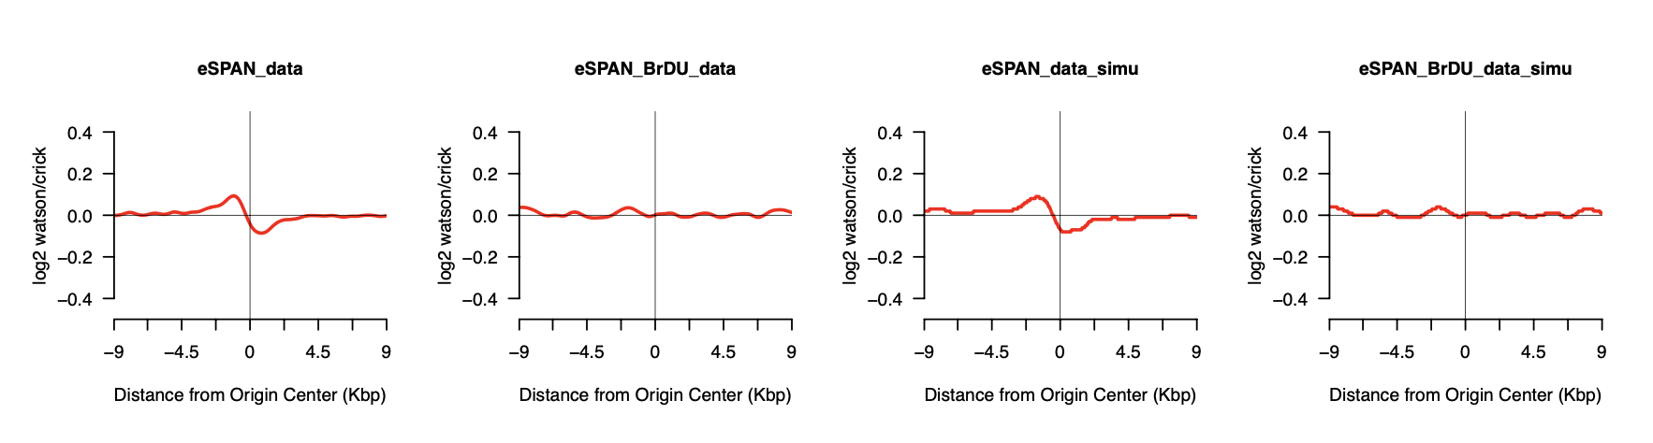
Pol3 eSPAN – shrink in watson/crick bias pattern
5’ end of mate1… 5’ end of the fragment
Midpoint of the fragment

Slide 6
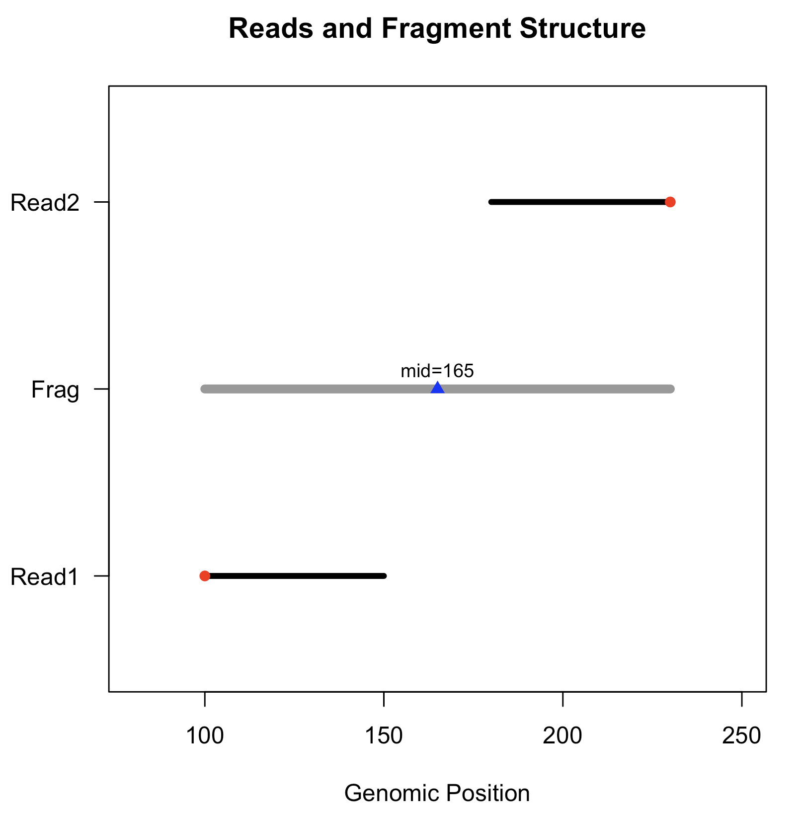
What is a fragment?
Illumina paired-end sequencing generates two reads (Read1 and Read2)
These two reads originate from opposite ends of one DNA fragment
In FASTQ, you see reads, not fragments
In BAM, once aligned and paired, the two reads become a fragment
Every fragment has:
a 5′ end on each read
a start and end coordinate on the genome
a computed fragment midpoint
(frag_mid) = (start + end)/2

Slide 7
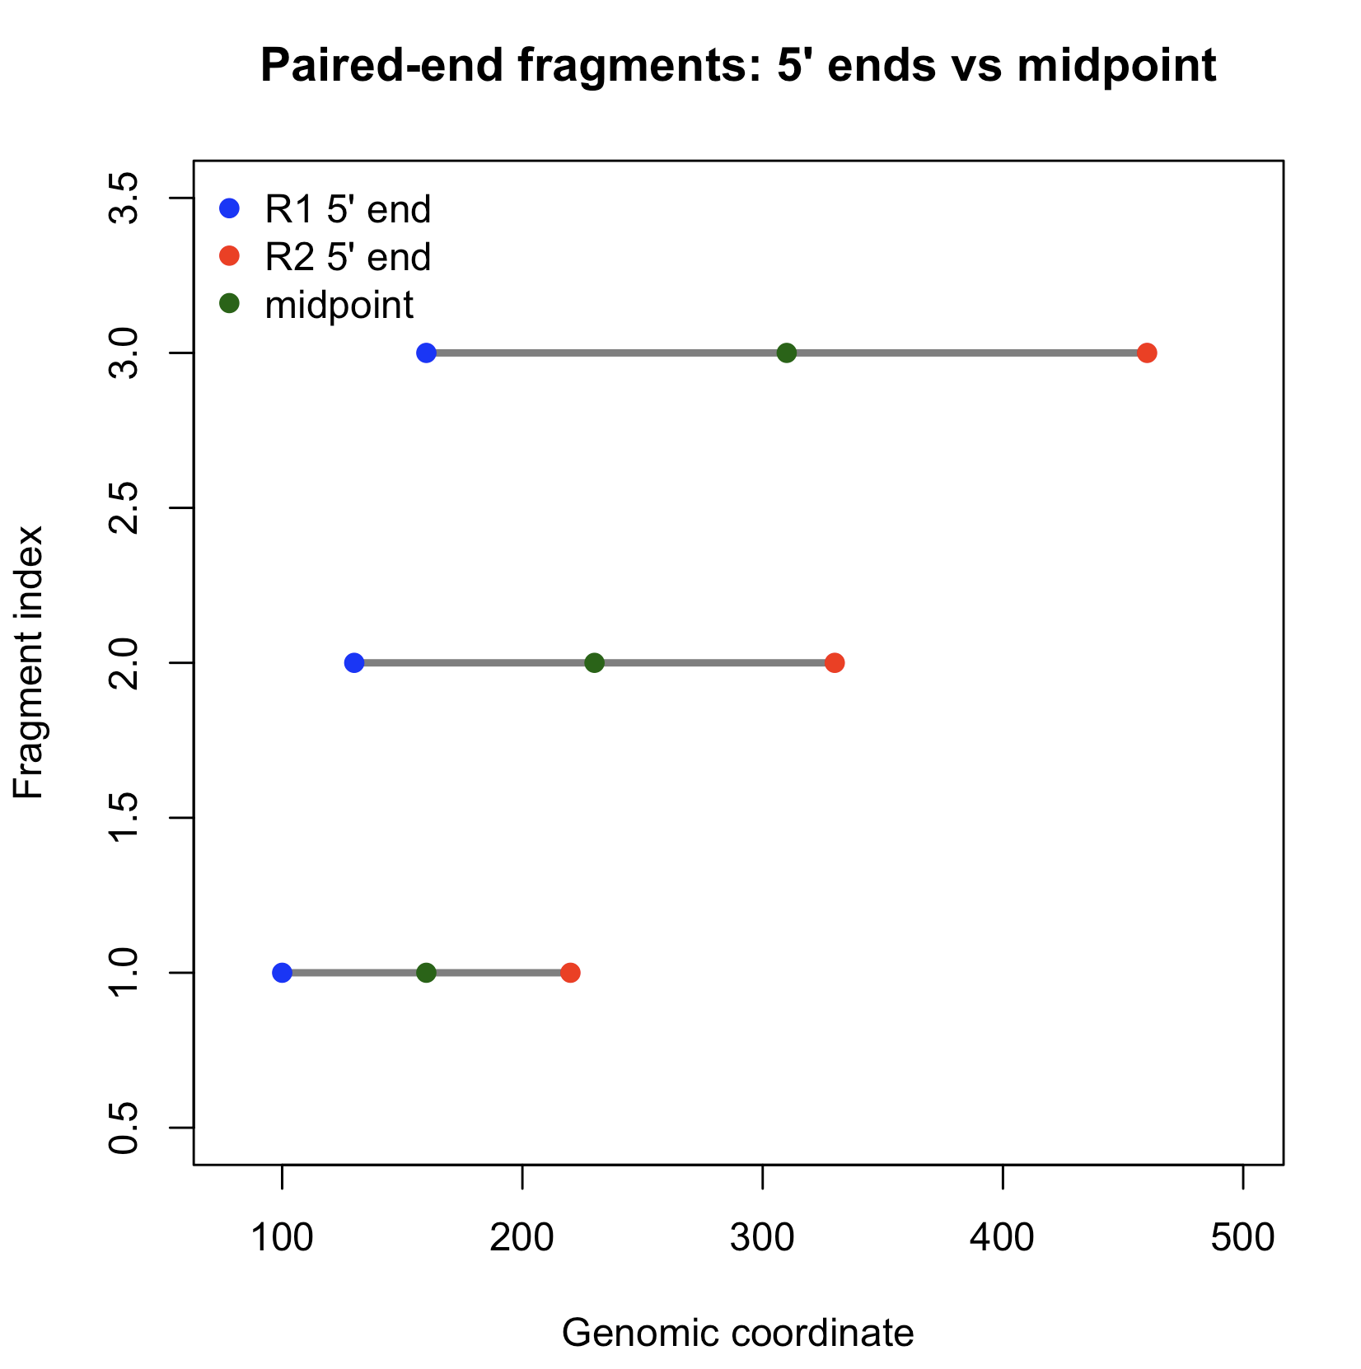
Paired-End Sequencing Captures DNA Fragments, Not Just Reads
Key Points:
A paired-end read pair originates from one physical DNA fragment.
The fragment has:
  Two 5′ ends (start of R1 and start of R2)
  A true center (midpoint)
  A true orientation dictated by the genome strand
Fragment lengths vary (100–400+ bp).
Because fragment length varies:
➜ 5′ ends shift left/right depending on length
➜ Fragment midpoints remain centered

Slide 8
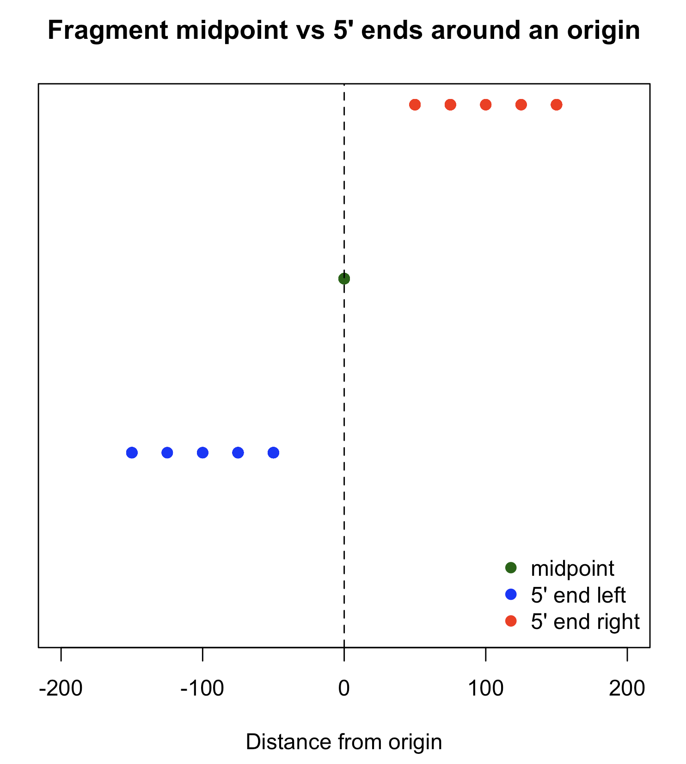
Why 5′ Ends Shift Asymmetrically Relative to an Origin
Key Points:
Around a replication origin, DNA synthesis produces two strands:
Watson (leading) and Crick (lagging).
If we count fragment midpoints, Watson and Crick distributions are symmetric around the origin.
But if we count 5′ ends, each fragment contributes:
  One end left of the midpoint
  One end right of the midpoint
  The distances depend on fragment length.
Because fragment lengths vary from 100 to 400+ bp:
  Short fragments place 5′ ends close to the origin.
  Long fragments place 5′ ends far from the origin.
Result:
5′ ends create a length-dependent left/right displacement.
This displacement causes:
  Apparent shift of Watson/Crick peaks
  We used mate1 5’ end for our analysis
Mate 1 is the first read generated from the 5′ end of the fragment that the sequencer starts with.
It has more reliable strand information
It defines the fragment’s coordinate system

Slide 9
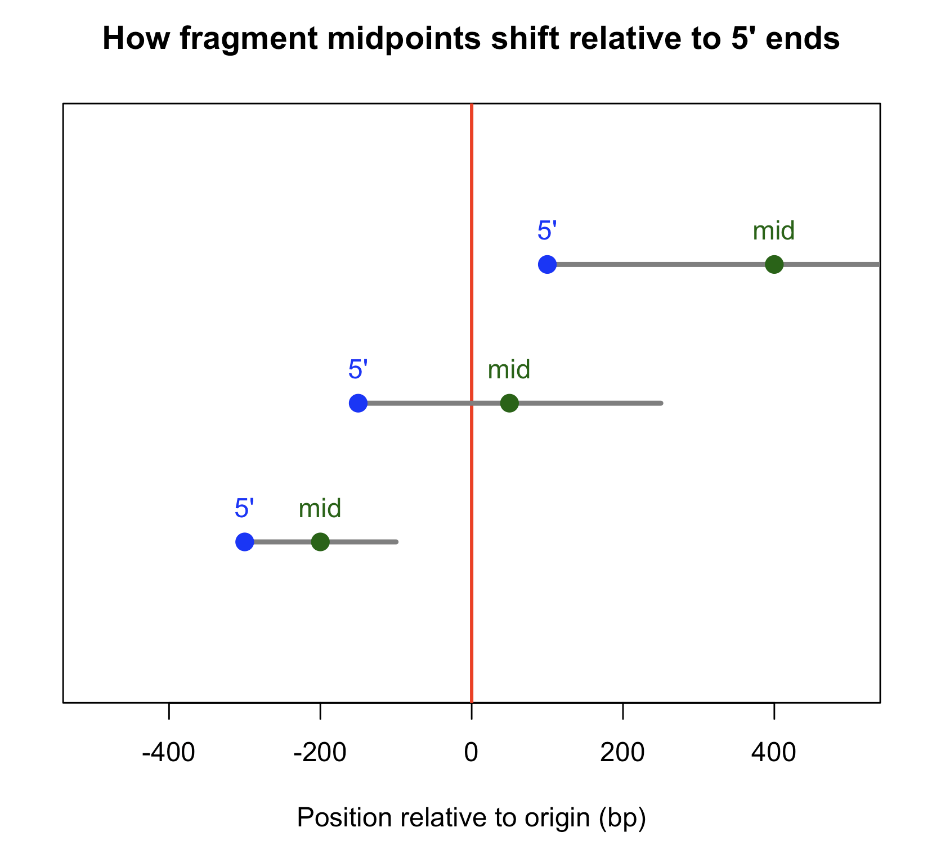
5′ Ends vs. Fragment Midpoints Around Origins
Key observation
Even when using the same fragments, the two methods produce very different spatial profiles around the origin:
5′ ends
Peaks are sharper and more displaced
Watson and Crick strands appear well separated
Orientation ratio looks stable
Fragment midpoints
Distribution becomes flattened / more uniform
Watson/Crick strand ratio can shrink or even flip
Apparent displacement of peaks reduces

Slide 10
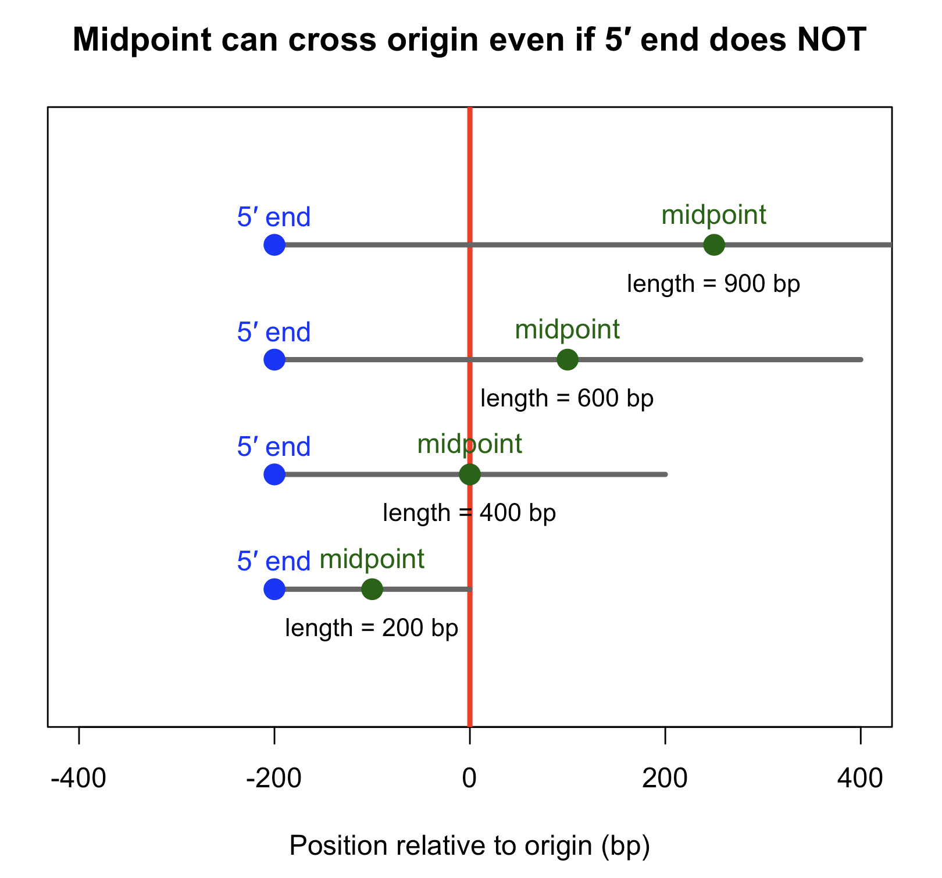
5′ Ends vs. Fragment Midpoints Around Origins
Why this matters
Midpoints “pull” long fragments toward the opposite side of the origin.
This distorts signed distances, especially when fragment lengths are variable.
The artifact is strong enough to predict W→C shrink or flip in some samples.
This figure shows that even with the same fragments, just switching the measurement from 5′ ends to midpoints dramatically changes the apparent distribution around the origin.
This is not biology — this is geometry. Midpoints of long fragments cross the origin, altering the inferred signed distance relative to the origin. That is where the Watson–Crick flip or shrink comes from.

Slide 11
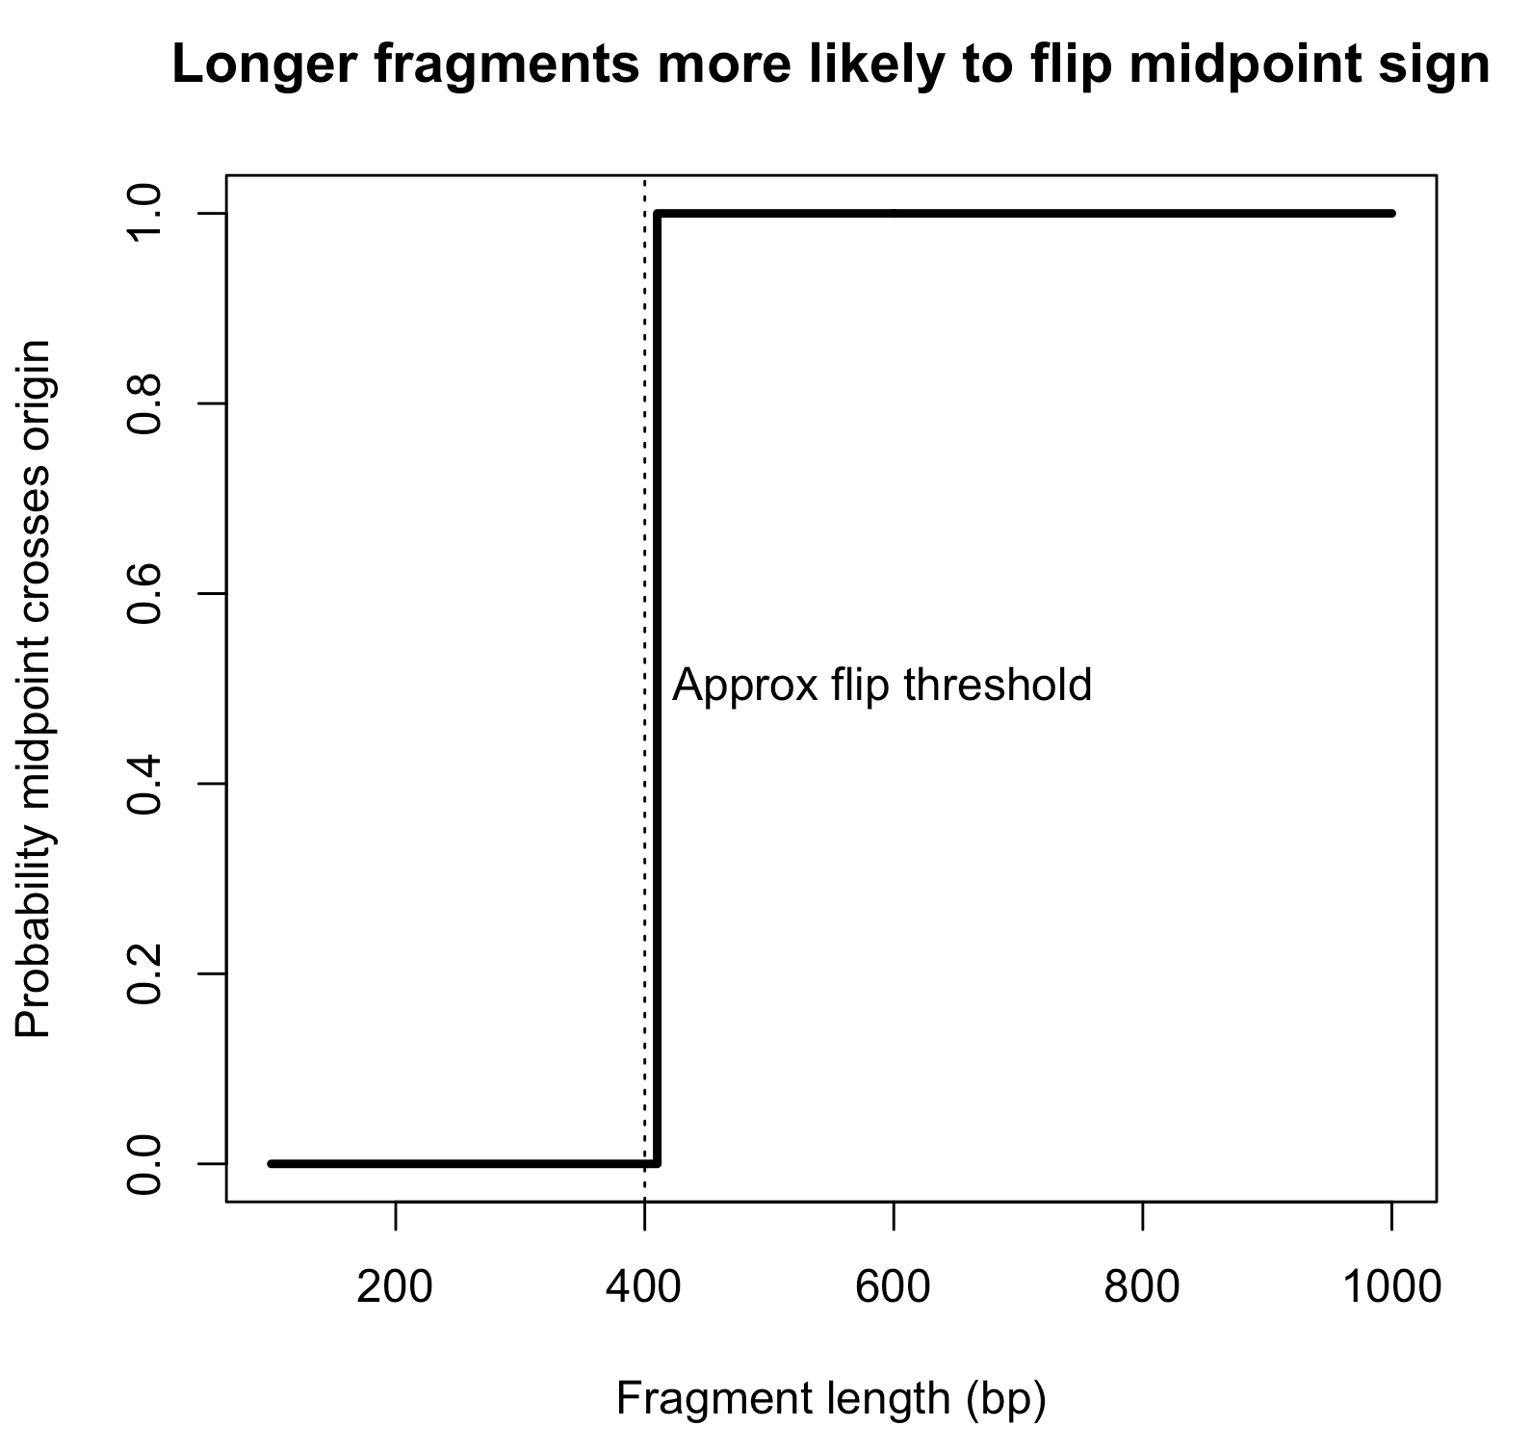
How fragment length + origin proximity distort strand classification
When a fragment spans across the origin window, the midpoint may fall on the opposite side of the origin from the 5′ end.
Because strand assignment is based on the sign (left/right), long fragments are more likely to cross the origin → causing:
Bias pattern “shrink”
Bias pattern “flip”
The extent of shrink/flip depends on the fragment length distribution
The effect depends on fragment length:
Short fragments →
midpoint ≈ 5′ end → minimal distortion
Long fragments →
midpoint shifts left/right → increasing chance of crossing origin

Slide 12
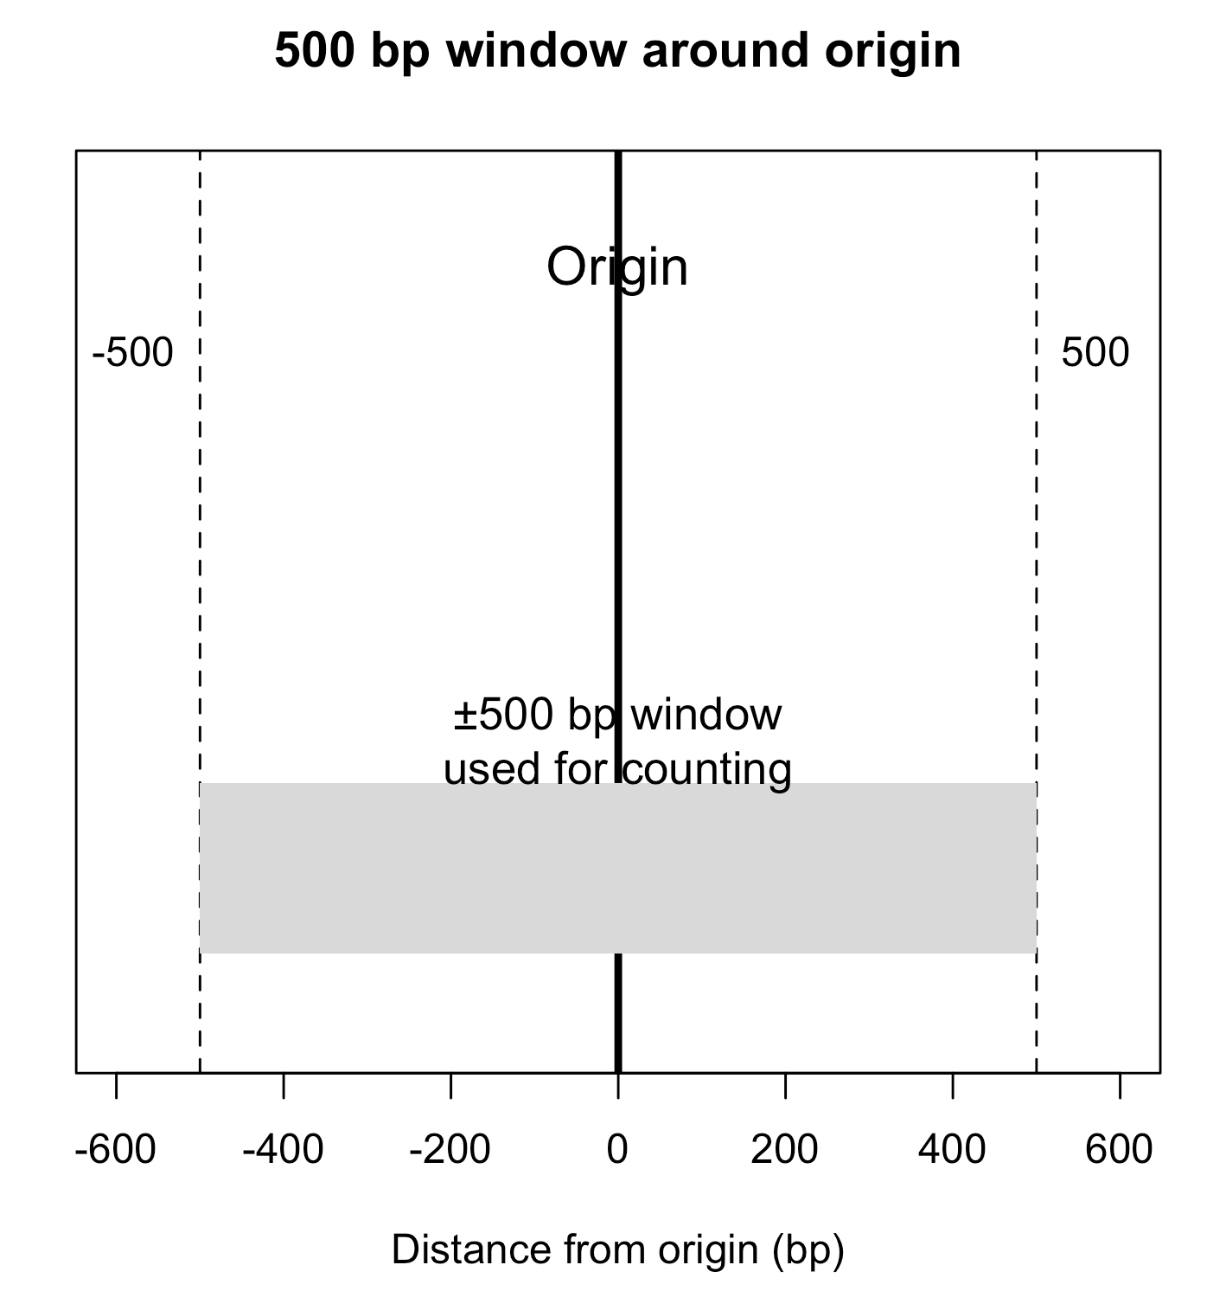
A simple model to Quantify Strand “Flip” vs “Normal”
What we do:
Take each mapped fragment
– Use its 5′ end and fragment length to compute the midpoint.
Measure distance to the nearest origin
– If midpoint is left of origin → expected “+” strand
– If midpoint is right of origin → expected “–” strand
Compare expected vs observed
– Count how many fragments match the
expected orientation (“normal”)
– Count how many match the opposite (“flipped”)
Compute two numbers:
  Normal-match rate
  Flipped-match rate
These two values are what we report — for example:
Pol2: 43% normal / 57% flipped
Pol3: 59% normal / 41% flipped
Flip fraction < 0.5
→ Most fragments keep the same strand assignment
Flip fraction > 0.5
→ More than half of fragments change sides
Monte-Carlo Simulation: We repeat the calculation many times using randomly resampled fragment lengths to estimate whether the observed flip/normal bias is stronger than expected by chance.

Slide 13
Possible reason why Pol2 Flips
Key biological point
Pol2 travels with the leading strand.
Key geometric point
Leading-strand fragments tend to be longer.
Longer fragments place their midpoints farther from their 5′ ends,
so midpoints more often cross the origin center.
Result in our data
With midpoint classification:
Pol2 shows a higher flipped-match rate than normal-match
(≈0.57 flipped vs ≈0.43 normal).
Interpretation
Because Pol2 preferentially marks leading-strand DNA,
and leading-strand fragments are longer,
their midpoints shift across the origin boundary more frequently.
This produces an apparent Watson/Crick flip when using midpoints.
Takeaway
Pol2 flips because leading-strand fragments are longer,
and midpoint-based assignment exaggerates this bias.

Slide 14
Possible reason why Pol3 Shrinks
Key biological point
Pol3 tracks lagging-strand synthesis, which produces many short Okazaki fragments
Key geometric point
Lagging-strand fragments tend to be shorter.
Shorter fragments place their midpoints closer to their 5′ ends,
so midpoints are less likely to cross the origin center.
Result in our data
Using midpoint classification, Pol3 shows
~0.59 normal-match vs ~0.41 flipped-match
→ a shrink toward 0.5, not an inversion.
Interpretation
Because Pol3 marks primarily short lagging-strand fragments,
their midpoints shift very little relative to the origin.
This reduces Watson/Crick asymmetry but does not reverse it.
Takeaway
Pol3 shrinks because its fragments are short,
and midpoint-based assignment compresses the strand imbalance
without producing a flip.

Slide 15
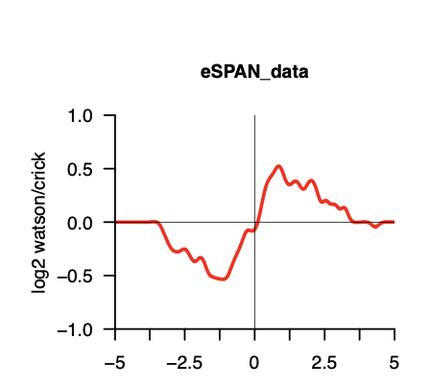
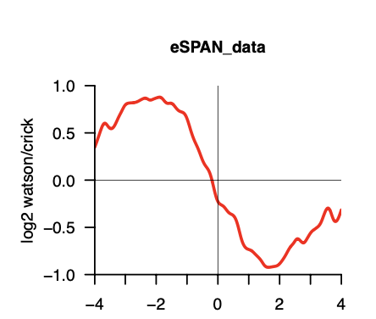
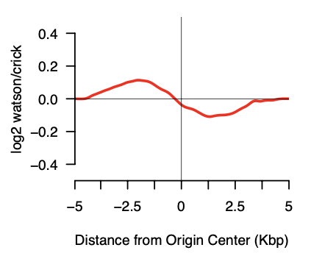
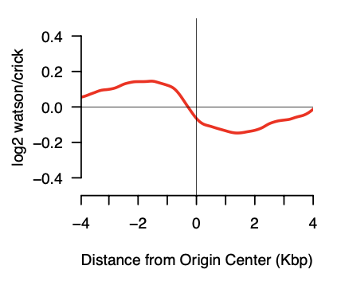
Rev1-Myc-0422
Rfa1-0924
Rev1: 45% normal / 55% flipped
Rfa1: 49% normal / 51% flipped
5’ end of the fragment
5’ end of the fragment
Midpoint of the fragment
Midpoint of the fragment

Slide 16
Thanks…

