Slide 1
Project 1: Deep Learning-Image Classification with CNN
Team
Neu Falcons
Mohammed Almatrafi – Yazeed Alghamdi – Yasser Alshehri

Slide 2
AGENDA
Project Overview
Data Wrangling and Cleaning
Exploratory Data Analysis
Model Building
Teamwork & Project Management
Major Obstacle
Conclusion and Insights

Slide 3
Project Overview

Slide 4
Project Overview
The CIFAR-10 dataset was used for this project, which consists of 60,000 32x32 color images categorized into 10 distinct classes: airplanes, automobiles, birds, cats, deer, dogs, frogs, horses, ships, and trucks.
Our hypothesis was that a well-structured Convolutional Neural Network (CNN) could effectively classify these images with high accuracy, outperforming traditional machine learning approaches.

Slide 5
Data Wrangling and Cleaning

Slide 6
Data Wrangling and Cleaning
CIFAR-10 dataset can be loaded from the keras package.
It’s cleaned and requires no action to process (missing data, duplicates, formatting issues, etc.).
Loading and Splitting: 50K training images, 10K testing images
Normalization: Pixel values were scaled to a range of 0 to 1 to improve model convergence and stability
One-Hot Encoding: The categorical class labels were converted into one-hot encoded vectors to align with the neural network’s output layer.
Data Augmentation: Applied transformations such as random cropping, horizontal flipping, and rotation to enhance model generalization and reduce overfitting.

Slide 7
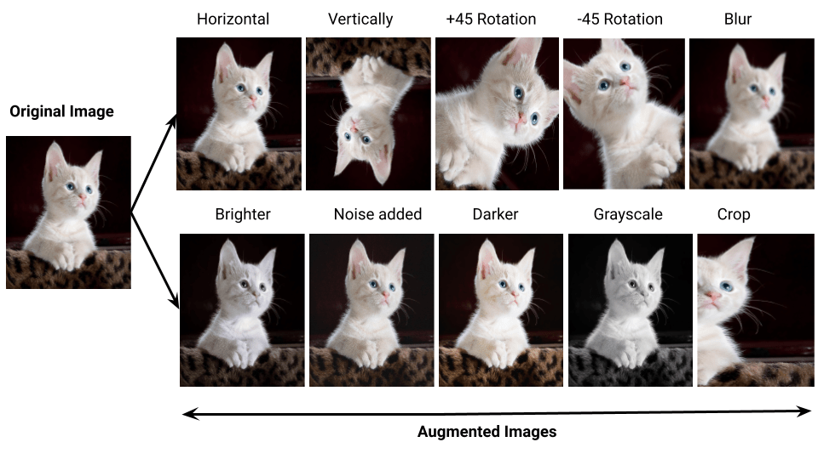
Data Augmentation

Slide 8
Exploratory Data Analysis

Slide 9
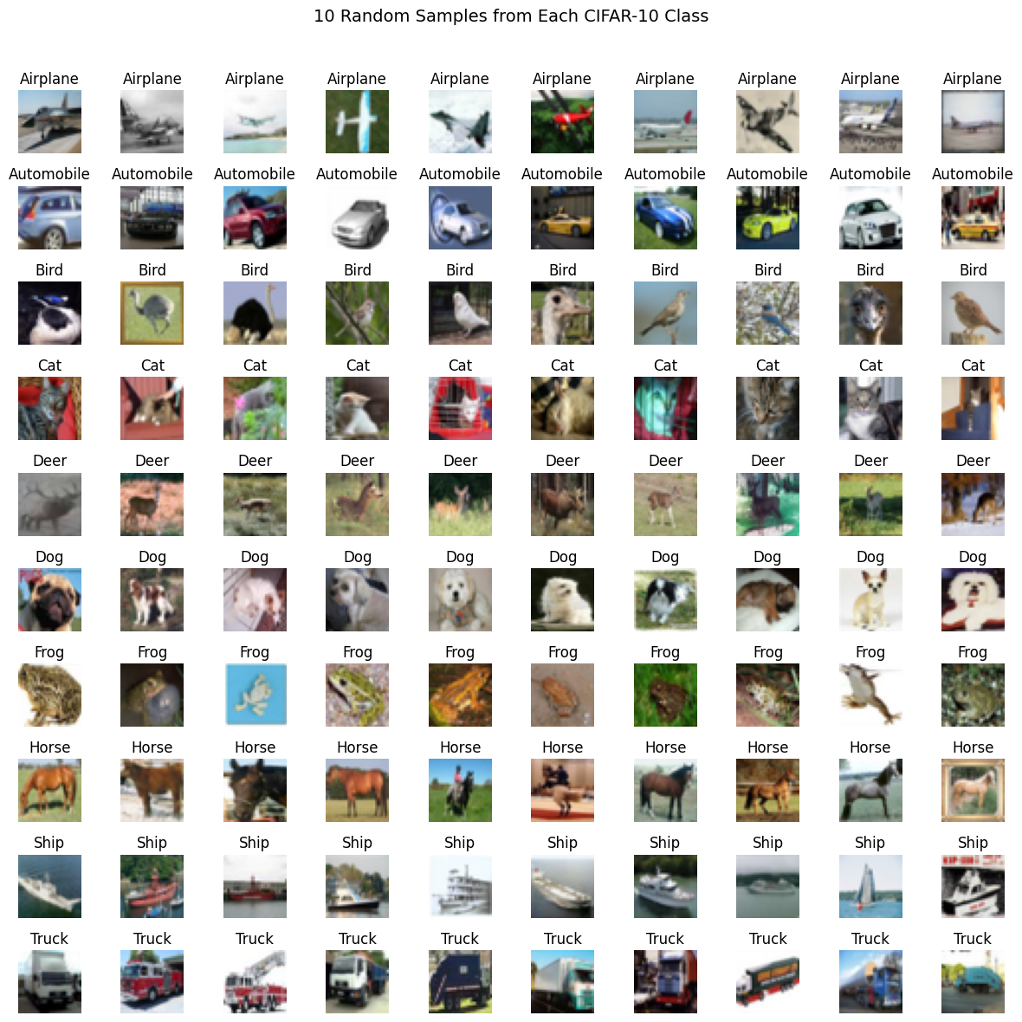
Exploratory Data Analysis
6000 images per class. 60K images in total.
Visualized the images and different classes.

Slide 10
Model Building

Slide 11
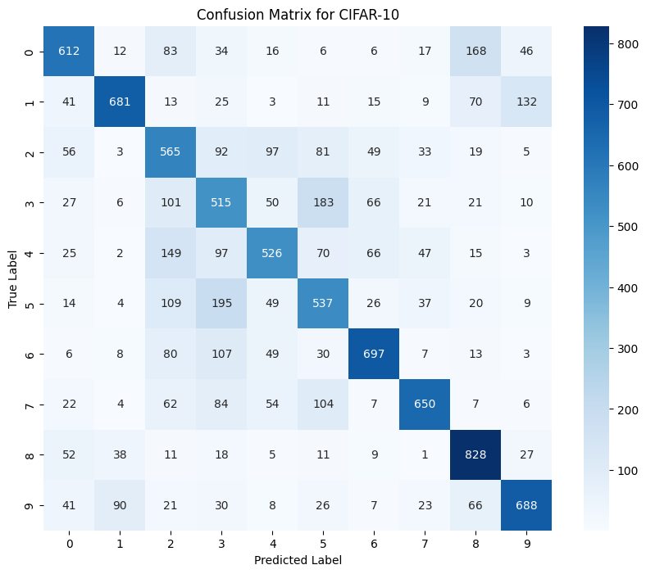
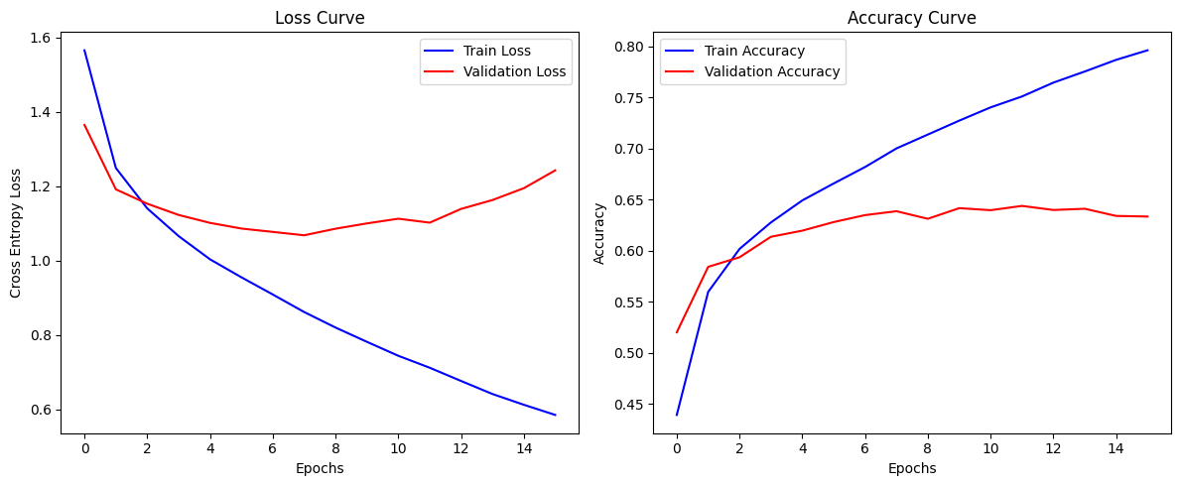
Model Building (first cnn model)
From scratch
Total params: 722,006
Training Accuracy: 78% - Validation Accuracy: 65%

Slide 12
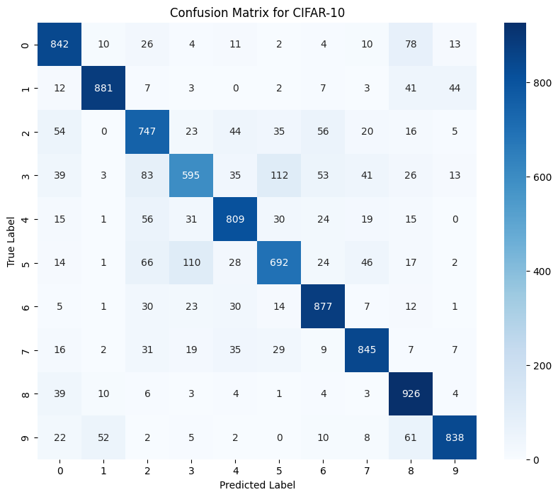
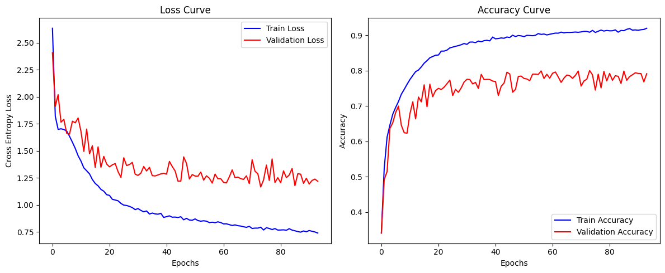
Model Building (Second cnn model)
From scratch
Total params: 5,058,954
Training Accuracy: 89% - Validation Accuracy: 74%

Slide 13

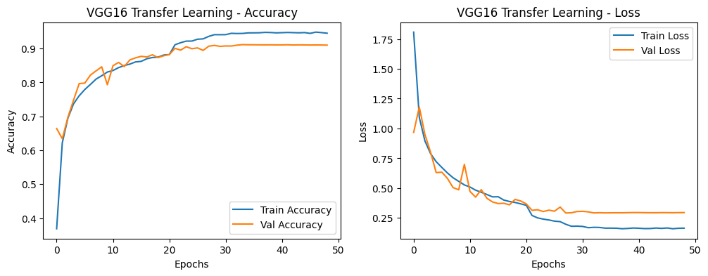
Model Building (Transfer learning model)
Pre-trained VGG16
Total params: 15,905,866
Training Accuracy: 94% - Validation Accuracy: 91%

Slide 14
Teamwork & Project Management

Slide 15
Teamwork & Project Management
Linear app to assign & track tasks.
Each task has its own priority.
Daily Stand-ups.

Slide 16
Major Obstacle

Slide 17
Major Obstacle
Training large models takes time.
CPU -> GPU utilizing CUDA.
Around 6x times faster.
Saving and loading
Transfer model file corrupted.
We must do everything AGAIN.

Slide 18
Conclusion and Insights

Slide 19
Conclusion and Insights
Convolutional Neural Networks are significantly better at recognizing patterns in images.
Data augmentation can be using to help the model to generalize better
We must find better ways to handle model saving and loading and ensure it works every time.

Slide 20
Questions?

Slide 21
THANK YOU
Team NeuFalcons
Mohammed Almatrafi
Yazeed Alghamdi
Yasser Alshehri

