Slide 1
Project 2: NLP Project
Team
Neu Falcons
Mohammed Almatrafi – Yazeed Alghamdi – Yasser Alshehri

Slide 2
AGENDA
Project Overview
Data Wrangling and Cleaning
Exploratory Data Analysis
Model Building
Teamwork & Project Management
Conclusion and Insights

Slide 3
Project Overview

Slide 4
Project Overview
The NLP Challenge aims to build a classifier that distinguishes between real and fake news using a labeled dataset. We train a model to predict news authenticity and apply it to a validation set. The final classifier is deployed locally and in the cloud using Streamlit while maintaining the original data format.

Slide 5
Data Wrangling and Cleaning

Slide 6
Data Wrangling and Cleaning
Remove Duplicates:
Drop any duplicate entries to ensure data consistency.
2.Normalization:
Convert text into numerical representations using TF-IDF and Word Embeddings such as Word2Vec.
Converts text to lowercase.
Removes digits.
Strips punctuation.
Lemmatizes words and removes stop words for better processing
3.Load and Split the Data:
Split the dataset into 80% training and 20% testing.
4.Label Encoding:
Since this is a binary classification task, we used a sigmoid activation function instead of one-hot encoding.

Slide 7
Exploratory Data Analysis

Slide 8
Exploratory Data Analysis
Number of samples (rows): 39942
Number of columns: 5 (Label , Title ,Text , Subject, Date)
Number of categories: 2 (0 = Fake News, 1 = Real News)
Average number of words per title: Around 10 words

Slide 9
Model Building

Slide 10
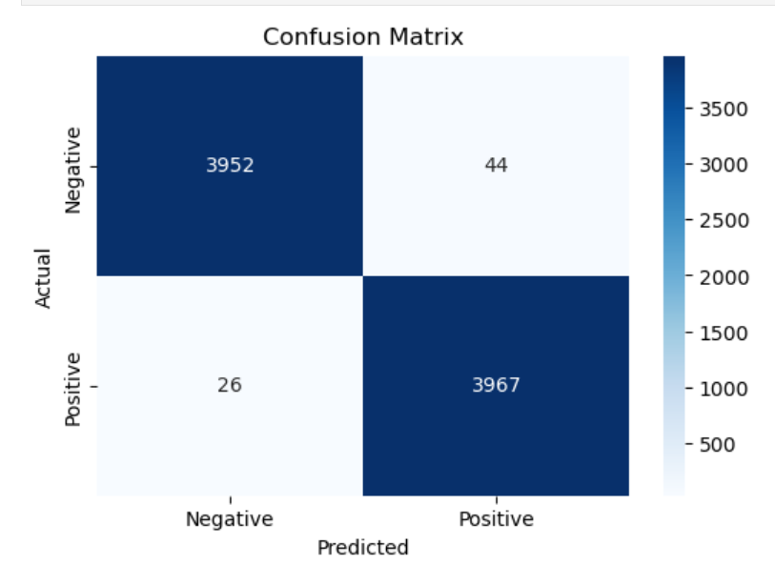
Model Building (first logistic model)
From scratch
Accuracy: 98.85%
For the real news : 99%
For the fake news: 99%

Slide 11
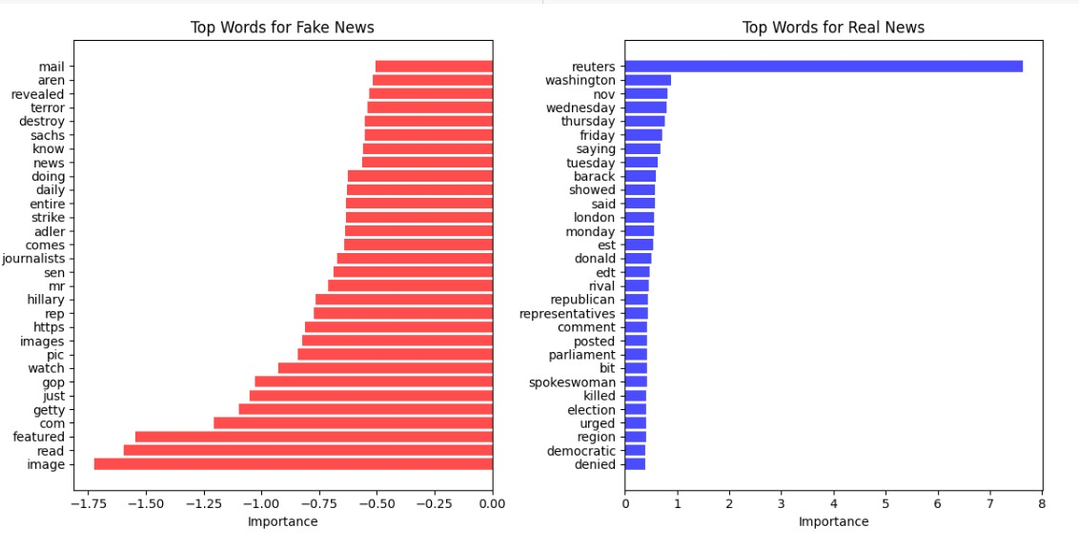
Model Building (Second yoon kim cnn model)
From scratch
Accuracy: 98.80%

Slide 12
Teamwork & Project Management

Slide 13
Teamwork & Project Management
Linear app to assign & track tasks.
Each task has its own priority.
Daily Stand-ups.

Slide 14
Conclusion and Insights

Slide 15
Conclusion and Insights
In this project, we successfully used NLP techniques to analyze and process the dataset.
applying methods such as text cleaning, tokenization, and model training, we were able to extract valuable insights and build a model that performs well on the given task.
Moving forward, further improvements could include refining data preprocessing and exploring advanced model architectures for even better performance

Slide 16
Questions?

Slide 17
THANK YOU
Team NeuFalcons
Mohammed Almatrafi
Yazeed Alghamdi
Yasser Alshehri

