Slide 1
LESSON #03
Sensitive Data Exposure
Admin Receipt Disclosure via Unauthorized Lambda Invocation
ICS-344: Information Security · Term 252 King Fahd University of Petroleum and Minerals (KFUPM) Mohammed Alroomi

Slide 2
1 & 2 · Vulnerability Summary and Root Cause
Vulnerability Summary
Root Cause
Affected Function: DVSA-ADMIN-GET-RECEIPT Category: A3:2017 – Sensitive Data Exposure Severity: Critical The admin function packaged ALL user receipts from S3 into a ZIP and returned a presigned URL — with NO authorization check. Any user could invoke it directly via AWS CLI.
The lambda_handler starts processing IMMEDIATELY upon invocation: def lambda_handler(event, context):
client = boto3.client('s3')
y = event["year"] # No auth check!
# → downloads ALL receipts
No identity check. No role verification. Complete trust in the caller.
ICS-344 · Lesson 03 — Sensitive Data Exposure · KFUPM Term 252
2 / 9

Slide 3
3 & 4 · Environment and Reproduction Steps
Component | Detail
Platform | AWS Lambda (Python 3.8)
Affected Function | DVSA-ADMIN-GET-RECEIPT
Attacker | User B — regular non-admin user
Victim | User C — Super Mario 2 order
Tools | AWS CLI · CloudShell · CloudWatch
Reproduction Steps
1
Invoke admin receipt function as regular User B via AWS CLI with date payload
2
Function returns presigned S3 URL — no admin check performed
3
Download the ZIP archive containing ALL users' receipts
4
Extract and read User C's private receipt (order, items, total)
ICS-344 · Lesson 03 — Sensitive Data Exposure · KFUPM Term 252
3 / 9

Slide 4
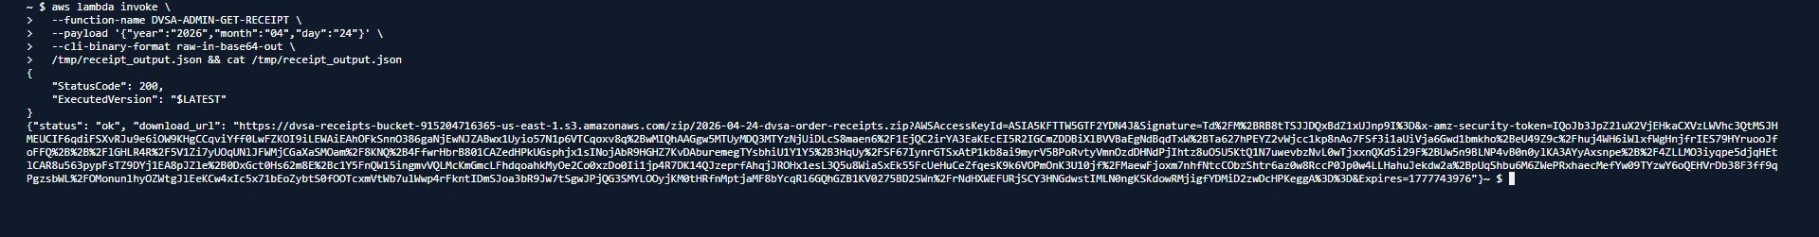
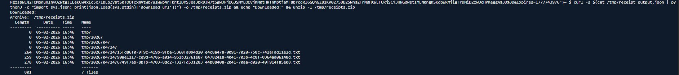
5 · Evidence — Presigned URL Returned & ZIP Downloaded
Figure 1: Admin function invoked as non-admin returns valid presigned S3 URL (HTTP 200)
Figure 2: Downloaded ZIP contains receipt files from ALL 3 users — not just the attacker's
ICS-344 · Lesson 03 — Sensitive Data Exposure · KFUPM Term 252
4 / 9

Slide 5
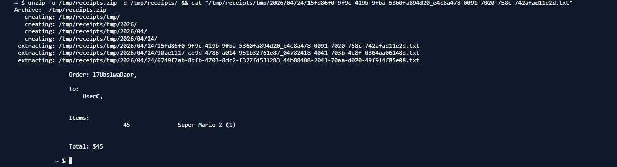
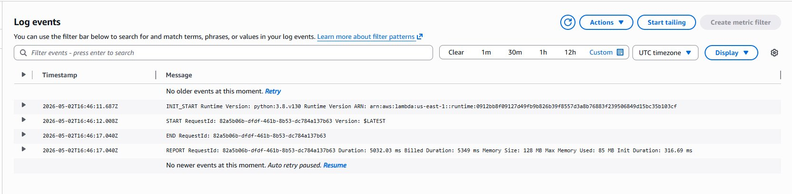
5 · Evidence — Receipt Exposed & CloudWatch Confirmation
Figure 3: User C's private receipt exposed — UserC, Super Mario 2 (1), Total $45
Figure 4: CloudWatch confirms DVSA-ADMIN-GET-RECEIPT was invoked at 2026-05-02T16:46 UTC
ICS-344 · Lesson 03 — Sensitive Data Exposure · KFUPM Term 252
5 / 9

Slide 6
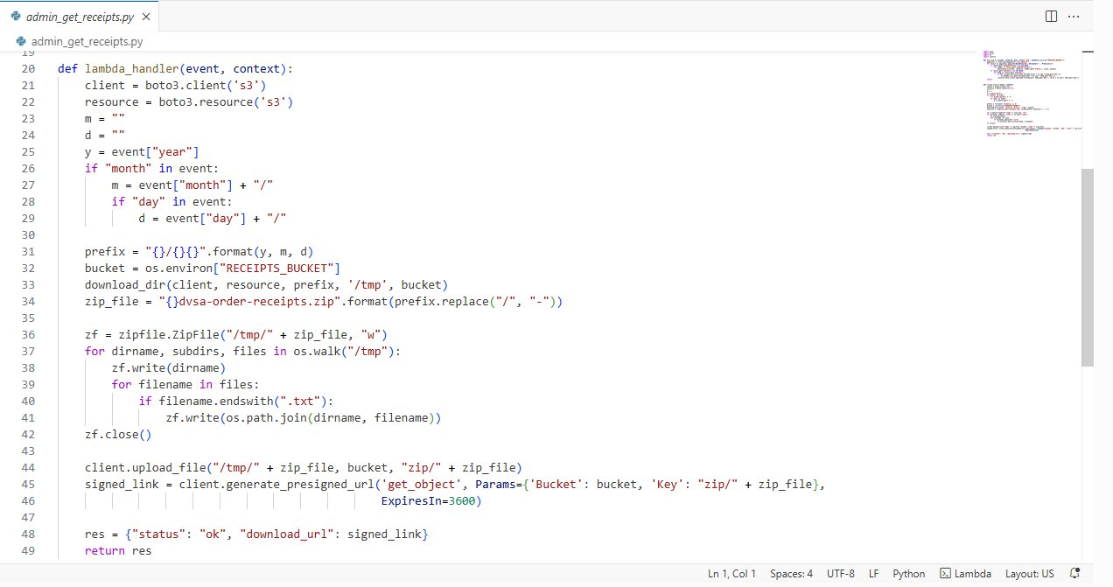
5 · Evidence — Vulnerable Code (No Authorization Check)
Figure 5: lambda_handler at line 20 — no isAdmin check before proceeding to S3 operations
ICS-344 · Lesson 03 — Sensitive Data Exposure · KFUPM Term 252
6 / 9

Slide 7
6 & 7 · Fix Strategy and Code Changes
Fix Strategy
1
Extract requesting user's identity from the event (userId field)
2
Look up the user in DynamoDB to verify identity
3
Check the isAdmin attribute — return 403 Forbidden if not admin
4
Only confirmed admins proceed to S3 receipt operations
def lambda_handler(event, context):
requesting_user_id = event.get("userId", "")
if not requesting_user_id:
return {"statusCode": 403, "body": ...}
resp = user_table.get_item(Key={"userId": requesting_user_id})
if not resp.get("Item",{}).get("isAdmin", False):
return {"statusCode": 403, "body": ...} # ← NEW GATE
client = boto3.client('s3') # original code continues
ICS-344 · Lesson 03 — Sensitive Data Exposure · KFUPM Term 252
7 / 9

Slide 8
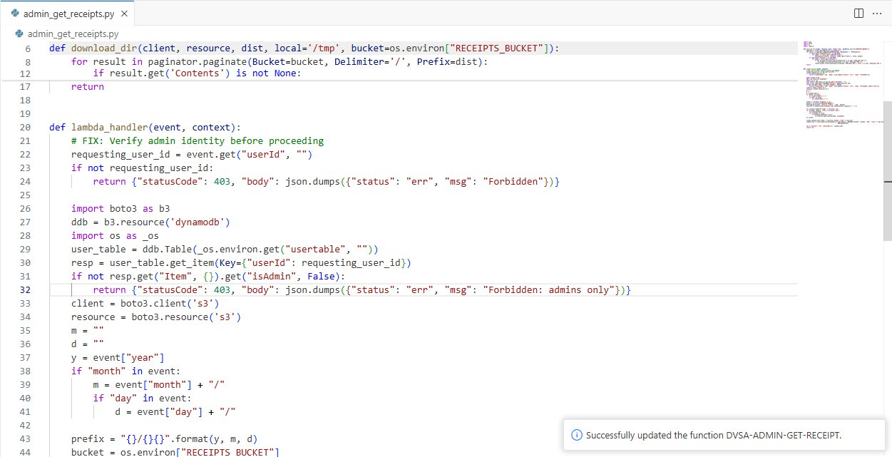
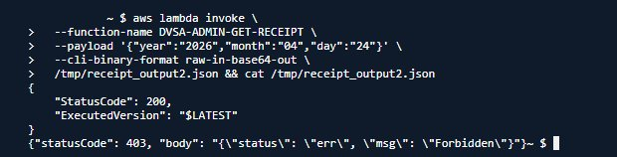
7 & 8 · Fix Deployed and Verification
Figure 6: Authorization check at lines 21-32 — 'Successfully updated the function DVSA-ADMIN-GET-RECEIPT'
Figure 7: Same invoke command now returns 403 Forbidden — attack completely blocked
ICS-344 · Lesson 03 — Sensitive Data Exposure · KFUPM Term 252
8 / 9

Slide 9
10 · Key Takeaways
Admin functions must enforce their own access control
Obscurity is not security — every sensitive function must verify caller identity and role
Direct Lambda invocation bypasses API Gateway
Anyone with lambda:InvokeFunction permission can call functions directly, skipping API auth
S3 data is only as secure as the code accessing it
A private bucket is irrelevant if the function generating presigned URLs has no access gate
Least privilege = IAM + function-level auth
IAM controls what a function can do; function logic controls who should trigger it
Every Lambda is an independent entry point
Unlike monoliths, each serverless function must independently enforce its own access control

