Slide 1
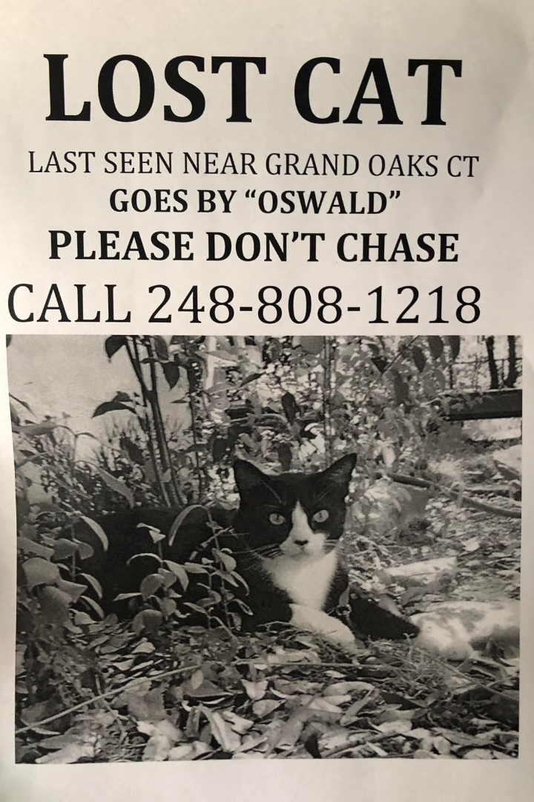

FindIt website
The Missing Report Project is an innovative platform that helps users easily file missing reports for lost items, pets, or personal belongings. By providing a centralized system, the project aims to streamline the process of reporting and recovering lost items, ultimately reducing the stress and frustration associated with such situations.

Slide 2

The Problem: Users Struggling to Find Lost Items
1
Scattered Information
2
Lack of Coordination
Users often have to search through various channels, such as social media, community groups, or local authorities, to report a lost item, leading to a fragmented and inefficient process.
Without a centralized platform, it becomes challenging for finders to connect with the rightful owners, resulting in many lost items never being returned.
3
Emotional Stress
The stress and anxiety associated with losing valuable items or beloved pets can significantly impact an individual's well-being and quality of life.

Slide 3
The Solution: A Centralized Missing Report Platform
Easy Reporting
Coordinated Efforts
Reduced Stress
The Missing Report Platform provides a user-friendly interface where individuals can quickly and easily file a missing report for their lost item or pet.
The platform connects finders with the rightful owners, facilitating the recovery process and increasing the chances of reuniting lost items or pets with their owners.
By streamlining the missing report process, the platform helps alleviate the emotional stress and anxiety experienced by those who have lost something valuable.

Slide 4





Key Features of the Missing Report Platform
Geo-Tagging
Advanced Search
Users can pinpoint the last known location of their lost item or pet, helping finders narrow down their search.
The platform's robust search functionality allows users to easily browse and filter through existing reports, increasing the chances of finding a match.
Direct Communication
Reward Incentives
The platform facilitates direct communication between finders and owners, enabling seamless coordination and the return of lost items or pets.
Users can offer rewards for the safe return of their lost items or pets, incentivizing the community to participate in the recovery process.

Slide 5




Features
Filing A missing Report
Describing The Item in details
id, name, description, category, brand, model, color, unique identifiers, date lost, location lost, value
Found report (Closing)

