Slide 1
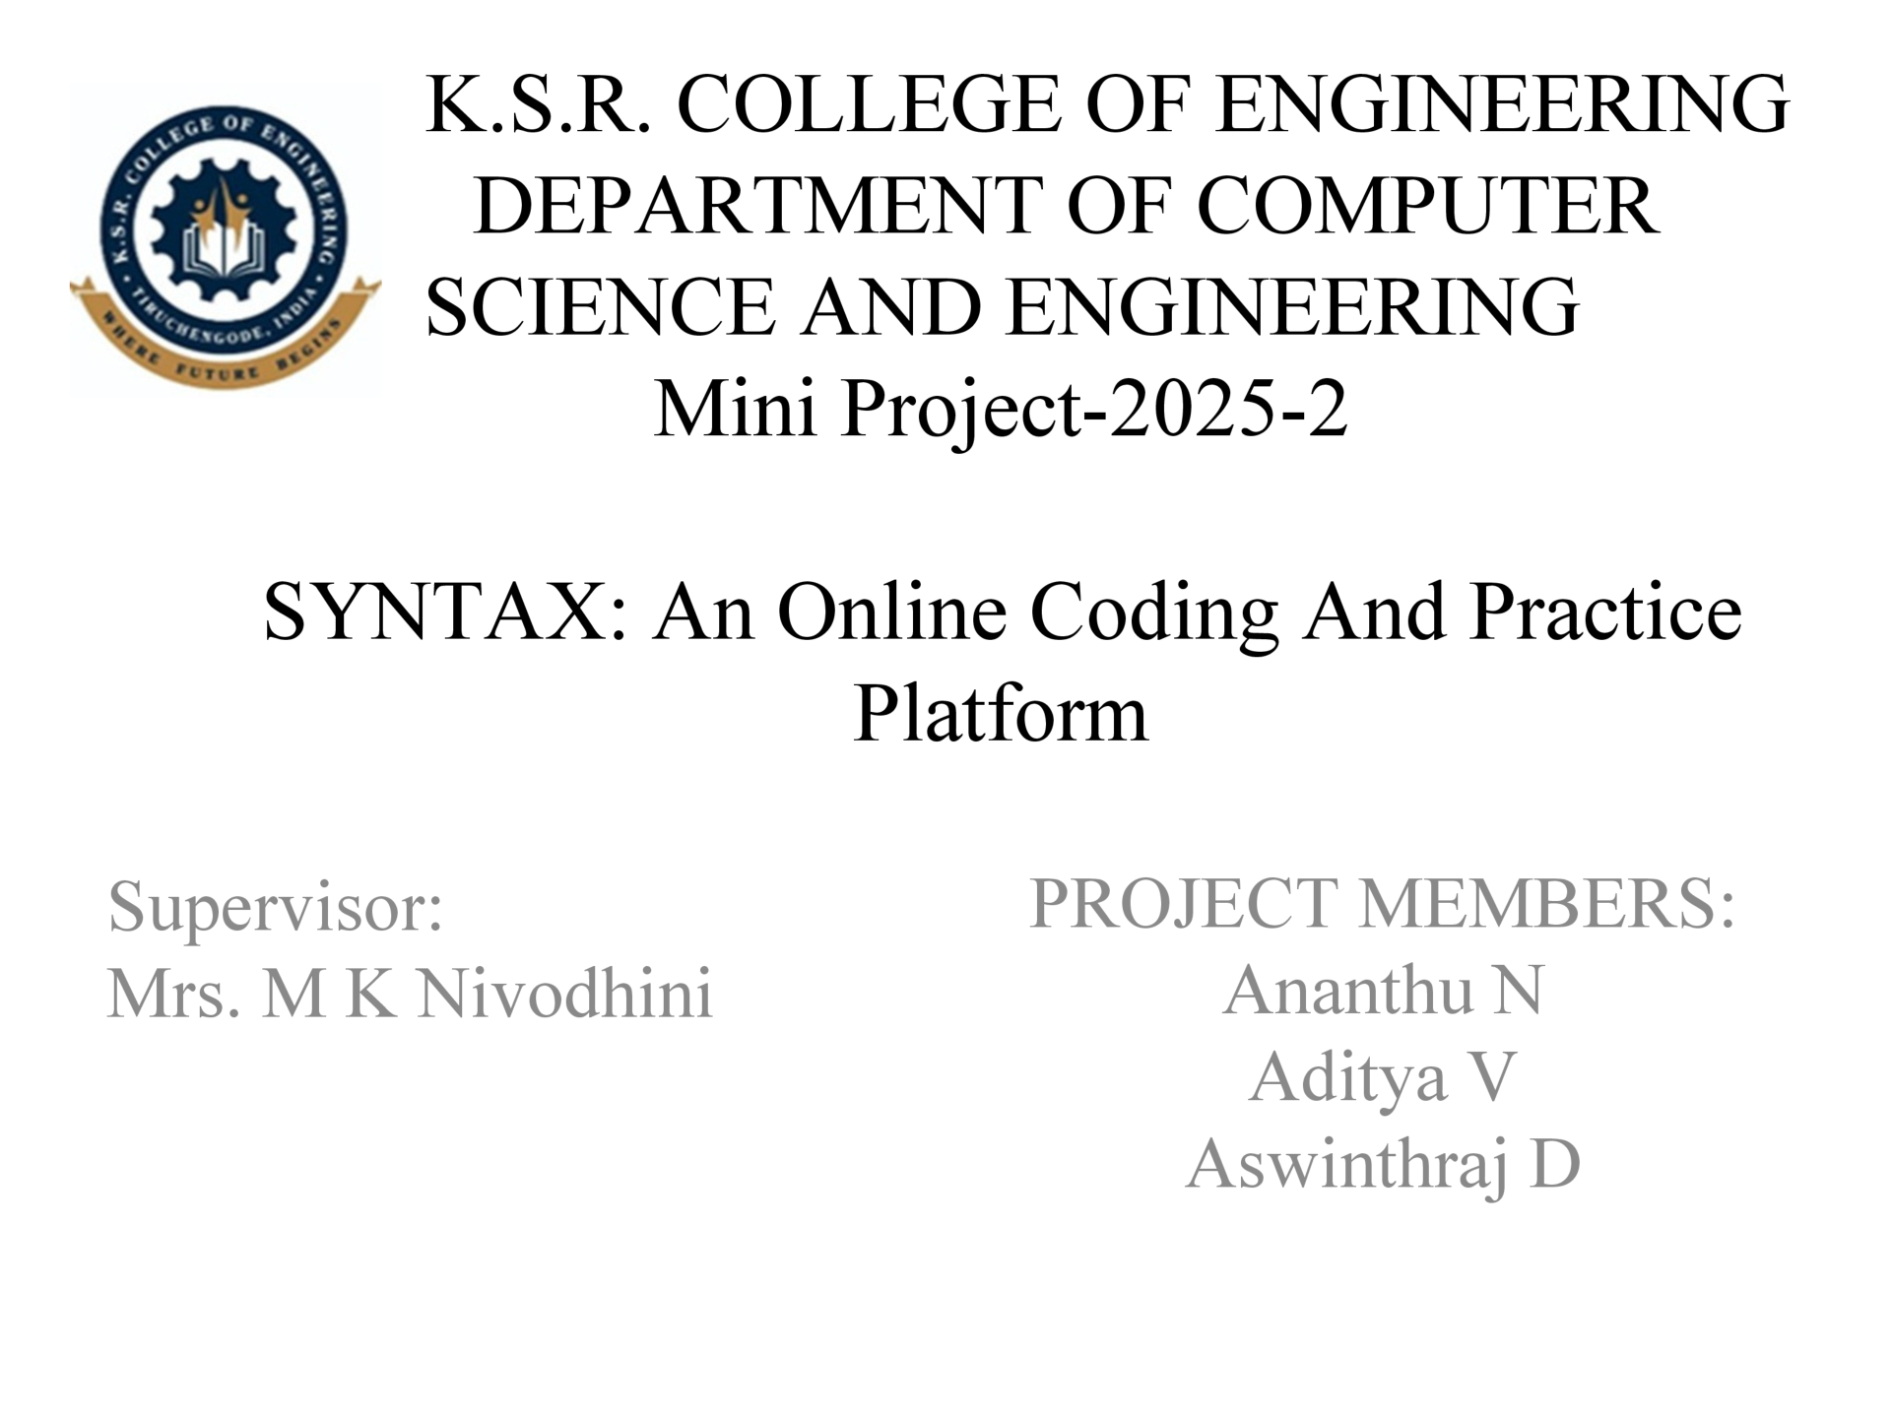
SYNTAX: FULL-STACK QUIZ AND CODING
CONTEST PLATFORM FOR
EDUCATIONAL INSTITUTIONS

Slide 2
Abstract
Project Summary • Syntax is a full-stack quiz and coding contest platform for educational institutions. • It manages quizzes, coding contests, student submissions, proctoring logs, leaderboards, and result analysis in one online system. Technology Foundation • Frontend uses React 19 with Vite 6 as a single page application. • Backend uses Node.js 20, Express 5, Firebase Firestore, and Firebase Admin SDK. • Code execution uses Judge0 CE for Python, Java, C, C++, and JavaScript. Security and Deployment • Authentication uses JSON Web Tokens stored in httpOnly cookies. • Student, Admin, and Super Admin access is separated using role guards. • Deployment uses Vercel for frontend and Google Cloud Run for backend services.
Source: Project report abstract

Slide 3
Problem Statement
Colleges need a secure, customizable platform to conduct quizzes, coding contests, automatic evaluation, and proctored assessments under one controlled academic system.
Current Gap • Manual quiz and contest management is slow, repetitive, and error-prone. • Basic forms and spreadsheets cannot compile code, validate hidden test cases, or record detailed execution results. • Public coding platforms are useful for practice, but they do not give institutions full control over users, events, rules, proctoring, and records. What Syntax Solves • It centralizes quiz creation, coding contest execution, student participation, scoring, result storage, and proctoring logs. • It creates separate, role-based workflows for students, admins, and super admins.

Slide 4
Objectives
Primary Objective • Build a secure, full-stack web platform for colleges to host quizzes and coding contests. • Support Student, Admin, and Super Admin portals with strict role-based access control. • Enable automatic scoring, leaderboard generation, proctoring violation logging, and secure result storage. Functional Objectives • Allow admins to create contests, add quiz questions, build coding problems, publish articles, and manage participants. • Allow students to preview contests, attempt quizzes, run open test cases, submit code, and review submission history. • Use Judge0 for sandboxed code execution and Firestore for centralized cloud data storage. Expected Outcome • A dedicated institutional assessment platform that reduces manual work and improves transparency, security, and learning engagement.

Slide 5
Literature Overview
Online Assessment Platforms • Reduce manual evaluation and allow question display, timer control, answer submission, mark calculation, and result publication. • Many platforms focus mainly on multiple-choice questions and do not support programming submissions or sandboxed compilation. Programming Judge Systems • Evaluate code automatically by running submissions against predefined test cases and returning accepted, wrong answer, compilation error, or runtime error status. • Syntax adapts this model for college use with admin-controlled contests, open test cases, hidden test cases, and Firestore-based result storage. Proctoring and Cloud Deployment • Browser-side proctoring logs tab switching, fullscreen exit, clipboard usage, right-click actions, and navigation attempts. • Cloud database and serverless deployment improve scalability, reliability, and maintenance.

Slide 6
Existing System
Manual Management • Faculty prepare questions, share them manually, collect answers, and evaluate submissions individually. • Programming submissions may be collected through email or classroom systems and then compiled and tested manually. Spreadsheet and Form Systems • Useful for simple objective quizzes and small classroom activities. • Do not provide code compilation, hidden test cases, detailed execution data, strong dashboards, or strict proctoring. Public Coding Platforms • Good for practice and competitions, but designed for public communities rather than institution-owned assessment workflows. • Institutions may not control authentication, question ownership, proctoring logs, or internal result records.

Slide 7
Drawbacks / Disadvantages
Fragmented Workflow • Faculty often use different tools for quizzes, coding practice, marks, announcements, and result sharing. • This increases administrative effort and reduces transparency for students. Limited Technical Support • Basic tools cannot execute code, verify hidden test cases, store execution status, or support multi-language submissions. • Public systems do not always match college-level rules, batches, internal assessments, and department ownership. Weak Control and Integrity • Existing systems usually lack clear Student, Admin, and Super Admin separation. • Proctoring actions such as tab switch, fullscreen exit, clipboard usage, and browser navigation are not consistently logged.

Slide 8
Proposed System
System Overview • Syntax is a full-stack quiz and coding contest platform built for educational institutions. • It provides separate portals for Students, Admins, and Super Admins. Key Workflows • Admins create quizzes, coding contests, articles, and reusable problem-bank entries. • Students view events, attempt quizzes, solve coding problems, run sample tests, submit final answers, and view history. • Super admins manage institutional admins and oversee contests globally. Backend Design • The backend follows a route-controller-service pattern, which separates API endpoints, request handling, business logic, and database operations.

Slide 9
Advantages of the Proposed System
Centralized Academic Workflow • Manages quizzes, contests, problem banks, articles, submissions, proctoring logs, and leaderboards in one system. Automatic Code Evaluation • Judge0 compiles and runs programs against predefined test cases and returns structured results such as accepted, wrong answer, compilation error, runtime error, time, and memory. Security and Integrity • JWT authentication, httpOnly cookies, and role-based middleware restrict access to protected operations. • Proctoring records tab switches, fullscreen exits, clipboard actions, right-clicks, and suspicious browser interactions. Cloud-Ready Deployment • Vercel frontend hosting and Docker-based Google Cloud Run backend deployment improve scalability and maintenance.

Slide 10
Scope of the Project
Included • Secure login and role detection • Contest creation and question addition • Student participation and answer submission • Judge0-based code execution and scoring • Leaderboard and submission history • Article publishing and problem-bank management • Profile updates, skills, languages, and academic metadata
Current Boundaries • Designed as a web platform, not a mobile application. • Advanced AI-based cheating detection and facial recognition are not included at this stage. • Learning Management System integrations such as Moodle or Google Classroom are future extensions. • The system requires stable internet access for online contests and cloud services.

Slide 11
Methodology / Technology Stack
Layer | Technology / Tool
Frontend | React 19, Vite 6, React Router DOM v7
Styling | CSS, CSS Modules, dark mode theme
Backend | Node.js 20, Express 5
Database | Firebase Firestore with Admin SDK
Authentication | JWT, bcryptjs, httpOnly cookies
Code Execution | Judge0 CE API
Security | Helmet, CORS, rate limits, validators
Deployment | Vercel frontend, Docker, Google Cloud Run backend
Development Model • Agile methodology with modular sprint-based development across authentication, admin dashboard, student interface, code editor, and proctoring modules. External Tools • Postman is used for API testing, GitHub for version control, and npm for package management.

Slide 12
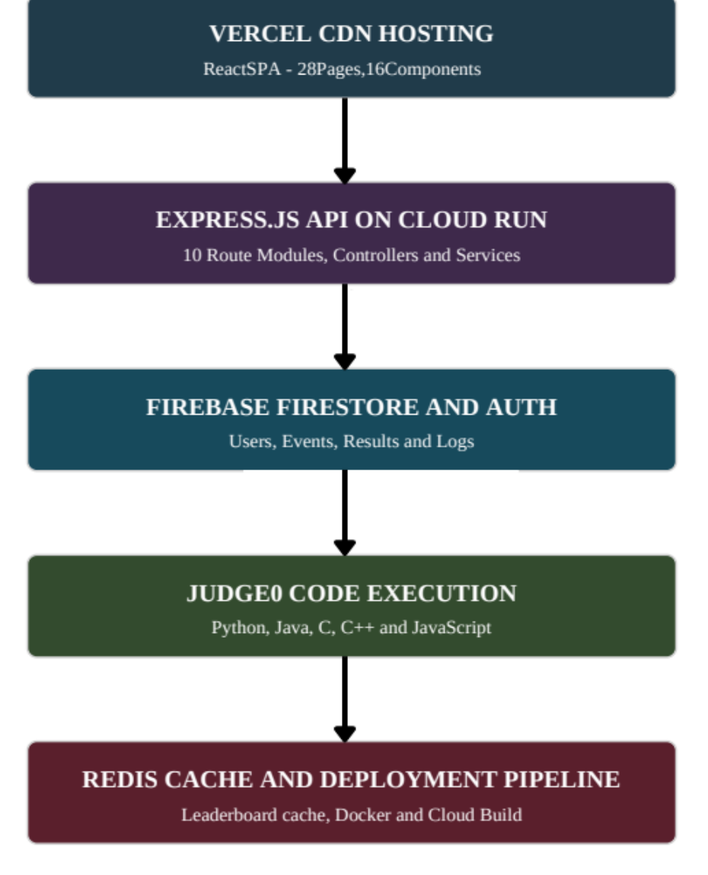
High Level Architecture
Architecture Flow • Vercel hosts the React single page application. • Express.js API on Cloud Run handles route modules, controllers, and services. • Firebase Firestore stores users, events, results, and logs. • Judge0 executes code for Python, Java, C, C++, and JavaScript. • Redis supports leaderboard cache and deployment pipeline workflows. Why This Design Matters • Frontend, backend, database, code execution, cache, and deployment infrastructure can scale independently.

Slide 13
Authentication and Authorization Model
Role | Flag in Database | Main Capability
Student | isStudent: true | Participate, submit, leaderboard, profile
Admin | isAdmin: true | Create contests, manage students and articles
Super Admin | isSuper: true | Create/delete admins and oversee contests
Login
Form
Role Login
API
Validate
Firestore
Sign JWT
Cookie
Role
Middleware
Protected
Page/API
Security Logic • The backend verifies the cookie on protected routes and checks role flags before allowing access. • httpOnly cookies reduce the risk of client-side token theft.

Slide 14
Frontend Routing and State Management
Public and Role-Based Routes • Public routes include landing page and login pages. • Admin routes include dashboard, contest creation, question creation, contest management, article management, participant management, profile, and problem bank. • Student routes include home, contests, preview, quiz, coding contest page, codeground, leaderboard, practice, profile, and submissions. • Super admin routes include dashboard, user management, contest oversight, and profile. Shared State • ContestContext stores events, loading states, admin information, student contests, articles, authentication checks, and submission history. • AlertContext handles global success, error, warning, and information notifications. Benefit • Centralized state reduces repeated API calls and makes new pages easier to extend without duplicating logic.

Slide 15
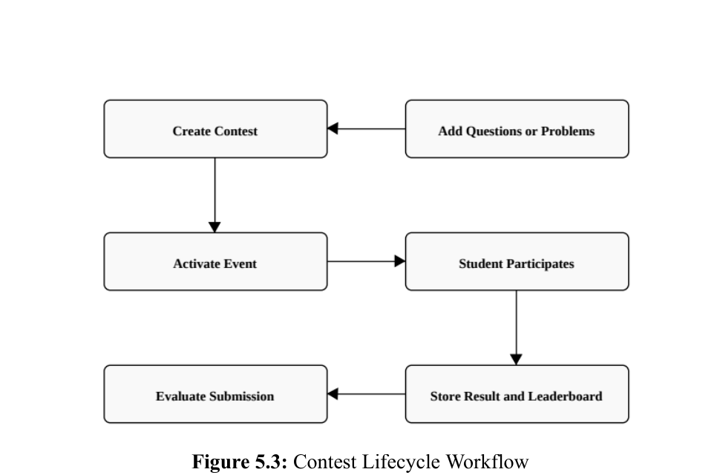
Contest Lifecycle Workflow
The contest lifecycle begins when an admin creates an event. Based on the event type, the admin adds quiz questions or coding problems. Students participate, submit answers or code, and the backend evaluates the result.
Create contest → Add questions or problems → Activate event → Student participates → Evaluate submissions → Store result and leaderboard.
Final scores are stored and shown in leaderboard and submission pages.

Slide 16
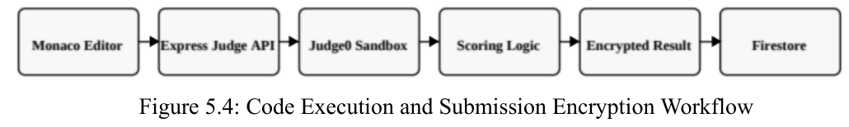
Code Execution and Submission Flow
Open Test Execution • Student writes code in the frontend editor and selects a supported programming language. • Frontend sends code to the backend; backend formats the Judge0 request and returns pass or fail results for visible test cases. Final Submission • Backend evaluates all test cases, including hidden test cases. • Final result is encrypted and stored so students cannot casually modify submission data from the browser. • Hidden test cases and correct answers are not exposed to the frontend.
Supported languages include Python 3, Java, C++17, C11, and JavaScript.

Slide 17
Database Schema and Functional Modules
Important Firestore Collections
Major Functional Modules
Collection | Purpose
users | User details, roles, profile, skills, languages
events | Quizzes, contests, questions, deadlines
eventAttempts | Attempt status, code, language, test results
eventResults | Final score, evaluated result, timestamp
Module | Primary Responsibility
User Interface | Render pages, handle inputs and routing
Client Models | Layout, states and performance control
State Models | Participants, submissions, leaderboard, profile
Backend API | Routing, workflow, services and validation
Security Module | JWT creation, bcryptjs and role middleware
How Data Supports the Platform • User, event, attempt, result, proctoring, article, and problem-bank records are stored centrally in Firestore. • This structure supports result tracking, audit review, leaderboard generation, profile updates, and long-term academic performance history.

Slide 18
Result Analysis and Future Enhancement
Result Analysis • The implementation shows that cloud services and modular backend design can support scalable academic assessment systems. • JWT authentication, role-based middleware, and httpOnly cookies help maintain controlled access across student, admin, and super admin workflows. • The unified platform reduces dependency on disconnected tools for quizzes, coding contests, proctoring, profile management, and leaderboards. Conclusion • Syntax provides a complete full-stack solution for institutional quizzes and coding contests using React, Express.js, Firebase Firestore, Judge0, and proctoring logic. • The route-controller-service structure makes the project suitable for future extension and maintenance. Future Enhancement • Live classroom monitoring dashboards, richer performance analytics, plagiarism detection, automated certificates, email notifications, mobile application support, LMS integrations, stronger audit logs, and flexible contest templates.

Slide 19


