Slide 1

DEPARTMENT OF INFORMATION SCIENCE AND ENGINEERING
TECHNICAL SEMINAR
On
“Explainable AI Revolutionizing Kidney Transplants: Seeing Clearly to Save Lives”
Presented by: Under the guidance of:
Mr. Mohammed Parveez Amrutha C
[1VE21IS034] Assistant Professor
Dept of ISE
Dept. of ISE, SVCE

Slide 2

CONTENTS
Introduction
Related Background
Working/Implementation
Applications & Future Enhancement
Conclusion
References
Dept. of ISE, SVCE

Slide 3

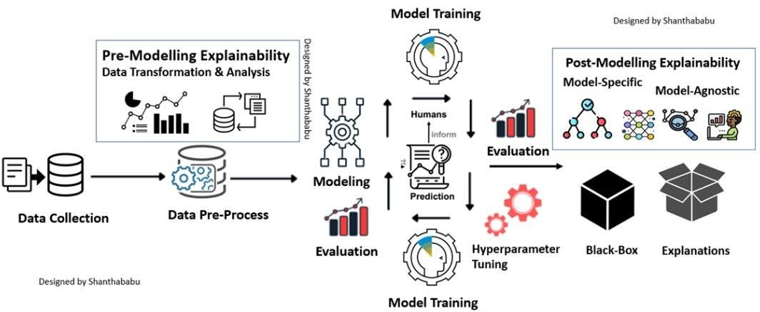
INTRODUCTION
Explainable AI (XAI) is a game-changing framework that brings clarity and trust to AI-powered predictions in healthcare—specifically in kidney transplant decision-making. It focuses on understanding not just what an AI model predicts, but why—ensuring transparency for doctors and patients alike.
The increasing reliance on AI in medicine calls for systems that are not just accurate, but interpretable. In critical domains like organ transplants, explainability can literally mean the difference between life and death.
Key Contributions:
Prediction analysis of kidney transplant outcomes using clinical data
SHAP-based explainability of AI decisions for improved doctor trust
Comparison of AI predictions vs traditional clinical methods using interpretable techniques
Dept. of ISE, SVCE

Slide 4

RELATED BACKGROUND
Title | Year | Author(s) | Relevance to Kidney Transplant AI
EmoXpt: Analyzing Emotional Variances in Human Comments and LLM-Generated Responses | 2025 | Shireesh Reddy Pyreddy, Tarannum Shaila Zaman | Emphasizes the importance of transparency in AI outputs. Similarly, explainability (via SHAP) in kidney transplant models helps interpret predictions, increasing clinical trust.
Sentiment Analysis of Social Media Data: A Review of Current Research | 2023 | Cambria, E., et al. | Offers a landscape of sentiment analysis tools. Demonstrates the necessity of choosing the right model, parallel to selecting optimal interpretable models in clinical decision support
Unsupervised Sentiment Analysis for Social Media Texts | 2022 | Balage, P.,et al. | Introduces lightweight unsupervised techniques—highlighting the trade-off between accuracy and interpretability.
Context-Aware Sentiment Analysis for Chatbots | 2024 | Chen,l.,et al. | Tackles contextual understanding in dynamic conversations. Similarly, kidney transplant decisions require context-aware predictions based on patient history and comorbidities
Mitigating Bias in Sentiment Analysis: A Survey | 2023 | Friedman, J., et al. | Underscores the issue of model bias, a critical concern in medical AI. Ensuring explainability helps detect and address potential biases in transplant predictions
Dept. of ISE, SVCE

Slide 5

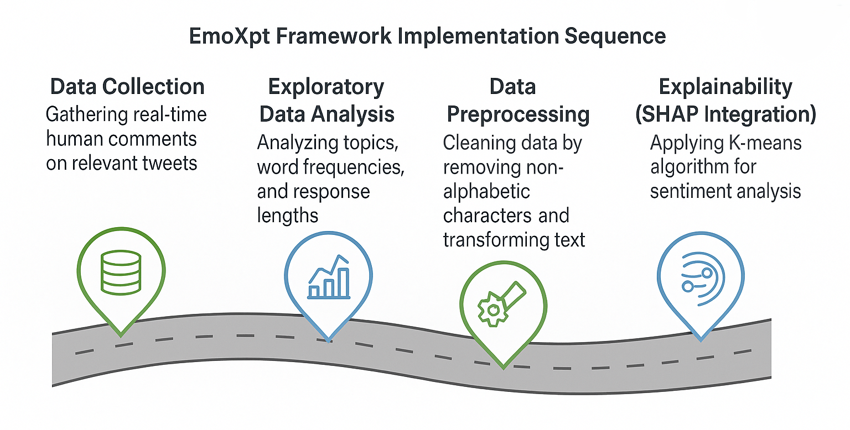
WORKING / IMPLEMENTATION
Dept. of ISE, SVCE

Slide 6
WORKING / IMPLEMENTATION Contd..
Data Handling
Dataset: Artificially created, simulating transplant scenarios.
Features include: donor/recipient age, blood group, GFR, comorbidities, etc.
Steps Involved
Data Preprocessing: Encoding, scaling, missing value imputation.
Feature Engineering: Added interaction terms and reduced dimensionality.
Model Training:
Random Forest Regressor
Gradient Boosting Regressor
Support Vector Regressor
Model Evaluation:
Metrics: MSE & R²
Best results: Random Forest with SHAP (MSE = 0.089, R² = -0.125)
Clinical Validation:
Tested in simulated scenarios for practical integration.
Technologies Used
Python libraries: pandas, NumPy, scikit-learn, SHAP, matplotlib, seaborn
Dept. of ISE, SVCE

Slide 7

APPLICATIONS & FUTURE ENHANCEMENT
Applications:
"XAI enhances the transparency of AI-driven tools used in kidney transplantation, fostering trust among clinicians and patients.“
"XAI facilitates a deeper understanding of the factors influencing transplant outcomes, leading to more informed decision-making.“
Examples:
"XAI helps to explain why a particular donor-recipient match is considered high-risk."
"XAI provides insights into which factors (e.g., donor age, recipient comorbidities) are most critical in predicting graft survival."
Future Enhancement:
"Future research will focus on developing more robust and user-friendly XAI tools tailored to the specific needs of transplant centers.“
"There is a need for XAI methods that can handle complex, multimodal data (e.g., integrating genetic data with imaging data).“
"Future work should explore the use of XAI to personalize immunosuppressant therapies based on individual patient characteristics."
"Investigating the ethical implications of XAI in transplant decisions is crucial
Dept. of ISE, SVCE

Slide 8

CONCLUSION
Explainable AI (XAI) offers a transformative leap in the field of kidney transplantation by bridging the gap between machine intelligence and clinical decision-making. By providing transparency in predictive models, XAI not only enhances the interpretability of complex algorithms but also fosters trust among medical professionals and patients alike.
This approach empowers clinicians to understand why a certain match or outcome is recommended, allowing for more confident and informed decisions regarding donor-recipient compatibility. Through improved accuracy in predicting graft survival and post-operative complications, XAI contributes to reducing transplant rejection rates and optimizing long-term patient care.
Moreover, by streamlining the evaluation process, XAI can significantly reduce wait times for transplants, prioritizing patients more effectively and equitably. As healthcare increasingly embraces AI, the integration of explainability is essential to uphold ethical standards, ensure fairness, and maintain human oversight.
In essence, the adoption of XAI in kidney transplant systems marks a critical step toward a future where artificial intelligence enhances—not replaces—clinical judgment. It sets the stage for a more reliable, efficient, and patient-centered healthcare ecosystem.
Dept. of ISE, SVCE

Slide 9

REFERENCES
[1] J. Devlin, M. W. Chang, K. Lee, and K. Toutanova, “BERT: Pre-training of Deep Bidirectional Transformers for Language Understanding,” in Proc. 2019 Conf. of the North American Chapter of the Association for Computational Linguistics: Human Language Technologies (NAACL-HLT), vol. 1, pp. 1728–1743, 2019. doi: 10.18653/v1/N19-1423.
[2] J. MacQueen, “Some methods for classification and analysis of multivariate observations,” in Proc. 5th Berkeley Symp. on Mathematical Statistics and Probability, vol. 1, pp. 281–297, 1967.
[3] B. Liu, Sentiment Analysis and Opinion Mining, vol. 5, no. 1, Synthesis Lectures on Human Language Technologies, pp. 1–167, 2012. doi: 10.2200/S00416ED1V01Y201204HLT016.
[4] T. B. Brown et al., “Language Models are Few-Shot Learners,” in Advances in Neural Information Processing Systems (NeurIPS), vol. 33, pp. 1877–1901, 2020.
[5] D. Goleman, Emotional Intelligence: Why It Can Matter More Than IQ, New York: Bantam Books, 1995. ISBN: 978-0553375806.
[6] Y. Zhang and B. C. Wallace, “A Sensitivity Analysis of (and Practitioners’ Guide to) Convolutional Neural Networks for Sentence Classification,” in Proc. 2015 Conf. on Empirical Methods in Natural Language Processing (EMNLP), pp. 2531–2541, 2015. doi: 10.18653/v1/D15-1307.
Dept. of ISE, SVCE

Slide 10

THANK YOU
A.Y 2024-25

