Slide 1

Telco Customer Churn Analysis Project
📌 Team Members:
Mohammad Awad (ID: 8875)
Mohammed Bilal (ID: 8971)

Slide 2

Telco Customer Churn Analysis Project
This project focuses on analyzing and predicting customer churn for a telecommunications company using machine learning techniques. By identifying factors that contribute to customer churn, this analysis aims to help the company develop strategies to improve customer retention.

Slide 3

Dataset
Customer Demographics
Service Subscriptions
Gender
Phone service
Senior citizen status
Internet service
Partner status
Security features
Dependents
Streaming services
Account Information
Financial & Churn Data
Contract type
Monthly charges
Billing method
Total charges
Payment method
Churn status (target variable)
The dataset used in this project is WA_Fn-UseC_-Telco-Customer-Churn.csv, which contains information about customer demographics, service subscriptions, account information, financial details, and churn status.

Slide 4
Data Preprocessing
Handling missing values
Loading and initial exploration
Identified 11 missing values in the TotalCharges column
Examining the dataset structure and contents
Converted TotalCharges to numeric format
Filled missing values with the median

Slide 5
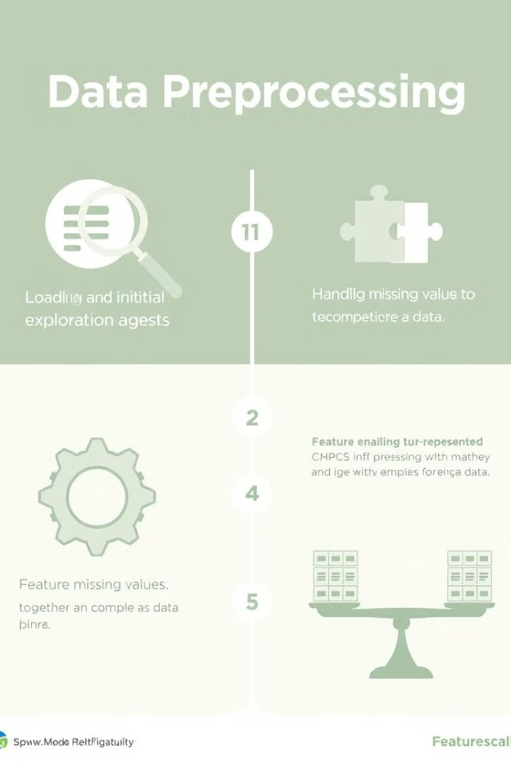
Data Preprocessing
Feature engineering
Feature scaling
Removed non-informative columns (customerID)
Applied StandardScaler to numeric features (tenure, MonthlyCharges, TotalCharges)
Applied Label Encoding to categorical variables
Binary features (Yes/No) encoded as 1/0
This ensures all features contribute equally to model performance
Multi-class features encoded appropriately
Detailed mapping documented for reference

Slide 6
Encoding Reference
Feature
Encoding
Gender
Female: 0, Male: 1
Partner
No: 0, Yes: 1
Dependents
No: 0, Yes: 1
PhoneService
No: 0, Yes: 1
MultipleLines
No: 0, No phone service: 1, Yes: 2
InternetService
DSL: 0, Fiber optic: 1, No: 2
Online features
No: 0, No internet service: 1, Yes: 2
Contract
Month-to-month: 0, One year: 1, Two year: 2
PaperlessBilling
No: 0, Yes: 1
PaymentMethod
Bank transfer: 0, Credit card: 1, Electronic check: 2, Mailed check: 3
Churn
No: 0, Yes: 1

Slide 7
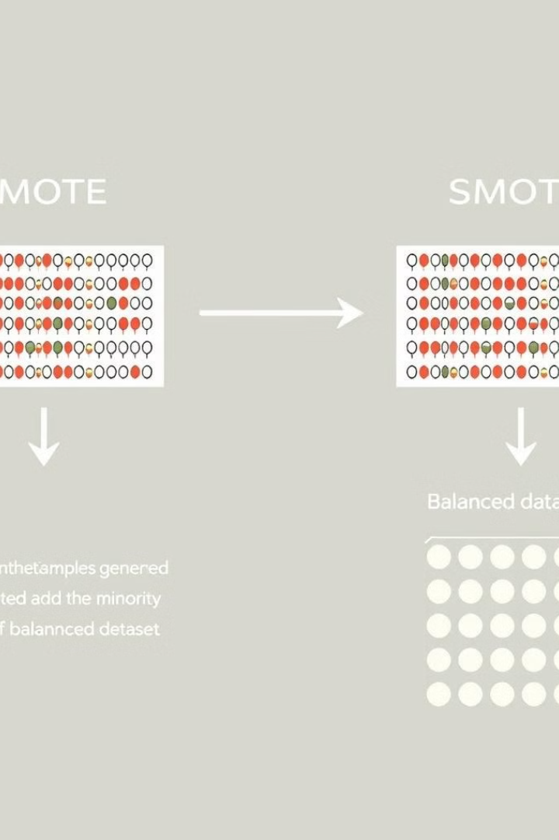

Model Development
Addressing Class Imbalance
To address the class imbalance in the dataset (fewer churned customers than non-churned), we applied SMOTE (Synthetic Minority Over-sampling Technique) to the training data, which creates synthetic examples of the minority class.

Slide 8



Base Models
Random Forest
Logistic Regression
XGBoost
Hyperparameter tuning via RandomizedSearchCV
Hyperparameter tuning via GridSearchCV
Hyperparameter tuning via RandomizedSearchCV
Key parameters: n_estimators, max_depth, min_samples_split, min_samples_leaf
Key parameters: C, penalty, solver
Key parameters: n_estimators, max_depth, learning_rate, subsample
Results on original data: 82% accuracy
Results on original data: 81% accuracy
Results on SMOTE-balanced data: 75% accuracy, with improved recall for the positive class (from 58% to 84%)
Results on original data: 81% accuracy
Results on SMOTE-balanced data: 75% accuracy, but with improved recall for the positive class (from 51% to 77%)
Results on SMOTE-balanced data: 75% accuracy, with improved recall for the positive class (from 53% to 76%)

Slide 9



Stacked Model
Base Models Produce Probability Predictions
Random Forest, Logistic Regression, and XGBoost generate probability outputs
Probabilities Used as Features
These probabilities become input features for the meta-model
Meta-Model Makes Final Prediction
XGBoost meta-model combines base model predictions for final output
Results:
Accuracy: 76%
Precision for non-churn (class 0): 93%
Recall for non-churn (class 0): 74%
Precision for churn (class 1): 54%
Recall for churn (class 1): 84%
F1-score (weighted): 0.78
The stacked model achieves a good balance between detecting churned customers (high recall for class 1) while maintaining reasonable overall accuracy.

Slide 10










Feature Importance Analysis
Tenure
Negatively correlated with churn
Monthly charges
Higher charges increase churn probability
Longer-tenured customers less likely to churn
Contract type
Threshold effect where impact becomes more pronounced
Effect is nearly linear
Internet service type
Most influential feature
Fiber optic customers show higher churn probability
Month-to-month contracts associated with higher churn probability
Online security
Two-year contracts strongly correlate with customer retention
Customers without online security more likely to churn

Slide 11










Recommended Retention Strategies
Customer Segmentation
Personalized retention strategies based on churn probability
Service Improvements
Address fiber optic issues and bundle security features
Tenure Rewards
Loyalty bonuses at specific milestones
Pricing Strategies
Targeted discounts for high-risk segments
Contract Incentives
Special offers for longer-term commitments
Based on the model findings, these actionable strategies are recommended to improve customer retention and reduce churn. Each approach targets specific factors identified in the feature importance analysis.

Slide 12

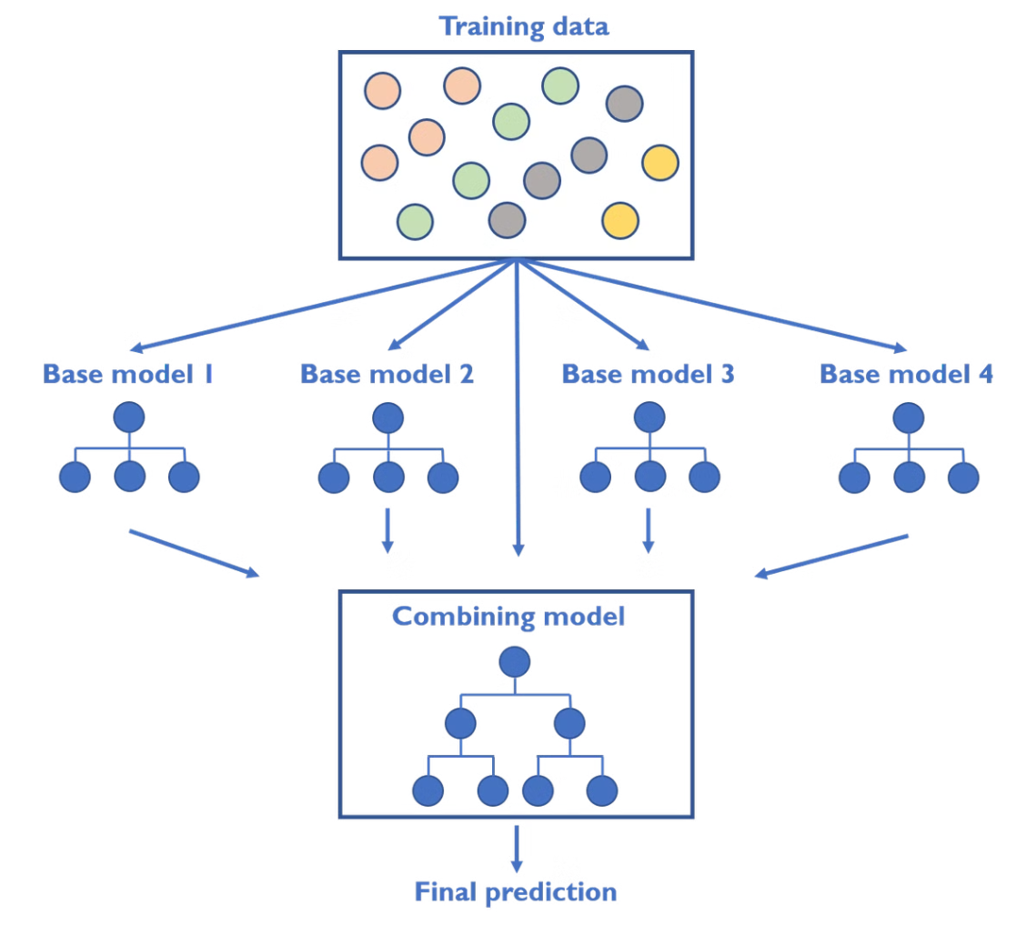
Conclusion
84%
76%
Churn Recall
Overall Accuracy
Success rate identifying at-risk customers
Model prediction performance
0.78
F1-Score
Balanced precision and recall metric
The stacked ensemble model successfully identifies customers at risk of churning with 84% recall while maintaining good overall performance metrics. The SHAP analysis provides valuable insights into the factors driving customer churn, enabling the development of targeted retention strategies. By implementing the recommended approaches, the telecommunications company can work proactively to improve customer retention and reduce churn.

