Slide 1


Image Classification with CNN
Presented By:
Tech Trio
Mohammed Bunahyah
Lama Alwuthaynani
Abrar Alanazi

Slide 2
Project Overview
Dataset: CIFAR-10 (60,000 images across 10 classes)
Goal: Classify images into 10 categories using CNN
Tools: Google Colab, TensorFlow, Keras, Seaborn
Techniques: Data Augmentation, Learning Rate Scheduling, Transfer Learning

Slide 3
CIFAR-10 Dataset Overview
Slide Content:Total Images: 60,000 (50,000 for training, 10,000 for testing)
Image Size: 32x32 pixels, 3 color channels (RGB)
Number of Classes: 10
Classes:🛩 Airplane | 🚗 Automobile | 🐦 Bird | 🐱 Cat | 🦌 Deer🐶 Dog | 🐸 Frog | 🐴 Horse | 🚢 Ship | 🚛 Truck
Dataset Balance: Each class has 6,000 imagesPreprocessing Techniques:✅ Normalization (Pixel values scaled between [0,1])✅ One-Hot Encoding for categorical labels✅ Data Augmentation (Rotation, Shifts, Flips, Brightness Adjustments)

Slide 4
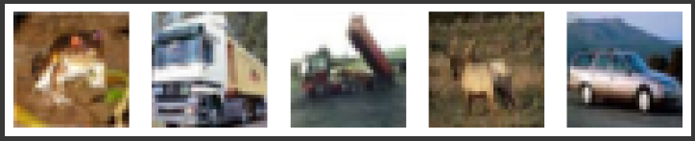
Data Preprocessing
• Loaded CIFAR-10 dataset & normalized pixel values to [0,1]
• Applied One-Hot Encoding for class labels
• Data Augmentation: Rotation, Shifts, Flips to prevent overfitting

Slide 5
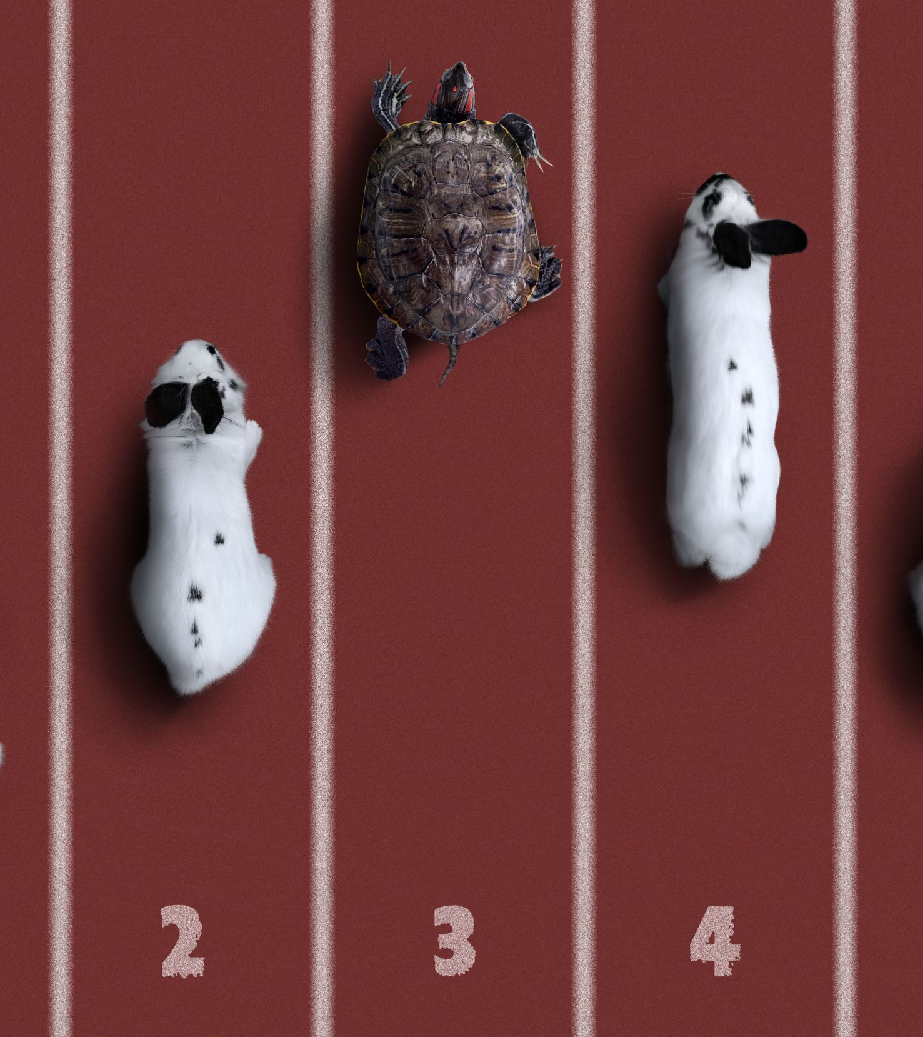
CNN Model Architecture
3 Convolutional Blocks with Batch Normalization & Max Pooling
Fully Connected Layer with 1024 neurons
Dropout (0.3 - 0.5) added to reduce overfitting

Slide 6
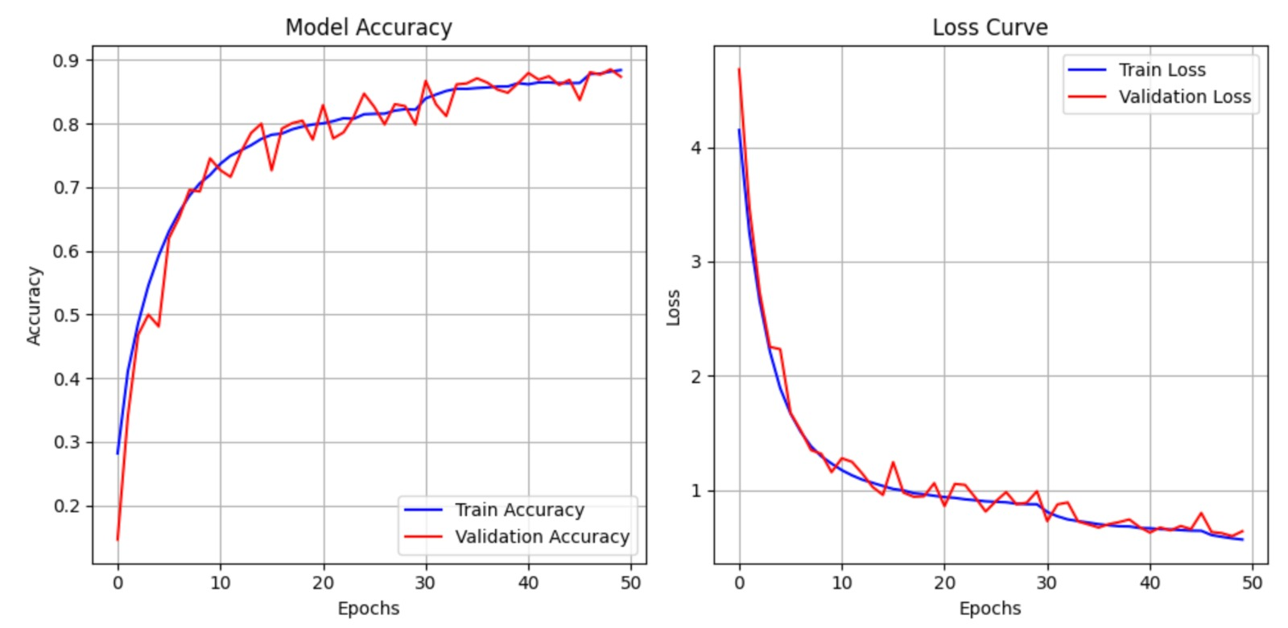
Model Training
Hyperparameter | Value
Optimizer | Adam
Learning Rate | 0.0003
Batch size | 128
Epochs | 50
Loss Function Callback | Categorical Cross-Entropy ReduceLROnPlateau

Slide 7
Model Evaluation
Accuracy | 87%
Precision | 88%
Recall | 87%
F1 score | 87%

Slide 8
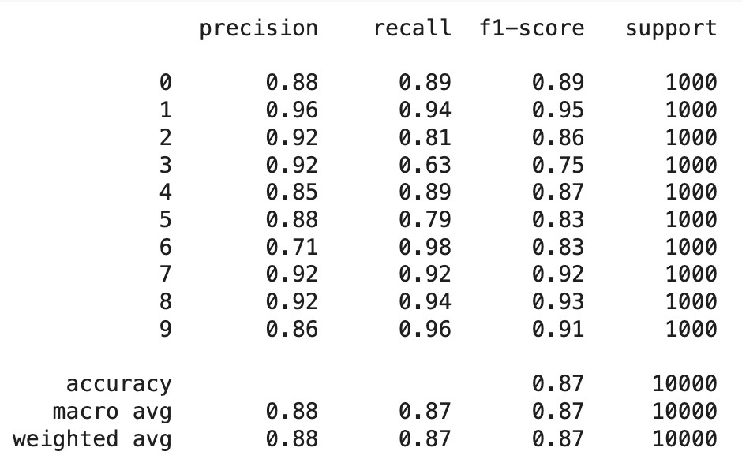
Classification Report

Slide 9
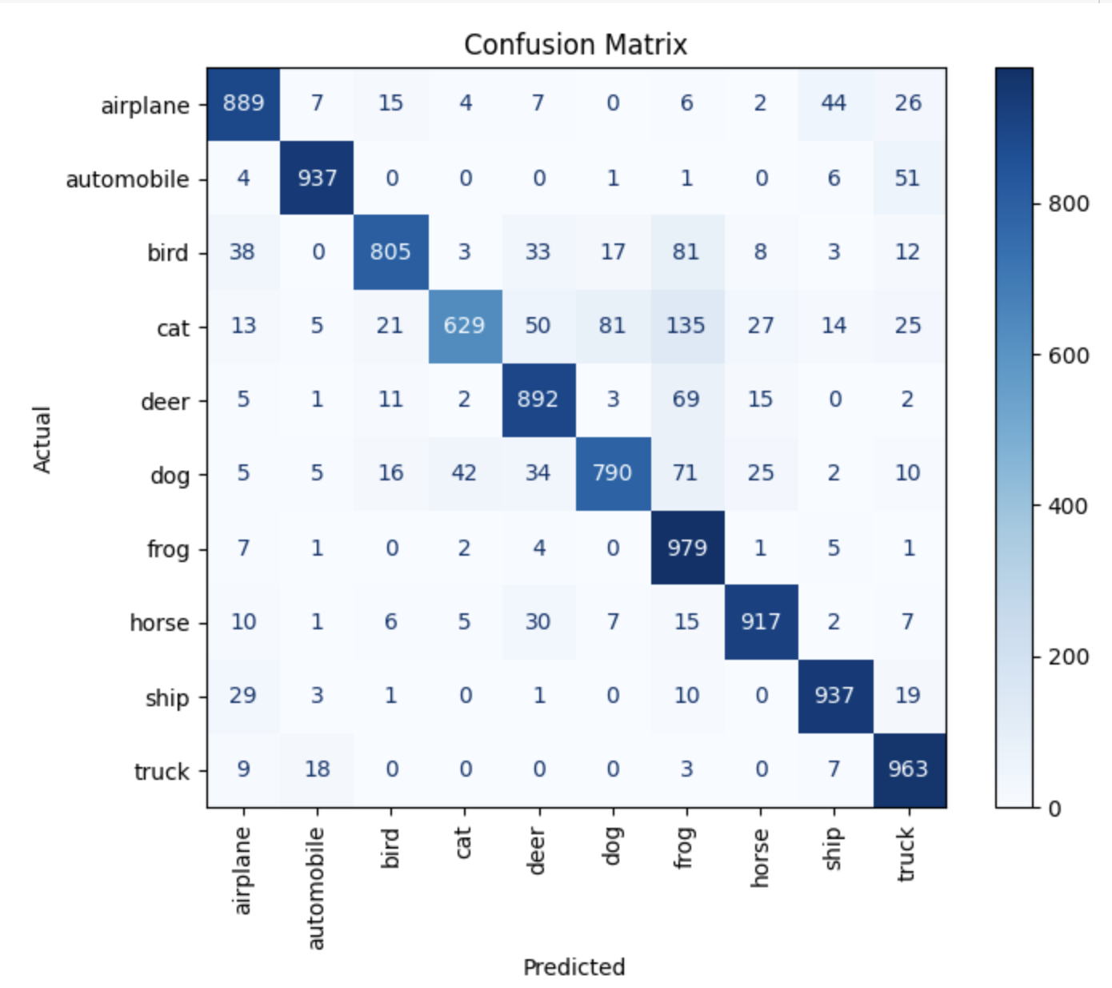
Confusion Matrix
Strong performing classes:
Frog
Automobile
Truck

Slide 10
Transfer Learning
We Load Pre-trained VGG16 model and train the new model on the CIFAR 10 dataset

Slide 11
Transfer Learning Evaluation
Accuracy | 84%
Precision | 84%
Recall | 84%
F1 score | 84%

Slide 12
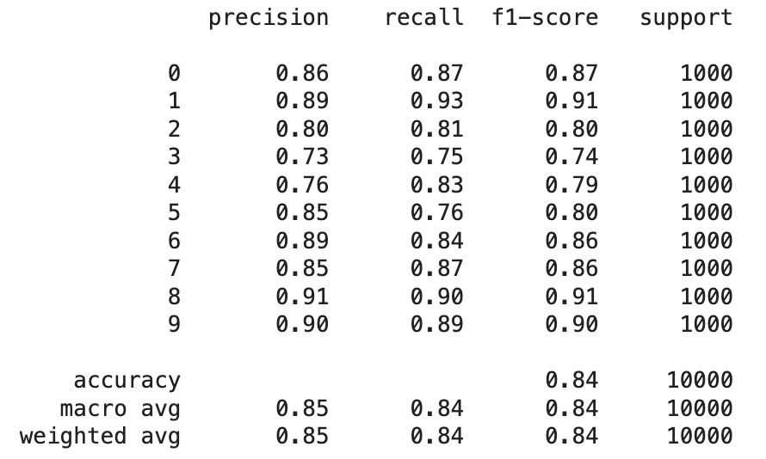
Classification Report

Slide 13
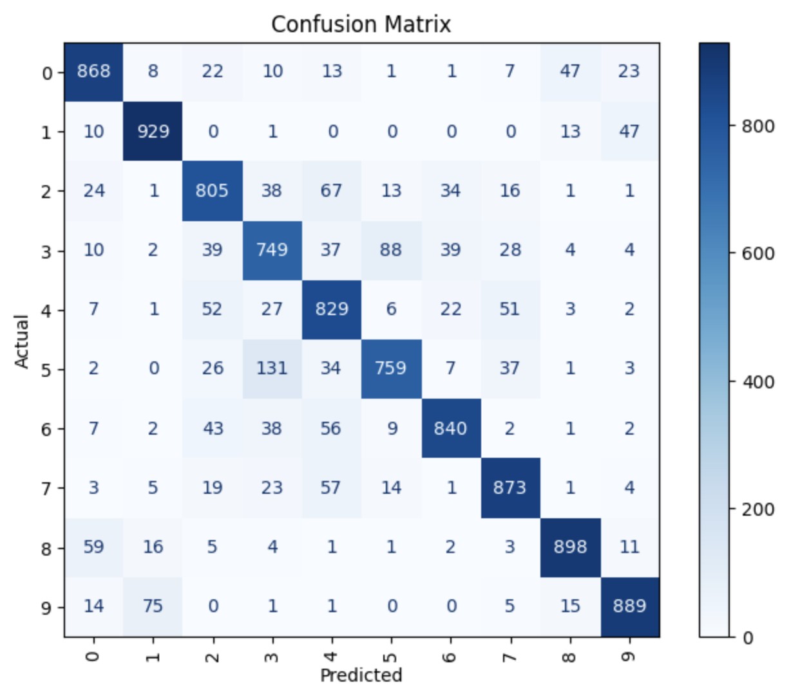
Confusion Matrix

Slide 14
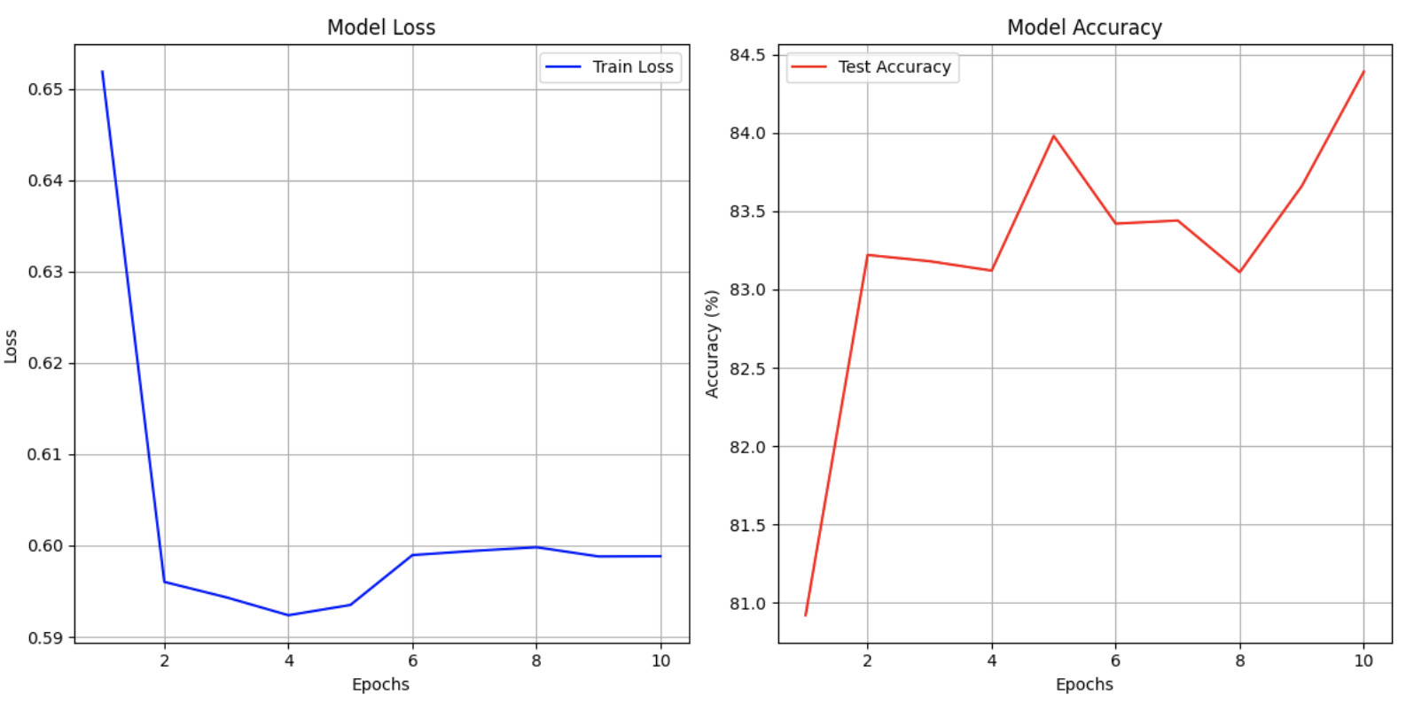
Loss & Accuracy

Slide 15
CNN vs Pre-trained VGG16
Our CNN model achieved an accuracy of 87%, while the pre-trained VGG16 model reached an accuracy of 84%

Slide 16
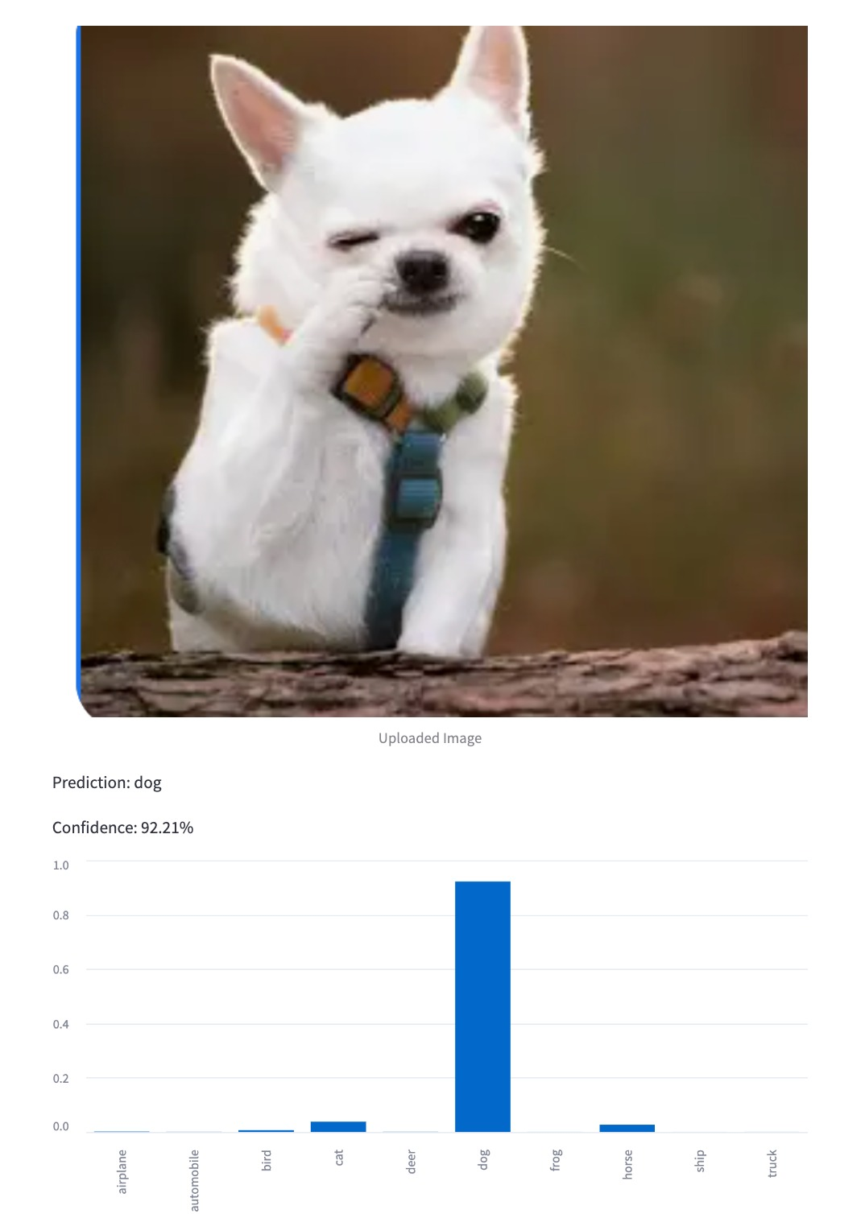
Model Deployment Result

Slide 17
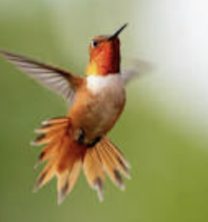
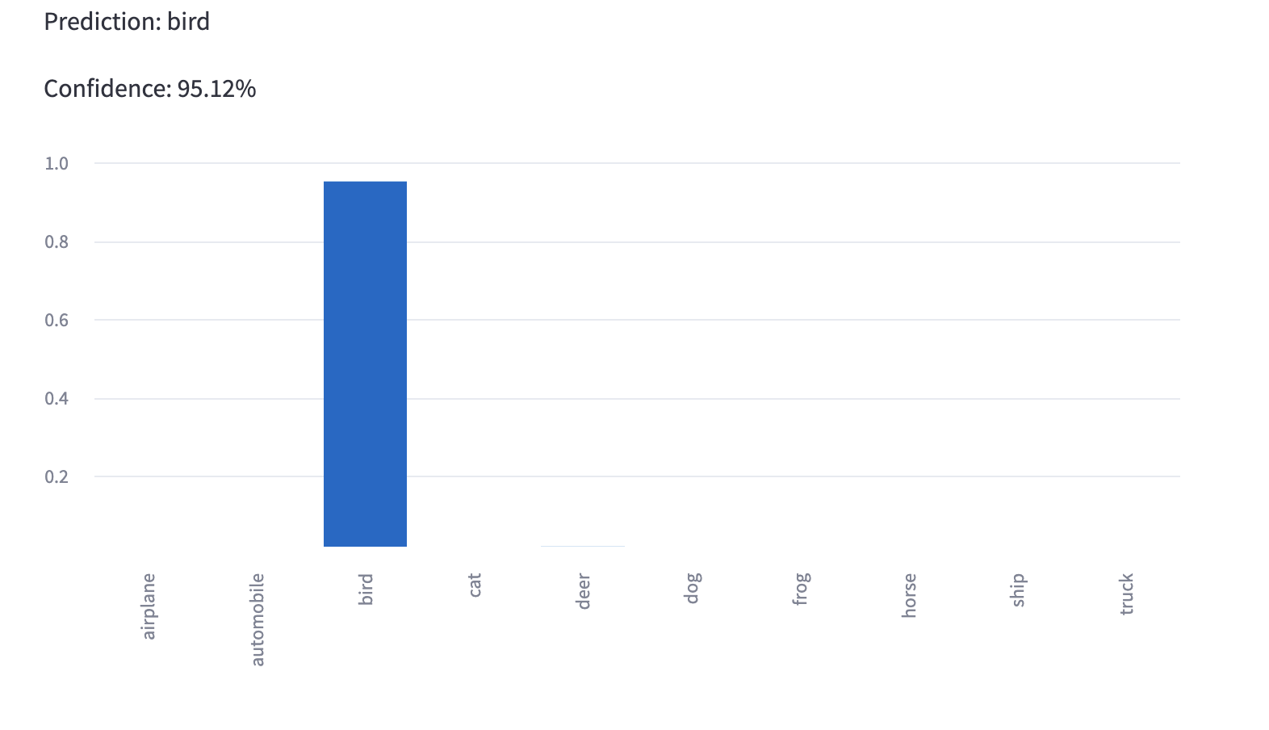

Slide 18
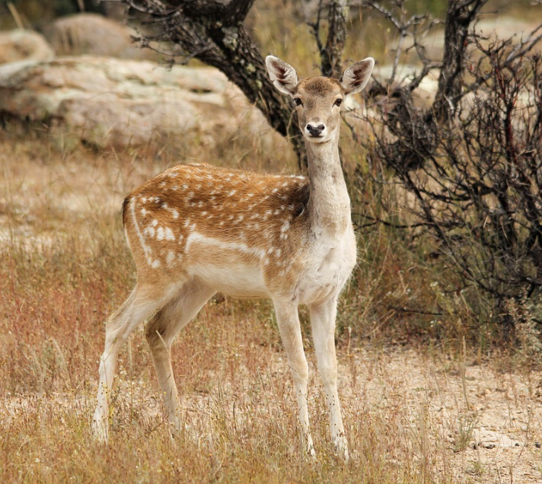
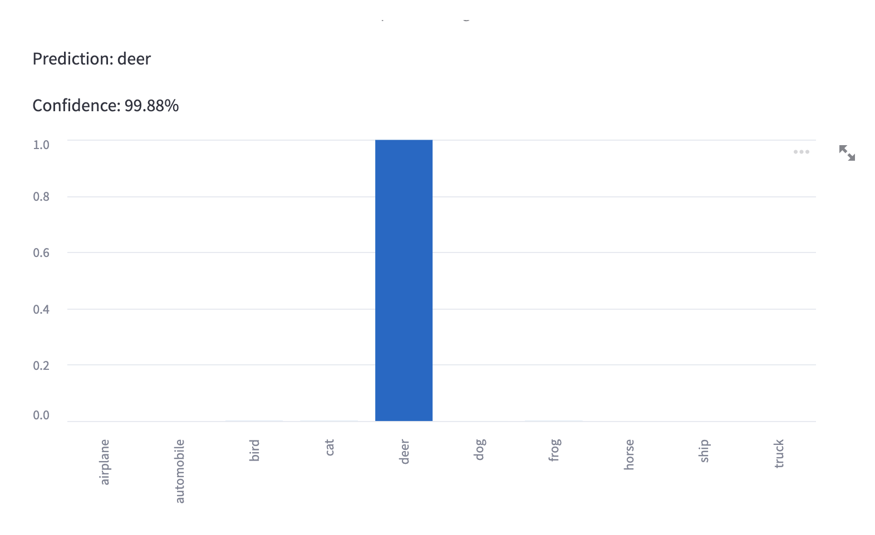

Slide 19
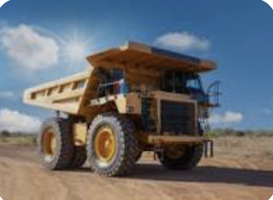
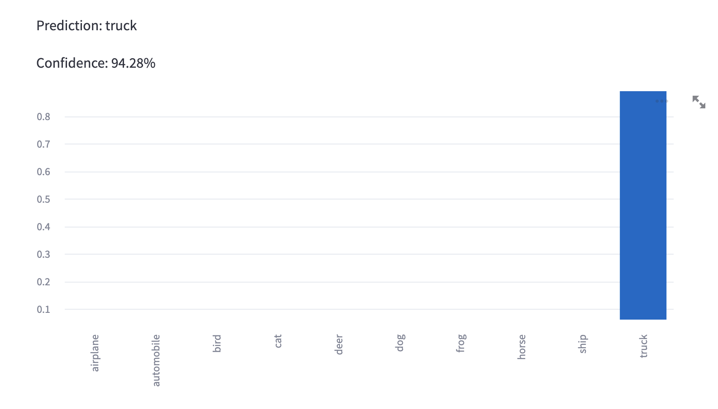

Slide 20
Thank you for listening !

