Slide 1

improving of sales Northwind company
Mohammed Alghamdi

Slide 2
Introduction:
Northwind Traders company is a company that sells foods around the world.
Category of foods are : Beverages, Condiments, Confections, Dairy Products, Meat and Seafood.

Slide 3
Strategy to Improve Sales Performance
What are two common products that can be packaged together to make an attractive offer? In what regions?

Slide 4
Western Europe, South America, Central America, North America, Northern Europe, Scandinavia, Southern Europe, British Isles and Eastern Europe

Slide 5
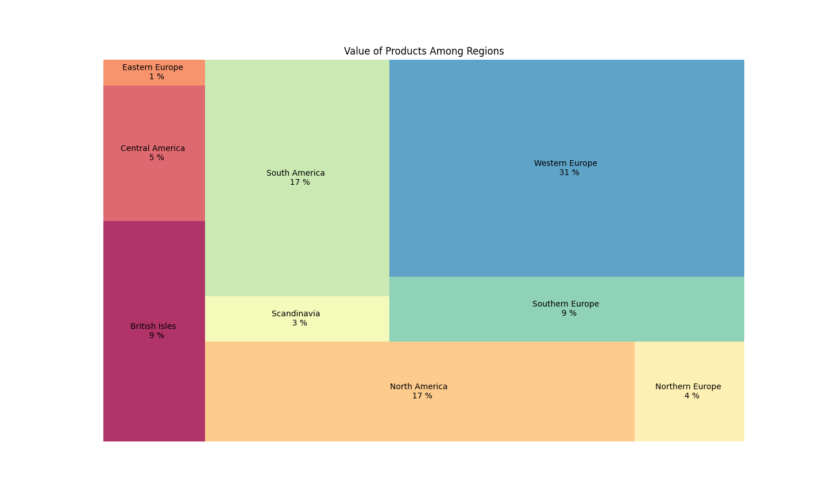

Slide 6
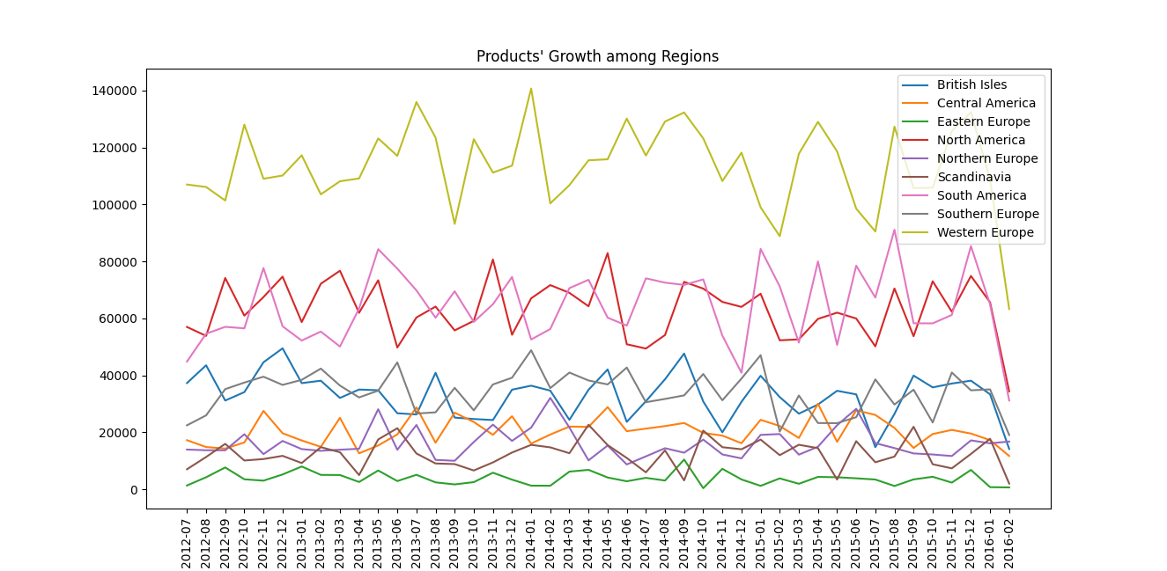

Slide 7
Western Europe and North America
Western Europe, South America, Central America, North America, Northern Europe, Scandinavia, Southern Europe, British Isles and Eastern Europe

Slide 8
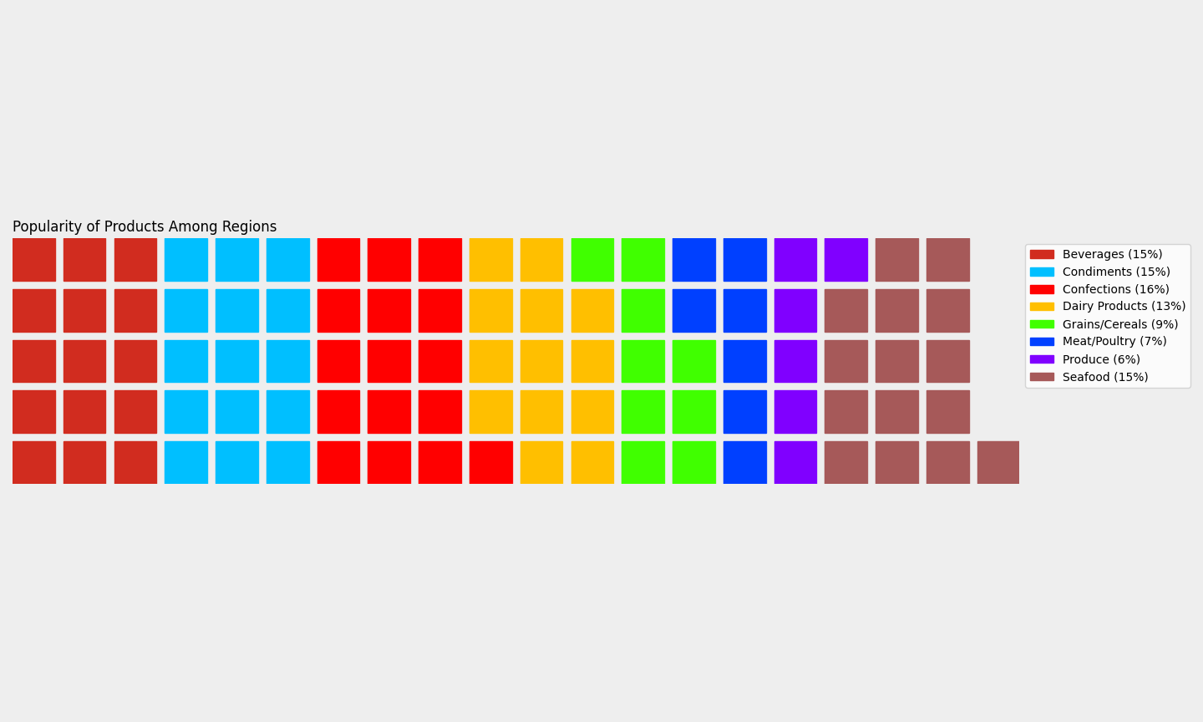

Slide 9
Beverages, Condiments, Confections, Dairy Products and Seafood
Western Europe and North America
Western Europe, South America, Central America, North America, Northern Europe, Scandinavia, Southern Europe, British Isles and Eastern Europe

Slide 10
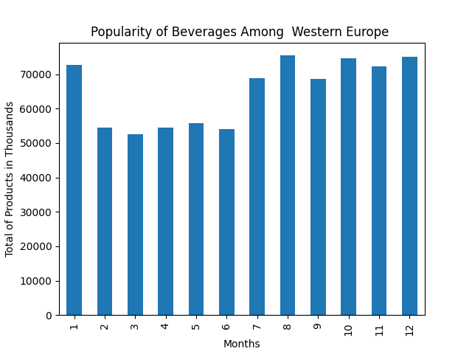
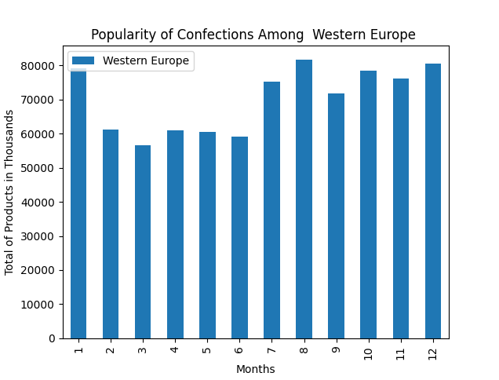
Western Europe

Slide 11
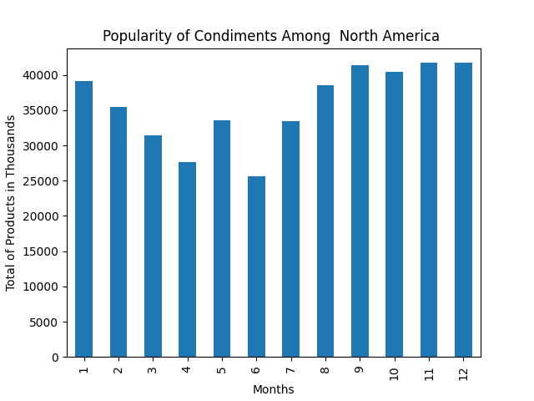
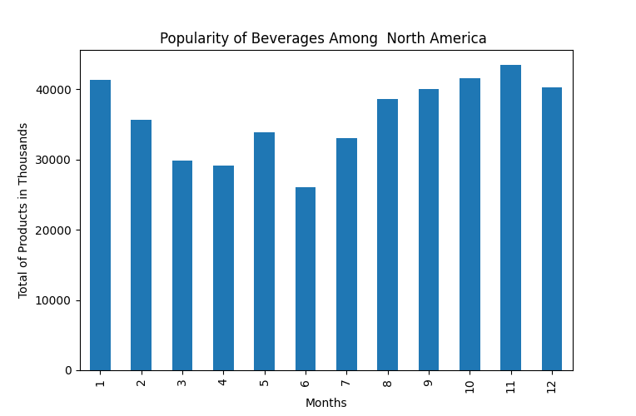
North America

Slide 12
What are two common products that can be packaged together to make an attractive offer? In what regions?
North America
Beverages and Condiments
Western Europe
Beverages and Confections
Beverages, Condiments, Confections, Dairy Products and Seafood
Western Europe and North America
Western Europe, South America, Central America, North America, Northern Europe, Scandinavia, Southern Europe, British Isles and Eastern Europe

Slide 13
Recommendation
For Western Europe, we can use Beverages and Confections to make attractive package
For North America, we can use Beverages and Condiments to make attractive package

Slide 14
Challenges
This filed is new to me.
Amount of data is very huge
Consum long time to make data clean and ready to use

Slide 15
Thank you

