Slide 1


Predict the income of movies
Mohammed Alghamdi

Slide 2
Project Introduction:
This project is about guessing the income of movies based on different features such as stars, directors , runtime, release year, film type

Slide 3



Source of data
Wikipedia [Get Movies’ names : 2016, 2017, 2018, 2019 , 2020 ]
https://www.rottentomatoes.com [Moves data ]
https://www.the-numbers.com [directors rank , stars ranks]

Slide 4
Feature selection
First top stars
Directors
Movie type
Released year
Runtime
Movie's income

Slide 5
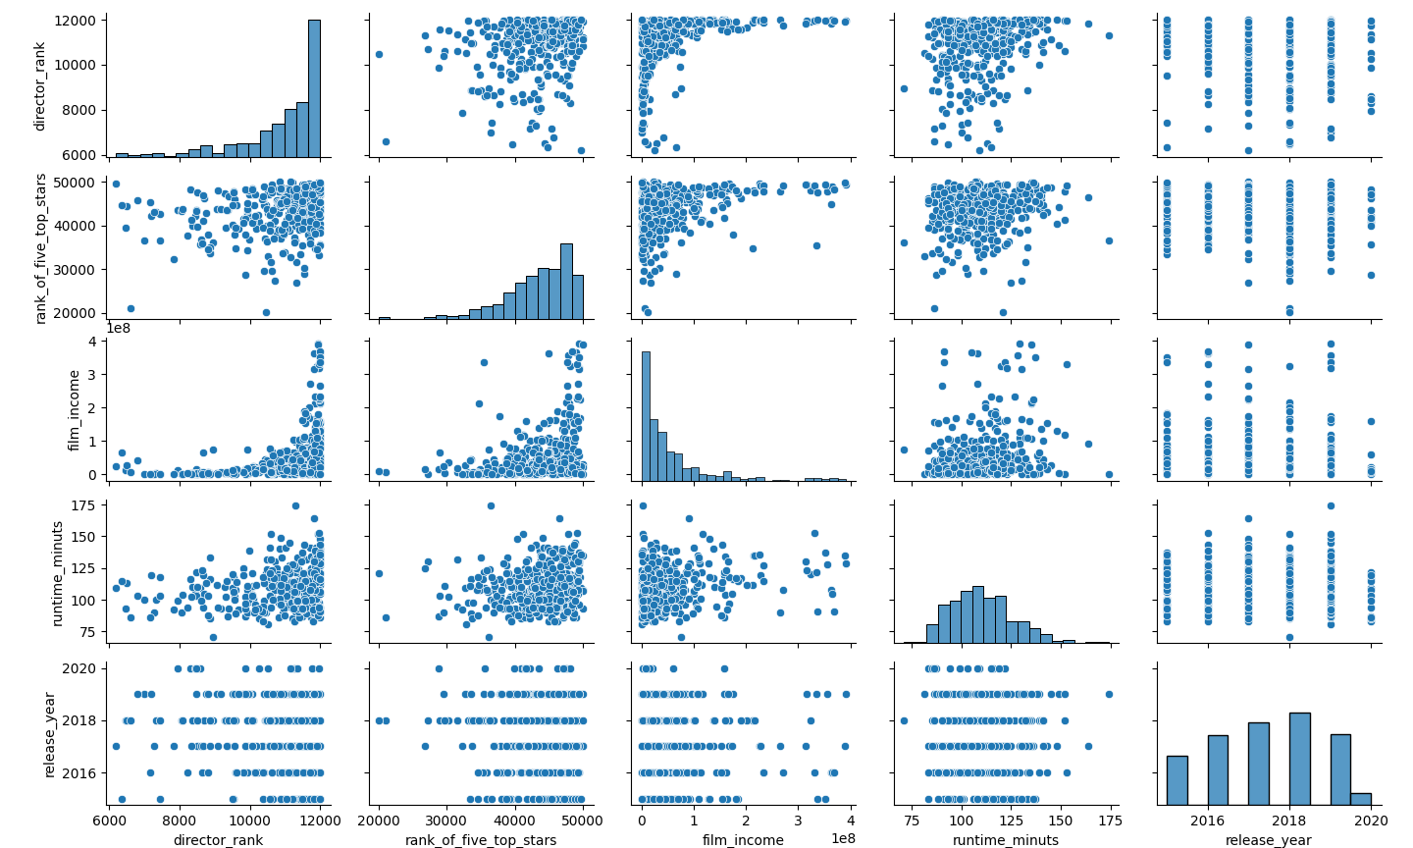
Validation testing and modeling selection

Slide 6
Validation and modeling selection
Cross validation has been done
Linear Regression val R^2: 0.271
Ridge Regression val R^2: 0.283
Degree 2 polynomial regression val R^2: 0.523

Slide 7
Improving Data
converting stars names to ranks
converting directors name to ranks
calculate run time to be in minutes
dummy for movies type
focusing on performance of similar movies
increased the degree of polynomial to 9

Slide 8
Conclusion
After doing feature engineering and select the appropriate features, the R^2 for testing improved to be 0.951 with Degree 9 polynomial regression

Slide 9
Thank you

