Slide 1
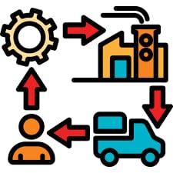
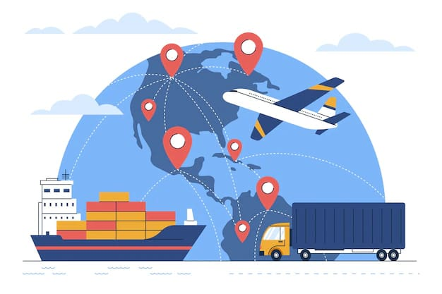
SUPPLY CHAIIN ANALYTICS
PRECISION IN
MOTION, INSIGHTS IN action
By Mohammed Dhanish
INTERN @ AARD

Slide 2
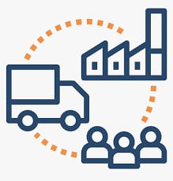
MECHANISM WORKFLOW
Planning
Procurement
TO MEET CUSTOMER DEMAND
ACQUIRE RAW MATERIALS
Inventry
Management
ware
Housing
Manufactoring
OPTIMIZE STOCK LEVELS TO PREVENT SHORTAGE
STORES MATERIALS AND FINISHED GOODS
TRANSFORM RAW TO FINISHED GOODS

Slide 3
Logistics
Distribution
MANAGE MOVEMENT OF GOODS
DELIVER GOODS TO CUSTOMERS & RETAILERS
MANAGE RETURN GOODS FOR REPAIR, RECYCLE OR DISPOSAL
Reverse
Logistics
Customer
Service
ADDRESS CUSTOMER CONCERNS AND ENSURE SATISFACTION
Performance
Monitoring
EVAUATE THE EFFECIENCY AND EFFECTIVENESS OF THE SUPPLY CHAIN

Slide 4

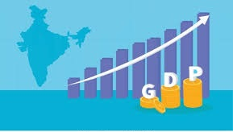
MARKET RESEARCH
GROWTH TREND OF GLOBAL SUPPLY CHAIN MARKET 10.6% AND EXPECTED TO REACH 94.71 BILLION IN 2035
GROWTH TREND OF INDIAN SUPPLY CHAIN MARKET 11.1% AND EXPECTED TO REACH 6,433 MILLION IN 2030

Slide 5


REVENUE OF SUPPLY CHAIN MARKET
REVENUE GENERATED BY GLOBAL MARKET IN 2024 IS 31.27 BILLION
REVENUE GENERATED BY INDIAN MARKET IN 2024 IS 3,421 MILLION
CHALLENGES IN SUPPLY CHAIN MANAGEMENT
DEMAND FORECASTING
RISK MANAGEMENT
DATA MANAGEMENT
MATERIAL SHORTAGE
INCRESED FRIEGHT PRICES
LABOUR SHORTAGE
PORT CONGESTION
DATA VISIBLITY
GEOPOLITICS

Slide 6

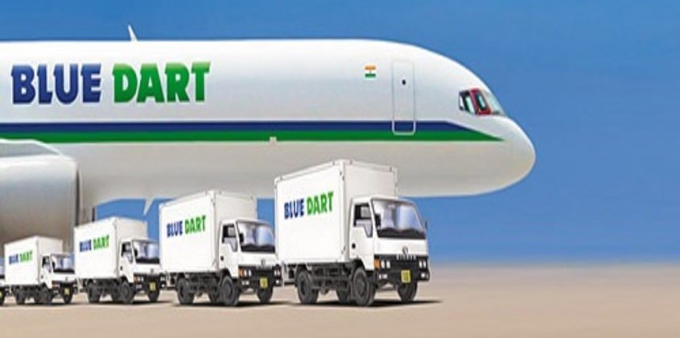
COMPETITOR ANALYSIS
COMPANIES
PROBLEM
SOLUTION
Inefficient inventory management,overstock,stockouts and high logistics cost.
Implemented predictive analytics for accurate demand forecasting
optimized delivery routes ,
inventory cost reduced by 15% and saving $5 billion annually
Inefficiencies in delivery routes, particularly in tier2&3 cities caused delays and higher operational cost
Implemented route optimization using analytics.
reducing fuel consumption and delivery delays.
Achieved 8-10% cost reduction and 2.8% growth in operating income, with a 12.6% operating margin

Slide 7

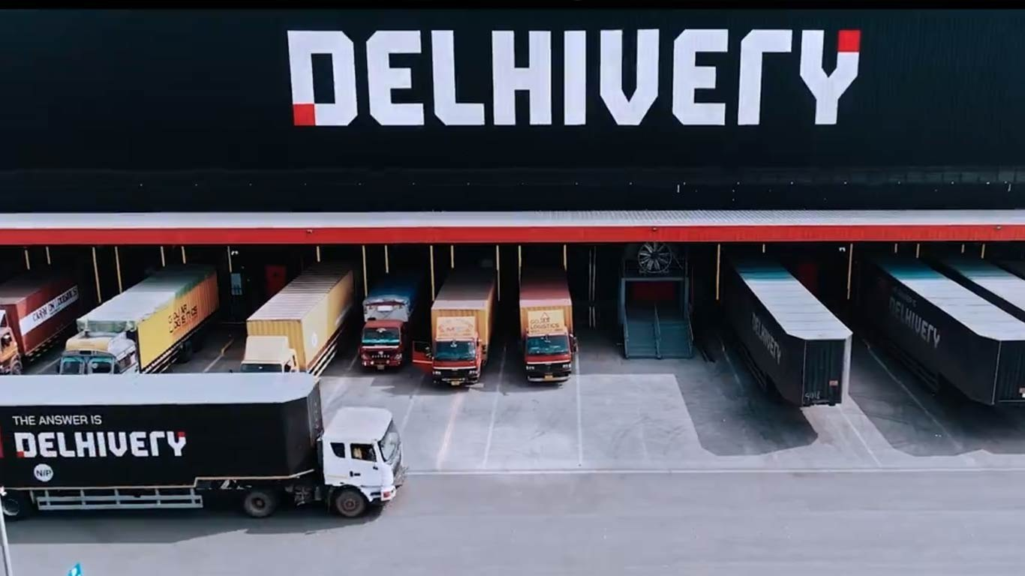
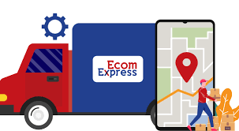
Inefficient fleet management and unplanned maintenance schedules led to higher downtime and costs.
Adopted IoT sensors and predictive analytics for fleet management.
reducing downtime by 15-20%, maintenance costs by 10%, and achieving a 12% cost reduction.
Scalability and maintaining visibility over shipments, resulting in delays and lost packages.
predictive analytics for demand forecasting and real-time tracking,
improving delivery efficiency and reducing delays by 20%, contributing to 45% revenue growth.
predicting demand during peak seasons, leading to stockouts and overstocking.
Used analytics for inventory optimization and demand forecasting, improving fulfillment rates by 25% and reducing costs by 15-20%, increasing profit margins by 15%.

Slide 8
BUSINESS IMPACT – ACTIONABLE INSIGHTS, PROFITABLE OUTCOMES
Forecast demand accurately, cutting inventory costs up to 25% and increase service level by 20%
PREDECTIVE ANALYTICS SOFTWARE
Increase supply chain visibility, cutting delays by 30% and increase customer satisfaction by 15%
ANALYTICS IMPACT IN SUPPLY CHAIN
REAL TIME TRACKING SYSTEM
Analytics-driven inventory optimization lowers holding costs by 20% and reduce stockouts by 15%
INVENTRY MANAGEMENT SYSTEM
This allows companies to proactively address disruptions, reducing lead times by 20% and improving on-time delivery rates by 30%.
VISIBLITY SOFTWARE SYSTEM

Slide 9
Oracle Transportation Management
SAP Transportation Management
Uber Freight
Transportation
Freightview
MyCarrierTMS
TruckingOffice
TOOLS
&
TECHNOLOGIES
FRIEGHT MANAGEMENT SOFTWARE
ORDER PROCESSING SOFTWARE
WAREHOUSE MANAGEMENT SOFTWARE TOOLS
TRANSPORT MANAGEMENT SOFTWARE TOOLS
IBM Sterling Order Management
Fluent Order Management
Kibo Order Management
Manhattan Associates WMS
SAP warehouse management tool

Slide 10
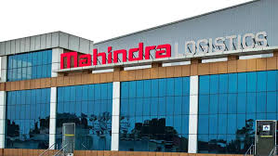
CASE STUDY
MAHINDRA LOGISTICS AND IMPACT OF DATA ANALYTICS ON LAST MILE DELIVERY
INTRODUCTION:
Mahindra Logistics, a leader in the Indian logistics sector has been providing last mile delivery solutions to major e-commerce platforms. Their primary focus on First Day Delivery Success and Inventory Accuracy.
KEY OPERATIONS:
Inventory Management: wall to wall audits to ensure accuracy and reliability.
Employee training: emphasis on training staff to improve productivity and maintain delivery standards
Inventory Management: wall to wall audits to ensure accuracy and reliability.
Employee training: emphasis on training staff to improve productivity and maintain delivery standards

Slide 11

Maintained shrinkage rate of only 0.25%
Effective inventory management and improving the reliability of stock handling
Achieved 92% first day delivery
Majority of customers receive their delivery on first day, which critical for customer satisfaction.
FIRST DAY DELIVERY
INVENTORY SHRINKAGE
PLANNED DELIVERY DATE
KEY METRICS ACHIEVED
ZERO DAMAGE
Achieved 98.5% success rate
Most deliveries arrived as per the scheduled date and improving logistical efficiency.
Maintained a 0% damage rate for goods during delivery
High quality control in packaging and transportation

Slide 12
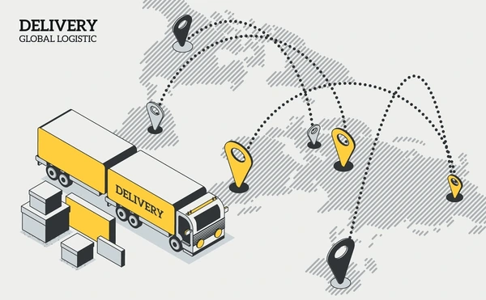


FINANCIAL IMPACT OF DATA ANALYTICS
Data analytics has enhanced on-time deliveries, route efficiency and driver performance ,reducing cost and ensuring customer satisfaction
OPTIMIZED
OPERATIONS
Predictive analytics minimizes fuel consumption, inventory shrinkage, and transit damages, lowering operational expenses.
COST REDUCTION
High FDDS (92%) and PDD (98.5%) rates improve customer retention, driving repeat business and higher revenue.
REVENUE GROWTH

Slide 13

Efficiency gains and cost reductions help Mahindra Logistics maintain an estimated profit margin of 5-10%.
PROFITABILITY ESTIMATE
CONCLUSION
Mahindra Logistics' success in last-mile delivery results from leveraging data analytics to optimize operations, improve customer satisfaction, and reduce costs. By focusing on key metrics like on-time delivery and route efficiency, they have enhanced performance and sustained healthy profit margins, estimated at 5-10%. This showcases how data-driven decisions enable logistics companies to remain competitive and grow in the dynamic e-commerce landscape.

