Slide 1
POWER BI PROJECT
Sales
Performance
Dashboard
Project
At a Glance
8
Raw CSV Source Files
4
Interactive Dashboard Pages
Power BI Desktop · DAX · Data Modeling
Interactive Dashboard · Business Intelligence
40+
DAX Measures & Calculated Columns
1
Relational Star Schema Data Model
Mohammed Drihmi — Data Analyst

Slide 2
POWER BI PROJECT
The Brief: From Raw Data to Business Intelligence
01
Situation
02
The Brief
03
Objective
The management team has no structured way to monitor performance. Data sits in disconnected CSV files with no analytical layer on top of it.
Use Power BI Desktop to connect raw data, build a relational model, create DAX measures, and design an interactive multi-page dashboard.
Track KPIs (revenue, profit, returns), compare regional performance, analyze product-level trends, and identify high-value customers.
Global multi-country operation
Only raw CSV files provided
No unified analytical view
Connect & transform all source data
Build relational data model
Write DAX calculated measures
Design interactive visuals
Track: Revenue, Profit, Returns
Compare: Regional performance
Analyze: Product-level trends
Identify: High-value customers
2

Slide 3
POWER BI PROJECT
Source Data: 8 Raw CSV Files → Unified Data Model
All data was sourced from flat CSV files. No database, no pre-built model, no existing relationships.
Sales_Data_2020.csv
Sales_Data_2021.csv
What Was Built
Transaction records — 2020
Transaction records — 2021
Power Query
Connected all 8 CSVs, cleaned and transformed data types, removed nulls
Sales_Data_2022.csv
Product_Lookup.csv
Transaction records — 2022
Product catalog and pricing
→
Data Model
Built a star schema with 1 fact table and 5 dimension tables
Customer_Lookup.csv
Territory_Lookup.csv
Relationships
Customer demographics
Sales territories & regions
Defined one-to-many relationships across all tables
DAX Layer
Product_Categories.csv
Returns_Data.csv
Created 40+ calculated columns and measures
Category hierarchy
Return transactions
4 Report Pages
Executive, Map, Product, and Customer dashboards
3

Slide 4
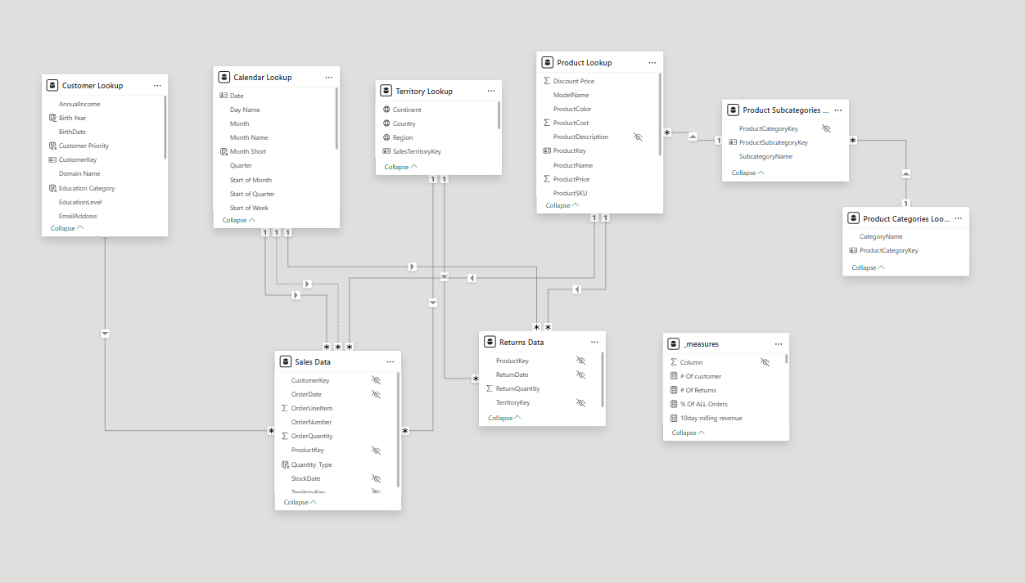
DATA MODELING
Star Schema Data Model — 1 Fact, 5 Dimensions
All tables connected through one-to-many relationships. Optimized for performance and DAX calculations.
4
ProductColor
ProductCost
ProductPrice
SubcategoryKey

Slide 5
PART ONE
The Dashboard
Four interactive pages built in Power BI Desktop — each answering a specific business question.
01
02
03
04
Executive Summary
Map
Product Detail
Customer Detail
KPIs, revenue trend, top products
Regional & continental performance
Category drill-down, targets, trends
Segmentation, top customers, revenue

Slide 6
PAGE 01 — EXECUTIVE SUMMARY
KPI Dashboard: Revenue, Orders, Profit & Returns
Top-level metrics with MoM comparisons, targets, and trend sparklines. Filterable by date.
$24.9M
$10.5M
25,164
2.17%
Total Revenue
Total Profit
Total Orders
Return Rate
↑ +3.31% MoM
57.8% margin
↑ +1.23% MoM
↓ Below target
Monthly Targets
Revenue vs Target
Orders vs Target
Return Rate vs Target
$1.83M
Target: $1.77M
2,146
Target: 2,000
2.17%
Target: 2.00%
✓ Achieved
✓ Achieved
⚠ Monitor
📌 Key Insight:
Revenue and orders consistently hit or exceed monthly targets. Return rate is the only KPI above its threshold — a signal to investigate product-specific return drivers and adjust quality controls.
6

Slide 7
PAGE 01 — EXECUTIVE SUMMARY / REVENUE TREND
Revenue Trending: Consistent Growth with Seasonal Peaks
Monthly revenue tracked from Jan 2020 through Jun 2022 with MoM% change overlay.
+107%
Revenue growth
Jan 2020 → Jun 2022
$1.83M
Peak month revenue
June 2022
$1.77M
Monthly revenue target
Set by management
Revenue by Product Category
+3.31%
MoM growth rate
Accessories $571K
Bikes $23.6M
Clothing $365K
Most recent period
7

Slide 8
PAGE 02 — GEOGRAPHIC PERFORMANCE
Regional Analysis: USA Leads, Pacific Region Surges
Sales territory performance across 6 countries and 3 continents, filterable by date and region.
🌎 North America
$11.37M
45.6% share
USA + Canada
🌏 Pacific
$9.06M
36.3% share
Australia
🌍 Europe
Visual: Interactive bubble map in Power BI with territory-level filters and drill-through
$9.02M
36.2% share
UK, Germany, France
8

Slide 9
PAGE 03 — PRODUCT DETAIL
Product Analysis: Bikes Drive Revenue, Returns Need Monitoring
Drill down by product, subcategory, and category.
Bikes
Accessories
Clothing
Revenue
Revenue
Revenue
$23.6M
$571K
$365K
Orders
Orders
Orders
13,929
17,038
7,152
Return Rate
Return Rate
Return Rate
1.98%
2.44%
2.47%
94.8% of total revenue — primary growth engine
Highest volume, lowest revenue — impulse purchases
Growing category — upsell opportunity with bikes
9

Slide 10
PAGE 04 — CUSTOMER DETAIL
Customer Analysis: 17,415 Customers — Top 100 Drive ~30% of Revenue
Customer segmentation by income, occupation, and revenue contribution. Filterable by year and metric type.
17,416
Unique Customers
$1,431
Revenue by
Occupation
Revenue Per Customer
2.17%
Overall Return Rate
10
Notes:
Professionals & Skilled Manuals account for 54% of revenue — primary HVP segment
High-income customers drive significantly higher AOV, especially in the Bikes category
Customers with 2+ orders are 3× more likely to be classified as VIP-tier spenders

Slide 11
PART TWO
The Technical
Layer
DAX Measures · Calculated Columns · Data Transformations · Key Insights
Power Query (M Language)
DAX — Window & Time Intelligence
Calculated Columns & Measures
Conditional Formatting Logic
Field Parameters (Metric Selection)

Slide 12
TECHNICAL LAYER — DAX
Key DAX Measures: From Simple Totals to Advanced Logic
40+ measures and calculated columns spanning aggregations, time intelligence, KPI comparisons, and conditional formatting.
Core KPIs
Time Intelligence
Target & KPI Logic
Total Revenue
Previous Month Revenue
Monthly Achievement
SUMX(Sales, Sales[OrderQty] * RELATED(Products[ProductPrice]))
CALCULATE([Total Revenue], DATEADD(Calendar[Date], -1, MONTH))
DIVIDE([Current Month Revenue], [Monthly Target Revenue], 0)
Total Profit
MoM Revenue %
CF MoM% Card
SUMX(Sales, Sales[OrderQty] * (RELATED(Products[ProductPrice]) - RELATED(Products[ProductCost])))
DIVIDE([Current Month Revenue] - [Prev Month Revenue], [Prev Month Revenue], 0)
IF([MoM Revenue %] >= 0, "▲ " & FORMAT(...), "▼ " & FORMAT(...))
Total Orders
Current Month Orders
Profit margin
DISTINCTCOUNT(Sales[OrderNumber])
CALCULATE([Total Orders], DATESMTD(Calendar[Date]))
DIVIDE([Adjusted Profit], [Total Revenue], 0)
Return Rate %
Revenue Sparkline
Revenue Per Customer
DIVIDE([Total Returns], [Total Orders], 0)
CALCULATE([Total Revenue], ALLSELECTED(Calendar[Date]))
DIVIDE([Total Revenue], [# of Customers], 0)
12

Slide 13
BUSINESS INSIGHTS
What the Data Reveals: 5 Actionable Findings
Insights derived directly from the dashboard — each linked to a specific metric or visual.
01
Bikes Drive Nearly All Revenue
04
Revenue Consistently Exceeds Target
Bikes account for $23.6M (94.8%) of total revenue despite representing only 55% of orders. This concentration creates dependency risk.
Revenue has hit or surpassed the monthly target in the majority of tracked periods, with overall growth of +107% from 2020 to 2022.
→ Diversify marketing toward Accessories & Clothing for sustainable revenue balance.
→ Recalibrate targets upward to maintain stretch goals and sales team motivation.
02
USA & Australia = 72% of Revenue
05
Top 100 Customers Are Disproportionate
North America and Pacific regions dominate. European markets (UK, Germany, France) underperform relative to their market potential.
Professionals & Skilled Manuals drive 54% of revenue. The top customer alone represents 10× the average customer value.
→ Increase territory-specific campaigns in European markets — particularly Germany and France.
→ Build a VIP retention program — exclusive offers, early access, dedicated account management.
03
Return Rate Exceeds Target
Overall return rate sits at 2.17% vs the 2.00% target. Accessories and Clothing have higher rates (2.44–2.47%) than Bikes (1.98%).
→ Investigate returns by SKU — identify highest-returning products and address quality or description issues.
13

Slide 14
POWER BI PROJECT
Skills
Demonstrated
Summary
Data Architecture
Power BI Desktop
Power Query (M Language)
8 CSVs → Power Query → Star Schema with 5 dimensions
KPI Tracking
DAX — Calculated Columns
DAX — Measures & KPIs
Revenue, Profit, Orders, Returns — all with MoM comparisons and targets
Geographic View
Star Schema Design
Time Intelligence
6-country coverage across 3 continents — North America leads
Product Intelligence
Conditional Formatting
Field Parameters
Category drill-down — Bikes dominate, Accessories grow
Customer Insights
Interactive Dashboard Design
Business Storytelling
17,415 customers profiled by occupation, income, and revenue tier
DAX Mastery
40+ measures — time intelligence, KPI logic, conditional formatting
AdventureWorks Sales Performance Dashboard · Power BI · Mohammed Drihmi

