Slide 1


Tyk Onboarding
Sr. Customer Solutions Architect

Slide 2

Custom Plugins
Exploring custom plugins in Tyk

Slide 3
Custom Plugins in Tyk
Custom Plugins enable execution of specific custom code for unique tasks, beyond Tyk’s standard middleware.
Users can hook plugins into various phases of the API lifecycle.
Tyk includes 7 hooks for custom plugins across the middleware execution order.
Notes:
Introduction:
"Custom Plugins in Tyk allow you to extend the functionality of the Gateway by writing your own code for tasks that go beyond standard middleware capabilities."
"You can use these plugins to add unique logic into specific parts of the API lifecycle
Key Concept:
"Tyk provides 7 hooks that allow you to inject your custom code at various phases of a request lifecycle. This includes things like pre-processing a request, modifying the response, or handling authentication."
"Hooks determine when and how your plugin runs."
Example: Logging incoming requests
"Imagine you want to log the incoming request details before Tyk processes it. You can hook into the pre phase using a custom plugin."
Why Use Custom Plugins?
"By leveraging custom plugins, you can meet unique business requirements such as:
Custom rate limiting logic.
Integration with external services.
Real-time request and response transformation."

Slide 4
Custom Middleware
Hook Type | Plugin Type | Phase | Execution | Details | Common Use Cases
Pre (Request) | Request Plugin | HTTP Request | Before reverse proxy | First to execute, before middleware | IP rate limiting, request enrichment
Authentication | Auth Plugin | HTTP Request | Before reverse proxy | Replaces default authentication | Custom auth flow (e.g. legacy auth)
Post-Auth (Request) | Auth Plugin | HTTP Request | Before reverse proxy | After auth middleware | Special custom authentication logic
Post (Request) | Request Plugin | HTTP Request | Before reverse proxy | Final request phase middleware | Modify request (e.g., add headers)
Response | Response Plugin | HTTP Response | After reverse proxy | Executes after upstream API response | Modify response before returning to client
Analytics | Analytics Plugin | Request/Response | After reverse proxy | Final middleware for analytics | Obfuscate sensitive data in logs
Notes:
Overview of the Table:
"Here, I’ve summarized the key middleware hooks, their purpose, and common use cases
Hook Types and Execution Phases
Pre (Request) Hook – Request Plugin
"The Pre hook runs before the reverse proxy processes the request. This is the first middleware to execute."
"It’s commonly used for tasks like IP rate limiting or request enrichment."
Example Use Case:
"You can use this hook to validate headers or inject metadata into the request before passing it further."
Authentication Hook – Auth Plugin
"This hook runs before the reverse proxy as well, but it specifically handles authentication."
"It replaces the default Tyk authentication flow, allowing you to integrate custom authentication logic, such as legacy auth systems."
Example Use Case:
"You can validate tokens against external identity providers or custom databases."
Post-Auth (Request) Hook – Auth Plugin
"The Post-Auth hook runs after the authentication middleware but still before the reverse proxy."
"It allows you to add special custom authentication logic."
Example Use Case:
"You can use it to implement additional authorization checks, like verifying user roles or permissions."
Post (Request) Hook – Request Plugin
"The Post hook is executed at the final request phase before the reverse proxy sends the request to the upstream API."
"It’s ideal for modifying the request, such as adding headers or transforming payloads."
Example Use Case:
"You can dynamically append headers, like an API key or a custom tracking ID."
Response Hook – Response Plugin
"The Response hook runs after the upstream API sends the response back to Tyk."
"It allows you to modify the response before it reaches the client."
Example Use Case:
"You can obfuscate sensitive data, format JSON responses, or inject additional headers like caching policies."
Analytics Hook – Analytics Plugin
"The Analytics hook operates at the final phase of request or response processing."
"It’s specifically used for logging and analytics."
Example Use Case:
"You can obfuscate sensitive data in logs, ensuring compliance with data protection regulations."
Key Takeaways:
"By using these hooks, you gain full control over the request and response lifecycle."
"This is particularly useful for scenarios like custom authentication, rate limiting, or response transformation."
"Each hook has its own specific execution phase, allowing you to optimize your middleware logic effectively."

Slide 5
Plugin Types
Plugin Type | Description
Go Plugins | Native plugins implemented in Go, the same language as Tyk Gateway, offering high performance.
gRPC Plugins | Executed remotely on a gRPC server, supporting development in any gRPC-compatible language.
JavaScript (JSVM) | JavaScript plugins run within an ECMAScript 5 compatible JavaScript Virtual Machine (JSVM).
Python Plugins | Embedded directly in Tyk Gateway, allowing Python code to run within the same process.
Notes:
Go Plugins:
"First, we have Go Plugins. These are native plugins written in the Go programming language, the same language that Tyk Gateway is built on."
"Because Go Plugins run natively within the Tyk Gateway, they deliver high performance and are ideal for production environments."
Example Use Case:
"You could implement a plugin to validate API requests or enhance rate-limiting logic using Go."
gRPC Plugins:
"Next, we have gRPC Plugins. These plugins run on a gRPC server, which allows you to write plugins in any gRPC-compatible programming language like Python, Java, or Node.js."
"gRPC Plugins are executed remotely, making them ideal when you want to decouple the plugin logic from the Tyk Gateway."
Example Use Case:
"You could use a gRPC plugin to call an external service for advanced request validation."
JavaScript Plugins (JSVM):
"Tyk also supports JavaScript Plugins that run within a JavaScript Virtual Machine (JSVM), compatible with ECMAScript 5."
"These plugins are lightweight and easier to write, making them perfect for quick customizations or prototyping."
Example Use Case:
"You could add custom headers, transform payloads, or perform a quick check on incoming requests using JavaScript."
Python Plugins:
"Finally, we have Python Plugins, which are embedded directly into the Tyk Gateway. This allows you to execute Python code within the same process as the gateway."
"Python plugins are a great choice for teams already familiar with Python and looking to quickly extend Tyk’s behavior."
Example Use Case:
"You can implement logic for advanced logging, API transformations, or even dynamic authentication."
Key Takeaways:
"Each plugin type has its advantages depending on your use case and development preferences."
"Go Plugins provide the best performance, while gRPC offers flexibility across languages. JavaScript and Python plugins are ideal for lightweight tasks and quick iterations."
"Choose the plugin type that aligns with your team’s expertise and performance needs."

Slide 6
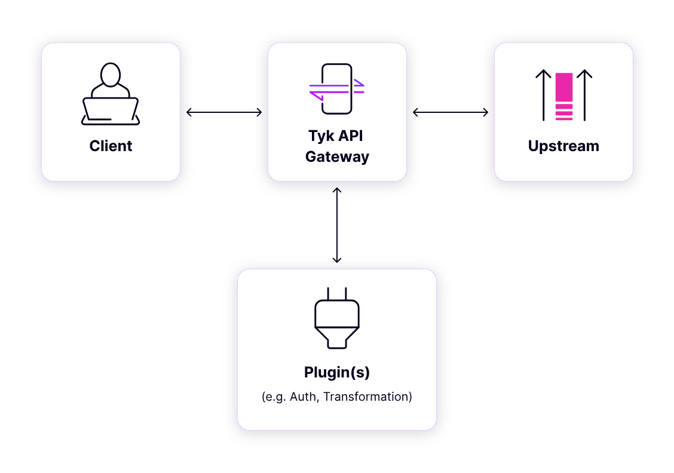
How it works
The client sends request to API on Tyk Gateway.
Tyk processes the request and forwards it to one or more plugins implemented and configured for that API.
A plugin performs operations (e.g., custom authentication, data transformation).
The processed request is then returned to Tyk Gateway, which forwards it upstream.
Finally, the upstream response is sent back to the client.
Notes:
"Let’s take a look at how a typical request flows through the Tyk Gateway and how plugins come into play to process the request."
Step-by-Step Explanation:
Step 1: The Client Sends a Request
"The process starts with a client sending an HTTP request to an API managed by the Tyk Gateway."
"This could be any type of client—an application, a web browser, or even a mobile app."
Step 2: Tyk Gateway Processes the Request
"The Tyk Gateway acts as the entry point for all incoming requests."
"It first evaluates the API request and checks for any configurations applied to that API, like authentication, rate limiting, or access policies."
Step 3: Plugins Execution
"Once the request reaches the gateway, any configured custom plugins are executed."
"Plugins can perform tasks such as:"
Custom Authentication: Validate tokens or credentials.
Data Transformation: Modify request payloads or headers.
Rate Limiting Enforcement: Check if a request exceeds the rate limits."
"Plugins are essential for extending Tyk's capabilities with custom logic tailored to your needs."
Step 4: Forwarding to Upstream Services
"Once the plugins have processed the request, Tyk forwards the modified request to the upstream service or backend API."
"At this point, the request is fully ready and contains any transformations or additional checks performed by the plugins."
Step 5: Response Back to the Client
"The upstream service processes the request and returns a response to the Tyk Gateway."
"Tyk Gateway forwards the upstream response back to the client, completing the request-response cycle."
Key Takeaway:
"Tyk acts as a smart intermediary, not just forwarding requests but also performing critical operations using plugins."
"This modular approach ensures that you can handle complex use cases like authentication, rate limiting, and data manipulation if needed

Slide 7
Plugin Deployment Options in Tyk
Local Plugins
The plugin source code and configuration are stored locally on the same file system as the Tyk Gateway.
Configuration is specified within the API Definition.
Plugin Bundles (Remote)
Plugin source code and configuration are bundled into a zip file and uploaded to a remote web server.
Tyk Gateway downloads, extracts, caches, and executes these plugins for the configured phases of the API lifecycle.
gRPC Plugins (Remote)
Custom plugins are hosted on a remote server and executed via gRPC.
Tyk Gateway sends requests to the gRPC server, allowing plugins to run at specific points during the API request/response lifecycle, using any preferred programming language.
Notes:
Introduction:
"Tyk provides flexibility with a few deployment options: Local Plugins, Plugin Bundles, and gRPC Plugins."
1. Local Plugins
"Local Plugins are the simplest option."
"Here, the plugin source code and its configuration are stored directly on the same file system as the Tyk Gateway."
"Configuration is defined within the API Definition, and the plugins execute locally."
"This is ideal for environments where the gateway and plugins reside on the same machine."
2. Plugin Bundles (Remote)
"In the second option, Plugin Bundles allow you to bundle your plugin source code and configuration into a zip file."
"These bundles are then uploaded to a remote web server."
"The Tyk Gateway will download, extract, cache, and execute these plugins as part of the API lifecycle."
"This approach works well for distributed systems or when plugins are frequently updated."
Example Use Case:
"For production setups where plugins are managed centrally and shared across multiple Tyk Gateways."
3. gRPC Plugins (Remote)
"Lastly, Tyk supports gRPC-based remote plugins."
"With gRPC Plugins, your custom plugins are hosted on a remote server and executed via gRPC."
"The Tyk Gateway sends requests to the gRPC server during specific points in the API request/response lifecycle."
"This allows you to use any programming language to develop your plugins, not just Go or JavaScript."
Example Use Case:
"For enterprises that need high performance, remote plugin execution, or use other languages
Key Takeaways:
"To summarize, Local Plugins are simple and fast but tied to the Gateway's file system."
"Plugin Bundles offer central management for shared plugins across multiple gateways."
"gRPC Plugins provide the most flexibility with remote execution and multi-language support."

Slide 8
Local Plugins
Local Plugins
Pros:
Performance: Since the plugin code is stored locally, execution is fast with minimal latency.
Simplicity: Easy to configure and manage directly within Tyk Gateway.
No network dependencies: No need for external communication, making it ideal for environments without external connectivity.
Cons:
Limited scalability: Not suitable for large, distributed environments or for reusing plugins across multiple instances of Tyk Gateway.
Harder to manage updates: Every update requires manual changes on each Tyk instance.
Notes:
What are Local Plugins?
"Local Plugins are custom plugins where the source code is stored and executed directly on the Tyk Gateway."
"This approach ensures low latency and minimal dependencies."
Pros of Local Plugins:
Performance
"Because the plugin code is executed locally, the performance is high with minimal latency."
"This is ideal for real-time operations where speed matters."
Simplicity
"Local plugins are easy to configure and manage since everything resides within the Tyk Gateway."
No Network Dependencies
"You don’t need to worry about external communication or connectivity issues, making local plugins a good fit for isolated environments like on-prem setups."
Cons of Local Plugins:
Limited Scalability
"Local plugins don’t scale well in distributed environments or across multiple Tyk Gateway instances."
"If you need to reuse plugins across a fleet of gateways you will have to compile for each gateway that you are using
Harder to Manage Updates
"Every time you make an update to the plugin, you need to manually update it on each gateway."
"This can become time-consuming, especially as the infrastructure grows."
Summary:
"To summarize, Local Plugins are great for simplicity and performance, especially isolated environments."

Slide 9
Plugin Bundles
Plugin Bundles
Pros:
Reusability: Multiple plugins can be bundled together and reused across different APIs and Tyk Gateways.
Centralized management: Plugins can be centrally stored and updated on a remote server, making it easier to manage changes.
Flexible deployment: Suitable for large, distributed architectures where plugins need to be updated across multiple gateways.
Cons:
Network dependency: Tyk Gateway depends on the remote server, which may introduce latency or fail if the server is down.
Complexity: Configuration and deployment can be more complex compared to local plugins.
Notes:
Plugin Bundles allow you to bundle multiple plugins together and deploy them remotely."
"This makes it easy to reuse plugins across multiple APIs and Tyk Gateway instances."
Pros of Plugin Bundles:
Reusability
"You can package multiple plugins together into a single bundle and reuse them across different APIs and Gateways."
"For example, a plugin bundle for rate limiting and authentication can be shared across multiple environments."
Centralized Management
"Plugins are stored on a central remote server, making it easier to update and manage changes."
"Instead of updating each Tyk Gateway manually, you simply update the bundle on the server."
Flexible Deployment
"Plugin Bundles are ideal for large, distributed architectures."
"If you have multiple Gateways, they can download and execute plugins from the central bundle without requiring local storage."
Cons of Plugin Bundles:
Network Dependency
"The Tyk Gateway depends on a remote server to fetch the plugin bundle."
"If the server is down or experiences latency, the Gateway may be unable to execute the plugins."
Complexity
"Configuration and deployment of Plugin Bundles can be more complex compared to Local Plugins."
"It involves managing the bundle, uploading it to a remote server, and configuring the Gateways to fetch it."
Summary:
"In summary, Plugin Bundles are great for centralized management and large-scale deployments, but they require careful consideration for network availability and setup complexity."
"If you have a distributed environment and want to scale efficiently, Plugin Bundles are the way to go."

Slide 10
gRPC Plugins
gRPC Plugins (Remote)
Pros:
Language flexibility: You can write plugins in any gRPC-supported language, offering more flexibility for developers.
Scalability: Ideal for large-scale environments where plugins need to run across distributed systems.
Separation of concerns: Plugins are executed remotely, keeping the Tyk Gateway lightweight.
Cons:
Network latency: Involves remote execution, which can add network latency depending on the server’s location and load.
More complex setup: Requires additional infrastructure (e.g., a gRPC server) and more configuration.
Potential failures: Relies on external gRPC server availability, which could lead to service disruptions if the server fails.
Notes:
What are gRPC Plugins?
"gRPC Plugins allow you to write and run plugins on a remote server using the gRPC protocol."
"This approach decouples plugin execution from the Tyk Gateway, making it lightweight and scalable."
Pros of gRPC Plugins:
Language Flexibility
"You can write plugins in any gRPC-supported language, such as Python, Go, or Java."
"This flexibility gives developers the freedom to use their preferred programming language."
Scalability
"gRPC Plugins are ideal for large-scale deployments where plugins need to run across distributed systems."
"The remote execution model ensures efficient resource utilization and improved performance."
Separation of Concerns
"By executing plugins remotely, the Tyk Gateway remains lightweight and focused on its core tasks."
"The plugin logic resides on a dedicated server, simplifying the Gateway’s responsibilities."
Cons of gRPC Plugins:
Network Latency
"Since plugins are executed remotely, there can be additional latency depending on the server’s location and network load."
Complex Setup
"gRPC Plugins require additional infrastructure, such as a gRPC server."
"This means more configuration and management compared to Local Plugins."
Potential Failures
"If the external gRPC server goes down, the plugin execution will fail."
"This could lead to service disruptions if not properly managed with retries or failover strategies."
Example Use Case:
"Imagine you want to run a plugin written in Python for a custom data transformation. Instead of running the plugin locally, you can deploy it on a gRPC server and configure Tyk to call it remotely during the API request lifecycle."
Summary:
"In summary, gRPC Plugins are a fantastic choice for large-scale, distributed environments where you need language flexibility and separation of concerns."
"However, they do require careful planning around infrastructure, latency, and server availability."

Slide 11
Plugin Development Flow
Step 1: Initialize Go Module
Create a folder for your plugin.
Initialize Go modules - go mod init tyk-plugin
Step 2: Write the Plugin
Plugin structure:
A Go main package.
An exported function like AddFooBarHeader() for custom logic.
Step 3: Sync Dependencies
Run go mod tidy
Step 4: Build the Plugin
Build the Go plugin as a shared library (.so) using Tyk’s Docker image or Go commands.
docker run --rm -v `pwd`:/plugin-source \
tykio/tyk-plugin-compiler:v5.2.1 plugin.so
Notes:
Step 1: Initialize the Go Module
This is an example of a plugin dev flow using go plugins
"First, you need to set up your plugin’s workspace. Start by creating a folder for your plugin."
"Next, initialize Go modules
"This command prepares your workspace for dependency management."
Step 2: Write the Plugin
"The core of the plugin development lies in writing your custom logic."
Plugin Structure:
"The plugin must have a Go main package."
"Within the package, create an exported function. For example:" func AddFooBarHeader() {
// Custom logic here
}
"This function will contain the code you want the Tyk Gateway to execute, like modifying requests, responses, or performing authentication."
Step 3: Sync Dependencies
"After writing your plugin code, you need to ensure all dependencies are in sync."
"This will fetch and clean up all required dependencies for your plugin."
Step 4: Build the Plugin
"The final step is to build the Go plugin as a shared library (.so file), which can be used by the Tyk Gateway."
"You can do this in two ways:"
Using Docker:
"Use Tyk’s official plugin compiler Docker image
Using Go Build Commands:
"Alternatively, you can build the .so file directly using Go:" go build -buildmode=plugin -o plugin.so
"This process generates a plugin.so file, which Tyk will load as part of the plugin execution."
Summary:
"In summary, the plugin development flow involves initialization, writing custom logic, syncing dependencies, and building a shared library."

Slide 12
Deploying Plugins Tyk Classic Def
Step 1: Open Tyk Classic API Definition Editor
Select your API from the list of created APIs.
Click View Raw Definition to access the API Definition editor.
Step 2: Edit API Definition
In the editor, navigate to the custom_middleware section.
Configure the plugins by updating this section with the necessary plugin settings.
Step 3: Save Changes
Click Update to apply the changes to your Tyk Classic API Definition
"custom_middleware": {
"pre": [
{
"name": "myCustomPlugin",
"path": "/opt/tyk-gateway/plugins/plugin.so"
"driver": "otto/goplugin",
}
]
}
Notes:
Step 1: Open Tyk Classic API Definition Editor
"Start by navigating to the Tyk Dashboard and selecting the API you want to edit."
"Click on View Raw Definition to access the API Definition editor."
"This editor allows you to see and modify the entire API configuration in JSON format."
Step 2: Edit the API Definition
"Locate the custom_middleware section in the raw API Definition."
"Here, you’ll specify your plugin configuration by adding the following details:
The plugin path or shared library name.
Hook points where the plugin will be executed, such as Pre-request, Post-request, or Response hooks."
}
"In this configuration:
name refers to the plugin name.
path specifies the location of your shared plugin file."
Driver specifies which language you are using (mandatory)
Step 3: Save Changes
"Once you’ve updated the custom_middleware section, save your changes by clicking Update."
"Tyk will reload the API Definition and load the configured plugin. Make sure your Tyk Gateway has access to the plugin path or remote plugin server."
Key Notes to Remember:
"Double-check the file path or endpoint configuration to avoid deployment issues."
"Test your plugin by sending requests to the API and verifying the expected behavior."

Slide 13
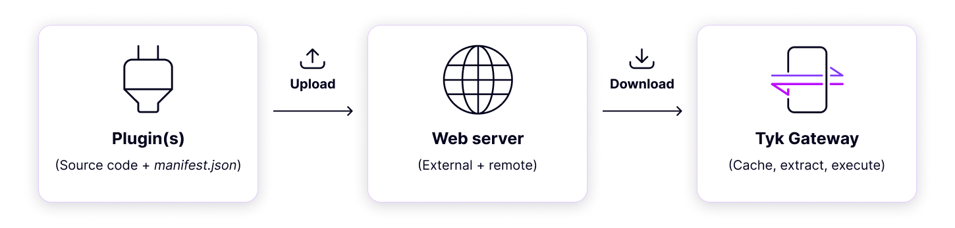
Bundling Plugins
Notes:
Introduction: "Let’s now discuss the process of bundling plugins in Tyk. Bundling is an efficient way to manage custom plugins by centralizing and distributing them across multiple Tyk Gateways."
Step 1: Plugin Creation
"First, you write the plugin source code and create a manifest.json file."
"The manifest.json file contains metadata about your plugin, such as the name, version, and entry points."
Example of manifest.json:
Step 2: Upload to Web Server
"Next, you upload the bundled plugin—source code and manifest file—to a web server. This can be an external file server"
"The server acts as a central repository where Tyk Gateways can fetch the plugin."
Step 3: Download and Execution in Tyk Gateway
"When a Tyk Gateway starts or reloads the API, it downloads the plugin bundle from the web server."
"Tyk then caches, extracts, and executes the plugin according to the configuration in the API definition."
"This allows the Gateway to efficiently use the plugin without repeatedly downloading it."
Key Benefits of Bundling Plugins:
Centralized Management – "Plugins can be updated in one location and distributed across all Gateways."
Scalability – "Suitable for distributed architectures where multiple Gateways need the same plugins."
Performance Optimization – "Tyk caches plugins locally, reducing network calls after the first download."

Slide 14
Bundling Plugins
How Plugin Bundles Work
ZIP contains source code + manifest file.
API definition references the plugin bundle name.
Tyk Gateway downloads, caches, extracts, and executes plugins from the bundle.
Bundle Caching
Plugin bundles are cached locally for efficiency.
Use unique filenames (e.g., version numbers) to update bundles.
Cache location: {TYK_ROOT}/{CONFIG_MIDDLEWARE_PATH}/bundles
Gateway Configuration
Add the following to tyk.conf:
"enable_bundle_downloader": true
"bundle_base_url": "http://my-bundle-server.com/bundles/"
"public_key_path": "/path/to/my/pubkey"
"enable_coprocess": true (for rich plugins)
Notes:
Introduction "Let's dive into how bundling plugins works in Tyk. Bundling plugins enables efficient management and execution of custom middleware across Tyk Gateways."
How Plugin Bundles Work
"A plugin bundle is a ZIP file that contains the source code and the manifest.json file."
"The API definition references the plugin bundle name to identify it."
"The Tyk Gateway takes care of downloading, caching, extracting, and executing the plugin from the bundle."
Bundle Caching
"For performance, Tyk caches plugin bundles locally."
"To ensure updates to a plugin bundle, you can use unique filenames, such as version numbers."
"The cached location is: {TYK_ROOT}/{CONFIG_MIDDLEWARE_PATH}/bundles."
Gateway Configuration
"To enable plugin bundles, you need to update the tyk.conf file with the following configurations:
Explanation:
enable_bundle_downloader: Enables the Tyk Gateway to download bundles from a specified URL.
bundle_base_url: The base URL where the plugin bundles are stored.
public_key_path: Path to the public key for verifying signed bundles.
enable_coprocess: Enables advanced plugin execution features, such as rich plugins.

Slide 15
Bundler CLI Tool
The Bundler tool is a CLI service, provided by the Gateway as part of its binary since v2.8
To create plugin bundles, you will need
Manifest.json
Pugin source code files
Certificate key(optional)
Use the following command to create a bundle:
$ tyk bundle build
The resulting file will contain all your specified files and a modified manifest.json with the checksum and signature (if required) applied, in ZIP format.
By default, Tyk will attempt to sign plugin bundles for improved security. If no private key is specified, the program will prompt for a confirmation. Use -y to override this
Notes:
What is the Bundler CLI Tool?
"The Bundler CLI Tool allows you to package all the components required for your plugin into a single ZIP bundle. This makes it easy to deploy plugins to Tyk Gateways."
What You Need to Create a Plugin Bundle
To successfully create a plugin bundle, you will need:
Manifest.json:
This file contains metadata and configuration for the plugin, including pre/post middleware logic, driver type, and file inclusion list.
Plugin Source Code Files:
These are the actual code files (e.g., .py for Python, .so for Go) that implement the plugin’s logic.
Certificate Key (Optional):
Certificates can be used to sign the bundle
How to Build a Bundle
Run the Command: "To create a plugin bundle, you can run the following command:" $ tyk bundle build
What Happens After?
"The resulting ZIP file will include:
All specified files (based on the manifest).
A modified manifest.json with the necessary checksum and signature fields added, if required."
Security Note:
"By default, Tyk will attempt to sign plugin bundles for security purposes.
If no private key is specified, you’ll be prompted for confirmation.
Why Use the Bundler CLI Tool?
"It simplifies the process of creating and deploying plugins by automating file inclusion, checksum generation, and signature validation.
It ensures the plugin is packaged securely and ready for execution by the Tyk Gateway."

Slide 16
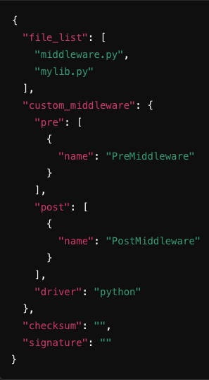
Bundles - Manifest Files
Contains critical configuration details for the plugin bundle.
Lists the source code files to be included.
Files not specified in the manifest will not be included, even if present in the directory.
Key Notes
custom_middleware block defines pre/post execution logic.
driver specifies the plugin language (e.g., Python).
checksum and signature are auto-filled during the build process.
Notes:
Introduction "Next, we’ll discuss the manifest files within plugin bundles and their importance in configuring plugins for Tyk."
What is a Manifest File?
"A manifest file is a critical configuration file for your plugin bundle."
"It defines which source code files are included in the bundle
"If a file isn’t listed in the manifest, it will be ignored, even if it’s present in the plugin directory."
Key Components of the Manifest File
file_list Block
"This block specifies the source files to include in the plugin bundle.
custom_middleware Block
"This block allows you to define pre and post execution middleware. For instance: "custom_middleware": {
"pre": [ { "name": "PreMiddleware" } ],
"post": [ { "name": "PostMiddleware" } ]
}
The pre block runs before the request is proxied to the upstream.
The post block runs after receiving a response from the upstream."
driver Field
"The driver specifies the programming language used for the plugin.
checksum and signature Fields are usually autofilled during the build process
"These fields ensure the integrity of the plugin bundle:
checksum: Automatically generated during the build process to validate the content.
signature: Provides an additional layer of security to confirm the bundle is trusted."
Why is the Manifest File Important?
"The manifest file ensures that:
Only the required source files are included in the bundle.
Execution behavior (pre/post middleware) is explicitly defined.
The plugin bundle is secure and tamper-proof through checksums and signatures."

Slide 17
Javascript custom plugin
Step 1: Create a plugin within the gateway directory
injectCustomHeader.js
Step 2: Modify the API definition on the Dashboard
"pre": [
{
"disabled": false,
"name": "injectCustomHeader",
"path": "/opt/tyk-gateway/jsvm/injectCustomHeader.js",
"require_session": false,
"raw_body_only": false
}
Test via postman

Slide 18
JSVM Custom plugin /w Bundles
Step 1: Create 2 plugins within the gateway directory
injectCustomHeader.js
tracingHeader.js
Step 2: Create a manifest.json file and place define both plugins in json file
Step 3: Use tyk bundler CLI to create a bundle and serve it to the web server
Step 4: Ensure you have a web server up and running
Step 5: Update the API definition to receive plugins via the bundle
"custom_middleware_bundle": "bundle.zip",
Step 6: Test via postman

