Slide 1


Tyk Onboarding
Sr. Customer Solutions Architect

Slide 2

Module 2
Single Sign-On

Slide 3
Single Sign-On
Authenticate once, access multiple apps without re-entering credentials.
Benefits:
Centralized identity management
Consistent access policies
Reduced password fatigue
Faster onboarding/offboarding
Protocols:
OpenID Connect (OIDC)
OAuth 2.0
SAML 2.0
LDAP/Active Directory
Notes:
“Single Sign-On, or SSO, means you log in once and get access to all your apps without re-entering credentials.
The benefits are clear:
Centralized identity management, so access is controlled in one place.
Consistent policies across every app.
Less password fatigue for users.
And faster onboarding or offboarding.
Behind the scenes, SSO relies on open standards like OIDC, OAuth 2.0, SAML 2.0, and integration with LDAP or Active Directory.
In short: SSO improves security, simplifies user experience, and saves IT time.”

Slide 4
Tyk Identity Broker
TIB bridges your Identity Management Systems with Tyk Dashboard, Portal & Gateway
Middleware between Identity Providers (IdPs) and Tyk
Key Use Cases:
SSO for Dashboard or Portal
Social logins (Google, GitHub, etc.)
LDAP/AD for internal teams
Token generation for mobile/web apps
Built-in since Tyk v3.0
Two Modes:
Internal TIB: embedded in Dashboard
External TIB: standalone service
Notes:
“Tyk Identity Broker, or TIB, is the bridge between your identity management systems and the Tyk Dashboard, Portal, and Gateway.
Think of it as middleware — it sits between your Identity Providers, like Google, GitHub, or Active Directory, and Tyk.
The key use cases are:
Single Sign-On for the Dashboard or Developer Portal,
Social logins using providers like Google or GitHub,
LDAP or Active Directory for internal teams,
And even token generation for mobile and web apps.
Since version 3.0, TIB has been built right into Tyk. You can run it in two modes:
Internal TIB, embedded directly in the Dashboard,
Or External TIB, as a standalone service for more complex setups.
In short, TIB gives you the flexibility to plug in any identity system you need while keeping Tyk secure and user-friendly.”

Slide 5
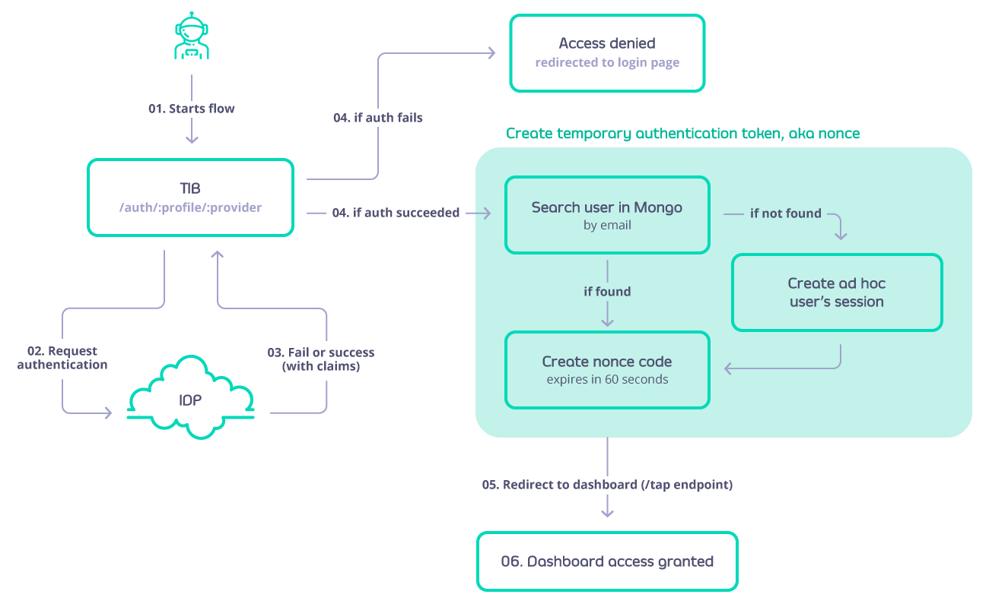
SSO Flow
User initiates login via SSO endpoint.
TIB redirects to IDP for authentication.
Keycloak validates user and returns ID token.
TIB verifies token and searches in database for user
If found, nonce code created
If not found, ad hoc user session is created
Redirects to Dashboard
Notes:
The user starts by hitting the SSO login endpoint.
TIB redirects them to the Identity Provider
The IDP handles the authentication and returns an ID token.
TIB verifies that token, then checks the database for the user.
If the user exists, TIB creates a nonce code.
If not, it creates an ad hoc session on the fly.
Finally, the user is seamlessly redirected into the Tyk Dashboard.
So from the user’s perspective, it’s just one clean login. Behind the scenes, TIB is doing the heavy lifting to connect Keycloak and Tyk securely.”

Slide 6
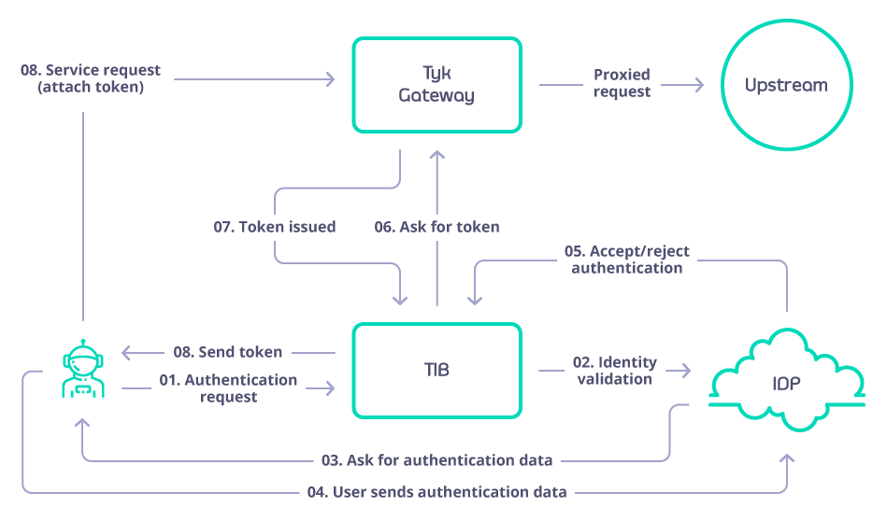
Authentication Flow
User initiates authentication via TIB
TIB validates identity via IDP
IDP requests for authentication data from the client
TIB receives accepted or rejected response from IDP
TIB requests for token from Tyk Gateway
Returns token to client
Client can now make a request to the Gateway
Notes:
When enterprises adopt GraphQL, they quickly realize that centralizing everything into a single GraphQL service doesn’t scale well—it becomes hard to manage, and teams step on each other’s toes.
GraphQL Federation addresses this by enabling multiple services to define parts of the graph independently.
With Tyk’s federation support, you can stitch these services into a unified API surface—making it easier for teams to work independently while offering a seamless experience to API consumers.

Slide 7
TIB Architecture
Request Flow:
User attempts login
TIB matches request to a Profile
Profile invokes:
Identity Provider → validates identity
Identity Handler → maps to Tyk (Dashboard, Portal, OAuth)
Notes:
When enterprises adopt GraphQL, they quickly realize that centralizing everything into a single GraphQL service doesn’t scale well—it becomes hard to manage, and teams step on each other’s toes.
GraphQL Federation addresses this by enabling multiple services to define parts of the graph independently.
With Tyk’s federation support, you can stitch these services into a unified API surface—making it easier for teams to work independently while offering a seamless experience to API consumers.

Slide 8
Identity Providers
Social: Google, GitHub, Twitter, Bitbucket, etc.
LDAP: Validate username/password against LDAP server
Proxy: Forward to external service, validate by status/response
SAML: Authenticate against enterprise SAML IdP
Notes:
When enterprises adopt GraphQL, they quickly realize that centralizing everything into a single GraphQL service doesn’t scale well—it becomes hard to manage, and teams step on each other’s toes.
GraphQL Federation addresses this by enabling multiple services to define parts of the graph independently.
With Tyk’s federation support, you can stitch these services into a unified API surface—making it easier for teams to work independently while offering a seamless experience to API consumers.

Slide 9
Identity Handlers
GenerateOrLoginUserProfile → Dashboard SSO
GenerateOrLoginDeveloperProfile → Portal SSO
GenerateOAuthTokenForClient → Issue Tyk OAuth token
Notes:
When enterprises adopt GraphQL, they quickly realize that centralizing everything into a single GraphQL service doesn’t scale well—it becomes hard to manage, and teams step on each other’s toes.
GraphQL Federation addresses this by enabling multiple services to define parts of the graph independently.
With Tyk’s federation support, you can stitch these services into a unified API surface—making it easier for teams to work independently while offering a seamless experience to API consumers.

Slide 10
Profiles
Profiles define how a Provider + Handler + Action fit together
Stored in MongoDB or file depending on setup
Dashboard UI simplifies management
Example: Azure AD (OIDC) → TIB → Dashboard SSO
Notes:
When enterprises adopt GraphQL, they quickly realize that centralizing everything into a single GraphQL service doesn’t scale well—it becomes hard to manage, and teams step on each other’s toes.
GraphQL Federation addresses this by enabling multiple services to define parts of the graph independently.
With Tyk’s federation support, you can stitch these services into a unified API surface—making it easier for teams to work independently while offering a seamless experience to API consumers.

Slide 11
Anatomy of a Profile
Core Fields: ID, OrgID, ActionType, Type, ReturnURL
Optional Fields: Group mappings, email claims, user ID claims
Security: Restrict SSO to registered users
Example JSON profile snippet shown in workshop
Notes:
When enterprises adopt GraphQL, they quickly realize that centralizing everything into a single GraphQL service doesn’t scale well—it becomes hard to manage, and teams step on each other’s toes.
GraphQL Federation addresses this by enabling multiple services to define parts of the graph independently.
With Tyk’s federation support, you can stitch these services into a unified API surface—making it easier for teams to work independently while offering a seamless experience to API consumers.

Slide 12
Provider-Specific Fields
LDAP: server, port, DN, filters, attributes
Proxy: target host, OKCode/Response/Regex, token field
Social: callback URLs, provider keys/secrets, scopes
SAML: metadata URL, certs, entity ID, redirect URLs
Notes:
When enterprises adopt GraphQL, they quickly realize that centralizing everything into a single GraphQL service doesn’t scale well—it becomes hard to manage, and teams step on each other’s toes.
GraphQL Federation addresses this by enabling multiple services to define parts of the graph independently.
With Tyk’s federation support, you can stitch these services into a unified API surface—making it easier for teams to work independently while offering a seamless experience to API consumers.

Slide 13
{
"ActionType": "GenerateOAuthTokenForClient",
"ID": "keycloak-profile",
"OrgID": "ORG_ID",
"IdentityHandlerConfig": {
"DashboardCredential": "DASHBOARD_ADMIN_API_KEY",
"PolicyID": "POLICY_ID"
},
"IdentityProvider": {
"Name": "OpenIDConnect",
"OpenIDConnectConfig": {
"ClientID": "tyk-tib",
"ClientSecret": "SECRET",
"CallbackBaseURL": "http://<TIB_HOST>:3010/auth/keycloak-profile/openid-connect/callback",
"IssuerURL": "http://<KEYCLOAK_HOST>/realms/TykSSO"
}
}
}
ID – Profile name
OrgID – Tyk Organization ID
ActionType – Action to perform (e.g., GenerateOAuthTokenForClient)
IdentityHandlerConfig – Policy, API, Dashboard mapping
IdentityProvider – IdP type & configuration
Notes:
When enterprises adopt GraphQL, they quickly realize that centralizing everything into a single GraphQL service doesn’t scale well—it becomes hard to manage, and teams step on each other’s toes.
GraphQL Federation addresses this by enabling multiple services to define parts of the graph independently.
With Tyk’s federation support, you can stitch these services into a unified API surface—making it easier for teams to work independently while offering a seamless experience to API consumers.

Slide 14
Hands-On Workshop

Slide 15
Hands-On Workshop
# Add Bitnami Helm repository
helm repo add bitnami https://charts.bitnami.com/bitnami
helm repo update
# Install Keycloak with Helm
helm install keycloak bitnami/keycloak \
--namespace keycloak \
--create-namespace \
--set auth.adminUser=admin \
--set auth.adminPassword=admin \
--set service.type=NodePort \
--set service.nodePorts.http=30082 \
--set service.nodePorts.https=30083
Notes:
When enterprises adopt GraphQL, they quickly realize that centralizing everything into a single GraphQL service doesn’t scale well—it becomes hard to manage, and teams step on each other’s toes.
GraphQL Federation addresses this by enabling multiple services to define parts of the graph independently.
With Tyk’s federation support, you can stitch these services into a unified API surface—making it easier for teams to work independently while offering a seamless experience to API consumers.

Slide 16
Hands-On Workshop
In your desired Realm, create a client of OpenID Connect type, and set your desired Client ID.
Enable client authentication, then save the client.
Retrieve the Secret (from the credentials tab) of the Client you just created.
Retrieve the well known endpoint of the realm.
Accessible from “Realm Settings” > “General” Tab > OpenID Endpoint Configuration.
Notes:
When enterprises adopt GraphQL, they quickly realize that centralizing everything into a single GraphQL service doesn’t scale well—it becomes hard to manage, and teams step on each other’s toes.
GraphQL Federation addresses this by enabling multiple services to define parts of the graph independently.
With Tyk’s federation support, you can stitch these services into a unified API surface—making it easier for teams to work independently while offering a seamless experience to API consumers.

Slide 17
Hands-On Workshop
Log in to your Dashboard and select Identity Management, located under System Management.
Create a profile, give it a name and select “Login to Tyk Dashboard”.
Set the provider type as “OpenID Connect”.
Fill in the Client ID, Client Secret and Discovery URL/endpoint from Keycloak.
Copy the callback URL from Tyk and then you can click “Create Profile” to save the profile.
Go to Keycloak, and paste the callback URL you just copied to “Valid redirect URIs” in the Keycloak Client, and then save the client.
This can be accessed by selecting the “Settings” tab when viewing a Keycloak client.
Save the profile.
Notes:
When enterprises adopt GraphQL, they quickly realize that centralizing everything into a single GraphQL service doesn’t scale well—it becomes hard to manage, and teams step on each other’s toes.
GraphQL Federation addresses this by enabling multiple services to define parts of the graph independently.
With Tyk’s federation support, you can stitch these services into a unified API surface—making it easier for teams to work independently while offering a seamless experience to API consumers.

Slide 18
Hands-On Workshop
From your Identity Management Profiles click the profile you created to open it.
Copy the Login URL and paste it into a browser tab.
You will now see the Keycloak login form.
Enter the email address and password of your Keycloak user.
You should now be redirected to the Tyk Dashboard and logged in.
Notes:
When enterprises adopt GraphQL, they quickly realize that centralizing everything into a single GraphQL service doesn’t scale well—it becomes hard to manage, and teams step on each other’s toes.
GraphQL Federation addresses this by enabling multiple services to define parts of the graph independently.
With Tyk’s federation support, you can stitch these services into a unified API surface—making it easier for teams to work independently while offering a seamless experience to API consumers.

