Slide 1


Tyk Architect Certification
Certification Preparation Course

Slide 2
Tyk Deployment Models

Slide 3
Tyk Deployment Models
On-premise
Tyk solution hosted on customer’s infrastructure
Cloud
Tyk solution hosted on Tyk’s infrastructure
Hybrid Cloud
Tyk solution hosting split between Tyk and customer infrastructure
Hybrid On-Premise
Tyk solution hosted on customer infrastructure spanning multiple data centers and/or regions

Slide 4
Tyk Deployment Models: On-Premise
Entire solution hosted on customer’s infrastructure
Full control over how Tyk is deployed and maintained
Fully customizable developer portal
Architecture limited to single data center
Install Options
Platforms: Docker, Kubernetes, OpenShift
OS Support: RHEL/Centos, Debian/Ubuntu, Amazon Linux
Cloud Host(s): Amazon AWS, GCP, Microsoft Azure, Heroku

Slide 5
Tyk Deployment Models: On-Premise Architecture
API OWNER INFRASTRUCTURE
Pump
MongoDB
Redis
API Developer
Portal
Dashboard
API Consumer
Gateway
API Owner
Upstream Endpoints

Slide 6
Tyk Deployment Models: Cloud
Solution hosted within Tyk infrastructure
SaaS product, no installation required
Single tenant, cloud infrastructure not shared with other clients
Customer can choose which AWS region(s) to host solution
Regions: Singapore (ap-southeast-1), Frankfurt (eu-central-1), London (eu-west-2), N. Virginia (us-east-1), and Oregon (us-west-2)
Dashboard and Gateway(s) can be deployed to different regions

Slide 7
Tyk Deployment Models: Cloud Architecture
TYK INFRASTRUCTURE
AUTO SCALING
Pump
MongoDB Replica Set
Portal
API Developer
Redis Cluster
Dashboard
API Owner
AUTO SCALING
API OWNER INFRASTRUCTURE
API Consumer
Load Balancer
Gateway
Upstream Endpoints

Slide 8
Tyk Deployment Models: Hybrid Cloud
Hosting split between Tyk and customer’s infrastructure
Tyk Hosts: Dashboard, Portal, MongoDB, and the primary Redis instance
Customer Hosts: Gateways and local Redis instance(s)
Allows customers to put their gateways in closer proximity to their upstream endpoints
Gateways an local Redis instance(s) is/are ephemeral so these can be spun up and down without worry about the loss of data, as all data is persisted on the primary Redis instance
All API traffic is routed via client’s infrastructure, no API traffic passes through Tyk’s network
Requires the Multi Data Centre Bridge component

Slide 9
Tyk Deployment Models: Hybrid Cloud Architecture
API OWNER INFRASTRUCTURE
TYK INFRASTRUCTURE
Redis Secondary
MongoDB
Portal
API Developer
API Consumer
Gateway
MDCB
Dashboard
API Owner
Upstream Endpoints
Redis Primary
Gateway
Notes:
All API traffic is routed through client’s infrastructure
Only Tyk specific data (API configurations, Policy Defs, Rate Limits, Analytics) is transferred between Gateway instance that sits in the Tyk infrastructure is only used by the Dashboard for key generation, it does not proxy any API traffic MDCB and Hybrid clients, instead of writing data to a temporary Redis list, sends it directly to the MDCB server, which processes them similar to Pump

Slide 10
Tyk Deployment Models: On-Premise
Solution hosted entirely on client’s infrastructure with no reliance on Tyk Cloud
Clients responsible for hosting of master and slave clusters
Can span multiple data centers and work across multiple regions
Requires the Multi Data Centre Bridge component

Slide 11
Tyk Deployment Models: On-Premise Architecture
API OWNER INFRASTRUCTURE
DATA CENTER 1
MASTER DATA CENTER
DATA CENTER 2
DATA CENTER N
MongoDB
API Developer
Redis Secondary
Portal
API Consumer
Gateway
MDCB
Dashboard
API Owner
Upstream Endpoints
Redis Primary
Gateway

Slide 12
Software Architectures

Slide 13
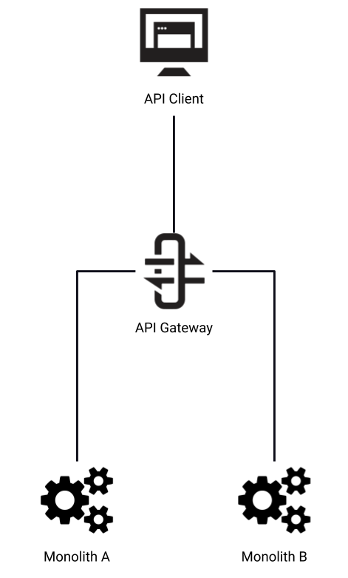
Software Architectures: Monolith
Monoliths are self-contained systems
API Gateway enables communication between consumers and monolithic applications
Transformation of protocols and data
Integration with legacy applications
Notes:
Monoliths contain all of their functionality within a single, self-contained application.
Since monoliths are single applications, they typically do not have any requirements for intra-service communication. However, they may need to communicate with other monoliths or, more commonly, have external systems communicate with them. In these scenarios, the API Gateway can provide the typical API Gateway functionality of authentication and authorisation.
In addition to this, for older monolithic applications which don’t support modern protocols or data formats, the Gateway can provide protocol and data transformation to make it easier to access and work with them.
The Gateway can also utilise custom middleware to provide a means of integrating with legacy applications, which would have otherwise operated within a silo.

Slide 14
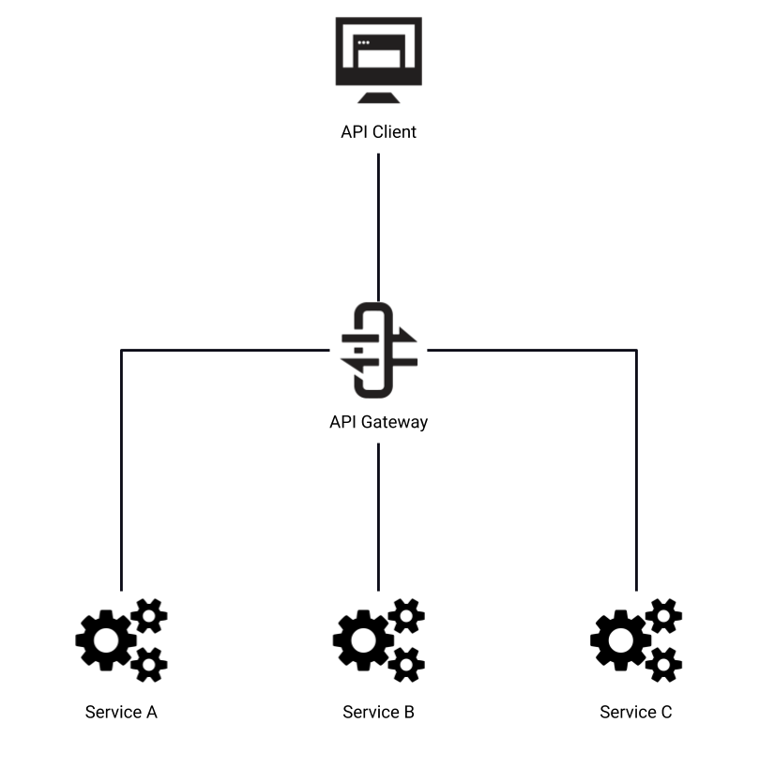
Software Architectures: Service Oriented Architecture
Services are discrete units of functionality
Centralised Gateway manages all traffic between consumers and services
Gateway implements common controls, such as authentication, authorisation, rate limiting and quotas
Service Discovery used to locate services
Notes:
The next step from monoliths are service oriented architectures (or SOA). This technique breaks applications into separate services, which perform discrete units of functionality. These units are designed to be accessed remotely, creating interconnected systems and services which are dependant on each other.
In this scenario the Gateway manages traffic between both consumers and the services themselves.
Since SOA promotes an increased number of applications communicating over the network, there is greater benefit in implementing common functionality at the API Gateway level, such as authentication, authorisation, rate limiting and quotas.
The Gateway can use Service Discovery to automatically adapt to changes in the services to which it is proxying.

Slide 15
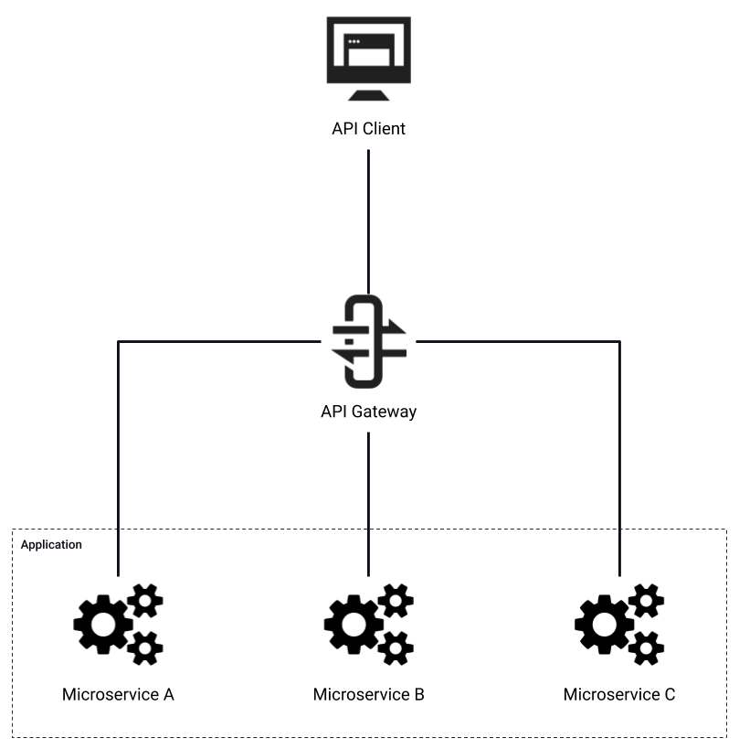
Software Architectures: Microservices
Architecturally similar to SOA, but services are decomposed to a smaller scope
Higher interconnectivity between systems
Benefits for Microservice architectures:
Distributed tracing
Centralised logging
Centralised analytics
Access control
Notes:
Microservices are a variant of the SOA approach, but the services have a smaller scope, with lightweight protocols and data formats. A single application may contain tens, hundreds or thousands of individual services.
This results in higher interconnectivity between systems and reliance on the network.
The increased number of systems and connections can present problems, which the API Gateway can solve:
Tracing of traffic between services
Centralised application logging
Centralised usage analytics
Access control between services

Slide 16
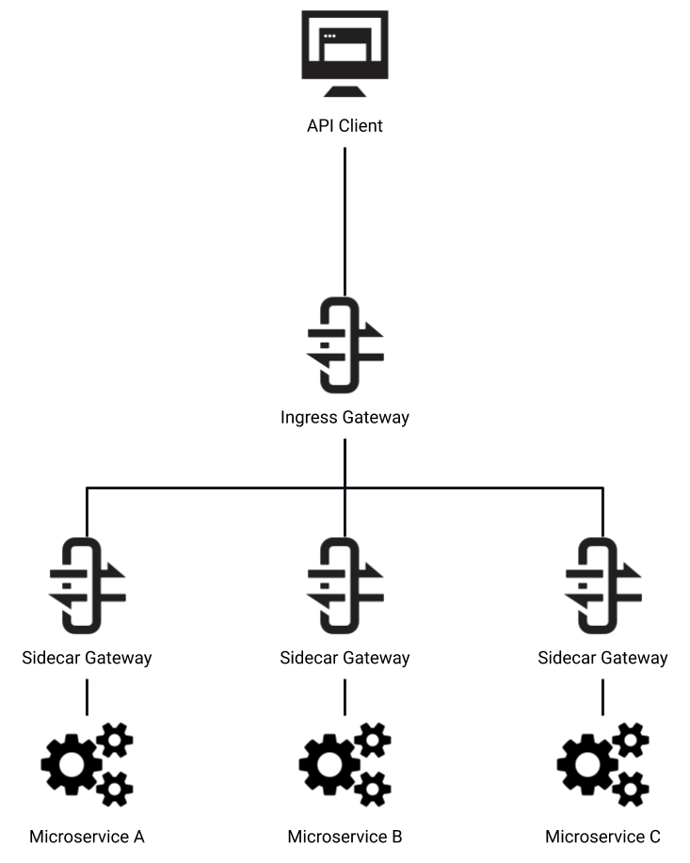
Software Architectures: Service Mesh
Services are paired with Sidecar Gateways
Deployed within the same container
Controlled by 3rd party tooling, such as Istio
Ingress Gateway controlled by Tyk
Benefits for Service Mesh architectures:
Automation of traffic flows
Centralised policy enforcement and monitoring
Notes:
Service mesh is a variant of the microservices approach. It adds additional Gateways, called Sidecar Gateways, which are paired with Services.
This approach is often deployed with container orchestration and service mesh tooling, such as Kubernetes and Istio, with the each Sidecar Gateway and Service pair deployed into the same container.
Tyk’s part of this architecture is as the Ingress Gateway, controlling access into the service mesh from external API Clients.
The benefit of a service mesh architecture is that it automates how traffic flows over the network. The Sidecar Gateways handle all the routing and authentication between services, so this information does not need to be included in the Service’s logic, making them simpler. The tooling around the service mesh also gives centralised policy enforcement and monitoring services, which are especially useful when dealing with large quantities of services.

