Slide 1


MDCB Analytics

Slide 2

Handling analytics data
Gateways record analytics in Redis when they are processing API traffic
Pump processes analytics data, and moves it to the target data stores:
MongoDB/PostgreSQL is the default data store for the Dashboard
Single data centre deployments use this approach:
Additional data stores can be targeted

Slide 3
01
MDCB Analytics
MDCB deployments have four approaches for handling analytics:
02
MDCB Direct
MDCB Direct
Control Plane Pump
Edge Pump
Edge Pump with Hybrid Forward
03
Control Plane Pump
04
Edge Pump
05
Edge Pump w/
Hybrid Forward

Slide 4
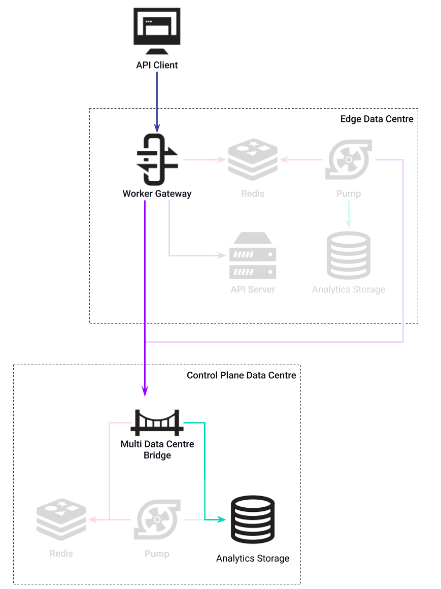
MDCB Direct
01
MDCB
Analytics
Original approach for handling MDCB analytics
Does not use Pump component
Gateway sends analytics data directly to MDCB, which processes and sends to Analytics Storage (MongoDB)
Simple, but lacks support for range of target data stores
02
MDCB Direct
03
Control Plane Pump
04
Edge Pump
05
Edge Pump w/
Hybrid Forward

Slide 5
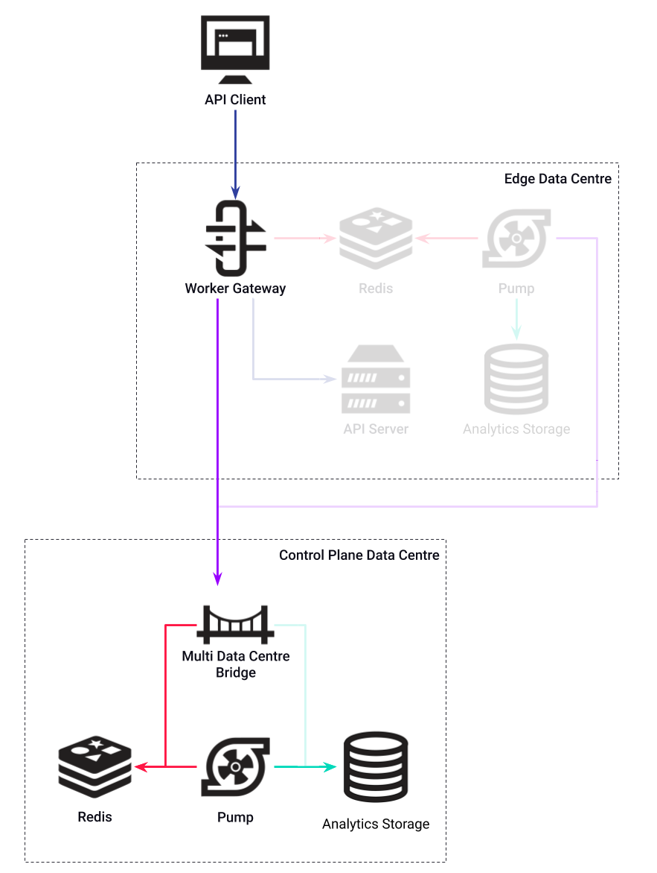
CP Pump
01
MDCB
Analytics
Reinstates the Pump into analytics workflow, improving storage options
MDCB writes data to Redis
Pump processes analytics data
Sends all analytics across internet
Set forward_analytics_to_pump to true in MDCB configuration file
02
MDCB Direct
03
Control Plane Pump
04
Edge Pump
05
Edge Pump w/
Hybrid Forward

Slide 6
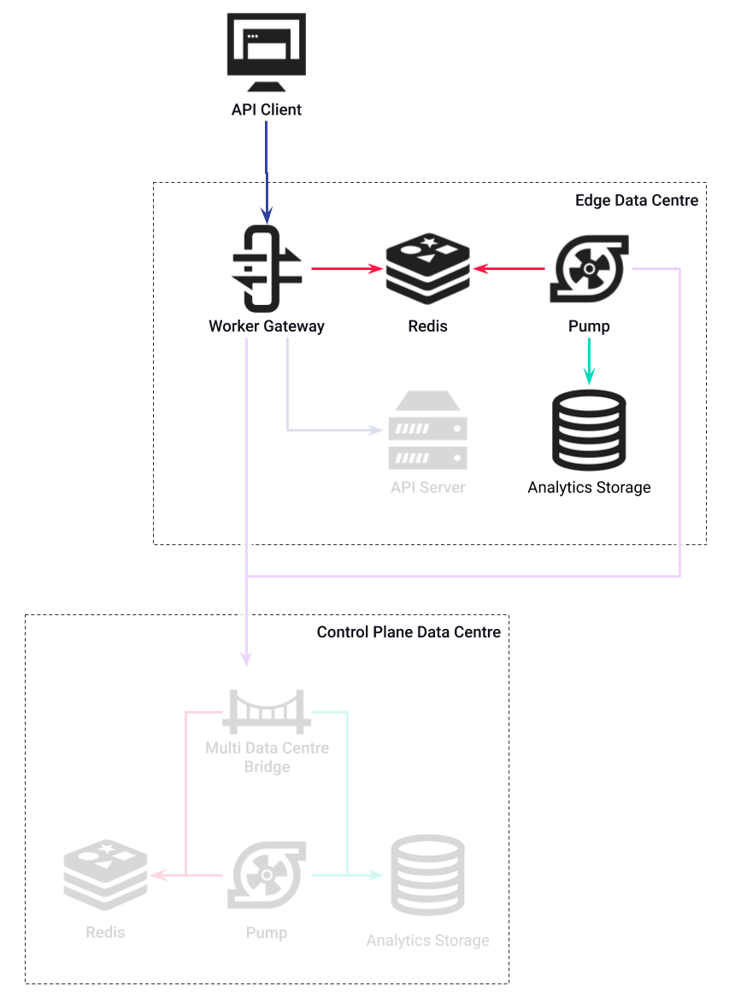
Edge Pump
01
MDCB
Analytics
Localises analytics processing in Edge data centres:
Avoids transferring data to Control Plane data centre
Reporting not possible from Dashboard
Operates in same way to single
data centre deployment:
Set analytics_config.type to empty string
02
MDCB Direct
03
Control Plane Pump
04
Edge Pump
05
Edge Pump w/
Hybrid Forward

Slide 7
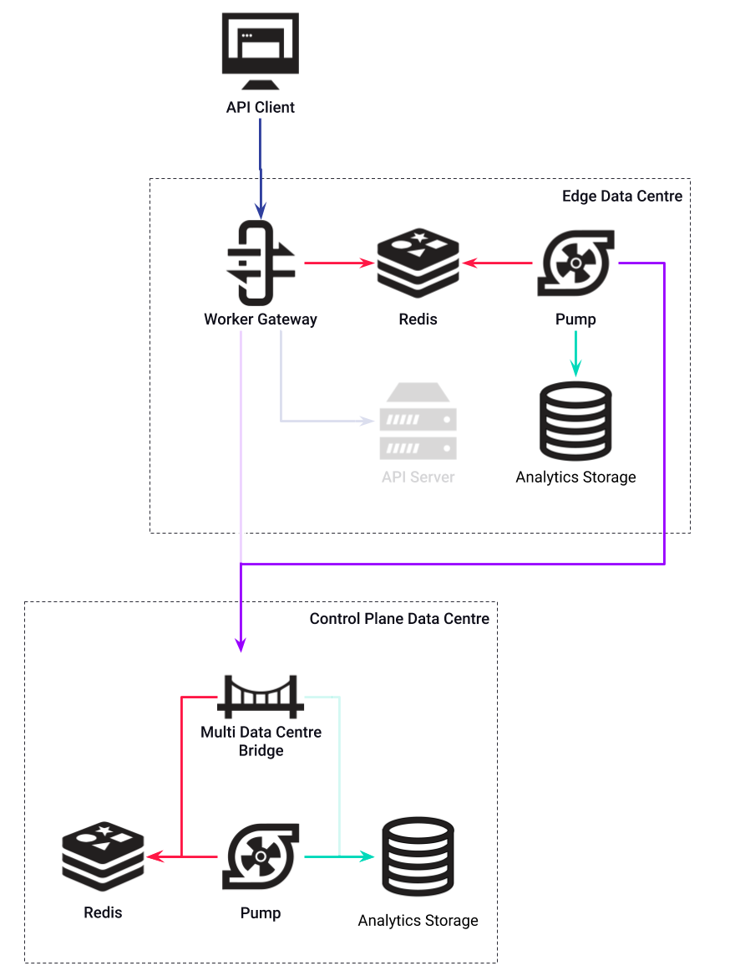
Edge Pump
Hybrid Forward
01
MDCB
Analytics
Edge Pump includes config for a hybrid type pump
Hybrid pump can be configured to send only aggregated analytics:
Set meta.aggregated to true in hybrid pump configuration
Allows non-aggregated analytics to be processed locally with aggregate analytics sent to Control Plane for Dashboard reports
02
MDCB Direct
03
Control Plane Pump
04
Edge Pump
05
Edge Pump w/
Hybrid Forward

