Slide 1

Module 4
DataSources

Slide 2
Connect Data Sources
Unified Data Graph (UDG) – Datasource Overview
Datasources power your UDG and its schema
Can be attached to any field in the UDG schema
Support nested configuration
Quick Start vs Full Control
You can add datasources directly to UDG without registering them as APIs in Tyk
For advanced features (rate limits, quotas, transformations), import the API into Tyk first
Supported Datasource Types:
REST
GraphQL
SOAP (via REST Datasource)
Kafka
Notes:
Unified Data Graph in Tyk relies on datasources — these are your backend systems that provide the actual data.
You can attach a datasource to any field in the UDG schema, and even nest them, enabling complex data compositions.
While you can add datasources quickly for testing or prototyping without creating a full Tyk API, this limits your access to key API management features.
For things like quotas, rate limiting, and transformations, we strongly recommend importing the backend API into Tyk first.
Tyk supports REST and GraphQL directly, SOAP via REST wrappers, and even Kafka for event-driven data access.

Slide 3
GraphQL Datasource Overview
Makes GraphQL queries to upstream GraphQL services
Configured similarly to REST Datasource
Handles query and response specifics automatically
Schema Example:
type Query {
employee(id: Int!): Employee
}
type Employee {
id: Int!
name: String!
}
Example Query:
query TykCEO {
employee(id: 1) {
id
name
}
}
Notes:
Tyk supports GraphQL Datasources which allow querying upstream GraphQL services. While the configuration is nearly identical to REST Datasources, there's a subtle but key difference in how GraphQL responses are handled, which we’ll explore next.
Let’s walk through a typical example. This schema and query target an employee by ID. The query asks for id and name fields.

Slide 4
GraphQL Datasource Overview
GraphQL Response Parsing
Actual Response:
{
"data": {
"employee": {
"id": 1,
"name": "Martin Buhr"
}
}
}
Tyk Extracts:
{
"employee": {
"id": 1,
"name": "Martin Buhr"
}
}
Notes:
Unlike REST, GraphQL wraps responses inside a data object. Tyk automatically unwraps this for you, simplifying field mapping.

Slide 5
GraphQL Datasource Overview
REST vs GraphQL
REST APIs do not wrap responses
GraphQL APIs wrap responses in root fields (like data, employee)
GraphQL field mapping is enabled by default
Why Use GraphQL Datasource?
Specification-compliant GraphQL requests
Supports nested REST & GraphQL APIs in a single schema
Query planner sends correct queries to upstreams
How the Query Planner Works
Checks if a field has a datasource
That datasource resolves the field and its children
If a nested field has its own datasource, ownership shifts
Notes:
One key takeaway: GraphQL responses include a wrapping field, while REST typically does not. Because of this, GraphQL field mapping is turned on by default.
Tyk’s GraphQL engine sends standard-compliant queries. You can mix multiple REST and GraphQL datasources—even nested—and Tyk will handle query composition and resolution automatically.
The query planner follows field ownership: when it hits a field with a datasource, it uses that datasource. If a nested field has its own, ownership shifts until it exits that field.

Slide 6
GraphQL Datasource Overview
Summary
Tyk supports full GraphQL Datasource configuration
Automatic unwrapping of data field
Query planner handles mixed datasources
Notes:
In summary, Tyk makes it simple to use GraphQL APIs as datasources, with support for automatic parsing, field-level attachments, and flexible query planning across services.

Slide 7
Kafka Datasource Overview
Enables subscribing to Kafka topics and querying events with GraphQL.
Integrates Kafka's powerful pub/sub model into your Universal Data Graph.
Operates based on Kafka’s consumer group mechanism.
Kafka Consumer Groups
A group of cooperating consumers that share processing load.
Kafka automatically manages membership and rebalances partitions.
Allows for horizontal scaling and fault tolerance.
Notes:
Kafka is a distributed messaging system used for building real-time data pipelines and streaming applications. In Tyk, we can treat Kafka as a data source in our Universal Data Graph. This means developers can subscribe to topics and access streamed data using GraphQL queries. This is incredibly powerful for use cases involving live data such as product updates, financial tickers, IoT data, or live metrics.
The Tyk Kafka DataSource is built on top of Kafka consumer groups. This is key, because it means it supports all Kafka features such as load balancing, fault tolerance, and scalability. When integrated into your schema, fields using Kafka can continuously stream updated data to any client that subscribes.
In Kafka, a consumer group consists of multiple consumers that coordinate to consume messages from a topic. Each partition in a topic is consumed by only one consumer in a group, ensuring messages are processed exactly once per group.
If we add more consumers than partitions, the extra consumers will remain idle. This model allows for dynamic scaling — consumers can be added or removed at runtime, and Kafka will rebalance automatically. Tyk leverages this model so multiple APIs or instances can share the workload for high-volume streams.

Slide 8
Kafka Datasource Overview
Basic Kafka Configuration
broker_addresses: Kafka broker hosts
topics: Kafka topics to subscribe to
group_id: Consumer group identifier
client_id: Optional identifier for logging and debugging
Notes:
To configure a Kafka DataSource in Tyk, the following fields are required:
broker_addresses: This is where your Kafka brokers live. It’s enough to supply just one broker; Kafka will discover the rest.
topics: These are the Kafka topics you want to subscribe to. All events must match the GraphQL schema.
group_id: This defines your consumer group. Multiple APIs can share this ID, which lets them cooperate on event processing.
client_id: This is a unique identifier for the client, used in Kafka logs and metrics to trace requests.
This configuration is part of the Tyk API Definition object, allowing this setup to be version-controlled and automated.

Slide 9
Kafka Datasource Overview
Configuring via Tyk Dashboard
Click the field to attach Kafka DataSource.
In Configure Data Source, choose KAFKA.
Provide:
Data source name
Broker addresses
Topics
Group ID
Client ID
(Optional) Kafka version, balance strategy, field mappings
Click Save.
Notes:
Tyk provides an intuitive UI to configure Kafka DataSources. Simply select a field in your schema and choose the Kafka data source type. You’ll be asked to input essential information like broker address and topic names.
Optional fields let you further customize how the consumer behaves. These settings allow for advanced balancing and mapping if your data structure is more complex. Once saved, you’ll see the data source type and name directly on the field, making schema maintenance easy.

Slide 10
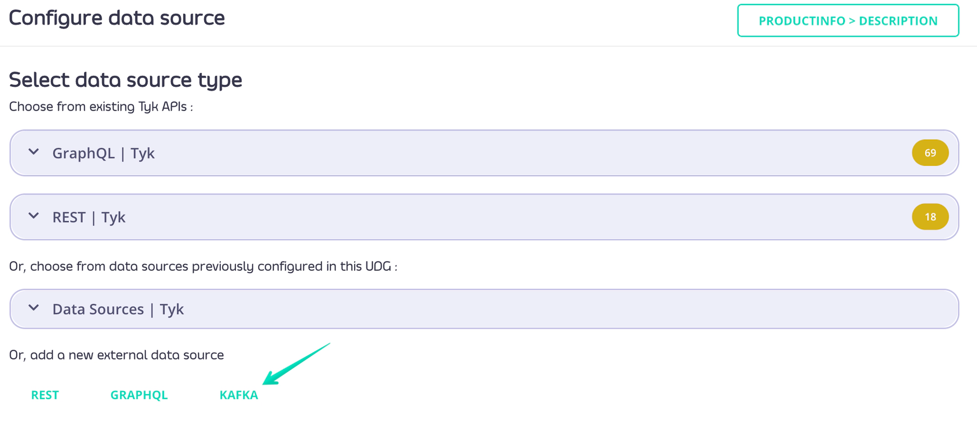
Kafka Datasource Overview
Notes:
Tyk provides an intuitive UI to configure Kafka DataSources. Simply select a field in your schema and choose the Kafka data source type. You’ll be asked to input essential information like broker address and topic names.
Optional fields let you further customize how the consumer behaves. These settings allow for advanced balancing and mapping if your data structure is more complex. Once saved, you’ll see the data source type and name directly on the field, making schema maintenance easy.

Slide 11
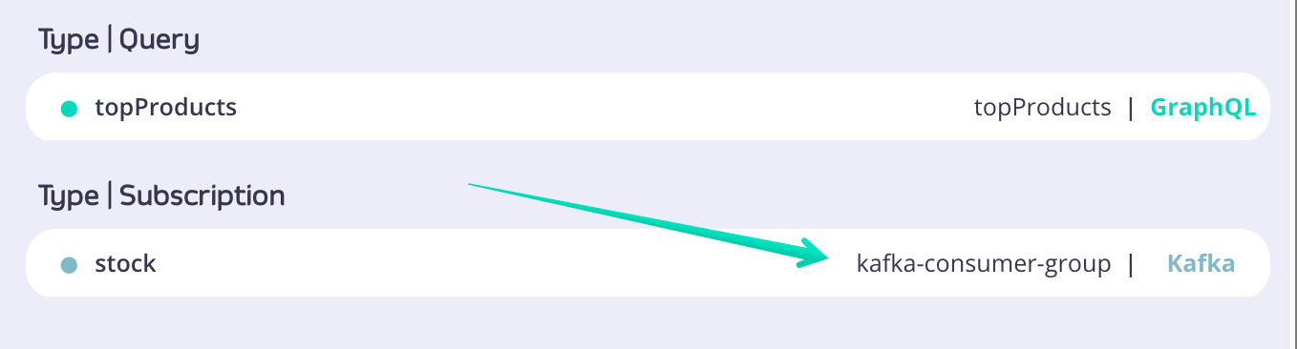
Kafka Datasource Overview
Once done the field you just configured will show information about data source type and name:
Notes:
Tyk provides an intuitive UI to configure Kafka DataSources. Simply select a field in your schema and choose the Kafka data source type. You’ll be asked to input essential information like broker address and topic names.
Optional fields let you further customize how the consumer behaves. These settings allow for advanced balancing and mapping if your data structure is more complex. Once saved, you’ll see the data source type and name directly on the field, making schema maintenance easy.

Slide 12
Kafka Datasource Overview
GraphQL Subscriptions with Kafka
Real-Time Subscriptions
Use GraphQL subscription queries to listen to Kafka events.
Define Subscription type in your schema:
type Product {
name: String
price: Int
inStock: Int
}
type Subscription {
productUpdated: Product
}
Subscribers will get real-time updates on every event.
Example Subscription Query
subscription Products {
productUpdated {
name
price
inStock
}
}
Automatically receives new product data when Kafka publishes an event.
Compatible with most GraphQL clients.
Notes:
GraphQL subscriptions are a powerful way to deliver real-time updates to clients. In Tyk, we can map Kafka topics to GraphQL subscription fields.
When an event is published to the topic, all subscribed clients will receive the update instantly. This is done using the standard GraphQL subscription query type. Clients can use any compliant GraphQL client or library to consume these updates — no need for custom protocols or vendor-specific solutions.
This allows real-time data streams to be cleanly integrated into your unified API architecture.
This is how simple it is to subscribe to Kafka-powered fields in Tyk. This GraphQL query on the right subscribes to the productUpdated field, which will be populated with data from the Kafka topic.
Whenever a new message comes through with product details, the client receives it immediately. This is ideal for use cases like e-commerce dashboards, live inventory trackers, or monitoring tools.
Developers can integrate this into frontend apps using tools like Apollo Client or urql.

Slide 13
Kafka Datasource Overview
Publishing Test Events
Simulating Kafka Events
Publish event to product-updates topic:
{
"productUpdated": {
"name": "product1",
"price": 1624,
"inStock": 219
}
}
Use any Kafka producer or GUI tool.
Useful for testing subscriptions and schema mappings.
Notes:
To test your setup, you can publish events manually to Kafka using tools like Kafka CLI, Postman + Kafka REST Proxy, or a Kafka GUI.
Here we’re sending a JSON message to the product-updates topic. When this happens, all GraphQL clients subscribed to productUpdated will receive the new product info instantly. This is a great way to validate your data mappings, consumer group configuration, and client subscriptions.
This enables full-cycle testing without needing a complete application stack.

Slide 14
Kafka Datasource Overview
Summary
Kafka DataSource in Tyk
Seamlessly integrates Kafka with GraphQL APIs.
Allows real-time streaming via GraphQL subscriptions.
Scalable via Kafka consumer groups.
Easy setup via Tyk Dashboard or API Definition.
Notes:
To wrap up: Tyk’s Kafka DataSource is a powerful way to bring live streaming data into your Universal Data Graph. It leverages Kafka’s proven scalability and fault-tolerance while giving developers a modern, flexible API layer using GraphQL.
It’s ideal for dynamic use cases — from IoT and supply chain systems to product catalogs and user behavior tracking. You can manage everything in one place — Tyk Gateway — and still keep your architecture loosely coupled and event-driven.
If you’re building anything real-time, Kafka with Tyk UDG is a compelling option.

Slide 15
REST Datasource Overview
REST DataSources connect REST APIs to your GraphQL schema
Enables field-level resolution via REST endpoints
Supported for both external APIs and Tyk-managed APIs
Notes:
REST DataSources act as connectors between your GraphQL schema and existing REST endpoints. Instead of rewriting your APIs, you attach a REST DataSource to a GraphQL field, allowing that field to be resolved via a REST call. These can be external APIs or APIs already managed in your Tyk Gateway.
If we add more consumers than partitions, the extra consumers will remain idle. This model allows for dynamic scaling — consumers can be added or removed at runtime, and Kafka will rebalance automatically. Tyk leverages this model so multiple APIs or instances can share the workload for high-volume streams.

Slide 16
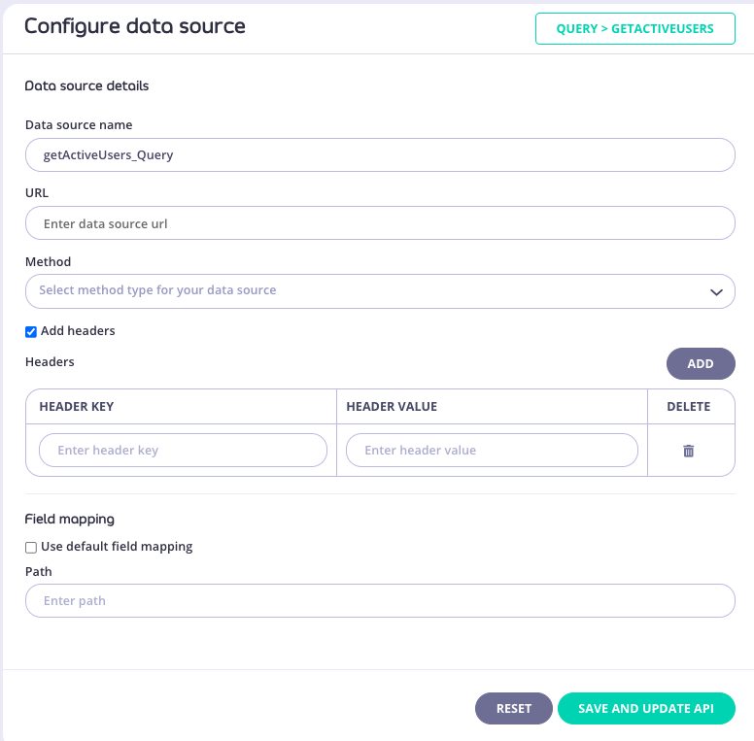
REST Datasource Overview
Select the field in your schema
Configure as External REST DataSource
Name
URL
Method (GET, POST, etc.)
Optional: Headers, Field Mapping
Notes:
To attach an external REST API to a GraphQL field, start by selecting the field in the schema editor. Use the right-side configuration panel to define your DataSource details. This includes naming it, entering the REST URL, HTTP method, and optionally setting request headers and field mapping to align the response with your schema.

Slide 17
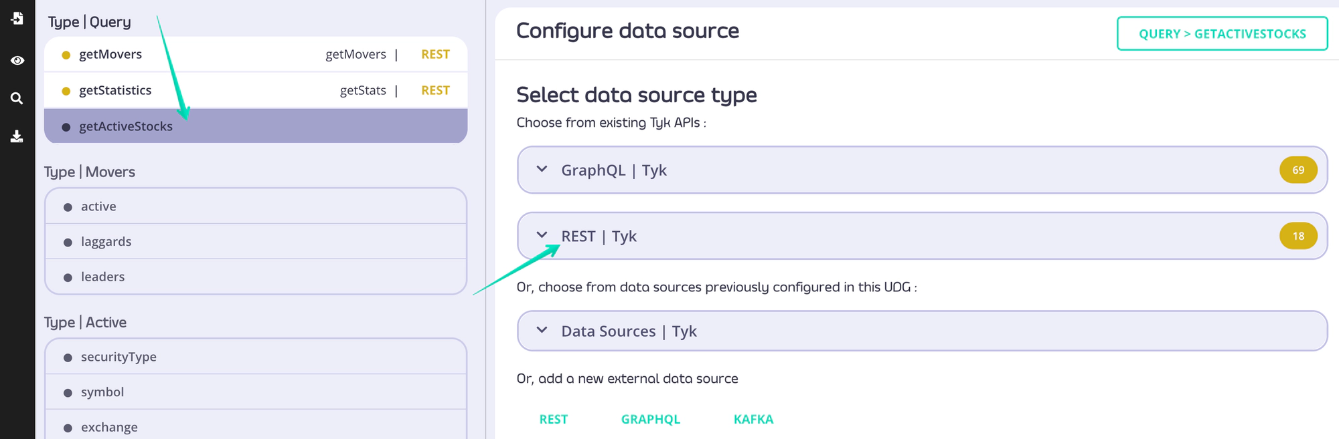
REST Datasource Overview
Attaching Tyk REST API
Select the field
Choose REST | Tyk from the dropdown
Pick from existing Tyk APIs
Provide endpoint and method
Optional headers and mapping
Save and Generate Resolver
Click "Save & Update API"
Resolver is auto-generated
GraphQL runtime will call the REST endpoint when the field is queried
Notes:
If your REST API is already managed by Tyk, the integration is even easier. Choose from the list of available Tyk APIs in the dropdown, then configure which endpoint and method to use. This method promotes reuse of existing API definitions and policies.
Once the DataSource configuration is complete, saving it will generate a resolver function under the hood. This resolver ensures that when your GraphQL field is queried, the corresponding REST call is made to retrieve the data dynamically.

Slide 18
REST Datasource Overview
Auto-generate REST DataSource via OAS
Use Tyk Dashboard API
Endpoint: POST /api/data-graphs/data-sources/import
Request Body:
{
"type": "string",
"data": "string"
}
type is an enum with the following possible values:
openapi
Asyncapi
To import an OAS specification you need to choose openapi
Notes:
To save time, Tyk allows you to auto-generate DataSource configurations from an OpenAPI (OAS) document. Just call the Dashboard API with the OAS content, and Tyk will generate and publish the corresponding GraphQL configuration. This is particularly useful for onboarding large REST APIs quickly.

Slide 19
REST Datasource Overview
Summary
REST DataSources make it easy to integrate legacy REST APIs
Both external and internal APIs are supported
Automatic configuration possible with OAS
Notes:
To wrap up, REST DataSources provide a powerful way to integrate legacy REST APIs into your modern GraphQL layer. You can attach them to any field, choose external or internal APIs, and even use OpenAPI specs to automate the setup. This enhances development agility while leveraging existing infrastructure.

