Slide 1

API Security with Tyk:
Request Quotas
Learn how request quotas in Tyk limit the total number of API calls a user or client can make over a defined time period (e.g., daily, monthly). This helps enforce usage plans, prevent abuse, and manage resource consumption fairly.

Slide 2
Quotas
A quota provides a limit of the number of requests an API client can make:
Similar to a rate limit, but over a longer term
Defined as a number of requests over a specific period of time, based on a selection of predefined durations:
1 hour, 6 hours, 12 hours, 24 hours, 1 week, 1 month, 6 months, 12 months
Once the quota is depleted, requests will be blocked
Notes:
Encapsulation of rules
Policies give you a way to encapsulate security and other access settings into a pre-defined entity.
Purpose is to make your life easier when managing lots of tokens.
The important thing to understand about policies is that a single policy can apply to many tokens, so having a few policies can let you manage very large numbers of tokens easily.
They allow you to define:
An access control list, which sets which APIs, versions, endpoints and methods the policy can access.
Rate limit
Quota
Dynamically attached
When a policy is saved on the Dashboard, it only takes around 10 seconds for it to take effect on the server.
Policies are attached to request sessions at the start of the Tyk processing pipeline, so updates are take effect immediately.
Partitioning
Once a policy is assigned to a token it will override the settings of that token.
However, with policy partitioning it is possible to override only a particular part of the token – the ACL, rate limit, or quota (or any combination of the three).
No effect on open APIs
Policies have no effect one APIs which have been configured to be open.
This is because the Tyk pipeline skips all authentication so does not process any tokens provided.

Slide 3
Quota Configuration
Quotas are configured on a Key or Policy via these properties:
quota_max is the amount of quota initially provided
quota_renewal_rate is used to calculate the epoch after which the quota can be reset to the maximum value
Policies can define separate quotas for each API they grant access to
A Key will track the quota state via these properties:
quota_remaining is the amount of quota remaining
quota_renews is the epoch after which the quota can be renewed
Notes:
Encapsulation of rules
Policies give you a way to encapsulate security and other access settings into a pre-defined entity.
Purpose is to make your life easier when managing lots of tokens.
The important thing to understand about policies is that a single policy can apply to many tokens, so having a few policies can let you manage very large numbers of tokens easily.
They allow you to define:
An access control list, which sets which APIs, versions, endpoints and methods the policy can access.
Rate limit
Quota
Dynamically attached
When a policy is saved on the Dashboard, it only takes around 10 seconds for it to take effect on the server.
Policies are attached to request sessions at the start of the Tyk processing pipeline, so updates are take effect immediately.
Partitioning
Once a policy is assigned to a token it will override the settings of that token.
However, with policy partitioning it is possible to override only a particular part of the token – the ACL, rate limit, or quota (or any combination of the three).
No effect on open APIs
Policies have no effect one APIs which have been configured to be open.
This is because the Tyk pipeline skips all authentication so does not process any tokens provided.

Slide 4
Quota Enforcement
Quota calculation is based on the amount of quota remaining:
If the quota remaining is zero, the request is blocked
Otherwise, the remaining quota is reduced by 1
API clients which have no quota remaining receive this response:
HTTP status code: 403 Forbidden
Body: quota exceeded
A Tyk ‘quota exceeded’ system event is triggered
If a quota renewal value is set to -1 then no quota is enforced
Notes:
Encapsulation of rules
Policies give you a way to encapsulate security and other access settings into a pre-defined entity.
Purpose is to make your life easier when managing lots of tokens.
The important thing to understand about policies is that a single policy can apply to many tokens, so having a few policies can let you manage very large numbers of tokens easily.
They allow you to define:
An access control list, which sets which APIs, versions, endpoints and methods the policy can access.
Rate limit
Quota
Dynamically attached
When a policy is saved on the Dashboard, it only takes around 10 seconds for it to take effect on the server.
Policies are attached to request sessions at the start of the Tyk processing pipeline, so updates are take effect immediately.
Partitioning
Once a policy is assigned to a token it will override the settings of that token.
However, with policy partitioning it is possible to override only a particular part of the token – the ACL, rate limit, or quota (or any combination of the three).
No effect on open APIs
Policies have no effect one APIs which have been configured to be open.
This is because the Tyk pipeline skips all authentication so does not process any tokens provided.

Slide 5
Quota Renewal
Quotas are renewed on the first request after the quota renewal epoch:
The quota remaining is reset to the original quota value
The new quota renewal epoch is calculated as the current time of the request plus the quota period
As the new epoch is calculated using the time of the request which triggers the renewal, the quota ‘window’ will move forward at each renewal
Notes:
Encapsulation of rules
Policies give you a way to encapsulate security and other access settings into a pre-defined entity.
Purpose is to make your life easier when managing lots of tokens.
The important thing to understand about policies is that a single policy can apply to many tokens, so having a few policies can let you manage very large numbers of tokens easily.
They allow you to define:
An access control list, which sets which APIs, versions, endpoints and methods the policy can access.
Rate limit
Quota
Dynamically attached
When a policy is saved on the Dashboard, it only takes around 10 seconds for it to take effect on the server.
Policies are attached to request sessions at the start of the Tyk processing pipeline, so updates are take effect immediately.
Partitioning
Once a policy is assigned to a token it will override the settings of that token.
However, with policy partitioning it is possible to override only a particular part of the token – the ACL, rate limit, or quota (or any combination of the three).
No effect on open APIs
Policies have no effect one APIs which have been configured to be open.
This is because the Tyk pipeline skips all authentication so does not process any tokens provided.

Slide 6
Quota Headers
For requests subject to a quota, the Gateway will return headers in the response which provide the current status of the quota:
X-Ratelimit-Limit: The original quota amount
X-Ratelimit-Remaining: The current quota remaining
X-Ratelimit-Reset: The epoch from which the quota can renew
These headers are not returned when a request is blocked due to exceeding the quota
Notes:
Encapsulation of rules
Policies give you a way to encapsulate security and other access settings into a pre-defined entity.
Purpose is to make your life easier when managing lots of tokens.
The important thing to understand about policies is that a single policy can apply to many tokens, so having a few policies can let you manage very large numbers of tokens easily.
They allow you to define:
An access control list, which sets which APIs, versions, endpoints and methods the policy can access.
Rate limit
Quota
Dynamically attached
When a policy is saved on the Dashboard, it only takes around 10 seconds for it to take effect on the server.
Policies are attached to request sessions at the start of the Tyk processing pipeline, so updates are take effect immediately.
Partitioning
Once a policy is assigned to a token it will override the settings of that token.
However, with policy partitioning it is possible to override only a particular part of the token – the ACL, rate limit, or quota (or any combination of the three).
No effect on open APIs
Policies have no effect one APIs which have been configured to be open.
This is because the Tyk pipeline skips all authentication so does not process any tokens provided.

Slide 7
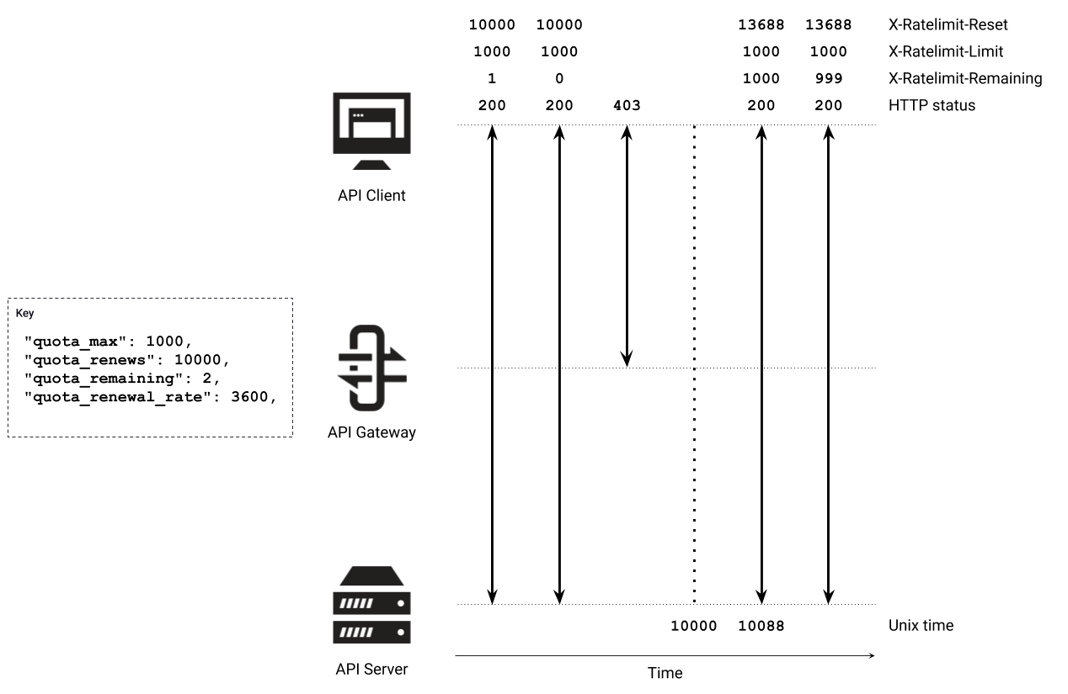
Quota Example
Notes:
Encapsulation of rules
Policies give you a way to encapsulate security and other access settings into a pre-defined entity.
Purpose is to make your life easier when managing lots of tokens.
The important thing to understand about policies is that a single policy can apply to many tokens, so having a few policies can let you manage very large numbers of tokens easily.
They allow you to define:
An access control list, which sets which APIs, versions, endpoints and methods the policy can access.
Rate limit
Quota
Dynamically attached
When a policy is saved on the Dashboard, it only takes around 10 seconds for it to take effect on the server.
Policies are attached to request sessions at the start of the Tyk processing pipeline, so updates are take effect immediately.
Partitioning
Once a policy is assigned to a token it will override the settings of that token.
However, with policy partitioning it is possible to override only a particular part of the token – the ACL, rate limit, or quota (or any combination of the three).
No effect on open APIs
Policies have no effect one APIs which have been configured to be open.
This is because the Tyk pipeline skips all authentication so does not process any tokens provided.

