Slide 1

API Security with Tyk:
Policies in Tyk
Learn how Tyk manages API access, quotas, and rate limits through reusable, scalable templates.

Slide 2
Policies
In Tyk, Security Policies act as templates for access control and rate limiting.
Access Keys (tokens) are what clients use to authenticate and access APIs.
By combining them, you can:
Standardize access control
Update access rights at scale
Implement tiered access levels (Basic → Premium → Enterprise)
Monitor and manage usage centrally
Notes:
Encapsulation of rules
Policies give you a way to encapsulate security and other access settings into a pre-defined entity.
Purpose is to make your life easier when managing lots of tokens.
The important thing to understand about policies is that a single policy can apply to many tokens, so having a few policies can let you manage very large numbers of tokens easily.
They allow you to define:
An access control list, which sets which APIs, versions, endpoints and methods the policy can access.
Rate limit
Quota
Dynamically attached
When a policy is saved on the Dashboard, it only takes around 10 seconds for it to take effect on the server.
Policies are attached to request sessions at the start of the Tyk processing pipeline, so updates are take effect immediately.
Partitioning
Once a policy is assigned to a token it will override the settings of that token.
However, with policy partitioning it is possible to override only a particular part of the token – the ACL, rate limit, or quota (or any combination of the three).
No effect on open APIs
Policies have no effect one APIs which have been configured to be open.
This is because the Tyk pipeline skips all authentication so does not process any tokens provided.

Slide 3
Security Policy Overview
A Security Policy defines reusable rules for:
API Access lists
Rate limits
Quotas
Tags & metadata
Acts as a template to apply consistent limits or permissions to many keys.
Makes it easy to modify access for thousands of keys at once.
Notes:
Encapsulation of rules
Policies give you a way to encapsulate security and other access settings into a pre-defined entity.
Purpose is to make your life easier when managing lots of tokens.
The important thing to understand about policies is that a single policy can apply to many tokens, so having a few policies can let you manage very large numbers of tokens easily.
They allow you to define:
An access control list, which sets which APIs, versions, endpoints and methods the policy can access.
Rate limit
Quota
Dynamically attached
When a policy is saved on the Dashboard, it only takes around 10 seconds for it to take effect on the server.
Policies are attached to request sessions at the start of the Tyk processing pipeline, so updates are take effect immediately.
Partitioning
Once a policy is assigned to a token it will override the settings of that token.
However, with policy partitioning it is possible to override only a particular part of the token – the ACL, rate limit, or quota (or any combination of the three).
No effect on open APIs
Policies have no effect one APIs which have been configured to be open.
This is because the Tyk pipeline skips all authentication so does not process any tokens provided.

Slide 4
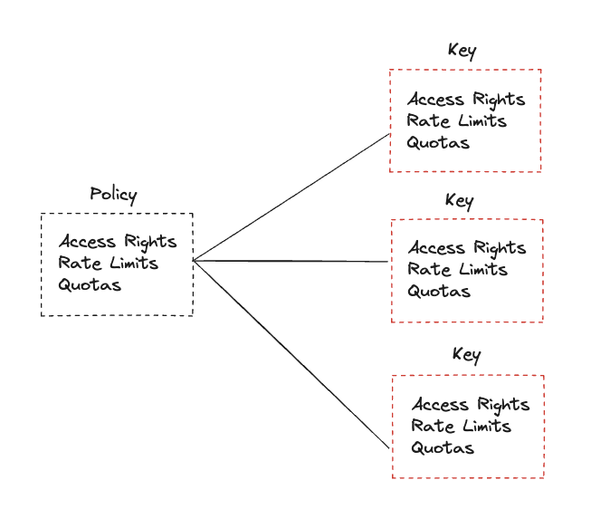
Why Use Policies?
Without policies:
Each API key must be updated manually.
With policies:
Update once → all associated keys inherit changes.
Example: Upgrade 10,000 users’ quotas by updating just one policy.
Notes:
Encapsulation of rules
Policies give you a way to encapsulate security and other access settings into a pre-defined entity.
Purpose is to make your life easier when managing lots of tokens.
The important thing to understand about policies is that a single policy can apply to many tokens, so having a few policies can let you manage very large numbers of tokens easily.
They allow you to define:
An access control list, which sets which APIs, versions, endpoints and methods the policy can access.
Rate limit
Quota
Dynamically attached
When a policy is saved on the Dashboard, it only takes around 10 seconds for it to take effect on the server.
Policies are attached to request sessions at the start of the Tyk processing pipeline, so updates are take effect immediately.
Partitioning
Once a policy is assigned to a token it will override the settings of that token.
However, with policy partitioning it is possible to override only a particular part of the token – the ACL, rate limit, or quota (or any combination of the three).
No effect on open APIs
Policies have no effect one APIs which have been configured to be open.
This is because the Tyk pipeline skips all authentication so does not process any tokens provided.

Slide 5
Policy Capabilities
A Tyk policy can define:
APIs and versions accessible
Allowed methods and paths
Rate limits
Quotas
Tags and metadata
Policies can also be partitioned — e.g.
Apply global ACLs for all users
Apply per-user rate limits and quotas
Notes:
Encapsulation of rules
Policies give you a way to encapsulate security and other access settings into a pre-defined entity.
Purpose is to make your life easier when managing lots of tokens.
The important thing to understand about policies is that a single policy can apply to many tokens, so having a few policies can let you manage very large numbers of tokens easily.
They allow you to define:
An access control list, which sets which APIs, versions, endpoints and methods the policy can access.
Rate limit
Quota
Dynamically attached
When a policy is saved on the Dashboard, it only takes around 10 seconds for it to take effect on the server.
Policies are attached to request sessions at the start of the Tyk processing pipeline, so updates are take effect immediately.
Partitioning
Once a policy is assigned to a token it will override the settings of that token.
However, with policy partitioning it is possible to override only a particular part of the token – the ACL, rate limit, or quota (or any combination of the three).
No effect on open APIs
Policies have no effect one APIs which have been configured to be open.
This is because the Tyk pipeline skips all authentication so does not process any tokens provided.

Slide 6
Relationship: Policy vs Access Key
Concept | Description
Security Policy | A template that defines access control, rate limits, and quotas
Access Key | The actual token used by a client to access APIs
Policies are applied to keys when keys are created.
Policies override any individual settings on the key.
Multiple policies can be combined for flexible control.
Notes:
Encapsulation of rules
Policies give you a way to encapsulate security and other access settings into a pre-defined entity.
Purpose is to make your life easier when managing lots of tokens.
The important thing to understand about policies is that a single policy can apply to many tokens, so having a few policies can let you manage very large numbers of tokens easily.
They allow you to define:
An access control list, which sets which APIs, versions, endpoints and methods the policy can access.
Rate limit
Quota
Dynamically attached
When a policy is saved on the Dashboard, it only takes around 10 seconds for it to take effect on the server.
Policies are attached to request sessions at the start of the Tyk processing pipeline, so updates are take effect immediately.
Partitioning
Once a policy is assigned to a token it will override the settings of that token.
However, with policy partitioning it is possible to override only a particular part of the token – the ACL, rate limit, or quota (or any combination of the three).
No effect on open APIs
Policies have no effect one APIs which have been configured to be open.
This is because the Tyk pipeline skips all authentication so does not process any tokens provided.

Slide 7
Policy Evaluation Flow
When a request comes in:
Tyk reads the Access Key
Checks which Policies are linked
Merges rules → applies rate limit, quota, ACL
Grants or denies API access accordingly
Note: This enables centralized management and consistent enforcement.
Notes:
Encapsulation of rules
Policies give you a way to encapsulate security and other access settings into a pre-defined entity.
Purpose is to make your life easier when managing lots of tokens.
The important thing to understand about policies is that a single policy can apply to many tokens, so having a few policies can let you manage very large numbers of tokens easily.
They allow you to define:
An access control list, which sets which APIs, versions, endpoints and methods the policy can access.
Rate limit
Quota
Dynamically attached
When a policy is saved on the Dashboard, it only takes around 10 seconds for it to take effect on the server.
Policies are attached to request sessions at the start of the Tyk processing pipeline, so updates are take effect immediately.
Partitioning
Once a policy is assigned to a token it will override the settings of that token.
However, with policy partitioning it is possible to override only a particular part of the token – the ACL, rate limit, or quota (or any combination of the three).
No effect on open APIs
Policies have no effect one APIs which have been configured to be open.
This is because the Tyk pipeline skips all authentication so does not process any tokens provided.

Slide 8
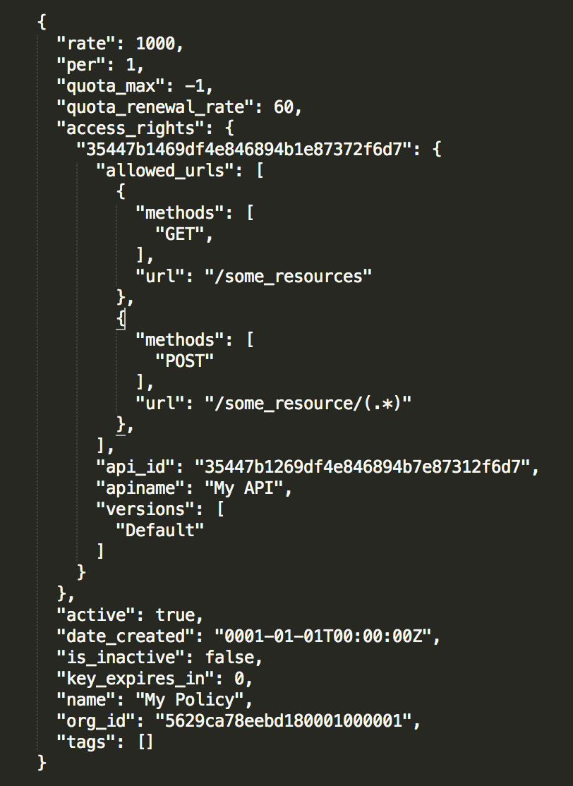
Quota and rate limiting data
Access control (API ID / Path Version)
Lock out policy holders
Meta data and analytics
Notes:
Encapsulation of rules
Policies give you a way to encapsulate security and other access settings into a pre-defined entity.
Purpose is to make your life easier when managing lots of tokens.
The important thing to understand about policies is that a single policy can apply to many tokens, so having a few policies can let you manage very large numbers of tokens easily.
They allow you to define:
An access control list, which sets which APIs, versions, endpoints and methods the policy can access.
Rate limit
Quota
Dynamically attached
When a policy is saved on the Dashboard, it only takes around 10 seconds for it to take effect on the server.
Policies are attached to request sessions at the start of the Tyk processing pipeline, so updates are take effect immediately.
Partitioning
Once a policy is assigned to a token it will override the settings of that token.
However, with policy partitioning it is possible to override only a particular part of the token – the ACL, rate limit, or quota (or any combination of the three).
No effect on open APIs
Policies have no effect one APIs which have been configured to be open.
This is because the Tyk pipeline skips all authentication so does not process any tokens provided.

Slide 9
Key Policy Fields
Field | Description
active | Must be true for Tyk to load policy
is_inactive | Disables keys using this policy
rate / per | Rate limiting window
quota_max / quota_renewal_rate | Quota configuration
access_rights | Defines accessible APIs
key_expires_in | Optional trial key expiry time (in seconds)
Notes:
Encapsulation of rules
Policies give you a way to encapsulate security and other access settings into a pre-defined entity.
Purpose is to make your life easier when managing lots of tokens.
The important thing to understand about policies is that a single policy can apply to many tokens, so having a few policies can let you manage very large numbers of tokens easily.
They allow you to define:
An access control list, which sets which APIs, versions, endpoints and methods the policy can access.
Rate limit
Quota
Dynamically attached
When a policy is saved on the Dashboard, it only takes around 10 seconds for it to take effect on the server.
Policies are attached to request sessions at the start of the Tyk processing pipeline, so updates are take effect immediately.
Partitioning
Once a policy is assigned to a token it will override the settings of that token.
However, with policy partitioning it is possible to override only a particular part of the token – the ACL, rate limit, or quota (or any combination of the three).
No effect on open APIs
Policies have no effect one APIs which have been configured to be open.
This is because the Tyk pipeline skips all authentication so does not process any tokens provided.

Slide 10
Access Key Example
{
"org_id": "53ac07777cbb8c2d53000002",
"apply_policies": [
"59672779fa4387000129507d",
"53222349fa4387004324324e"
],
"quota_max": 1000,
"rate": 3,
"per": 1
}
The key inherits all limits, ACLs, and quotas from the applied policies.
Any changes to the policy → immediately reflected for this key.
Notes:
Encapsulation of rules
Policies give you a way to encapsulate security and other access settings into a pre-defined entity.
Purpose is to make your life easier when managing lots of tokens.
The important thing to understand about policies is that a single policy can apply to many tokens, so having a few policies can let you manage very large numbers of tokens easily.
They allow you to define:
An access control list, which sets which APIs, versions, endpoints and methods the policy can access.
Rate limit
Quota
Dynamically attached
When a policy is saved on the Dashboard, it only takes around 10 seconds for it to take effect on the server.
Policies are attached to request sessions at the start of the Tyk processing pipeline, so updates are take effect immediately.
Partitioning
Once a policy is assigned to a token it will override the settings of that token.
However, with policy partitioning it is possible to override only a particular part of the token – the ACL, rate limit, or quota (or any combination of the three).
No effect on open APIs
Policies have no effect one APIs which have been configured to be open.
This is because the Tyk pipeline skips all authentication so does not process any tokens provided.

Slide 11
Policies: General vs Per-API Rules
Rules defined in the policy can be set generally for all APIs, or specifically for individual APIs
Only some rules can be set per-API:
Rate limiting
Throttling
Quotas
Path-based permissions
Important: This cannot be used at the same time as Policy partitioning
Notes:
Encapsulation of rules
Policies give you a way to encapsulate security and other access settings into a pre-defined entity.
Purpose is to make your life easier when managing lots of tokens.
The important thing to understand about policies is that a single policy can apply to many tokens, so having a few policies can let you manage very large numbers of tokens easily.
They allow you to define:
An access control list, which sets which APIs, versions, endpoints and methods the policy can access.
Rate limit
Quota
Dynamically attached
When a policy is saved on the Dashboard, it only takes around 10 seconds for it to take effect on the server.
Policies are attached to request sessions at the start of the Tyk processing pipeline, so updates are take effect immediately.
Partitioning
Once a policy is assigned to a token it will override the settings of that token.
However, with policy partitioning it is possible to override only a particular part of the token – the ACL, rate limit, or quota (or any combination of the three).
No effect on open APIs
Policies have no effect one APIs which have been configured to be open.
This is because the Tyk pipeline skips all authentication so does not process any tokens provided.

Slide 12
Policies: Policy Partitioning
Policy partitioning allows policies to enforce only specific rules
Helps reduce the total number of Policies required and provide more flexibility
Policies must select at least one rule set to enforce:
Quotas
Rate limiting
Access control
GraphQL query depth
Notes:
Encapsulation of rules
Policies give you a way to encapsulate security and other access settings into a pre-defined entity.
Purpose is to make your life easier when managing lots of tokens.
The important thing to understand about policies is that a single policy can apply to many tokens, so having a few policies can let you manage very large numbers of tokens easily.
They allow you to define:
An access control list, which sets which APIs, versions, endpoints and methods the policy can access.
Rate limit
Quota
Dynamically attached
When a policy is saved on the Dashboard, it only takes around 10 seconds for it to take effect on the server.
Policies are attached to request sessions at the start of the Tyk processing pipeline, so updates are take effect immediately.
Partitioning
Once a policy is assigned to a token it will override the settings of that token.
However, with policy partitioning it is possible to override only a particular part of the token – the ACL, rate limit, or quota (or any combination of the three).
No effect on open APIs
Policies have no effect one APIs which have been configured to be open.
This is because the Tyk pipeline skips all authentication so does not process any tokens provided.

Slide 13
Policies: Multi-Policy Keys
It is possible to assign multiple Policies to a Key:
Policy rules will be merged to create a combined rule set
It is possible to select Policies with the same API Access Rights, if their path-based permissions do not conflict
When using partitioned Policies, their partitions must not overlap
Notes:
Encapsulation of rules
Policies give you a way to encapsulate security and other access settings into a pre-defined entity.
Purpose is to make your life easier when managing lots of tokens.
The important thing to understand about policies is that a single policy can apply to many tokens, so having a few policies can let you manage very large numbers of tokens easily.
They allow you to define:
An access control list, which sets which APIs, versions, endpoints and methods the policy can access.
Rate limit
Quota
Dynamically attached
When a policy is saved on the Dashboard, it only takes around 10 seconds for it to take effect on the server.
Policies are attached to request sessions at the start of the Tyk processing pipeline, so updates are take effect immediately.
Partitioning
Once a policy is assigned to a token it will override the settings of that token.
However, with policy partitioning it is possible to override only a particular part of the token – the ACL, rate limit, or quota (or any combination of the three).
No effect on open APIs
Policies have no effect one APIs which have been configured to be open.
This is because the Tyk pipeline skips all authentication so does not process any tokens provided.

Slide 14
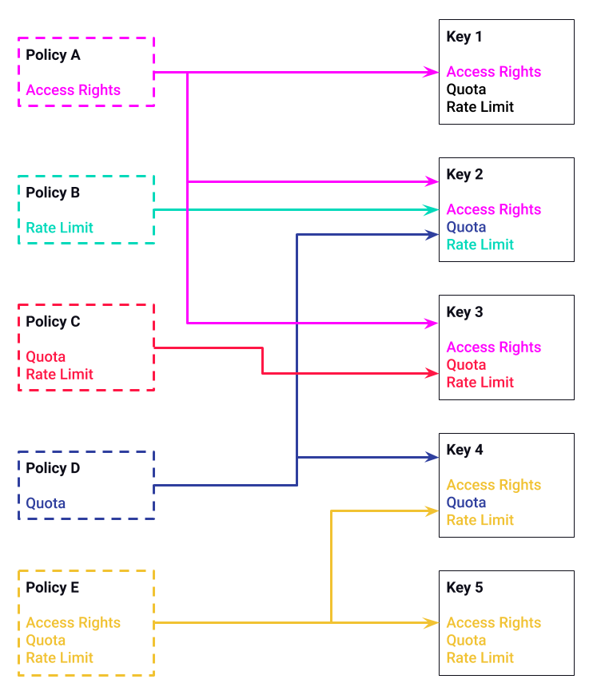
Example
Notes:
This example illustrates how Policies can be combined and the effect this has on the Key.
On the left side of the diagram are 5 Policies. 4 are partitioned Policies; A, B, C and D. And Policy E is a standard Policy. For the sake of simplicity, only three properties are shown; Access Rights, Quotas and Rate Limit.
On the right side of the diagram are 5 keys. The properties shown in the Keys are colour-code to match the Policies they are inherited from.
Starting at the top;
Key 1 is associated with Policy A. Policy A is a partitioned Policy which only defines Access Rights, so Key 1 inherits only that property, leaving the Key’s other properties, Quota and Rate Limit, to be defined directly on the Key itself.
Key 2 is associated with three Policies; A, B and D. Each of these Policies is partitioned, and none of the partitions overlap, so this is ok. This means that each of the Key’s properties is defined by a different Policy.
Key 3 is associated with two Policies; A and C. This is much like the last example, but in this case, Policy C defines two properties, but they don’t overlap with Policy A, so this is ok.
Key 4 is associated with two Policies D and E. This is a mixture of different types of Policy, Policy D is partitioned and Policy E is normal. This results in Policy D’s properties overriding Policy E’s properties; so although Policy E defines a Quota, the Key uses the Quota from Policy D, as it is a partitioned Policy.
Key 5 is associated with one Policy, E. Policy E is a standard Policy, so all of its properties are inherited.

Slide 15
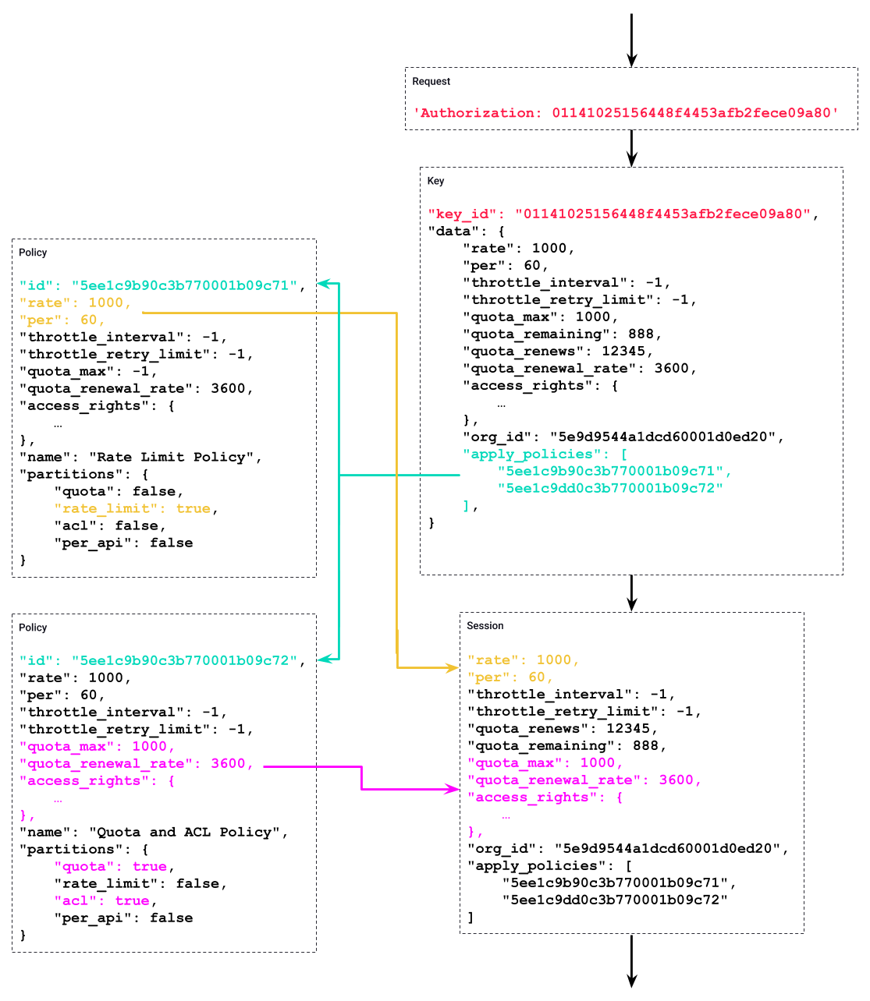
Example
Notes:
This example shows how Policy data is combined with Key data, resulting in the session data used by the Gateway to process the request.
The left side of the diagram has the Policy objects. The right side of the diagram shows the sequence as the request is processed by the Gateway.
The colour-coding and lines show the relationships between the data.
Starting at the top right with the Request, it provides an Authorization header containing a key.
The Gateway uses that value to retrieve the key data from the database. This is what’s shown in the Key box.
The Key defines the Policies it’s associated with in the “apply_policies” property. In this case it has 2 Policies, as linked by the teal colour and line.
The Gateway processes these Policies and merges them with the Key to create the session data.
In this case, the Policies are partitioned, with one Policies defining the Rate Limit data, and the other Policy defining the Quota and Access Rights data.
These are merged into the Key data as shown by the Yellow and Pink colours and lines.
This data is then used by the Gateway during the rest of the request lifecycle.

