Slide 1

API Security with Tyk:
Session Objects
Learn how Tyk handles identity, access, and lifecycle through session objects.

Slide 2
What is a Session Object?
In Tyk, every identity maps to a Session Object.
Supported identity types:
Bearer Tokens
HMAC Keys
JSON Web Tokens (JWT)
OpenID Connect (OIDC) identities
Basic Auth users
Think of it as the user’s metadata — how Tyk knows who is accessing what and how.

Slide 3
What Does a Session Object Contain?
A session object defines:
Rate limit rules
Quota limits
Access Control List (ACL)
Policy ID (if used)
Expiry time of the access
Optional metadata and alias for identification

Slide 4
Where are Session Objects Stored?
Stored in Redis (not MongoDB or Gateway memory).
Stored as:
<hashed_token_string> : <session_object_JSON>
Tokens are hashed for security.
Use Alias to identify sessions in logs and analytics.

Slide 5
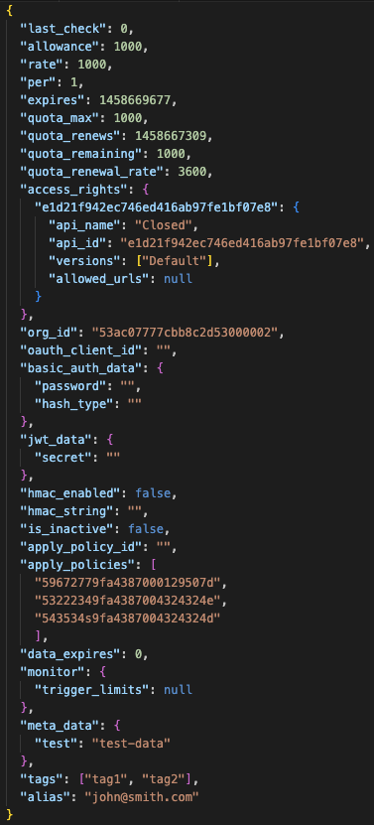
API Keys
Underlying data structure for keys stored in Tyk (in Redis)
Every auth type in the gateway will result in a structure like this existing under the hood.
Can be hashed with a number of algorithms i.e. murmur 64/128, sha1/256 or not at all.

Slide 6
Key Fields Explained (1/2)
Field | Description
rate / per | Defines rate limiting window (e.g., 1000 req/sec)
quota_max | Max requests in a quota period
quota_remaining | Remaining quota
quota_renewal_rate | How long the quota lasts (e.g., 3600 = 1h)
access_rights | Defines which APIs/versions are accessible
org_id | Organization that owns the token

Slide 7
Key Fields Explained (2/2)
Field | Description
apply_policies | List of attached policy IDs
meta_data | Custom info for transforms/middleware
tags | Tags added to analytics
alias | Human-readable identifier
is_inactive | If true → denies access
expires | UNIX timestamp for key expiry

Slide 8
Metadata & Alias
Metadata
Key/value pairs for user context (e.g., user_id, email, plan_type)
Can be injected into:
Headers
URL rewrites
Request/Response transforms
Virtual Endpoints
Used for personalization, validation, or upstream enrichment.
Alias
Human-readable identifier for a token
Appears in logs and analytics (important because tokens are hashed in Redis)

Slide 9
Session Metadata in Action
Metadata can be used by:
URL Rewrite
Header Transformations
Body Transformations
Virtual Endpoints
Custom Plugins
Example use case:
Inject meta_data.user_email into a header for upstream logging.

Slide 10
Expiry vs Invalidation
Term | Meaning
Expiry | Token remains in Redis but is no longer valid — returns 401 Key has expired.
Invalidation / Deletion | Token is deleted from Redis — returns 400 Access disallowed.
Important:
Developers who hardcode tokens may need expiry to notify renewal instead of full invalidation.

Slide 11
Key Lifetime and Expiry
Tyk distinguishes between:
Expiry: token can’t be used (but still in Redis)
Lifetime: how long token stays in Redis before deletion
Controlling Key Lifetime
You can control key deletion at:
API level → session_lifetime in API definition
Gateway level → global_session_lifetime in tyk.conf
Note: a 0 value means infinite lifetime (never deleted).

Slide 12
Lifetime Example
Example:
"session_lifetime": 86400
→ Token deleted from Redis after 24 hours of creation.
⚠️ Use session_lifetime_respects_key_expiration: true to prevent early deletion.

Slide 13
Key Lifetime Precedence Summary
force_global_session_lifetime | session_lifetime_respects_key_expiration | Effective Lifetime
true | true | global_session_lifetime
true | false | global_session_lifetime
false | true | larger of session_lifetime or expires
false | false | session_lifetime

Slide 14
Recap
Session Object = Identity + Access Metadata
Stored in Redis (hashed key → JSON object)
Controls rate limit, quota, ACL, expiry, and policy
Metadata enhances flexibility and customization
Separate expiry and deletion behavior
Key lifetime configurable at API or Gateway level

