Slide 1

Tyk OAS API Definitions

Slide 2

Tyk OAS Definition
Standard of defining APIs via OpenAPI Specification
Tyk supports the importing and configuration on the OAS
Significant time and complexity savings if you are already using it to design and document your APIs
Notes:
"Tyk supports the OpenAPI Specification, or OAS, which is the industry standard for defining APIs."
"If you’re already using OAS to design and document your APIs, you can import those definitions directly into Tyk."
"This offers significant time savings and reduces complexity because you don’t need to redefine your APIs from scratch."

Slide 3

What’s Tyk OAS API definition?
From your API design tool or code editor
(info, servers, paths, components, …)
Tyk OAS API Definition
OpenAPI description
=
Export from Dashboard or
Start from a template
(gateway configurations, middleware configurations, listenPath, metadata, …)
Tyk extension
Notes:
"This diagram shows the structure of a Tyk OAS API Definition, which is made up of two key parts."
"First, you have the standard OAS section. This is typically created in your code editor or design tool. It describes your API: the endpoints, methods, request/response models, and documentation—everything you’d expect in an OpenAPI Spec."
"Then, when you import this into Tyk, we automatically add a x-tyk-api-gateway section."
"This section contains Tyk-specific configurations—things like authentication, rate limiting, policies, plugins, and all the controls that Tyk applies to manage and secure your API traffic."
"So, in short: you design your API as usual in OAS, and Tyk adds the gateway-specific logic to bring it to life inside the Tyk platform."
“You can export an imported OAS definition for a full Tyk OAS definition or you can start from a template”

Slide 4
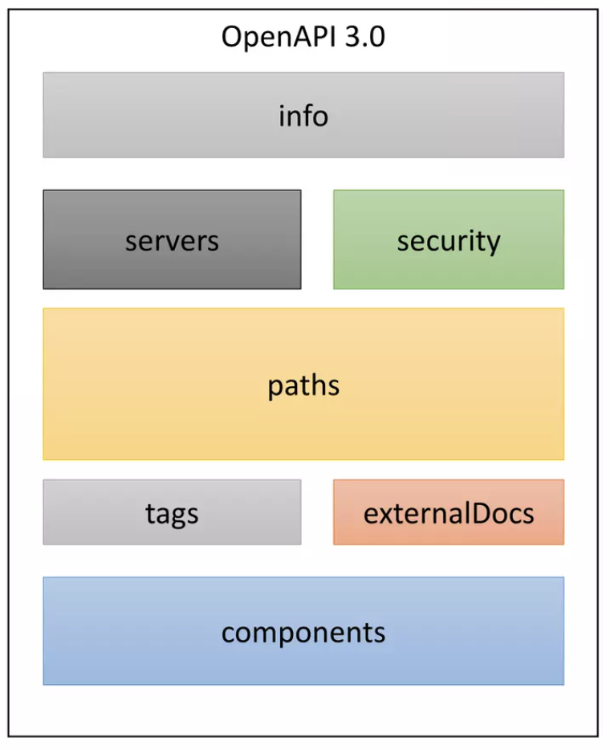
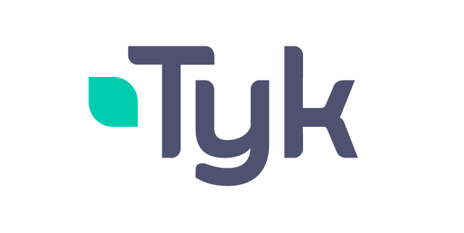
Tyk OAS Definition
Tyk OAS Definition
x-tyk-api-gateway
Notes:
“A deeper look into the different sections. On the left is an OAS 3.0 spec and upon import, we can see the sections are preserved with an additional x-tyk-api-gateway added”
“Let’s look at the different sections”

Slide 5
Tyk Vendor Extension Reference
x-tyk-api-gateway
Custom Tyk API extensions inside the OpenAPI definition.
Stored under the key x-tyk-api-gateway.
Main Fields
info (Info)
Main metadata for the API definition
upstream (Upstream)
Configurations related to the upstream target
server (Server)
Configurations for the API server
middleware (Middleware)
Configurations for Tyk middleware
Use x-tyk-api-gateway to enrich your OpenAPI spec with Tyk-specific runtime and security controls.
Notes:
Slide Intro: “Now let’s look at how Tyk extends the OpenAPI Specification with our own vendor extensions.”
Script Body:
“Tyk uses the extension key x-tyk-api-gateway inside your OpenAPI documents.”
“This allows you to store Tyk-specific configurations directly in the API definition, alongside the standard OpenAPI fields.”
“In other words, you can design and document your API in OAS as usual, but still capture the Tyk settings needed for deployment and runtime.”
Walkthrough of Fields:
Info – “This contains the main metadata for the API definition. Think of it as the high-level details about your API.”
Upstream – “Here you configure how Tyk connects to the upstream target — for example, the backend service you’re proxying.”
Server – “This defines the server-side configuration — things like the listen path, host, and protocol.”
Middleware – “Finally, middleware holds the configuration for all Tyk middleware. This is where you can enrich or protect requests and responses.”
Closing: “So with x-tyk-api-gateway, you can keep both your OpenAPI spec and your Tyk configuration in a single document. That makes APIs easier to manage, version, and deploy consistently across environments.”

Slide 6
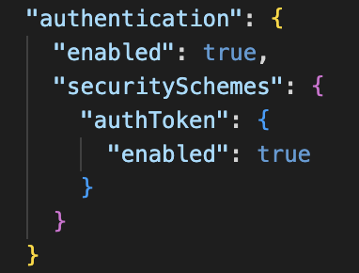
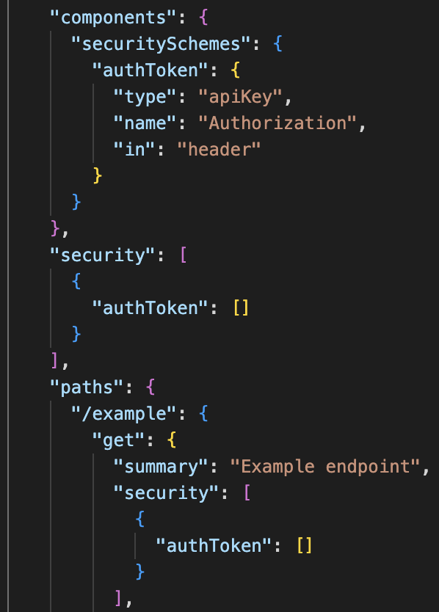
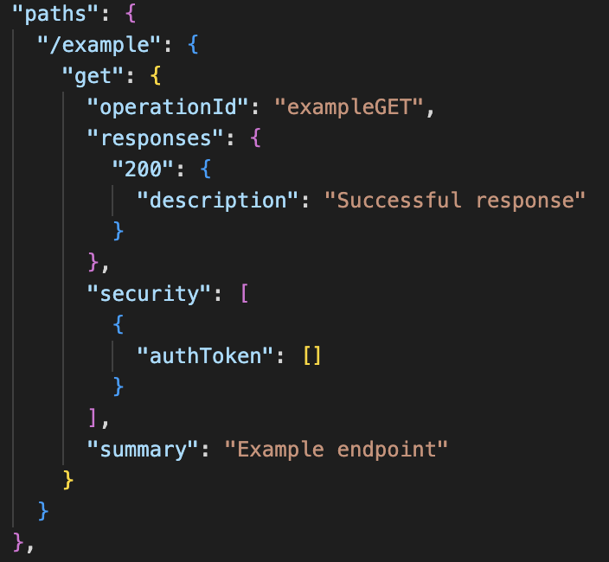
Tyk OAS Definition
Authentication
Auth token
JWT
OAuth 2.0
mTLS
Basic Auth
Multi-Auth
Notes:
OAS has the concept of securitySchemes which describes one way in which an API may be accessed, e.g. with a token. You can have multiple securitySchemes defined for an API. You decide which is actually active by declaring that in the security section.
When the apiKey securityScheme is configured in an OAS API Definition, this means that the authentication mechanism that can be configured in x-tyk-api-gateway, is an Authentication Token.
Since the location and token key name are documented in the OAS API Definition securityScheme, you only need to turn this authentication on at the Tyk level to tell Tyk to handle the authentication by setting enabled to true.

Slide 7
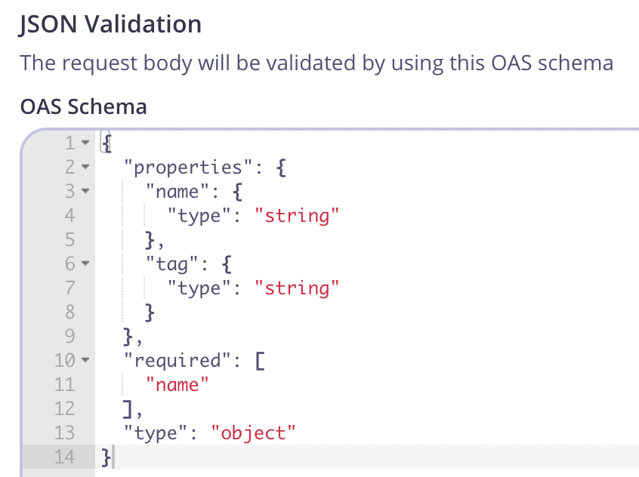
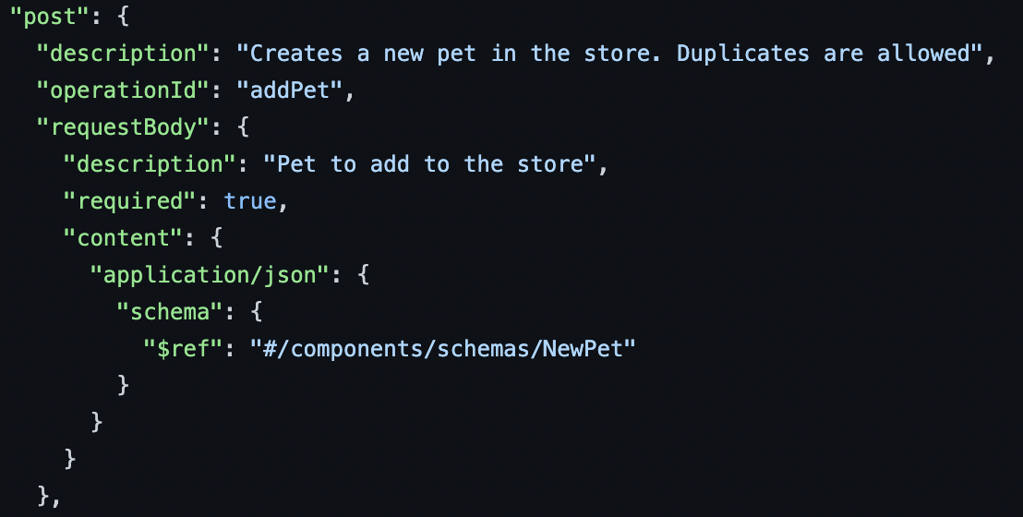
Tyk OAS Definition
Validation
Automatically creates a request validation middleware in Tyk with schema in OAS
Notes:
Tyk can protect any Gateway incoming request by validating the request parameters and payload against a schema provided for that path’s request body in the OAS API Definition.
The clever part is that in this schema you can reference another schema defined elsewhere in the API Definition; this lets you write complex validations very efficiently since you don’t need to re-define the validation for a particular object every time you wish to refer to it.

Slide 8
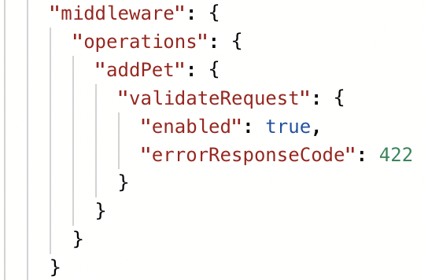
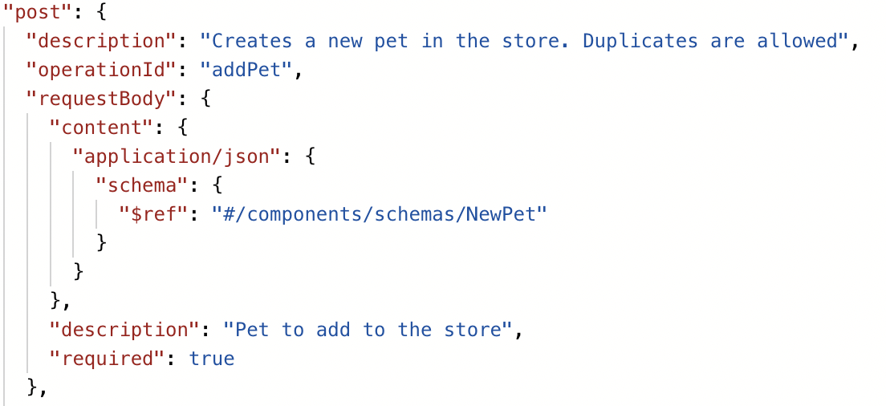
Tyk OAS Definition
Middleware
Uses operationIDs for middleware configured for each path
Middleware declared in x-tyk-api-gateway section
Notes:
configuration of the paths section within that will tell Tyk which endpoints are available to configure.
OAS gives the ability to define an operationID in an OAS API Definition. This allows for different parts of the definition to refer to each other. For instance in a Tyk OAS API Definition, if you turn on validation for a particular endpoint, the x-tyk-api-gateway middleware section will use the operationID to link the enabled validation middleware to the particular endpoint. This is needed because the endpoint is defined within the main OAS API Definition, whereas the details of how Tyk handles the validation is not, since a developer does not need to see that.
Whenever a middleware needs to be enabled for a specific API path, you need to make sure that the operationId of that path, is equal with the one under the middleware.operations section within x-tyk-api-gateway.

