Slide 1


Tyk Foundational Certification
Certification Preparation Course

Slide 2

About the Foundational Certification
Foundational API management knowledge on Tyk
Created for general audience - non-technical and technical
Hands-on lab sessions
Quizzes for progress checks
Preparation to progress on specific learning paths
Access to Customer Solutions Architects for additional support

Slide 3
About Tyk
Tyk is a modern API Management Platform: an open source gateway, powered by Go, and designed as cloud native from the start, enabling:
Traffic management via the open source gateway
Lifecycle management, analytics and observability via our intuitive dashboard
Developer self-service and community engagement through our Enterprise Developer Portal
Highly flexible deployment models: cloud, cloud/multi-cloud hybrid and on-prem

Slide 4



2014
2016
Today
Here
Tyk is born! Our CEO was looking for a lightweight yet highly performant API Gateway.
There
Tyk is incorporated and the paid
licensing and support model is made generally available.
Everywhere
Tyk has over 151 employees in 31 countries worldwide with hundreds of customers on six continents.

Slide 5
THE WHOLE CYCLE
Full lifecycle APIM
01
API Importing
OpenAPISpec 2/3
APIARY Blueprints
WSDL
REST/SOAP/GraphQL sources
02
API Implementation
API Testing
Access Control
Rate Limiting & Quotas
Custom Plugins
04
API Consumption
API Publishing & Monetization
Automated Key Provisioning
Multi-Tenant Management
03
API Management
Version Control
Environment Management
Monitoring & Optimization
Analytics

Slide 6

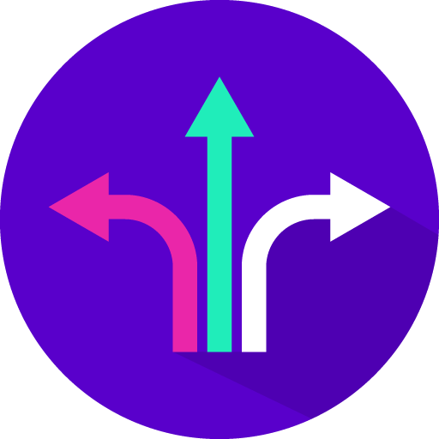


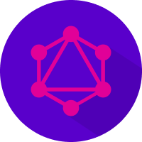
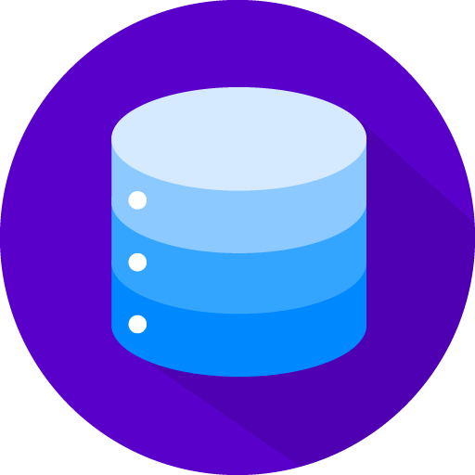
YEAH, BUT WHY TYK?
Tyk is not just a unique name!
Simplicity
Deployment flexibility
Batteries included
Highly secure
GraphQL/ Universal Data Graph
Our own stack

Slide 7

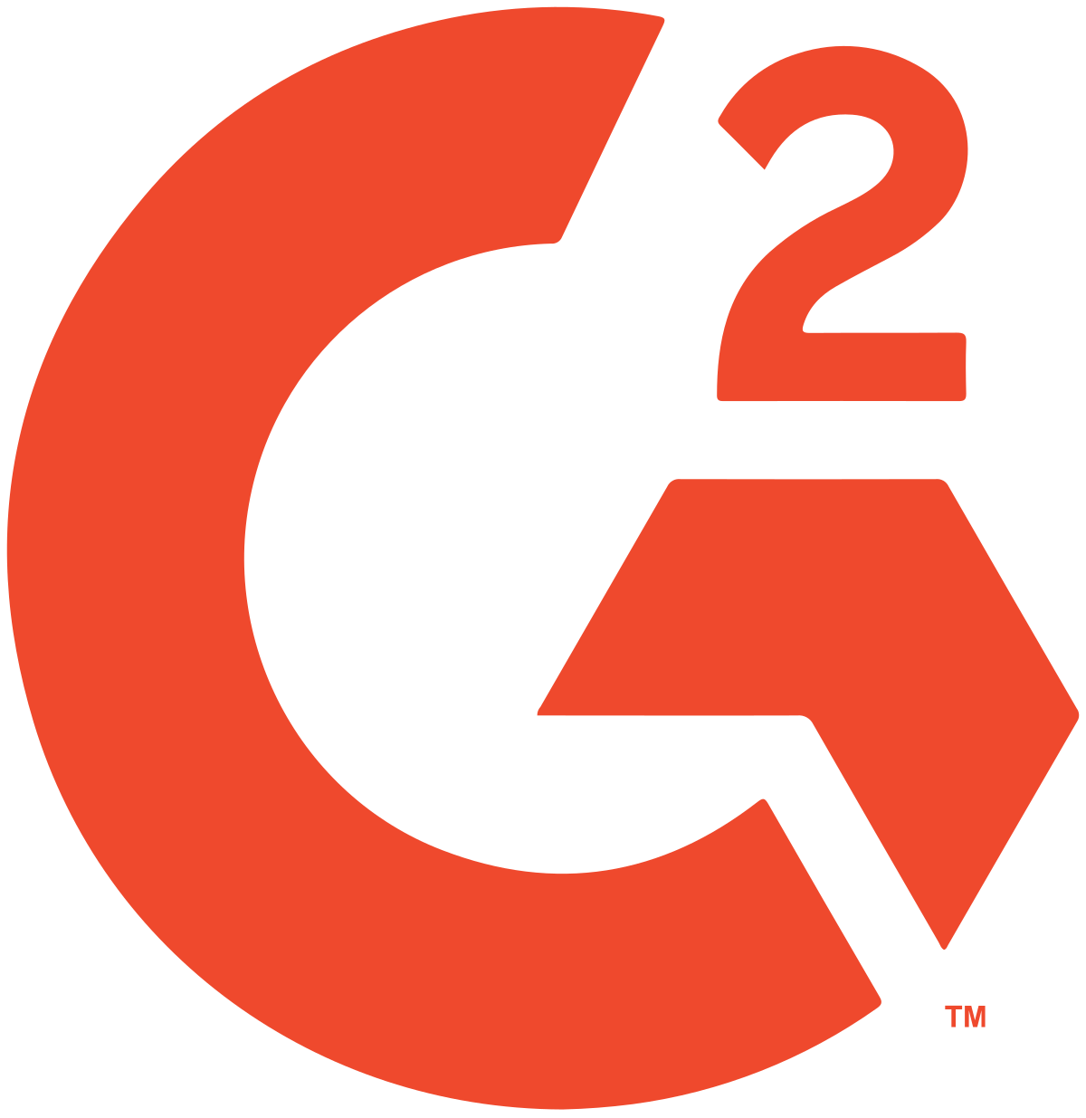

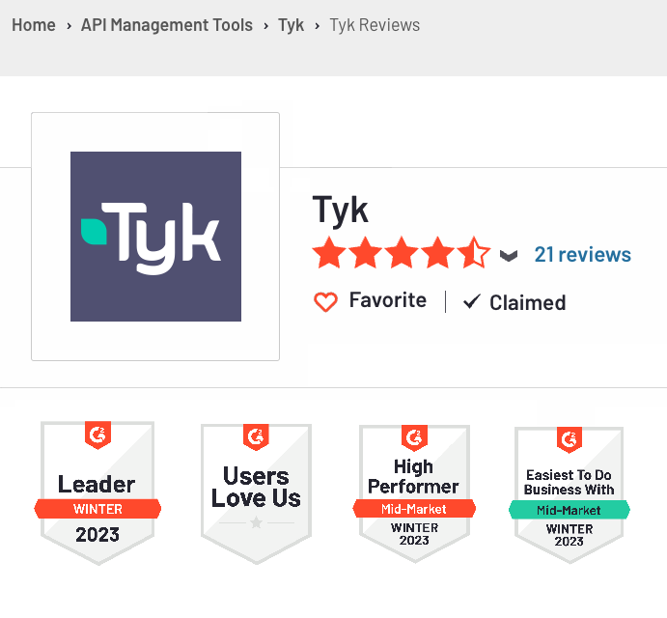
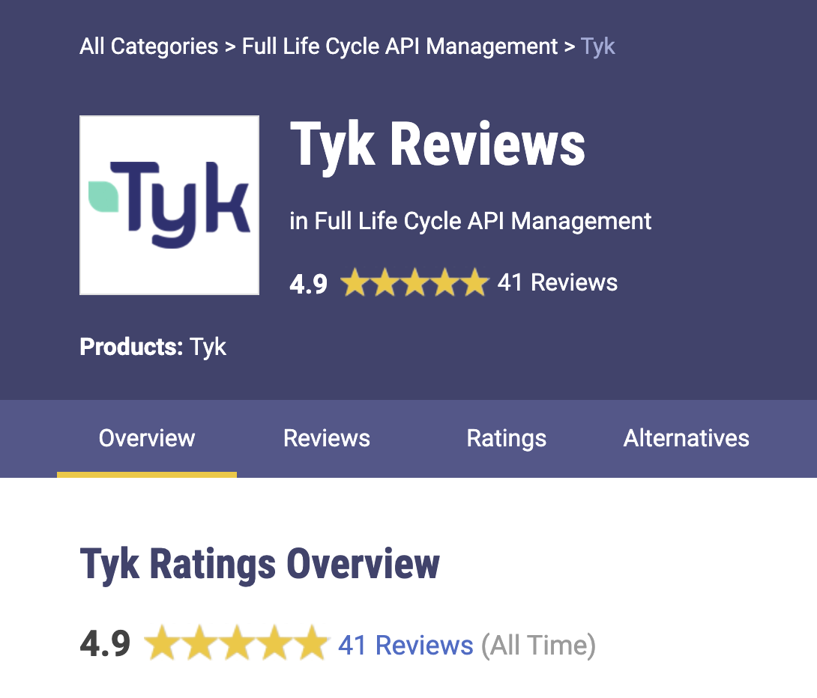
THE REVIEWS ARE IN
Highly rated APIM Solution
"Tyk is easy to set up, easy to integrate, support GraphQL and works excellent on K8s. The best dashboard out of any we tried. The support service is excellent"
Technical Director
"Most complete and feature-rich API Gateway. The onboarding process and the support we receive from Tyk Team are fantastic."
Senior Cloud Infrastructure Engineer
"The tyk platform allows us a consolidated and secure front-of-house for our APIs, from the ultra modern,all the way back to our most legacy (20+y/o) APIs, and it works every time"
Lead DevOps Engineer

