Slide 1

Tyk Product Components: Gateway & Redis
Exploring the role of each component in the Tyk Ecosystem

Slide 2

Tyk Gateway
Real Time Traffic Enforcement
Handles all inbound API traffic
Authentication & Authorization
Rate Limiting and Quotas
Enforces Policies
Observability
Gateway
Notes:
Let's talk about how the Tyk Gateway enforces control and governance over your API traffic in real time.
The Tyk Gateway is the core component that handles all inbound API traffic. Every request coming into your system first passes through the Gateway, making it the front line for traffic control.
One of its primary responsibilities is Authentication and Authorization. Tyk verifies that incoming requests are from legitimate clients and ensures those clients have the right permissions to access the resources they're asking for.
Next, it applies Rate Limiting and Quotas to protect your backend systems. This means you can control how many requests a client can make within a certain time period, helping to prevent abuse or overload.
It also enforces policies in real time—these policies might define access levels, transformations, or usage plans—ensuring that every request complies with the rules you’ve set.
And finally, the Gateway provides Observability out of the box. It captures rich telemetry—such as request logs, latencies, errors, and usage metrics—so you can monitor and analyze traffic patterns, detect anomalies, and troubleshoot issues effectively.
In short, the Tyk Gateway acts as a smart, real-time traffic enforcer that ensures every API call is secure, compliant, and well-governed.

Slide 3

Tyk & Redis
Fast in-memory performance
Enables real-time request validation
Minimise latency for high-throughput APIs
Stores:
Rate limit counters
Session tokens
API key states
Shared State across gateways
Synchronizes usage data across nodes
Pub/Sub Broker
Cluster-wide notifications
Redis
Gateway
Notes:
Redis is a core component in the Tyk stack, powering real-time request validation through its fast, in-memory performance.
It’s designed to minimize latency, making it ideal for high-throughput APIs where speed is critical.
Redis stores important runtime data such as rate limit counters, session tokens, and API key states.
This allows the Tyk Gateway to make decisions quickly—like whether a request is within quota or if an API key is valid—without hitting the database.
In multi-node environments, Redis also ensures shared state across all gateways. It synchronizes usage data, so no matter which gateway handles the request, it sees the same usage picture.
On top of that, Redis acts as a Pub/Sub broker to deliver cluster-wide notifications. This helps with cache purging, policy updates, and other real-time coordination between nodes.
In short, Redis enables Tyk to deliver both high performance and consistent behavior across your entire API infrastructure.

Slide 4
Redis High Availability in Tyk
Redis is a single point of failure
Tyk Gateway depends on Redis for live traffic processing
Redis unavailability = Gateway downtime
HA with Redis Sentinel
Monitor & Automatic Failover
Redis Clustering
Distribute data across multiple shards
Redis
Gateway
Notes:
Redis plays a critical role in the Tyk architecture—it’s used by the Gateway for live traffic processing, including rate limiting, quotas, and key management.
Because of this dependency, Redis is a potential single point of failure. If Redis becomes unavailable, it can lead to Tyk Gateway downtime.
To avoid this risk, we recommend implementing high availability for Redis.
One option is to use Redis Sentinel, which continuously monitors your Redis instances and automatically triggers failover if the primary goes down. This helps ensure minimal disruption to your API traffic.
For greater scalability and fault tolerance, Redis Clustering is another approach. It distributes data across multiple shards, allowing for horizontal scaling and reducing the impact of a single node failure.
By setting up Redis with either Sentinel or Clustering, you can protect your Tyk Gateway from unexpected Redis outages and ensure consistent, reliable traffic processing.
Let’s look at how this would look like:

Slide 5
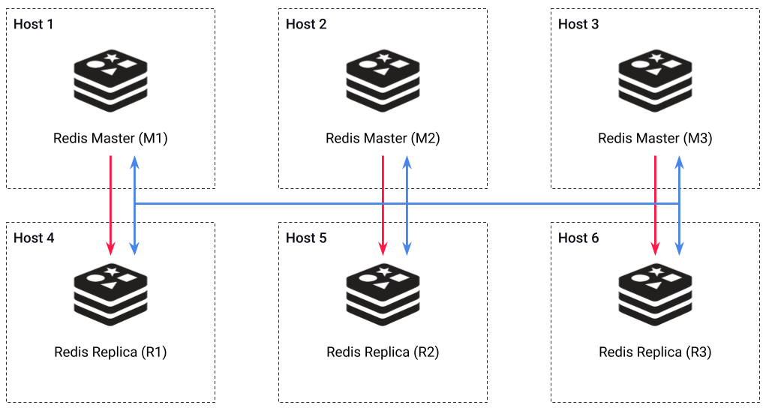
Redis Cluster: High-Availability
Distributed implementation of Redis for horizontal scaling and high availability.
It automatically partitions data across multiple nodes and supports failover.
Redis Cluster uses a sharded data set:
Horizontal scaling option
Primary-Replica Model: Each primary node has at least one replica.
Minimum of 3 Master instances required:
Master majority required for failover
Gossip Protocol: Nodes communicate to detect failures and trigger failovers.
Notes:
Let’s talk about Redis Cluster and how it enhances scalability and high availability in distributed deployments.
A distributed implementation of Redis allows us to scale horizontally, meaning we can add more nodes to handle increasing loads while maintaining performance. This setup automatically partitions data across multiple nodes and supports failover, ensuring resilience in case of node failures.
Redis Cluster operates using a sharded data set, which means that data is distributed across multiple Redis nodes rather than being stored on a single instance. This approach provides a horizontal scaling solution, allowing for better performance and resource utilization as traffic grows.
The cluster follows a Primary-Replica Model, where each primary node has at least one replica. This replication ensures redundancy—if a primary node goes down, its replica can take over to maintain availability.
To ensure stability, a Redis Cluster requires a minimum of three master instances. This is important because Redis uses a majority-based failover mechanism, meaning that at least half of the master nodes must be available to elect a new leader when failures occur.
Redis Cluster also relies on the Gossip Protocol for communication between nodes. This protocol enables nodes to detect failures and coordinate failover processes automatically, ensuring that the system can quickly recover from outages.
By leveraging Redis Cluster, we gain a highly available, fault-tolerant, and scalable caching layer, which is essential for handling large-scale API workloads efficiently."

