Slide 1

Tyk Architecture &
Ecosystem
Understanding the main Tyk components, their functions and its dependencies

Slide 2

Tyk Gateway
Real Time Traffic Enforcement
Handles all inbound API traffic
Authentication & Authorization
Rate Limiting and Quotas
Enforces Policies
Observability
Gateway
Notes:
Let's talk about how the Tyk Gateway enforces control and governance over your API traffic in real time.
The Tyk Gateway is the core component that handles all inbound API traffic. Every request coming into your system first passes through the Gateway, making it the front line for traffic control.
One of its primary responsibilities is Authentication and Authorization. Tyk verifies that incoming requests are from legitimate clients and ensures those clients have the right permissions to access the resources they're asking for.
Next, it applies Rate Limiting and Quotas to protect your backend systems. This means you can control how many requests a client can make within a certain time period, helping to prevent abuse or overload.
It also enforces policies in real time—these policies might define access levels, transformations, or usage plans—ensuring that every request complies with the rules you’ve set.
And finally, the Gateway provides Observability out of the box. It captures rich telemetry—such as request logs, latencies, errors, and usage metrics—so you can monitor and analyze traffic patterns, detect anomalies, and troubleshoot issues effectively.
In short, the Tyk Gateway acts as a smart, real-time traffic enforcer that ensures every API call is secure, compliant, and well-governed.

Slide 3

Tyk & Redis
Fast in-memory performance
Enables real-time request validation
Minimise latency for high-throughput APIs
Stores:
Rate limit counters
Session tokens
API key states
Shared State across gateways
Synchronizes usage data across nodes
Pub/Sub Broker
Cluster-wide notifications
Redis
Gateway
Notes:
Redis is a core component in the Tyk stack, powering real-time request validation through its fast, in-memory performance.
It’s designed to minimize latency, making it ideal for high-throughput APIs where speed is critical.
Redis stores important runtime data such as rate limit counters, session tokens, and API key states.
This allows the Tyk Gateway to make decisions quickly—like whether a request is within quota or if an API key is valid—without hitting the database.
In multi-node environments, Redis also ensures shared state across all gateways. It synchronizes usage data, so no matter which gateway handles the request, it sees the same usage picture.
On top of that, Redis acts as a Pub/Sub broker to deliver cluster-wide notifications. This helps with cache purging, policy updates, and other real-time coordination between nodes.
In short, Redis enables Tyk to deliver both high performance and consistent behavior across your entire API infrastructure.

Slide 4

Tyk Dashboard
Web-based Admin UI
Create, update, and organize your APIs visually
Define access policies
Control who can access which APIs, how often, and with what credentials
Manage users and teams
Set roles & permissions
View real-time analytics
See traffic, errors, usage trends, and performance
Push configuration to Gateway
Changes in the dashboard are synced automatically with Tyk Gateway
Supports Single Sign On (SSO)
Redis
Gateway
Dashboard
Notes:
The Tyk Dashboard is a web-based admin interface that gives you full control over your API ecosystem—without needing to touch raw JSON or configuration files.
It allows you to create, update, and organize your APIs visually. You can define endpoints, set authentication methods, and apply rate limits—all from an intuitive UI.
Through the Dashboard, you can also define access policies. These policies let you control who can access your APIs, how often, and what credentials they must use—such as API keys, JWTs, or OAuth tokens.
The Dashboard includes powerful user and team management features. You can assign roles and permissions, ensuring that only authorized users can make changes or access specific parts of the system.
In addition, the Dashboard provides real-time analytics. You can monitor traffic volume, error rates, latency, and usage trends, helping you stay on top of performance and troubleshoot issues quickly.
When you make configuration changes—like updating an API definition or editing a policy—those changes are automatically synced with the Tyk Gateway. This keeps your Gateway configuration up to date without requiring a manual redeploy.
And finally, for enterprise environments, the Dashboard supports Single Sign-On (SSO) via SAML or OIDC, allowing you to integrate with your identity provider and streamline user access management.
In short, the Tyk Dashboard makes managing, securing, and monitoring your APIs straightforward—so you can focus on building, not babysitting infrastructure

Slide 5
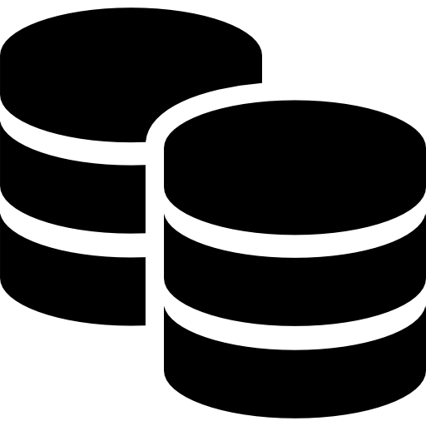
Database
Dashboard data store
Configuration Storage
Analytics and Reporting
User and Access Management
Audit Logs
Redis
Database
Gateway
Dashboard
Notes:
Tyk Dashboard requires a database to store and manage various types of data that are essential for its operation and the enhanced features it provides
The database stores API configurations, policies, and user settings. This allows the Dashboard to persistently manage and apply configurations across restarts and updates.
The database is used to store detailed analytics data collected from the Gateway. This data includes API usage statistics, performance metrics, and traffic logs, which the Dashboard processes to generate reports and insights.
Information about users, roles, and permissions is stored in the database. This supports the Dashboard's role-based access control and team collaboration features.
The database maintains audit logs of changes made through the Dashboard, providing a history of configuration changes and user actions for compliance and troubleshooting purposes.
Dashboard data store
Used by the Dashboard for data storage.
For production environments it is recommended to run MongoDB in a highly available manner e.g. MongoDB replica sets.
API configurations
Stores API configurations, analytics, Dashboard configurations, dashboard users, portal developers, portal configuration, policies, organisations.
Large size
Collections can grow large due to the amount of data collected.

Slide 6

Tyk Pump
Pumps analytics data to database
Data Aggregation
Data Transformation
Data Export
Flexibility
Redis
Pump
Database
Gateway
Dashboard
Notes:
Tyk Pump is a component of the Tyk API Management platform designed to handle the extraction, transformation, and loading (ETL) of analytics data from the Tyk Gateway into various storage backends.
Tyk Pump collects raw analytics data from the Tyk Gateway, which includes API usage statistics, performance metrics, and traffic logs.
It processes and transforms this data into a format suitable for storage and analysis, ensuring that it is structured and optimized for querying.
Tyk Pump exports the transformed data to various storage backends, such as databases (e.g., MongoDB, PostgreSQL), data warehouses, or analytics platforms. This allows for long-term storage and detailed analysis.
Tyk Pump supports multiple output targets, allowing organizations to choose the most suitable storage solution for their analytics needs.

Slide 7
Tyk Pro
Redis
Pump
Database
Gateway
Dashboard
Notes:
That sums up the main components that are part of the Tyk stack.
The Tyk stack is the full API management platform that runs on a single data center to meeting all your end to end API management needs.
In a later course, we will cover how from this Tyk Pro deployment in a single data center can be expanded to a multi-data center deployment. Let’s take a quick look at it

