Slide 1

Tyk Database:
MongoDB & PostgreSQL
Understanding the role of Tyk’s primary databases and how they support performance and high availability

Slide 2

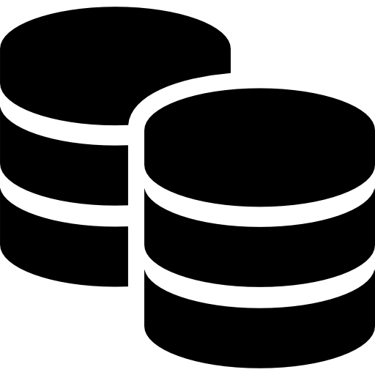


Tyk & Databases
Long-Term Data
API definitions/Policies
Analytics/Usage Statistics
Dashboard User and Access Management
Audit Logs
Supported Databases
PostgreSQL
MongoDB
Redis
Database
Gateway
Dashboard
Notes:
Tyk Dashboard requires a database to store and manage various types of data that are essential for its operation and the enhanced features it provides
The database stores API configurations, policies, and user settings. This allows the Dashboard to persistently manage and apply configurations across restarts and updates.
The database is used to store detailed analytics data collected from the Gateway. This data includes API usage statistics, performance metrics, and traffic logs, which the Dashboard processes to generate reports and insights.
Information about users, roles, and permissions is stored in the database. This supports the Dashboard's role-based access control and team collaboration features.
The database maintains audit logs of changes made through the Dashboard, providing a history of configuration changes and user actions for compliance and troubleshooting purposes.
Dashboard data store
Used by the Dashboard for data storage.
For production environments it is recommended to run MongoDB in a highly available manner e.g. MongoDB replica sets.
API configurations
Stores API configurations, analytics, Dashboard configurations, dashboard users, portal developers, portal configuration, policies, organisations.
Large size
Collections can grow large due to the amount of data collected.

Slide 3
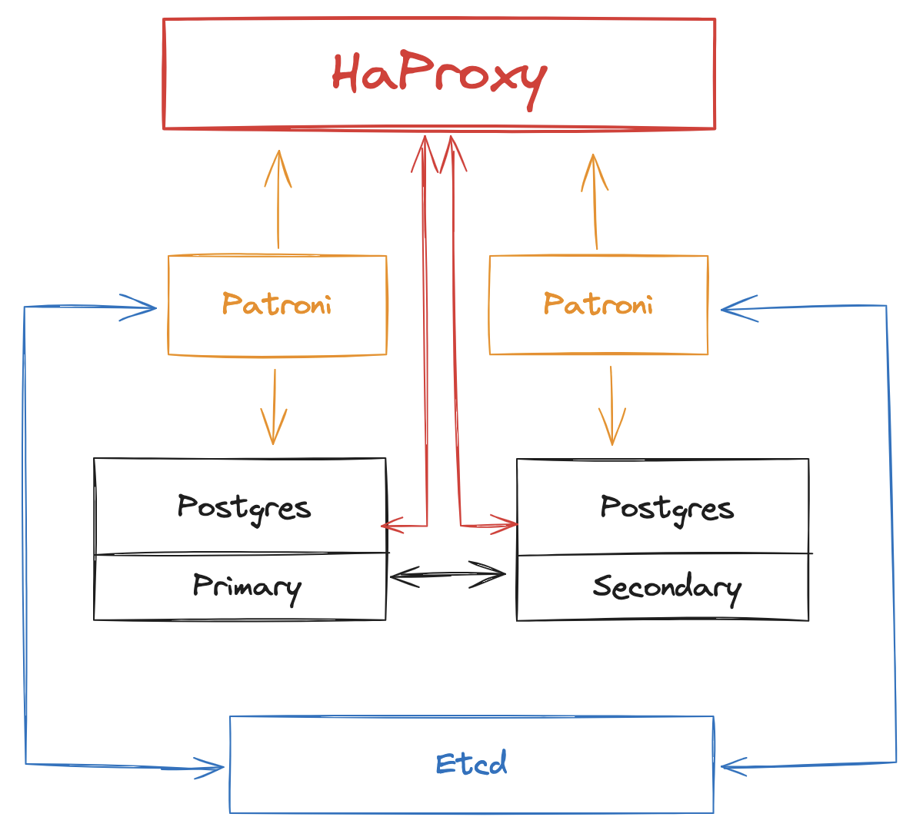
PostgreSQL
Combination of streaming replication, Patroni & Etcd for automated failover
HAProxy for load balancing:
Continuous Synchronization by streaming write-ahead logs (WAL) from primary to standby nodes
HAProxy
Monitors health of servers via Patroni(Primary & Standby)
Distributes incoming database connections
Etcd acts as a distributed key-value store for configuration management
Patroni
Manages failover and PostgreSQL cluster management, monitors health of servers & checking status & connectivity
Orchestrates standby promotion if there are issues detected on primary server
Notes:
To ensure high availability in a PostgreSQL setup, we can use a combination of streaming replication, Patroni, Etcd, and HAProxy. Note that you may have a different way of achieving this and this is solely for informational purposes.
Let's start with streaming replication. This enables continuous synchronization between the primary and standby PostgreSQL nodes by streaming the write-ahead logs, or WALs. It ensures that standby nodes are nearly up to date with the primary at all times.
Sitting on top of this is Patroni, which is responsible for managing the PostgreSQL cluster, handling failovers, and monitoring the health and connectivity of both primary and standby nodes.
In the event of an issue with the primary node, Patroni orchestrates a seamless promotion of a standby node, minimizing downtime.
Etcd supports this setup by acting as a distributed key-value store. It maintains the cluster state and helps coordinate decisions between nodes, ensuring there's no split-brain scenario during failover.
HAProxy plays the role of a load balancer. It constantly monitors server health via Patroni and distributes incoming database connections accordingly—directing reads and writes to the correct node depending on the cluster's current state.
Together, this setup provides a resilient, self-healing, and highly available PostgreSQL deployment designed to keep your database services running—even when things go wrong.

Slide 4
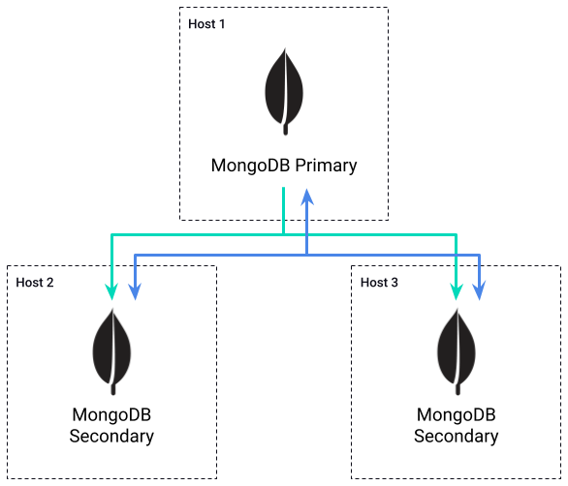
MongoDB
MongoDB uses Replica Sets for high availability:
Requires a minimum of three separate hosts for high availability
All members of Replica Set must be able to communicate with each other
Election occurs if Primary becomes inaccessible
Members can have different priorities, to determine the new Primary
A majority of Replica Set members are required for an election
Notes:
MongoDB uses what it calls Replica Sets to enable high availability deployments:
These deployments must consist of at least three hosts in order to be highly available. A three member replica set has a fault tolerance of 1 member, whereas a five member replica set has a fault tolerance of 2 members.
All members of the Replica Set must be able to communicate with each other. The purpose of this is to maintain a heartbeat between members, which provides a means of detecting when a member becomes inaccessible.
If the Primary member becomes inaccessible, then a new primary is elected from the remaining members.
Members can be given a priority, to determine which member is elected the new Primary. This might be useful to keep the Primary in a particular data centre, or on a high performance host.
In order to hold an election, a majority of members are required. This means that in the event of a network partition, the members on the minority side will not hold an election, and if the primary is within the minority group it will automatically step down as primary and become a secondary. This also means that replica sets must consist of an odd number of members, so that in the event of network partitions there will be majority and minority groups.

