Slide 1
Samsung
Innovation
Campus
Coding and Programming

Slide 2
Chapter 2.
Project
Coding and Programming

Slide 3
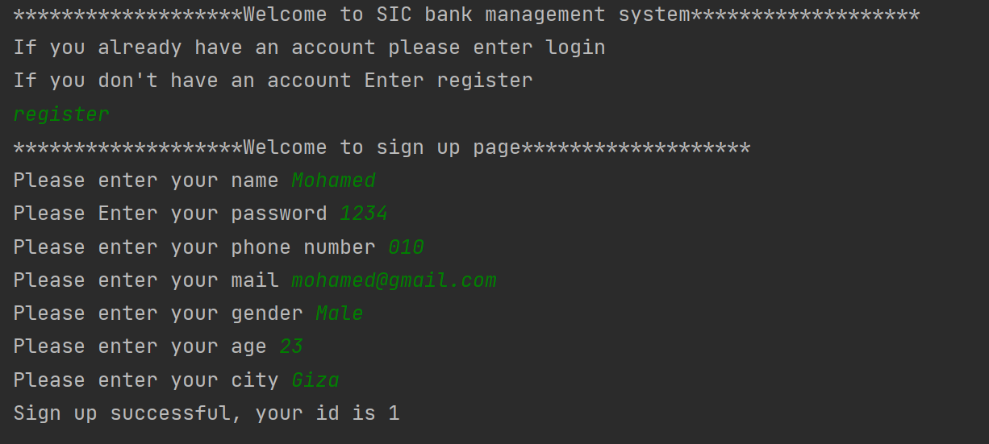
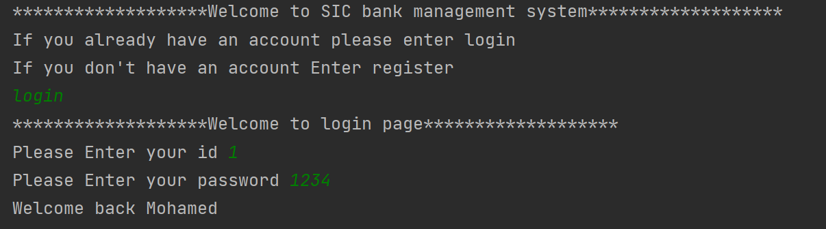
Project
Create SIC bank management system, In the home page the user should choose if he/she already have an account and will login using his/her id and password or he/she would create a new account, if the user entered false information a warning message should appear, and he/she should be allowed to renter it.

Slide 4
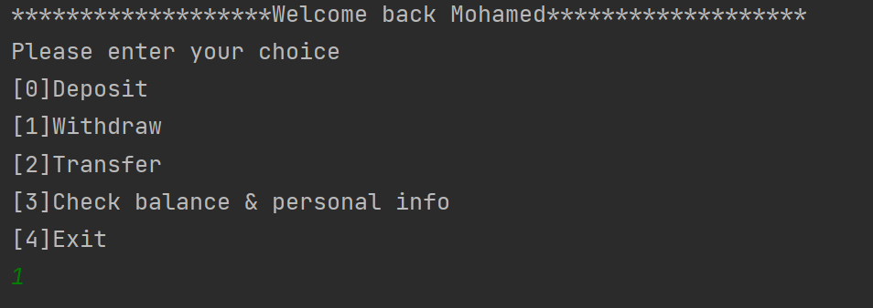
Project
After entering the system, The user should be able to see a menu of what he wants to do: deposit, transfer, check balance, withdraw or exit. If the user entered wrong input a warning message should appear, and he should be allowed to re-enter his choice.

Slide 5
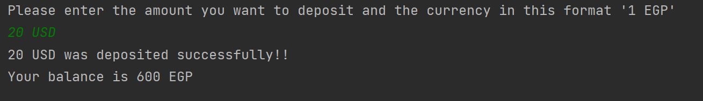
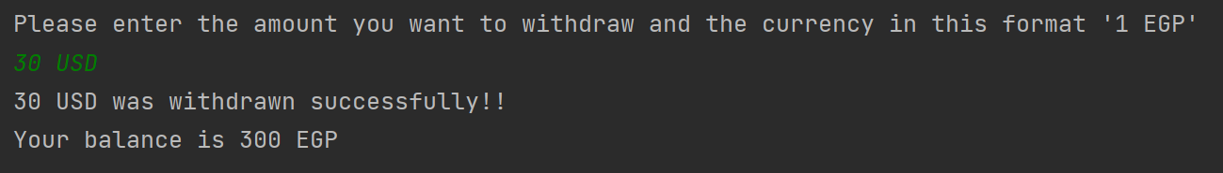
Project
In the deposit page the user should be asked the amount he want to deposit and the currency in which he will deposit whether USD, SAR or EGP and it should be converted to EGP in his bank account.
In the withdraw page the user should be asked the amount he want to withdraw and the currency in which he will withdraw whether USD, SAR or EGP and it should be converted to EGP in his bank account.

Slide 6
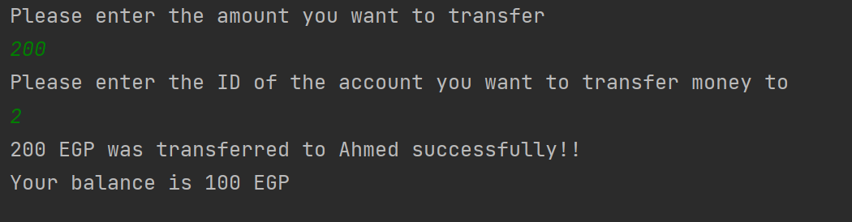
Project
In the transfer page the user should enter the amount he want to transfer and the id of the account he wants to transfer money to.
The system should check if this amount actually exists in his account and the second account actually exists in the system.

Slide 7
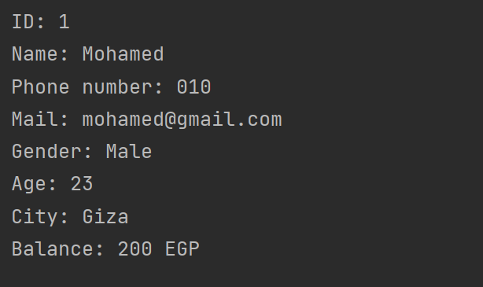
Project
If the user wants to check his balance or his personal information, he should be able to see it.

Slide 8
Project Hints
You can use a dictionary to store info of each user.
You can use a list to store dictionaries of all users and the user ID can be represented as the index of the user’s dictionary in the list.
While converting from 1 currency to another take in consideration that 1 USD = 30 EGP and 1 SAR = 9 EGP.
You can store the info of each user in a JSON file as a bonus task.
After entering the system, you can use a while loop to iterate multiple times on the features which the user can benefit from, The system should exit if and only if the user chooses to exit.

