Slide 1




TWITTER
Team #9
Mohamed ElEsh
Rodina Mohamed
David Nader
Esraa Elsayed

Slide 2
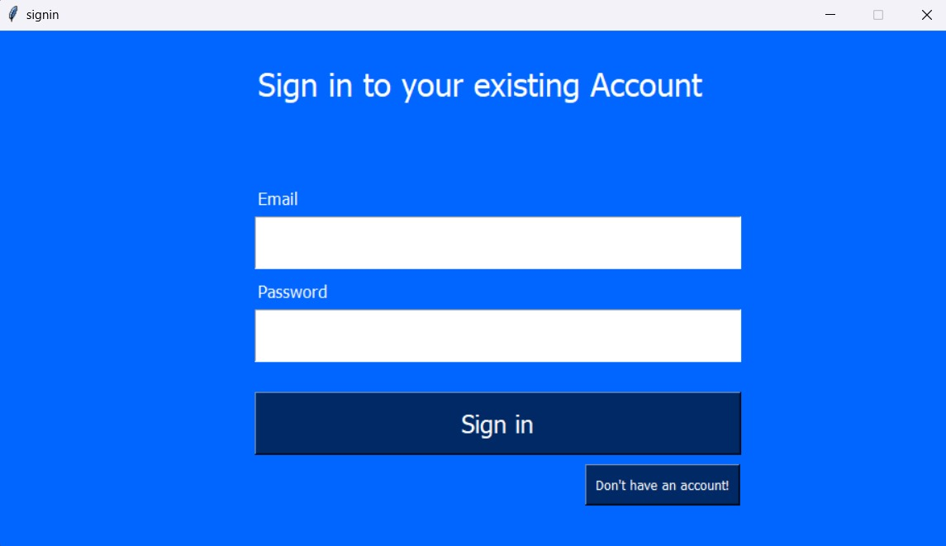
Team #9
Mohamed ElEsh
Rodina Mohamed
David Nader
Esraa Elsayed

Slide 3
Team #9
Mohamed ElEsh
Rodina Mohamed
David Nader
Esraa Elsayed
Sign in / Register Pages

Slide 4
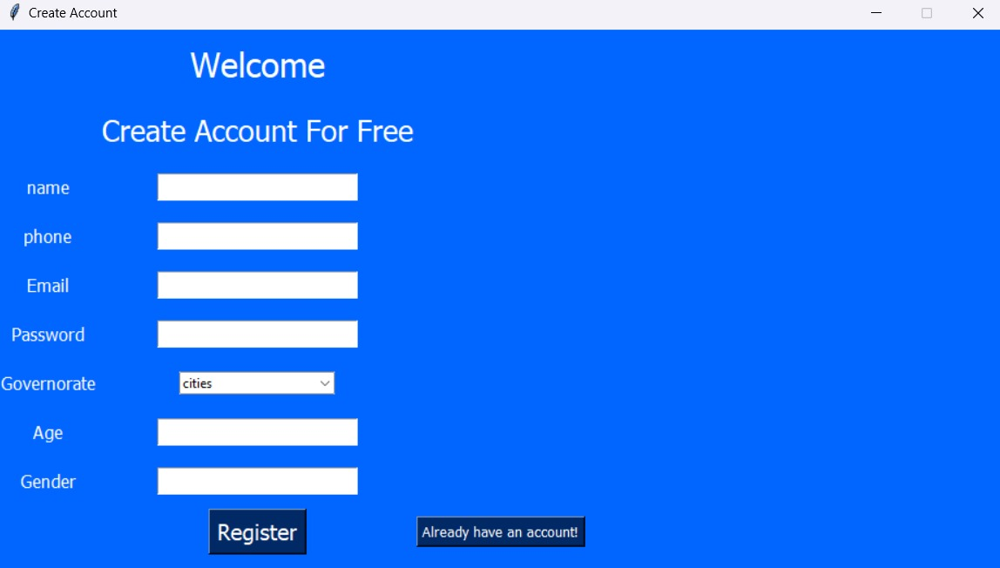
Team #9
Mohamed ElEsh
Rodina Mohamed
David Nader
Esraa Elsayed
Sign in / Register Pages

Slide 5
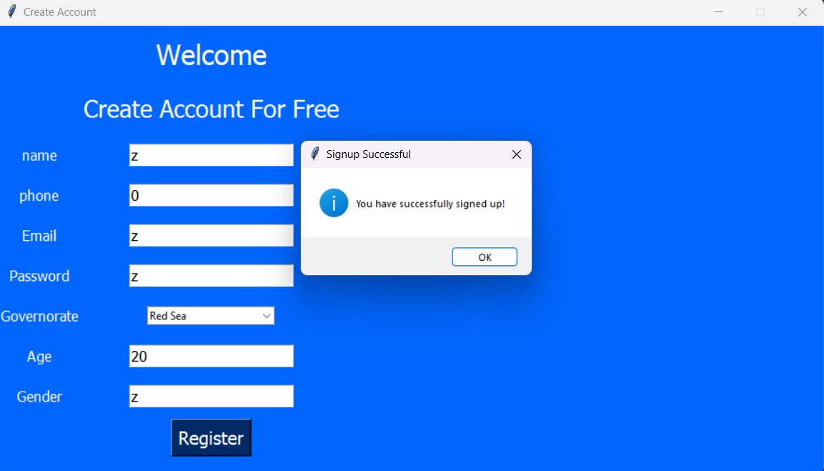
Team #9
Mohamed ElEsh
Rodina Mohamed
David Nader
Esraa Elsayed
Sign in / Register Pages

Slide 6
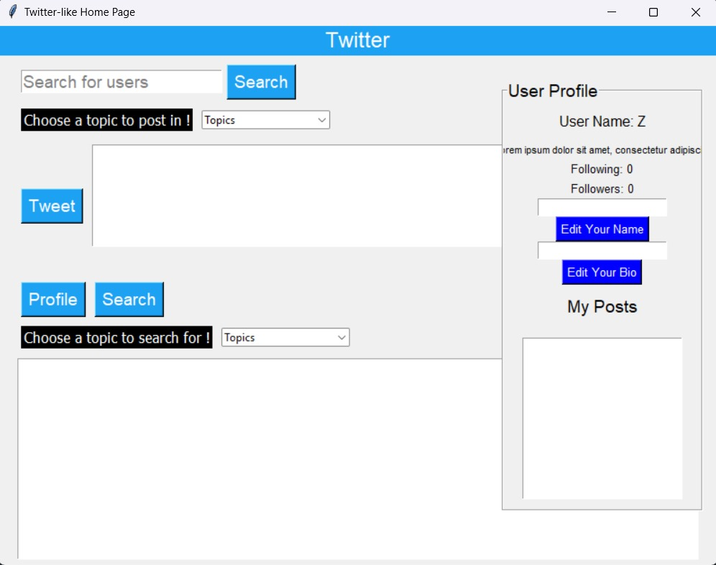
Team #9
Mohamed ElEsh
Rodina Mohamed
David Nader
Esraa Elsayed
Home page

Slide 7
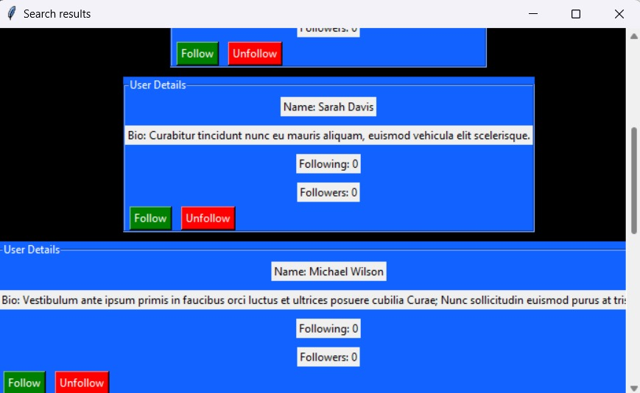
Team #9
Mohamed ElEsh
Rodina Mohamed
David Nader
Esraa Elsayed
Search page

Slide 8
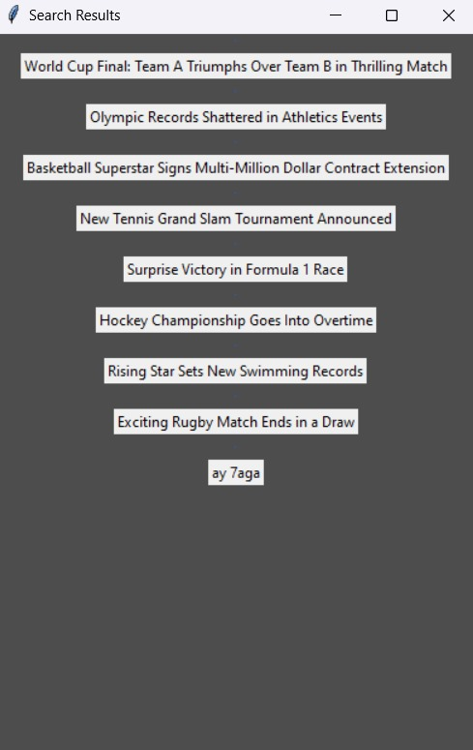
Team #9
Mohamed ElEsh
Rodina Mohamed
David Nader
Esraa Elsayed
Search page

Slide 9
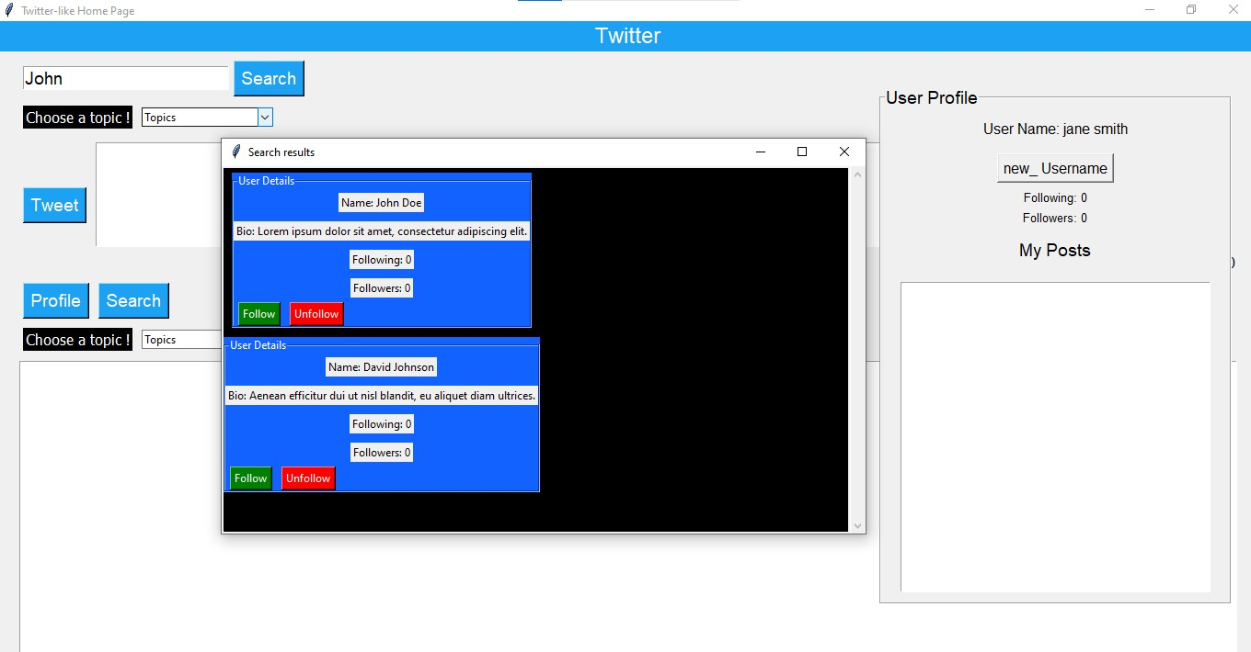
THE END :)
Team #9
Mohamed ElEsh
Rodina Mohamed
David Nader
Esraa Elsayed
Search page

Slide 10
Team #9
Mohamed ElEsh
Rodina Mohamed
David Nader
Esraa Elsayed
THE END :)

Slide 11
Thank you SIC community for this beautiful trip <3
THE END :)

