Slide 1

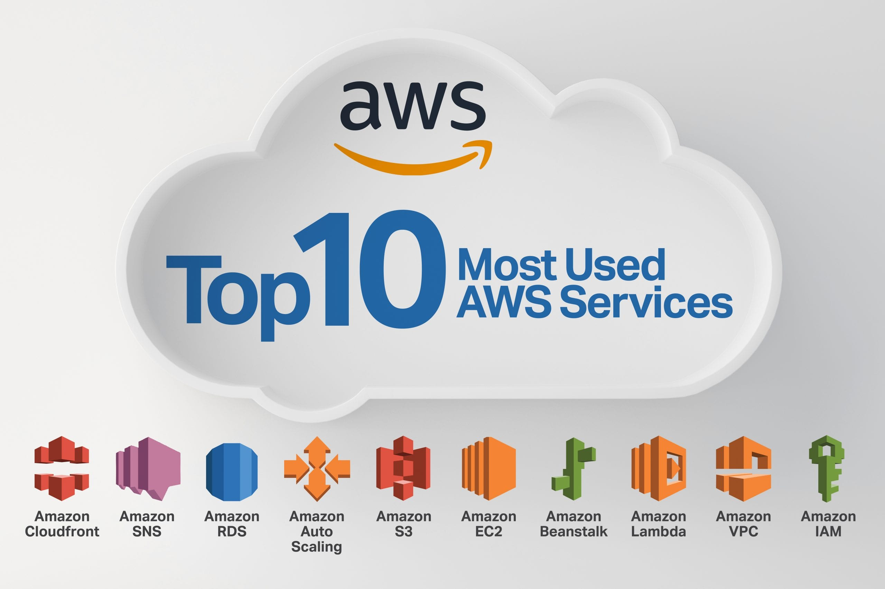
Faculty of Engineering and Technology
Department of Information and Communication Technology
Essential AWS APIs for Modern Cloud Engineering
By: Mohammed Hamid - 92301733059
Subject: Human Center Designed
Fab 2026

Slide 2
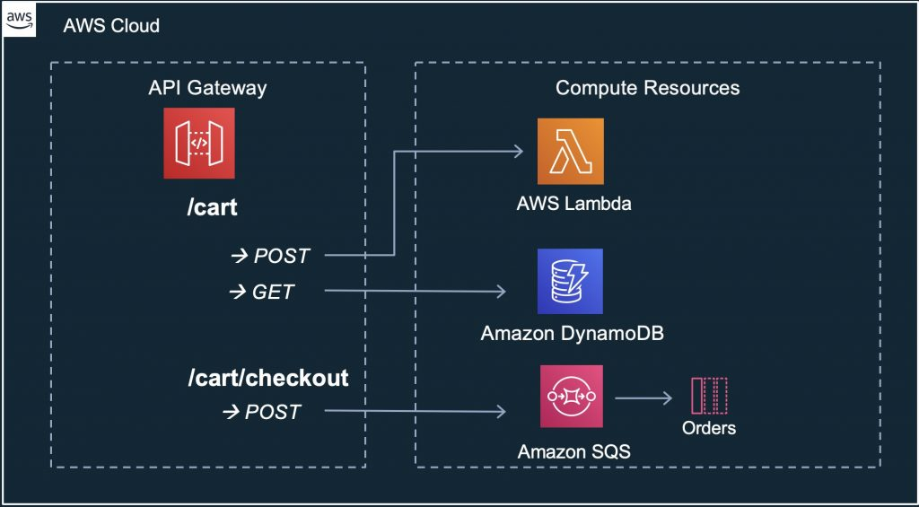
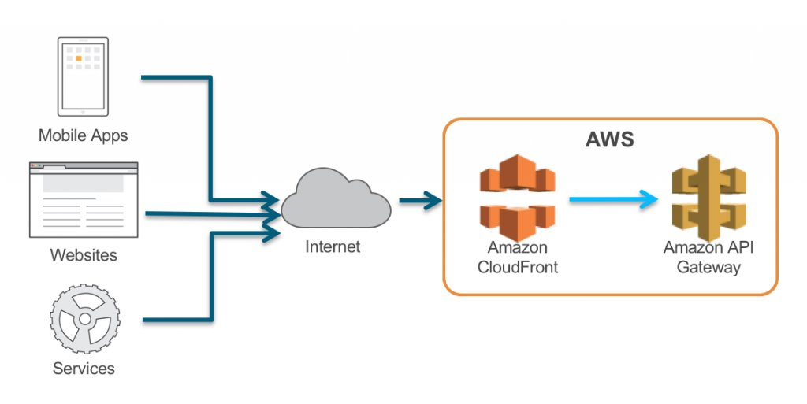
Role
In the world of Cloud Engineering, APIs are the "glue" that connects users, applications, and infrastructure. Since you are studying Human-Centered Design (HCD), it’s helpful to view APIs not just as code, but as the interface that translates human intent into machine action.

Slide 3
key points on the role of APIs in Cloud Computing:
Abstraction of Complexity: APIs allow developers to use complex cloud services (like Machine Learning or Global Databases) without needing to understand the underlying hardware or low-level code. From an HCD perspective, this simplifies the "mental model" for the engineer.
Automation and Orchestration: APIs enable Infrastructure as Code (IaC). Instead of a human manually clicking buttons in the AWS Console, scripts use APIs to deploy thousands of servers instantly, ensuring consistency and reducing human error.
Seamless Integration: Cloud computing relies on "Microservices"—small, independent pieces of software that talk to each other. APIs serve as the standardized communication channel that allows an authentication service to talk to a payment service or a storage bucket.
Scalability on Demand: APIs facilitate "Elasticity." When a user-facing application experiences a surge in traffic, the system sends an API call to the cloud provider to provision more resources immediately, maintaining a smooth user experience.
Security and Access Control: APIs act as gatekeepers. Every time a request is made to the cloud, the API checks for "keys" or "tokens." This ensures that only authorized users or applications can access sensitive data, which is a fundamental requirement for building trust in digital products.

Slide 4

1: Amazon EC2 API (Compute)
Definition: The interface for managing Elastic Compute Cloud instances. It allows you to programmatically launch, stop, and terminate virtual servers.
Key Features:
Auto-Scaling: Automatically adjusts capacity based on human traffic patterns.
Instance Customization: Choose CPU, GPU, and RAM configurations tailored to specific user needs.
Global Reach: Deploy servers in multiple regions to reduce latency for the end user.

Slide 5

2: Amazon S3 API (Storage)
Definition: An object storage service API designed to store and retrieve any amount of data from anywhere on the web.
Key Features:
99.99% Durability: Ensures user data is never lost.
Static Web Hosting: Host front-end HCD prototypes directly from a bucket.
Lifecycle Policies: Automatically moves old data to cheaper storage to save costs.

Slide 6

3: AWS Lambda API (Serverless)
Definition: A serverless compute service that runs code in response to triggers without the need to manage servers.
Key Features:
Event-Driven: Runs only when a user interacts (e.g., clicking a button or uploading a file).
No Infrastructure Overhead: Allows engineers to focus solely on the user-facing logic.
Sub-second Scaling: Handles 1 user or 10,000 users instantly.

Slide 7
4: Amazon API Gateway
Definition: A fully managed service that makes it easy for developers to create, publish, and maintain secure APIs at any scale.
Key Features:
Traffic Management: Prevents backend crashes by "throttling" excessive user requests.
Caching: Stores common responses to make the application feel faster to the human user.
Security: Integrates with IAM and Cognito for user authentication.

Slide 8

5: Amazon DynamoDB API (NoSQL Database)
Definition: A fast and flexible NoSQL database service for applications that need single-digit millisecond latency.
Key Features:
Schema-less: Easily adapt data structures as user requirements change.
Consistent Performance: Performance remains the same whether the table is 1GB or 100TB.
Point-in-Time Recovery: Protects against accidental user errors or deletions.

Slide 9

6: AWS IAM API (Security)
Definition: The Identity and Access Management API used to securely control access to AWS services.
Key Features:
Least Privilege: Ensures users only have access to what they need—a core principle of secure HCD.
Multi-Factor Authentication (MFA): Adds a layer of human-centric security.
Roles: Temporary permissions for applications, reducing the risk of hardcoded keys.

Slide 10
7: Amazon CloudWatch API (Monitoring)
Definition: A monitoring and observability service that provides data and actionable insights for applications.
Key Features:
Real-time Dashboards: Visualizes how humans are experiencing your app (errors, speed, etc.).
Alarms: Automatically notifies engineers if the user experience is degrading.
Log Insights: Helps troubleshoot why a user had a specific problem.

Slide 11
8: Amazon Cognito API (Authentication)
Definition: Provides a simple way for users to sign up and sign in to your web and mobile apps.
Key Features:
Social Login: Allows users to sign in with Google, Facebook, or Amazon.
User Pools: A secure directory that scales to millions of users.
Adaptive Authentication: Detects unusual login patterns to protect human accounts.

Slide 12
9: Amazon Rekognition API (AI/Vision)
Definition: An AI service that makes it easy to add image and video analysis to your applications.
Key Features:
Facial Analysis: Detects emotions (Happy, Sad, Angry), which is vital for HCD research.
Content Moderation: Automatically removes inappropriate content to protect users.
Object Detection: Helps build accessible apps for visually impaired users.

Slide 13

10: AWS CloudFormation API (Infrastructure as Code)
Definition: An API that allows you to model and set up your entire AWS infrastructure using a simple text file.
Key Features:
Consistency: Deploy the exact same environment for testing and production.
Version Control: Track changes to your infrastructure like you track code.
Rollbacks: If a new update breaks the user experience, you can revert to the previous state instantly.

