Slide 1



LOW-CODE APPLICATION DEVELOPMENT
Course Feedback
Sentiment Analysis
A Low-Code Application for Automated Feedback Classification and Faculty Review
Presented by: Mohammed Hamza
B.E. Computer Science Engineering — Third Year
Rajalakshmi Engineering College
Subject: Low-Code Application Development using Zoho Creator
Subject Code: CB23F35
Positive
Neutral
Negative
Notes:
Introduce the project as a low-code application that connects feedback submission, built-in AI sentiment classification, and faculty review.

Slide 2
PROBLEM STATEMENT
Manual feedback review creates avoidable friction
Faculty must manually read and analyze large volumes of student feedback, making sentiment identification, review, and response organization difficult.
MANUAL REVIEW
APPLICATION PATH
Read and sort by hand
Submit, classify, review
Feedback is centralized for faculty review and classified with built-in Zia Sentiment Analysis.
Objectives
Centralize course and faculty feedback.
Enable student feedback submission.
Classify sentiment with Zoho Zia’s built-in Sentiment Analysis.
Give faculty a dedicated review interface.
Separate Student and Faculty access with Role-Based Access Control.
Improve feedback organization and review efficiency.
Notes:
Contrast the friction of manual review with the intended application path. Emphasize that the goal is organization and review efficiency, not a custom AI model.

Slide 3
SYSTEM ARCHITECTURE
Zoho Creator connects submission, AI classification, and review
Administrator manages application data and user access.
System architecture
Technology stack
Platform: Zoho Creator
Low-code development: Forms, Reports, Pages
AI processing: Native Zoho Zia Sentiment Analysis
Database: Zoho Creator built-in data storage
Access control: User Permissions and Permission Sets
Workflow: Zoho Creator Form Workflow
1
Student
2
Feedback Submission Form
3
Built-in Zoho Zia Sentiment Analysis
4
Feedback Records
5
Faculty Feedback Review
6
Reports and Dashboard
Notes:
Walk left to right through the architecture. Clarify that Zia is a built-in AI feature of Zoho Creator, not a separately trained model.

Slide 4



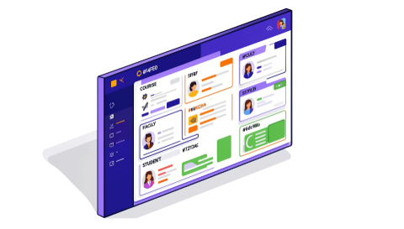
APPLICATION STRUCTURE
Three role-based modules organize the application
Student module
Faculty module
Feedback Submission Form · Course and Faculty feedback entry · Submission interface · Restricted access to feedback review records
Feedback Review Form · View and review submissions · Review Status management · Restricted access to student submission interface
Administrator module
Course Catalog management · Faculty Profile management · Student Profile management · Application-level management and dashboard access
Supporting features: Feedback Submission · Feedback Review · Sentiment classification · Reports and dashboard
Notes:
Explain the application through its three user roles. Each module has a focused responsibility and restricted access to the other role’s interface.

Slide 5

BUILT-IN AI CLASSIFICATION
Built-in Zia turns written feedback into organized sentiment
The application uses Zoho Creator’s native Zia Sentiment Analysis to classify submitted feedback.
Sentiment categories
Positive: satisfaction, appreciation, or positive experiences. Neutral: factual or balanced observations. Negative: dissatisfaction, concerns, or criticism.
Example
“The faculty explains concepts clearly and makes learning interesting.” → Positive
Benefits
Automated sentiment classification · Reduced manual analysis · Organized feedback records · Easier identification of positive and negative feedback
Notes:
Use the example sentence to show the audience what the built-in classification produces. The categories are Positive, Neutral, and Negative.

Slide 6
Role-based access keeps submission and review responsibilities separate
Role | Access, restriction or responsibility
Student | Access to Feedback Submission; restricted access to Feedback Review.
Faculty | Access to Feedback Review; restricted access to Feedback Submission.
Administrator | Manages application-level records and configurations.
Workflow
1
2
3
4
5
Feedback Submission
Feedback Record Creation
Sentiment Classification
Faculty Feedback Review
Review Status Update
Workflow rule: A form workflow controls Resolution Date visibility based on Review Status.
Security benefits: Role-specific access · Separation of responsibilities · Restricted form access · Improved application security
Notes:
Emphasize separation of responsibilities. The workflow uses Zoho Creator Form Workflow and does not imply advanced Blueprint workflows, batch workflows, custom Deluge scripts, or external integrations.

Slide 7
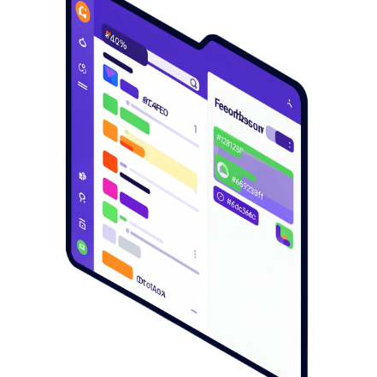
PROJECT REVIEW
Testing confirms a functional low-code feedback application
Testing
Results
Verified Student access to Feedback Submission; restrictions on Feedback Review.
Verified Faculty access to Feedback Review; restrictions on Feedback Submission.
Tested built-in Zia sentiment classification.
Tested Review Status and Resolution Date visibility workflow.
Centralized course feedback application developed; functional low-code application created using Zoho Creator.
Sentiment classification automated with native Zia AI; Role-specific Student and Faculty access implemented.
Feedback submission and review organized more efficiently.
Conclusion
Low-code development and built-in AI combine to create an organized, secure, and efficient course feedback management system.
Thank You
Questions & Answers
Notes:
Close with the evidence from testing: access restrictions, built-in Zia classification, and the Review Status workflow were verified. Then summarize the application as organized, secure, and efficient.

