Slide 1
Agenda
Introduction
History
Types of AI
Agents
Bonus Slide

Slide 2
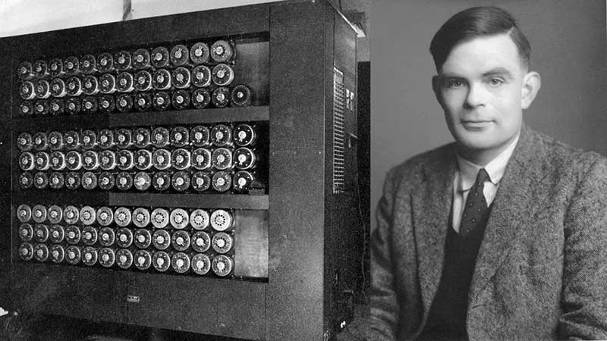
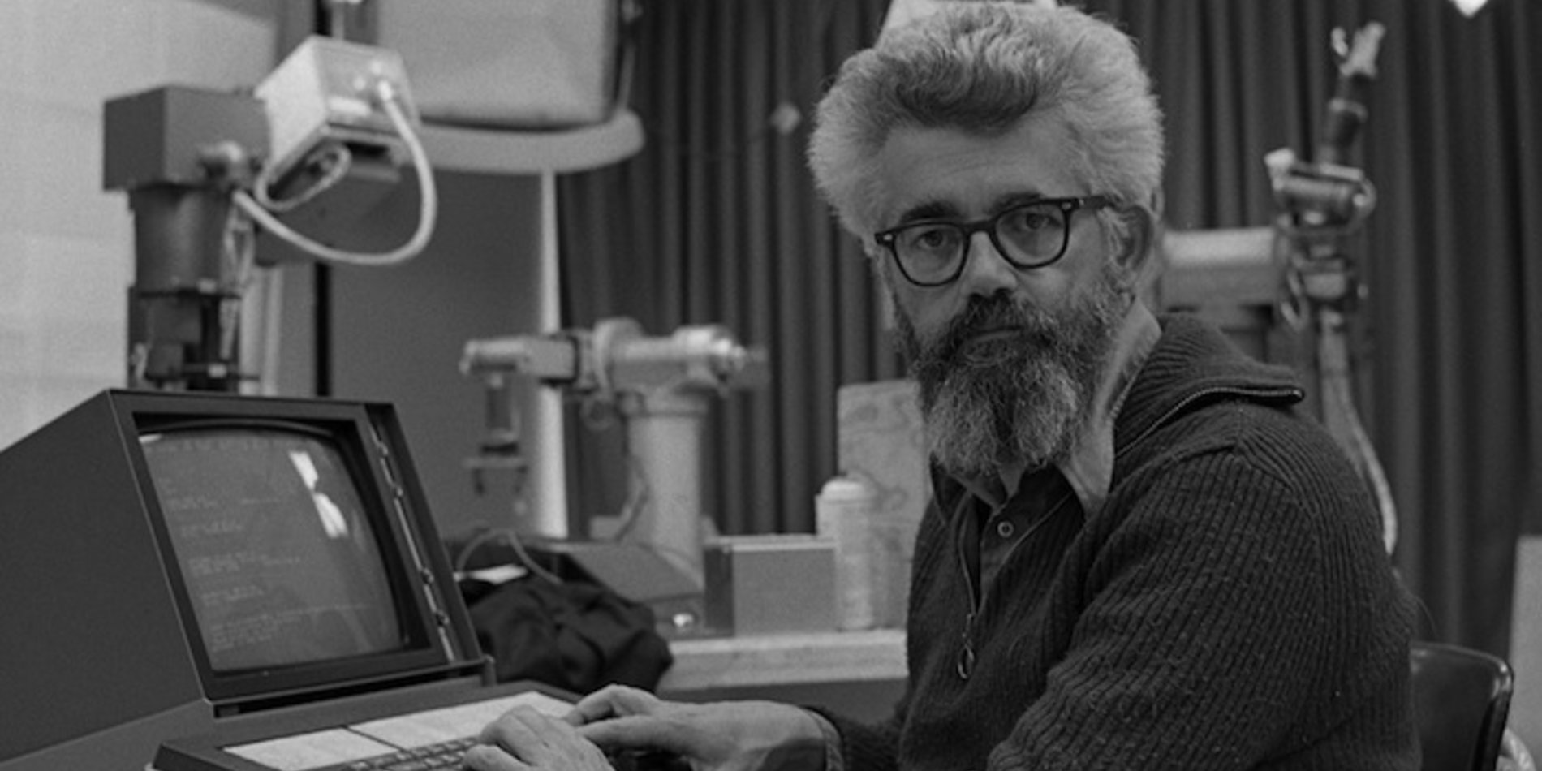
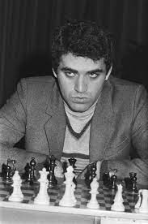
History
Allen Turing → (1950)
John McCarthy→ (1956) → Coined a term AI
(1965) → ELIZA, chatbot
(1989) → Garry Kasparov failed

Slide 3
Types of AI
ANI (Weak)
AGI (Strong)
ASI (terminator)

Slide 4
Agents
Simple Reflex Agents
Model based reflex agents
Goal based agents
Utility based agents
Learning agents

Slide 5
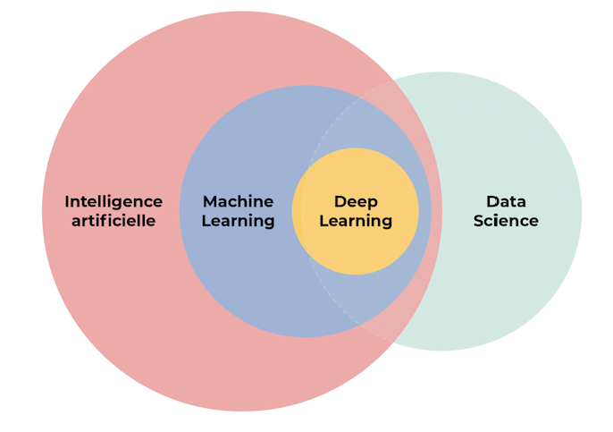
Bonus Slide
Python
Linear Algebra
Calculus
Statistics
SK-learn
Keras
Pytorch
Tensorflow
NLTK

