Slide 1
Implementing Data Integrity by Using Constraints
Lab 3
Notes:
This module introduces indexes, and describes how to implement data integrity in Microsoft® SQL Server® 2008 by using constraints and triggers.
After completing this module, students will be able to:
Describe the options for enforcing data integrity in SQL Server 2008.
Implement data integrity by using constraints.
Implement data integrity by using triggers.
Required materials
To teach this module, you need the Microsoft Office PowerPoint® file 6232A_04.ppt.
Important It is recommended that you use PowerPoint 2002 or a later version to display the slides for this course. If you use PowerPoint Viewer or an earlier version of PowerPoint, all the features of the slides might not be displayed correctly.
Preparation tasks
To prepare for this module:
Read all of the materials for this module.
Practice performing the demonstrations and the lab exercises.
Work through the Module Review and Takeaways section and determine how you will use this
section to reinforce student learning and promote knowledge transfer to on-the-job performance.
Make sure that students are aware that there are additional information and resources for the module on the Course Companion CD.
Module 4: Implementing Data Integrity by Using Constraints and Triggers
Course 6232A

Slide 2
Module Map
Database objects
Overview of Data Integrity
Check Constraints
Primary Key and Unique Constraints
Constraint Management
Defaults
Rules

Slide 3
Database Objects
Description | Object
Contains all data in SQL server databases | Table
Act as a virtual table or a stored query | View
Enable Fast retrieval, build from one or more columns in table or view | Index
Execute a batch of SQL code when an insert, update or delete command is executed against a specific table | Triggers
Accept parameters, contain statements, and return values | Procedure
Prevent inconsistent data from being placed in a column | Constrains
Specify acceptable values that can be inserted in column | Rules

Slide 4
Data Integrity
Data integrity helps to ensure that the data within a database is correct. This module discusses one method for enforcing the three types of data integrity
Three types of integrity help to ensure the correctness of data
Domain integrity
Ensures that any value in a column is within the acceptable set of values for that column
Entity integrity
Ensures that every row of a table can be uniquely identified
Referential integrity
Ensures that a given value cannot be entered in one table unless the value already exists in another table

Slide 5

Types of Data Integrity
Domain Integrity
(Columns)
Entity Integrity
(Rows)
Referential Integrity
(Between Tables or Columns of the Same Table)
Notes:
Enforcing data integrity ensures the quality of the data in the database.
The various types of data integrity developers must plan for are domain integrity, entity integrity, and referential integrity.
Entity integrity states that every table must have a primary key and that the column or columns chosen to be the primary key should be unique and not null. For example, if an employee table uses the employee identification number as the primary key, then there cannot be a row containing an employee without an employee identification number, nor can there be more than one employee with the same number.
Referential integrity states that any foreign key value must exist or be null. For example, if you have a table of employee contact details which refers to the employee table via the employee identification number, there cannot be a row in the contact table that uses an employee identification number that does not also exist in the employee table.
Domain integrity specifies that all columns in relational database must be declared upon a defined domain. For example, you would not have a phone number in the employee identification column, or a negative number in the age column.
Mention that XML schemas and XML data integrity will be covered in a later module.
Module 4: Implementing Data Integrity by Using Constraints and Triggers
Course 6232A

Slide 6


Options for Enforcing Data Integrity
Mechanism | Description
Data types | Define the type of data that can be stored in a column
Rules | Define the acceptable values that can be inserted into a column
Defaults | Define the value of a column is a value is not specified
Constraints | Define how the Database Engine enforces data integrity
Triggers | Define code that is executed automatically when table is modified
Notes:
Module 4: Implementing Data Integrity by Using Constraints and Triggers
Course 6232A

Slide 7
Two Methods of Enforcement
Focus of this module: constraints

Slide 8
What Are Constraints?
Integrity type | Constraint type | Description
Domain | DEFAULT | Specifies default value for column
 | CHECK | Specifies allowed value for column
 | FOREIGN KEY | Specifies column in which values must exist
 | NULL | Specifies whether NULL is permitted
Entity | PRIMARY KEY | Identifies each row uniquely
 | UNIQUE | Prevents duplication of nonprimary keys
Referential | FOREIGN KEY | Defines columns whose value must match the primary key of this table
 | CHECK | Specifies the allowed value for a column based on the contents of another column
Notes:
Module 4: Implementing Data Integrity by Using Constraints and Triggers
Course 6232A

Slide 9
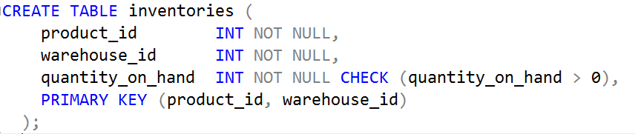
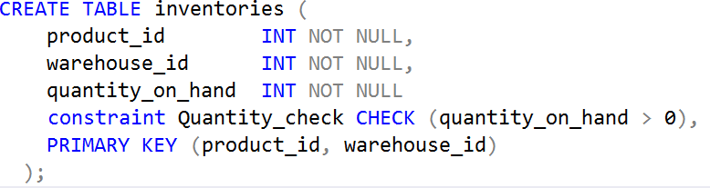
Column-Level Check Constraint
Without constrain Name
With constrain Name
Notes:
CREATE TABLE inventories (
product_id INT NOT NULL,
warehouse_id INT NOT NULL,
quantity_on_hand INT NOT NULL CHECK (quantity_on_hand > 0),
PRIMARY KEY (product_id, warehouse_id)
);
If the user does not supply a name for a column-level constraint, Adaptive Server generates one in the format table_column_systemID: inventories_ quantity_on_hand _015468
To simplify constraint management, the user should supply a name for all constraints
Constraint names must be unique within a database

Slide 10
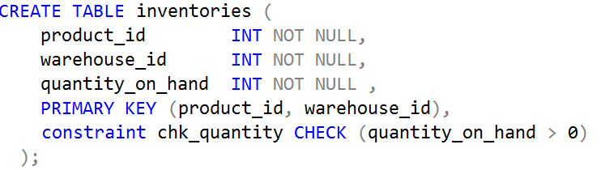
Table-Level Check Constraint
Notes:
CREATE TABLE inventories (
product_id INT NOT NULL,
warehouse_id INT NOT NULL,
quantity_on_hand INT NOT NULL ,
PRIMARY KEY (product_id, warehouse_id),
constraint chk_quantity CHECK (quantity_on_hand > 0)
);

Slide 11
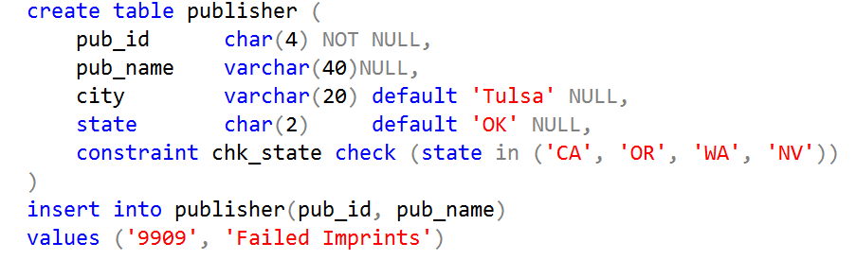
Check Constraints and Defaults
Adaptive Server allows a table to have a default and check constraint that contradict one another
Any insert using the default will fail
Notes:
create table publisher (
pub_idchar(4)NOT NULL,
pub_namevarchar(40)NULL,
cityvarchar(20)default 'Tulsa' NULL,
statechar(2)default 'OK' NULL,
constraint chk_state check (state in ('CA', 'OR', 'WA', 'NV'))
)
insert into publisher(pub_id, pub_name)
values ('9909', 'Failed Imprints')

Slide 12
Two Methods of Enforcement
Focus of this module: constraints

Slide 13
Primary Key Constraint
A primary key constraint enforces entity integrity
It creates a unique index on the column(s) specified
Integrity is enforced during inserts and updates
Limit of one primary key constraint per table

Slide 14
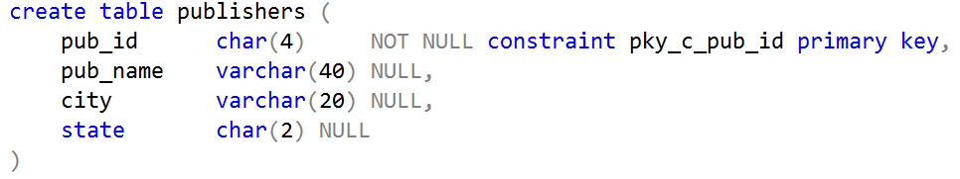
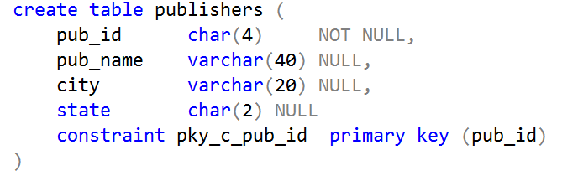
Column/Table Level Primary Key Constraint
Column Level:
Table level
Notes:
create table publishers (
pub_idchar(4) NOT NULL constraint pky_c_pub_id primary key,
pub_namevarchar(40)NULL,
cityvarchar(20)NULL,
statechar(2)NULL
)
Table level

Slide 15
Unique Constraint
A unique constraint also enforces entity integrity
It creates a unique index on the column(s) specified
Integrity is enforced during inserts and updates
Tables can have more than one unique constraint

Slide 16
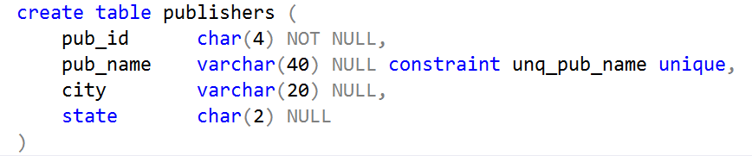
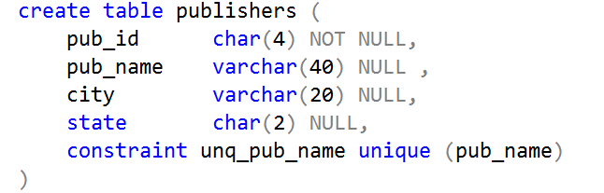
Column/Table-Level Unique Constraint
Column Level
Table Level
Notes:
create table publishers (
pub_idchar(4)NOT NULL,
pub_namevarchar(40)NULL ,
cityvarchar(20)NULL,
statechar(2)NULL,
constraint unq_pub_name unique (pub_name)
)

Slide 17
Primary Key Constraints VS Unique Constraints

Slide 18

Key Constraints Summary
Primary Key Constraints:
One PRIMARY KEY per table – based on one or more columns
CREATE TABLE [HumanResources].[Department] (…
CONSTRAINT [PK_Department_DepartmentID] PRIMARY KEY CLUSTERED ([DepartmentID] ASC) WITH (IGNORE_DUP_KEY = OFF) ON [PRIMARY])
Value must be unique – null values not allowed
Foreign Key Constraints:
Referential between columns in same or different tables
ALTER TABLE [Sales].[SalesOrderHeader] WITH CHECK
ADD CONSTRAINT [FK_SalesOrderHeader_Customer_CustomerID] FOREIGN KEY ([CustomerID]) REFERENCES [Sales].[Customer] ([CustomerID])
Must reference PRIMARY KEY or UNIQUE constraint
Notes:
Use this slide to explain what a key constraint is and discuss the relationship between a primary key and a foreign key.
A PRIMARY KEY constraint defines one or more columns in a table that constitute a primary key. The primary key uniquely identifies a row in a table and enforces entity integrity of the table. Mention also that a multi-column key, is also known as a composite primary key.
A FOREIGN KEY is a column or combination of columns that is used to establish and enforce a link between the data in two tables. Emphasize the point that indexes are not automatically created on foreign keys, and that this may be a performance issue that needs addressing.
You may find it helpful to show students an example of a primary key constraint in a database diagram in SQL Server Management Studio. The primary/foreign key relationship is best understood with the help of an example. For example, you might look at the Person.BusinessEntity table in the AdventureWorks2008 database.
Question: Is a foreign key always unique? Why or why not?
Answer: No, a foreign key is not always unique. For example, a table may contain a primary key such as a SalesPerson ID. The foreign key may be the SalesPerson ID in another table which lists the sales made. There may be multiple sales records for each SalesPerson ID.
Module 4: Implementing Data Integrity by Using Constraints and Triggers
Course 6232A

Slide 19
Summary
DEFAULT | Defines the value of a column if a value is not specified Only one DEFAULT per column Some system functions allowed
CHECK | Restricts the values that can be entered into a column Multiple CHECK constraints allowed per column Can reference columns in same table, no subqueries
UNIQUE | Ensures that every value in a column is unique Only one NULL value allowed in a unique column Can include one or more columns
Notes:
This slide discusses the other constraint types and gives examples of using each.
A DEFAULT constraint enters a value in a column when one is not specified in an INSERT statement. DEFAULT constraints enforce domain integrity.
A CHECK constraint restricts the data values that users can enter into a particular column during INSERT and UPDATE statements.
A UNIQUE constraint specifies that two rows in a column cannot have the same value.
Discussion: Ask students for examples of integrity requirements that could be implemented using CHECK constraints.
Highlight the difference between PRIMARY KEY constraints and UNIQUE constraints. Ask students for examples of when to use UNIQUE constraints.
Question: How would you create constraints for different columns to ensure that a person's calculated age is never a negative value?
Answer: You could make sure that the CHECK constraint is enabled for the date of birth column and that it is never allowed to be null or after today’s date. You could also default any transactional dates (such as issue date, hire date, or other) to today’s date in case no value is specified and use a check constraint to ensure that they never precede the date of birth.
Module 4: Implementing Data Integrity by Using Constraints and Triggers
Course 6232A

Slide 20

Adding Constraints
Simplified add syntax:
alter table table_name
add constraint constraint_name
{ check (condition) | primary key (column_list) | unique (column_list) |
foreign key (column_list) references table (column_list) }
Examples:
Notes:
alter table roysched
add constraint chk_hirange_lorange
check (hirange > lorange)
alter table publishers
add constraint pky_pub_id
primary key (pub_id)
alter table titles
add constraint ref_pub_id
foreign key (pub_id)
references publishers(pub_id)

Slide 21



Dropping Constraints
Simplified drop syntax:
alter table table_name
drop constraint constraint_name
Examples:
Notes:
alter table roysched
drop constraint chk_hirange_lorange
alter table publishers
drop constraint pky_pub_id
alter table publishers
drop constraint unq_pub_name
alter table titles
drop constraint ref_pub_id

Slide 22
System-Defined Constraint Messages
System-defined constraint messages are displayed when a statement fails due to a constraint violation
Example:
insert into publishers
values ("9222", "John, Manning & Sladen",
"Salem", "OR")
Msg 548, Level 16, State 1:
Line 1:
Check constraint violation occurred, dbname =
'pubs2', table name = 'publishers',
constraint name = 'chk_pub_id'.

Slide 23
User-Defined Constraint Messages
A user-defined constraint message is displayed when a statement fails due to a check or references constraint violation
The system-defined constraint message is not displayed
Example:
insert into publishers
values ("9222", "John, Manning & Sladen",
"Salem", "OR")
Msg 30001, Level 16, State 1:
Line 1:
The publisher ID must be in the format 99xx.
Each x must be a digit 0 through 9.

Slide 24
Default
A default is a database object that supplies a value to a column during an insert statement if no value was specified for that column
It can be bound to one or more columns

Slide 25
Creating and Binding Defaults
Simplified Create Syntax:
create default default_name as
constant_expression
Example:
create default def_state as "CA"
Simplified Bind Syntax:
sp_bindefault default_name, object_name
Example:
sp_bindefault def_state, "publishers.state"

Slide 26
Rules for Binding Defaults
A column can have only one default bound to it
If you attempt to bind a default to a column that already has a default bound to it, the attempted binding fails
A column with a default clause cannot have a default bound to it
When a default is bound, existing data in the table is not affected
It applies only to data inserted after the default was bound

Slide 27
Unbinding and Dropping Defaults
Simplified unbind syntax:
sp_unbindefault object_name
Example:
sp_unbindefault "publishers.state"
Simplified drop syntax:
drop default default_name
Example:
drop default def_state

Slide 28
Database Objects
Description | Object
Contains all data in SQL server databases | Table
Act as a virtual table or a stored query | View
Enable Fast retrieval, build from one or more columns in table or view | Index
Execute a batch of SQL code when an insert, update or delete command is executed against a specific table | Triggers
Accept parameters, contain statements, and return values | Procedure
Prevent inconsistent data from being placed in a column | Constrains
Specify acceptable values that can be inserted in column | Rules

Slide 29
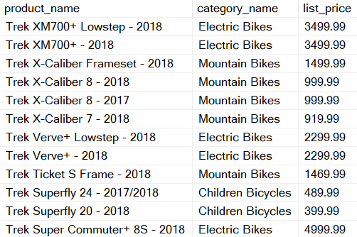
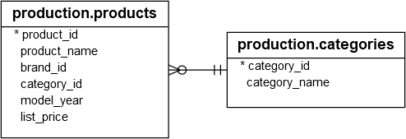
Views In SQL Server
SELECT product_name,category_name, list_price
FROM production.products p INNER JOIN production.categories c
ON c.category_id = p.category_id

Slide 30
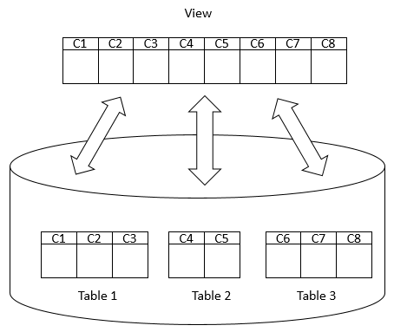
Views In SQL Server
create view sales.view_prd_categ
as
SELECT product_name,category_name, list_price
FROM production.products p INNER JOIN production.categories c
ON c.category_id = p.category_id
select * from sales.view_prd_categ

Slide 31
Advantages of views
Security
You can restrict users to access directly to a table and allow them to access a subset of data via views.
For example, you can allow users to access customer name, phone, email via a view but restrict them to access the bank account and other sensitive information.
Simplicity
A relational database may have many tables with complex relationships e.g., one-to-one and one-to-many that make it difficult to navigate.

Slide 32
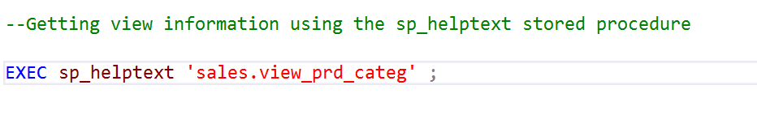
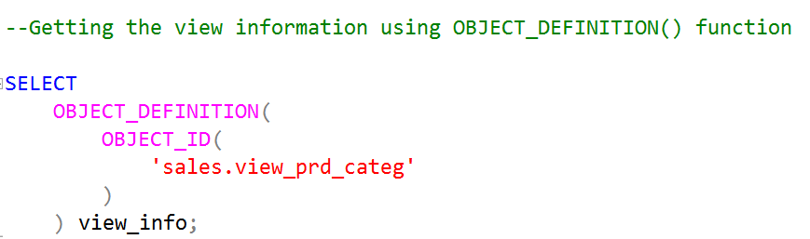
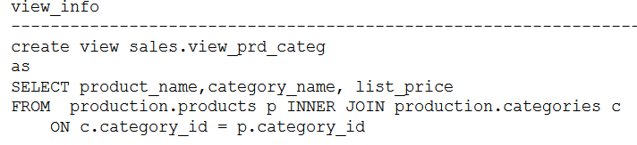
Getting Views information

Slide 33
DROP VIEW
-- Syntax
drop view [IF EXISTS] schema_name.view_name;
To remove multiple views
drop view IF EXISTS sales.view_prd_categ;
-- Syntax
drop view [IF EXISTS]
schema_name.view_name,
schema_name.view_name,
schema_name.view_name;

Slide 34
Database Objects
Description | Object
Contains all data in SQL server databases | Table
Act as a virtual table or a stored query | View
Enable Fast retrieval, build from one or more columns in table or view | Index
Execute a batch of SQL code when an insert, update or delete command is executed against a specific table | Triggers
Accept parameters, contain statements, and return values | Procedure
Prevent inconsistent data from being placed in a column | Constrains
Specify acceptable values that can be inserted in column | Rules
Notes:
From sql server 2005 and it’s recommend using check constraint rather than using rules

Slide 35
Rule
A rule is a database object that prevents inserts and updates if the rule’s condition is not met
Like a check constraint, it can be used to enforce domain integrity
A rule can be bound to one or more columns

Slide 36
Creating Rules
Simplified Syntax:
create rule rule_name as
condition_expression
Examples:
create rule rul_state as
@state in ("CA", "CO", "WA")
create rule rul_discount_range as
@discount between 0 and 20
create rule rul_file_date as
@date < 12 or @date > 22
create rule rul_pub_id as
@pub_id in ("1389", "0736", "0877") or
@pub_id like "99[0-9][0-9]"

