Slide 1

Ain Shams University.
Faculty Of Computers And Information Sciences.
Scientific Computing Department.
Intelligent Classification System for Bone Fractures

Slide 2

Team Members :
Mohammed Hussein Mohammed
Ahmed Ashour Kamal
Mahmoud Mohamed Abdel Fattah
Mahmoud Mohammed Al Sayed
Ahmed Salah Soliman
Supervisors :
Dr. Sally Saad

Slide 3

Introduction
1
Phase Description
5
Problem Definition
Experimental
2
6
Motivation
3
Demo
7
Objectives
4
Conclusion
8
System Architecture
5
Future Work
8
Datasets
References
6
8

Slide 4
Introduction

Slide 5
Introduction (bone fractures)
What is a Bones Fractures?
Bone fractures are any damage to the bone due to impact or trauma, causing it to
lose its successive shape .
Types of bone fractures .
Fractures are generally classified into:
. Closed (complex) fracture: does not cause external open wounds or puncture the skin.
. Open fracture (simple): Here the broken bone may puncture the surface of the skin and cause an external wound

Slide 6
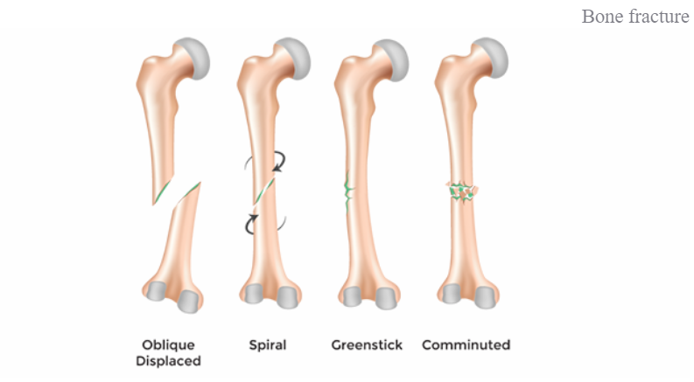

Slide 7
Introduction (bone fractures cont.)
How are bone fractures diagnosed ?
. Fractures are diagnosed using the following procedures:
. physical examination of the fracture site
. X-ray picture
. Other examinations are also performed as needed
. CT scan
. Magnetic resonance imaging (MRI)
. Bone examination

Slide 8
introduction
Medical imaging has led to improvements in the diagnosis and treatment of numerous medical conditions.
which help physicians in detecting different types of abnormalities.
There are many types - or modalities - of medical imaging procedures, each of which uses different technologies and techniques.
Fluoroscopy.
Radiography (X-rays).
Radiography : conventional X-ray" including mammography.
All the previous techniques use ionizing radiation to generate images of the body.
Notes:
Mammography is a type of medical imaging that uses x-rays to capture images (mammograms) of the internal structures of the breasts. Quality mammography can help detect breast cancer in its earliest, most treatable stages; when it is too small to be felt or detected by any other method.

Slide 9
Introduction cont.
What is Bone X-ray (Radiography)?
X-ray images (or Radiographs) are among the most common ways to detect problems in bones as well as other organs of the human body.
Imaging with x-rays involves exposing a part of the body to a small dose of ionizing radiation to produce pictures of the inside of the body.
The output image is a shadow-like image. Although CT and MRI images give better quality images for body organs than x-ray images.

Slide 10
Introduction (X-Ray).
What is Bone X-ray (Radiography)? Cont.
X-rays are the oldest and most frequently used form of medical imaging.
A bone x-ray makes images of any bone in the body.
hand, wrist, arm, elbow, shoulder, spine, pelvis, hip, thigh, knee, leg (shin), ankle or foot.

Slide 11
Introduction cont.
Why is Bone X-ray (Radiography)?
X-ray images have few limitations. Although, the level of quality of x-ray images is enough for the purpose of bone fracture detection.
It is commonly used to detect bone fractures due to some reasons such as:
ease of use.
wide availability.
faster.
low cost.
Hence, this relies on X-ray images to diagnose long bone fractures.

Slide 12
Problem Definition

Slide 13
Problem Definition
An X-ray test is very common. Millions of X-ray examinations are performed each year.
The most common use of an X-ray examination is to detect broken bones.
An X-ray examination can also reveal whether the bones of the joint are in an abnormal position.
Only doctors can know the result of x-rays so you should check with the doctor to see the result of x-rays.

Slide 14
Problem Definition cont. Human Errors.
Quick and accurate diagnosis can be crucial to the success of any prescribed treatment.
Since the only side that can specify results shown in X-ray plates are doctors, using their eyes, human errors have been arise.
Depending on human experts alone for such a critical matter have caused intolerable errors.
Hence, the idea of automating the diagnosis procedure has always been an appealing one.

Slide 15
Problem Definition cont. Human Errors Defeat.
There are many types of bone fractures: simple, oblique, compound, comminuted, spiral, greenstick and transverse.
In this work, we will consider the problem of detecting fractures in a bone without paying attention to the type of fracture.
Our diagnosis system can tell you the result of your X-rays as higher accuracy as possible.

Slide 16
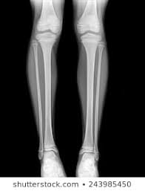
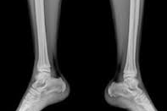
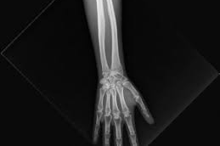
Example of Bone by x-ray

Slide 17
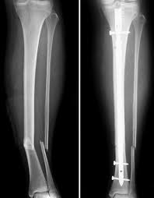
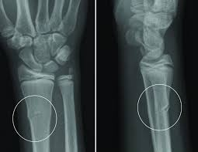
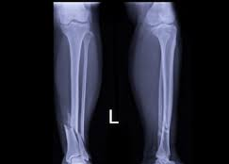
Examples of illustrating bones fractures in X-Ray Plates

Slide 18
Problem Definition cont. Misdiagnosis Results.
If arm fractures are not properly diagnosed and treated early, the following health complications occur, which are:
Uneven growth, especially when the bones in the child’s body are still growing.
Fractures that extend into a joint can cause arthritis years later.
Bone infection, if a portion of the bone is broken and protrudes through the skin, it can be exposed to germs that can cause infection.
Injury to a nerve or blood vessel. If the upper arm bone fractures into two or more pieces, it can result

Slide 19

Conclusion from problem definition

Slide 20

So, using artificial intelligence in diagnosis is a very active field of research. Specifically, using medical images to generate a quick and accurate diagnosis can save time, effort and cost as well as reduce errors.

Slide 21

Motivation

Slide 22
Motivation
Bone fractures are one of the most common injuries nowadays .
Every year, 2.7 million fractures occur across the EU6 nations and Middle east .
The effects of an untreated fracture may lead to permanent damage , so, there are a great responsibility for this lies with the doctors, who must evaluate tens of X-ray images a day.
who must evaluate dozens of x-rays per day. The technology used in the first diagnosis is mostly X-rays.
Notes:
Ensemble is a machine learning concept in which multiple models are trained using the same learning algorithm.
Bagging is a way to decrease the variance in the prediction by generating additional data for training from
dataset using combinations with repetitions to produce multi-sets of the original data.
Boosting is an iterative technique which adjusts the weight of an observation based on the last classification.
If an observation was classified incorrectly, it tries to increase the weight of this observation. Boosting in general builds strong predictive models.

Slide 23
Motivation cont.
Which is a modality that has been used for more than one hundred years and is still frequently used.
Why is challenging for doctors to evaluate X-ray images?
. firstly, X-ray could hide certain particularities of the bone.
. secondly, a lot of experience is needed to correctly classify different types of
fractures.
. thirdly, doctors have often to act in emergency situations and may be constrained by
fatigue.

Slide 24
Motivation cont.
the success of the treatment and prognosis strongly depends on an accurate classification of the fracture among standard types.
Therefore, specialists created software that assists the doctor in diagnosis and x-ray examination, easing the burden on the doctor and reducing errors resulting from the diagnosis during the specialist.
Notes:
Ensemble is a machine learning concept in which multiple models are trained using the same learning algorithm.
Bagging is a way to decrease the variance in the prediction by generating additional data for training from
dataset using combinations with repetitions to produce multi-sets of the original data.
Boosting is an iterative technique which adjusts the weight of an observation based on the last classification.
If an observation was classified incorrectly, it tries to increase the weight of this observation. Boosting in general builds strong predictive models.

Slide 25
Objectives
Developing an intelligent classification system for bone, long bones fractures and more.
Helping to save the owner of the fracture from the extravagances in dangerous situations.
Highest Accuracy .
Minimum Run time .
Using the newest technology in deep learning and CNN
(DenseNet-BC)

Slide 26

System Architecture
preprocessing
structure
DenseNet
normalization
Feature extraction
Using CNN
(convolutional
Layer )
Probabilistic
Classification (SoftMax
CNN)
Yes
or
No
Image X-Ray
Reshaping
Flipping and
Rotation

Slide 27
Description of dataset
We used (MURA) dataset in this Intelligent Classification System for Bone Fractures project.
MURA (musculoskeletal radiographs) is a large dataset of bone X-rays; Algorithms are tasked with determining whether an X-ray study is normal or abnormal.
A dataset consisting of 14,863 studies from 12,173 patients, with a total of 40,561 multi-view radiographic images.

Slide 28
Description of dataset cont.
Contains seven categories of the X-Ray image, they are elbow, finger, forearm, hand, humerus, shoulder, and wrist .
Each study was manually labeled as normal or abnormal by board-certified radiologists from the Stanford .
Each category contains about 150 to 170 patients .
Each patient contains about 2 to 3 images , Either positive or negative .

Slide 29
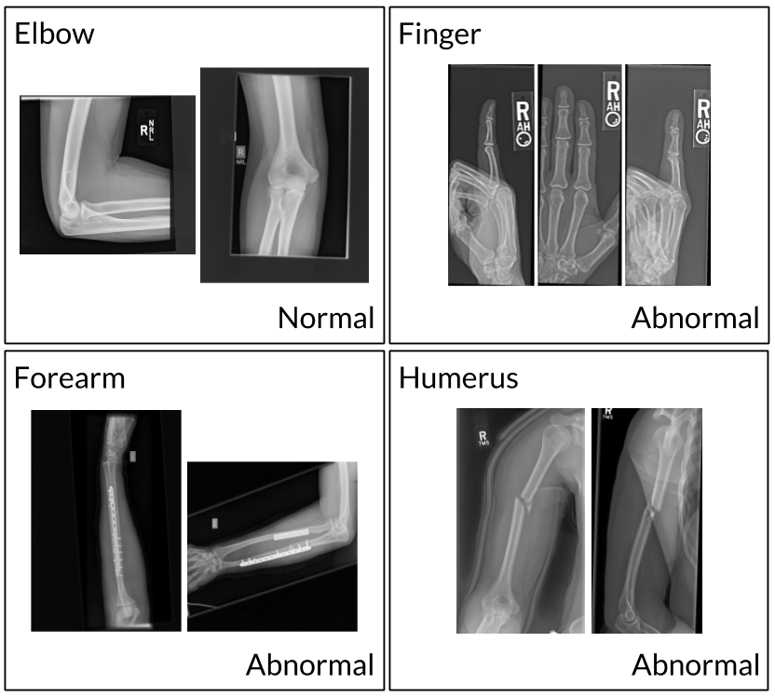
Description of dataset cont. example:

Slide 30
Why Densenet?!

Slide 31
Why Densenet?!
In ResNet There Is A Vanishing In Data
The X-Ray Image Is Very Sensetive Image That Need Every Detail In It
So,We Need To Solve The Vanishing In Data That Occur When Using ResNet
This Is Solved By Using DenseNet

Slide 32
Why Densenet?!
DenseNet Solve The Vanishing Data Problem
By Sharing Algorithm
It Work With Concatenation Not With Sum As ResNet
It Improve Information Flow By Combining Intermediate Layers Of Different Base Network
The Augmentation of Networks With Pathways That Minimize Reconstruction Loses
Improve Image Classification

Slide 33
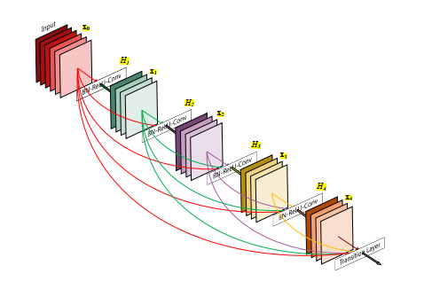
DenSeNET cont.

Slide 34
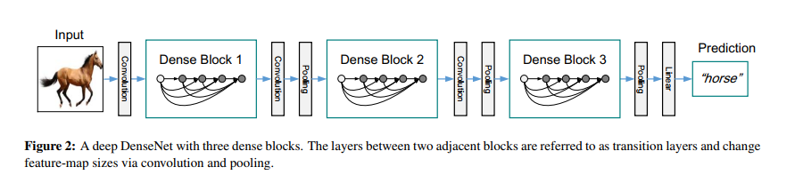
DenSeNET cont.

Slide 35
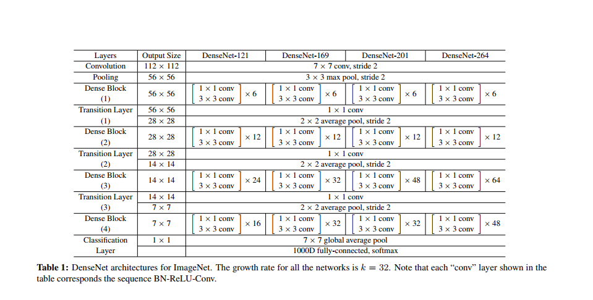
DenSeNET cont.

Slide 36
Description of finished Phase
The project is divided into a group of Phases.
Load data and normalization
Building various model structures
Training The model
Gui Interface
Testing

Slide 37
Description of finished phase cont. Load dataset
In this step contain a group of Functions .
get_labels_dirs function .
normalize function.
Load function

Slide 38
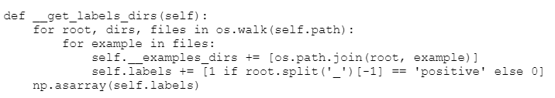
Load dataset cont.
get_labels_dirs function .
. this function used to build two list :
1: first list contain example directory (x-ray image directory)
2: second list contain label (positive or negative)

Slide 39
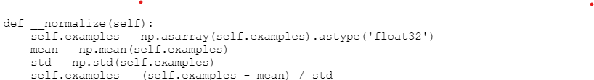
Load dataset cont.
normalize function.
. this function used to normalize feature by calculate mean and standard deviation
for data .

Slide 40
Load dataset cont.
Load function
. this function used to fill features and labels list.

Slide 41
Description of finished phase cont. Building Various Model Structures
Building Various Model Structures Of DenseNet as :
DenseNet 121 (Standard)
DenseNet 169 (Standard)
DenseNet 201 (Standard)
DenseNet 264 (Standard)
DenseNet Manual Configuration

Slide 42
Building Various Model Structures cont.
Build
Apply Initial Layer
Apply Blocks And Its Transition According To Number Of Blocks
Apply The Output Layer
Create The Model

Slide 43
Building Various Model Structures cont.
In this step there are 6 Global functions and 3 local functions
Dense Block :
create layers according to the number of layers in the model
each layer contains two convolution layers
the first convolution layer is 1*1
the second convolution layer is 3*3
start concatenation of the output of each layer and share them to the next layers

Slide 44
Building Various Model Structures cont.
Transition :
create the transition layers which consisting of
1. convolution layer
2. average pooling layer

Slide 45
Building Various Model Structures cont.
Output
Create The Output Layer Which Containing
Global Average Pool
Activation Function ( Softmax Classifier)

Slide 46
Building Various Model Structures cont.
Bn_relu_conv
this function contains 3 local functions
1- convolution creator
2- rectified linear units creator (Relu)
3- Batch normalization creator

Slide 47
Building Various Model Structures cont.
Initialize
create the input layer which contains
convolution layer ( Initial convolution )
max pooling layer

Slide 49
Description of finished phase cont. GUI Interface
In GUI there are
Image Viewer
label which indicates the result of the analysis
Browse Button to select the image
Analysis Button to start analyzing the selected image
exit Button to close the application

Slide 50
Conclusion
In this paper, image processing and neural network approaches for the detection of bone fractures were developed. Image processing techniques are very useful and significant in the medical field such as in X-ray radiographs .
We used in project convolutional neural network , named as CNN and use Densenet as Architecture .
We developed Densenet uses preprocessed, resized original images to detect bones with and without fractures, respectively.

Slide 51
Conclusion cont.
The developed system is a robust system since it was trained to recognize bone fractures.
The images used for training and testing the proposed system from Mura dataset .
Finally, it can be stated that the experimental analysis of the proposed bone fracture detection system showed a great efficiency and an outperforming rate.

Slide 52



Tools

Slide 53
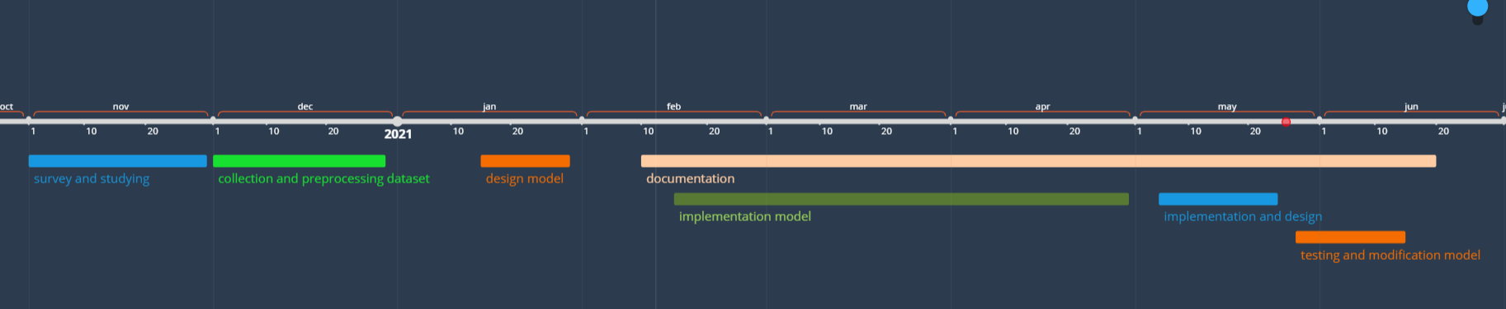
Time plane

Slide 54
Reference
[1] International Osteoporosis Foundation. Broken Bones, Broken Lives: A Roadmap to Solve the Fragility Fracture Crisis in Europe; International Osteoporosis Foundation, 2018. Available online: http://share.iofbonehealth.org/EU-6-Material/Reports/IOF%20Report_EU.pdf (accessed on 21 February 2020).
[2] Dimililer, K. IBFDS: Intelligent bone fracture detection system. Procedia Comput. Sci. 2017, 120, 260–267. [Google Scholar] [CrossRef]
[3] Tripathi, Ankur Mani, et al. “Automatic detection of fracture in femur bones using image processing." 2017 International Conference on Innovations in Information, Embedded and Communication Systems (ICIIECS). IEEE, 2017.
[4] Johari, Nancy, and Natthan Singh. "Bone Fracture Detection Using Edge Detection Technique." Soft Computing: Theories and Applications. Springer, Singapore, 2018. 11-19.
[5] Dhiraj B. Bhakare, Prajwal A. Jawalekar, Sumit D. Korde. “Novel Approach for Bone Fracture Detection Using Image Processing “ International Research Journal of Engineering and Technology (IRJET) 2018.
[6] Myint, San, Aung Soe Khaing, and Hla Myo Tun. "Detecting leg bone fracture in x-ray images." Int. J. Sci. Technol. Res 5 (2016): 140-144.

Slide 55
Reference
[7] A. K. Tanwani, J. Afridi, M. Z. Shafiq, and M. Farooq. Guidelines to select machine learning scheme for classification of biomedical datasets. Evolutionary Computation, Machine Learning and Data Mining in Bioinformatics, pages 128–139, 2009.
[8] L. Mena and J. Gonzalez. Machine learning for imbalanced datasets: Application in medical diagnostic. In Proceedings of the 19th International FLAIRS Conference, 2006.
[9] V. Vijaykumar, P. Vanathi, and P. Kanagasabapathy. Fast and efficient algorithm to remove gaussian noise in digital images. IAENG International Journal of Computer Science, 37(1), 2010.
[10] B. Green. Edge detection tutorial, 2002. http://dasl.mem.drexel.edu/ alumni/bGreen/www.pages.drexel.edu/ weg22/edge.html [Online; accessed June-2013].
[11] M. L. M. Zain, I. Elamvazuthi, and M. Begam. Enhancement of bone fracture image using filtering techniques. The International Journal of Video and Image Processing and Network Security, 9(10), 2009.

Slide 56
Reference
[12] E. Hmeidi , M. Al-Ayyoub. Hands Bons fractures classification system. Jordan University of Science and Technology , https://www.researchgate.net/publication/280037155
[13] T. Tian. Detection of femur fractures in x-ray images. Master’s thesis, National University of Singapore, Singapore, 2002.
[14] S. E. Lim, Y. Xing, Y. Chen, W. K. Leow, T. S. Howe, and M. A. Png.Detection of femur and radius fractures in x-ray images. In Proc. 2nd Int. Conf. on Advances in Medical Signal and Info. Proc, 2004.
[15] D. W.-H. Yap, Y. Chen, W. K. Leow, T. S. Howe, and M. A. Png. Detecting femur fractures by texture analysis of trabeculae. In Pattern Recognition, 2004. ICPR 2004. Proceedings of the 17th International Conference on, volume 3, pages 730–733. IEEE, 2004.
[16] V. L. F. Lum, W. K. Leow, Y. Chen, T. S. Howe, and M. A. Png. Combining classifiers for bone fracture detection in x-ray images. In Image Processing, 2005. ICIP 2005. IEEE International Conference on, volume 1, pages I–1149. IEEE, 2005.
[17] J. C. He, W. K. Leow, and T. S. Howe. Hierarchical classifiers for detection of fractures in x-ray images. In Computer Analysis of Images and Patterns, pages 962–969. Springer, 2007.
[18] S. Mahendran and S. S. Baboo. An enhanced tibia fracture detection tool using image processing and classification fusion techniques in X-ray images. Global Journal of Computer Science and Technology (GJCST), 11(14):23–28, 2011

Slide 57
Reference
[19] H. Y. Chai, L. K. Wee, T. T. Swee, and S. Hussain. Gray-level cooccurrence matrix bone fracture detection. WSEAS TRANSACTIONS on SYSTEMS, 10(1), 2011.
[20] A. Bielecki, M. Korkosz, and B. Zielinski. Hand radiographs pre-processing, image representation in the finger regions and joint space width measurements for image interpretation. Pattern Recognition, 41(12):3786–3798, 2008.
[21] H. Y. Chai, L. K. Wee, T. T. Swee, and S. Hussain. Glcm based adaptive crossed reconstructed (acr) k-mean clustering hand bone segmentation. Book GLCM based adaptive crossed reconstructed (ACR) k-mean clustering hand bone segmentation, pages 192–197, 2011.
[22] B. Zielinski. A fully-automated algorithm dedicated to computing metacarpophalangeal and interphalangeal joint cavity widths. Schedae Informaticae, 16:47–67, 2007.
[23] O. Bandyopadhyay, B. Chanda, and B. B. Bhattacharya. Entropy-based automatic segmentation of bones in digital x ray images. In Pattern Recognition and Machine Intelligence, pages 122–129. Springer, 2011.
[24] S. Hao, Y. Han, J. Zhang, and Z. Ji. Automatic isolation of carpal-bone in hand x-ray medical image. In Informatics and Management Science I, pages 657–662. Springer, 2013.
[25] T. M. Lehmann, D. Beier, C. Thies, and T. Seidl. Segmentation of medical images combining local, regional, global, and hierarchical distances into a bottom-up region merging scheme. In Proc. of SPIE Vol, volume 5747, page 547, 2005.
[26] P. Lin, C. Zheng, F. Zhang, and Y. Yang. X-ray carpal-bone image boundary feature analysis using region statistical feature based level set method for skeletal age assessment application. Optica Applicata, 35(2):283, 2005.

