Slide 1
ES6 Introduction :

Slide 2
ES6 Details
Categorizing ES6 Features
All the new features of ES6 can be categorized in 7 categories. Here is the list of categories:
Variables and Parameters
Classes
Modules
Integrators and Generators
Arrow function

Slide 3
What is ES6
  ECMAScript is a standard for a scripting language, and the Javascript language is based on the ECMAScript standard.
  The core features of Javascript are based on the ECMAScript standard, but Javascript also has other additional features that are not in the ECMA specifications/standard.
  ECMAScript version 5 was finished in December 2009, the latest versions of all major browsers (Chrome, Safari, Firefox, and IE) have implemented version 5.
  European Computer Manufacturer’s Association (ECMA) for standardization.
  ECMAScript is a subset of JavaScript. JavaScript is basically ECMAScript at it's core but builds upon it. Languages such as ActionScript, JavaScript,

Slide 4
ES6 Installations
Current browsers don't support all the new ECMAScript 6 (aka ECMAScript 2015) features yet .You need to use a compiler (transpiler) to transform your ECMAScript 6 code to ECMAScript 5 compatible code.
Babel : has become the de-facto standard to compile ECMAScript 6 applications to a version of ECMAScript that can run in current browsers. Babel can also compile other versions of ECMAScript as well as React's JSX,
Installations :
npm install babel-cli babel-core --save-dev
npm install babel-preset-es2015 --save-dev :
In Babel 6, every transformer is a plugin that can be installed separately. A preset is a group of related plugins. Using a preset, you don't have to install and update dozens of plugins individually.

Slide 5
ES6 const
Const : it is key world in the ES6 which is used to define constant values
For Example :
  window.onload=function(){
  const pi=3.142;
  // if we try to change get compile error
  pi=10;
  console.log(pi);
  }

Slide 6
ES6 Let
Let : it’s a scope specific variable declaration.
For example :
  let a = 50;
  let b = 100;
  if (true) {
  let a = 60;
  var c = 10;
  console.log(a/c); // 6
  console.log(b/c); // 10
  }
  console.log(c); // 10
  console.log(a); // 50

Slide 7
ES6 default prams value
In ES6 at the function when the parameters are passed we can initialize the params to avoid undefined values.
For Example :
  // Basic syntax
  function multiply (a, b = 2) {
  return a * b;
  }
  multiply(5) ; // 10

Slide 8
ES6 spread operator
Spread Operator (...) : The Array iterated to individual elements when passed as parameter to a function.
For Example :
  var frut1=[1,2,3];
  var frut2=[frut1,4,5,6]; => it will display the array object with number.
  var frut2=[...frut1,4,5,6]; => This will display the data as [1,2,3,4,5,6]

Slide 9
ES6 Arrow function
The arrow functions are nothing but lambda expressions in normal OOJS language.
For Example :
function add(a,b){return a+b ; }
var add = (a,b) =>a+b ;
Console.log(add(10,20));
var materials = ['Hydrogen', 'Helium‘,'Lithium', Beryllium'];
console.log(materials.map(material => material.length));

Slide 10
ES6 Details
Using Modules
Module is equivalent to java package functionality. To create a module we need to follow two functionality
  1) import : to access in other JS files
  2) export : allow to access the function in other JS files.
For example : export class Math { }
import {Math} from 'math';
var math = new Math();

Slide 11
ES 6 Details
Using Classes : ECMAScript 6 introduces the concept of class available in traditional object-oriented languages.
ECMAScript 6 introduced “class” keyword to define classes in JavaScript. Earlier to ES6, we had to use constructor function
For example:
//defines the class
class Student{ // define properties and methods}
//class person inherits student class
class Person extends Student{
//we can override the super class methods.
}

Slide 12
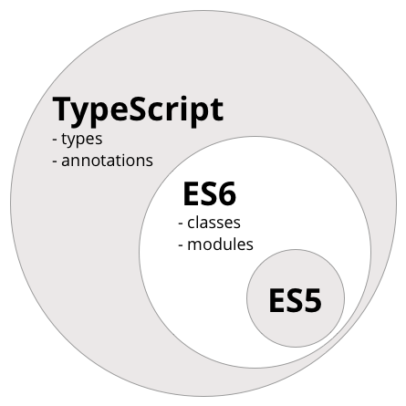
Type Script
TypeScript is a superset of JavaScript which primarily provides optional static typing, classes and interfaces. One of the big benefits is to enable IDEs to provide a richer environment for spotting common errors as you type the code.
It’s used to improve your code quality with OOP features and static typing.
TypeScript has its own compiler which takes in .ts files and outputs JS code in either ES5 orES6, your choice. Babel is not a language like TypeScript.
Babel is just a compiler which takes in ES6 code and outputs ES5 code.
So Babel is a transpiler , TS is a language with a compiler.

Slide 13
Why to use TypeScript
Simple class based OOP with inheritance
Access modifiers for all classes
Type setting for variables, parameters and return values
Incredible error detection which ties into static typing
  Any JavaScript code is a valid TypeScript code

Slide 14
Variable declaration
The variables which are present in typescript are :
Boolean , number , string , array , enum ,any ,void
var a:number = 10; this will accept only numbers if we try to pass the string value compilation error will occurs
var xy:string = “Simple String” ;
var array : number [] = [1,2,3] ;
var num : any = “string”; if we specify any then we can pass any kind of value to it.
enum triColor{Red , Green, Blue};
var c : triColor = triColor.Green;

Slide 15
TypeScript Function
Below is the declaration of functions :
function addNums(num1: number , num2:number) : number{
return num1 + num2;
}

Slide 16
Class Example
The below code creates the Car class with start function.
  class Car {
  engine: string;
  constructor (engine: string) {
  this.engine = engine;
  }
  start() { return "Started " + this.engine; }
  }

