Slide 1
REACTJS :

Slide 2
Topic Covered
Overview
Environment Setup
JSX
Components
State
Props Overview
Props Validation
Component Life Cycle
Events
Ref

Slide 3
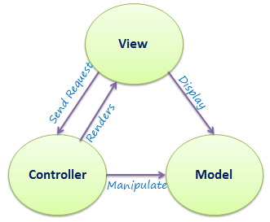
MVC Architecture
Model : holds the values
View : display the values
Controller: takes the request from the client and delegates to required Model and View.

Slide 4
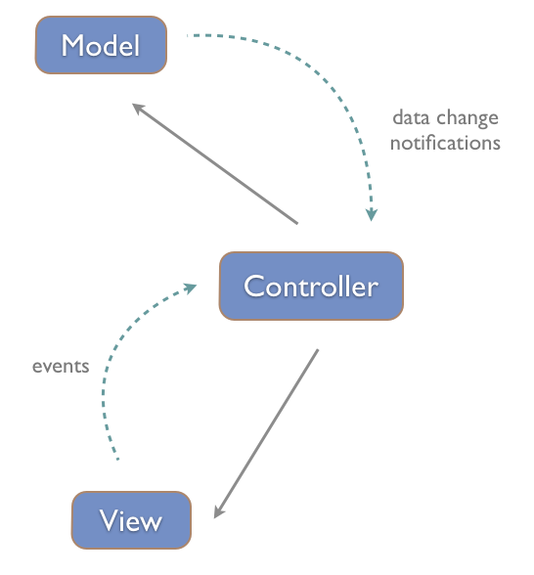
MVC in UI Development
The MVC (Model-View-Controller) design pattern is fundamental to UI development, In case of web apps, the DOM is the physical representation of a View. The View is an entity that brings the textual template to life as a DOM fragment. It also sets up event-handlers and takes care of manipulating the DOM tree as part of its lifecycle.
For the View to be useful, it needs to show some data, and possibly allow user interaction. The data is the Model, which comes from some data-source (a database, web-service, local-storage, etc.). Frameworks provide a way of "binding" the data to the view, such that changes in data are automatically reflected with changes on the view. This automatic process is called data-binding
The MVC triad is completed by the Controller, which engages the View and the Model

Slide 5
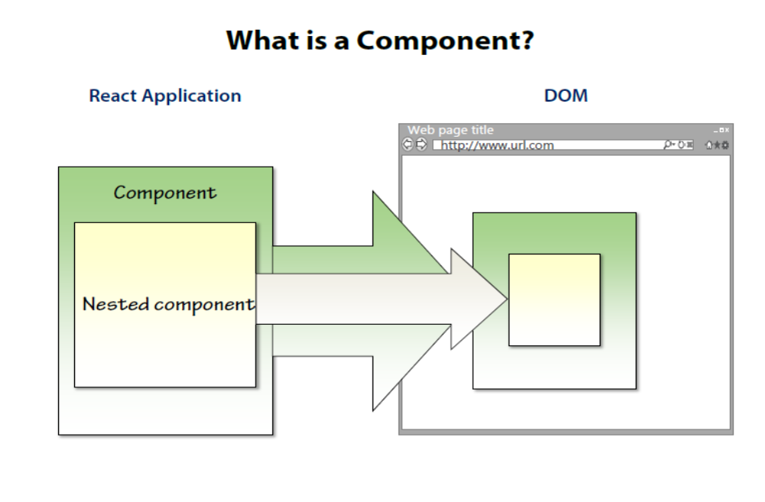
Component Architecture

Slide 6
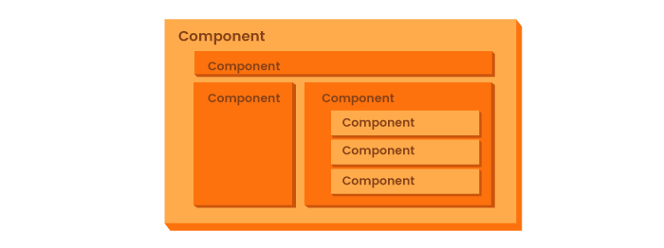
Component Architectures
Component-based architecture focuses on the decomposition of the design into individual functional or logical components that represent well-defined communication interfaces containing methods, events, and properties.
The primary objective of component-based architecture is to ensure component reusability.

Slide 7
What is the Framework
Frameworks that automatically handle the flow of data back and forth between the View and Model maintain an internal event-loop. This event-loop is needed to listen to certain user events, data-change events, external triggers, etc and then determine if there is any change from the previous run of the loop. If there are changes, at either end (View or Model), the framework ensures that both are brought back in sync.

Slide 8
ReactJS Installation (new version)
Load the React JS lib in two way’s
Local way
CDN way
The local way we can use the below commands to install the React JS .
The new version of the ReactJS is 16.8 it can be used installed in two way.
  a . npm install create-react-app
  b. create-react-app <name of the project>
  c. cd <project name>
  d project name> npm start

Slide 9
ReactJS installation (Old version)
1) npm init
2) npm install --save-dev webpack webpack-dev-server
3) npm install --save-dev babel-core babel-loader babel-preset-es2015
4) npm install --save-dev babel-preset-react
5) npm install --save react react-dom
6) npm install --save-dev react-hot-loader
7) npm start
Redux installations :
npm install --save redux react-redux

Slide 10
React installation
New version of React is installed in with below steps.
npm install create-react-app
create-react-app <name of project folder>
cd <name of project folder> npm start.
Install props validation.
npm install props-types
Redux installation
npm install redux
React-Redux installation
npm install react-redux

Slide 11
OverView of ReactJS
React is front end library developed by Facebook. It's used for handling view layer for web and mobile apps.
It encourages the creation of reusable UI components which present data that changes over time.
Lots of people use React as the V in MVC.
React.js is declarative, which means that React conceptually hits the “refresh” button any time data changes,

Slide 12
Advantages
React uses virtual DOM which is JavaScript object. This will improve apps performance since JavaScript virtual DOM is faster than the regular DOM.
React can be used on client and server side.
React can be used with other frameworks.
Disadvantages :
React only covers view layer of the app so you still need to choose other technologies to get a complete tooling set for development.
React is using inline templating and JSX. This can seem awkward to some developers.

Slide 13
Components of ReactJS
React elements are JavaScript objects which represent HTML elements. They do not exist in the browser. They represent browser elements.
Components are developer created React elements. They're usually larger parts of the user interface which contain both the structure and functionality .
JSX
It’s called JSX, and it is a Javascript XML syntax transform. This lets you write HTML-ish tags in your Javascript.
Unidirectional data flow and Flux − React implements one way data flow which makes it easy to reason about your app. Flux is a pattern that helps keeping your data unidirectional.
Use of ES6

Slide 14
What is JSX
JSX : It’s called JSX, and it is a Javascript XML syntax transform. This lets you write HTML-ish tags in your Javascript.
The react is : "A JS Library for building User Interfaces“.
In order to render the HTML data through JS we need the JSX lib.
Each JSX element is just syntactic sugar for calling
React.createElement(component, props, ...children)
For Example :
Without the JSX
render() {
return React.createElement('div', null, `Hello ${this.props.toWhat}`); }
With JSX
render() { return <div>Hello {this.props.toWhat}</div>; }

Slide 15
ES6 with babel in ReactJS
Classes usages in ES6 : Instead of using the React.createClass method to define a component, we can define a bonafide ES6 class that extendsReact.Component:
// The ES5 way
  var Photo = React.createClass({
  handleDoubleTap: function(e) { … },
  render: function() { … },
  });
// The ES6+ way
  class Photo extends React.Component {
  handleDoubleTap(e) { … }
  render() { … }
  }

Slide 16
ES6 with babel in ReactJS
State initialization into the constructor :
This means you can refactor away your `getInitialState` method by moving its return value to be assigned to the `this.state` instance variable in your class' constructor.
class ExampleComponent extends React.Component {
getInitialState() { return Store.getState(); }
constructor() {
super(); this. _handleClick = this. _handleClick.bind(this); }
// ... }
class ExampleComponent extends React.Component {
constructor() {
super(); this. _handleClick = this. _handleClick.bind(this);
this.state = Store.getState(); }
// ... }

Slide 17
React Component
With React, the View-part of the MVC triad takes prominence and is rolled into an entity called the Component. The Component maintains an immutable property bag called props, and a state that represents the user-driven state of the UI.
Instead of constructing a physical DOM directly from a template file/script/function, the Component generates an intermediate DOM that is a stand-in for the real HTML DOM.
An additional step is then taken to translate this intermediate DOM into the real HTML DOM.
As part of the intermediate DOM generation, the Component also attaches event-handlers and binds the data contained in props and state.

Slide 18
React Component
A component return a one DOM element if more than one DOM elements needs to be returned then it has to be wired with parent element.
Simple example to create ReactJS component
var MyComponent = React.createClass({
render: function(){
return ( <h1>Hello,world!</h1> );
}
});
React.render(<MyComponent />, document.getElementById('myDiv'));

Slide 19
React component
We create the Simple component by using React.createClass and passing in an object that implements some core functions.
The most important one is the render(), which generates the intermediate-DOM.
Here we are using JSX to define the DOM
The React.render() or React.renderComponent() will create the DOM element and render’s to the page

Slide 20
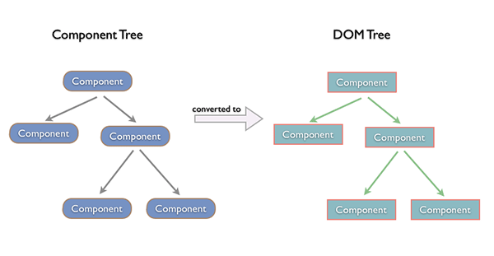
ReactJS Component
The Component is the primary building block in React.
You can compose the UI of your application by assembling a tree of Components. Each Component provides an implementation for the render() method, where it creates the intermediate-DOM. Calling React.renderComponent() on the root

Slide 21
Virtual DOM in ReactJS
We have person object with properties mirrored the persons current state with DOM.
Now think about if you took that object and made some changes, like added new property or updated the existing property how the react will update the changes to DOM elements
With React two things take place.
  React runs a “diffing” algorithm which identifies what has changed.
  Reconciliation, where it updates the DOM with the results of difference
  React is using a virtual DOM to update the new values with specific dom element which has changes need to be updated.

Slide 22
Why ReactJS
UI state becomes difficult to handle for complex web application dom management.
React help us manage the UI state
Single Page Application (SPA) : only one HTML page content is (re)rendered on client, built up with the multi component
Typically only one ReactDOM.render() call.
Multiple Page Application(MPA): Multiple HTML pages, content is rendered on server, it is not under react controller, widgets will be there independent to each other.
one ReactDOM.render() will call the "widgets"

Slide 23
Props in ReactJS
props is the property used to hold the dynamic values it's read only element we can't change the value of it.
to use this we need to add the prop's to our component and while calling.
For Example :
In the component props need to be handled
  class person extends React.Component{
  render(){
  return( <div>{this.props.name}</div> ); } }
While rendering the component pass the dynamic value:
  <Person name="Max" age="28" />

Slide 24
Props Validations
In the new version of reactjs the PropTypes has been moved to a separate package named prop-types.
So, you need to add it as a dependency for your project in order to get access to the PropTypes utility.
  npm install prop-types –save
Import the lib in your program to use the prop validations :
  import PropTypes from 'prop-types';

Slide 25
Basic Types of the Props
PropTypes.any — the prop can be of any data type
PropTypes.bool — the prop should be a boolean
PropTypes.number — the prop should be a number
PropTypes.string — the prop should be a string
PropTypes.func — the prop should be a function
PropTypes.array — the prop should be an array
PropTypes.object — the prop should be an object
PropTypes.symbol — the prop should be a symbol

Slide 26
State in ReactJS
State is the model data which can be modified using the setState().
We should always try to make our state as simple as possible and minimize the number of stateful components.
If we have, for example, ten components that need data from the state, we should create one container component that will keep the state for all of them.
Basically state is initialise in constructor of the class .
Initial state is updated with setState() method.

Slide 27
State Example
For Example :
  class App extends React.Component {
  constructor(props) {
  super(props);
  this.state = { header: “change header state",
  content: “change content state" } }
  render() {
  return ( <div> <h1>{this.state.header}</h1>
  <h2>{this.state.content}</h2>
  </div> ); } }
We can update the state dynamically by setState().
See the example

Slide 28
Component API
In reactJS we have three methods by which we can change the state of the component which is called as Component API.
setState() : method is used to update the state of the component. It will not replace the state instead updated the existing state with new value.
forceUpdate() : this is used when manually we want to update the state of the component.
ReactDOM.findDOMNode() : conditionally we want to manipulate the DOM element like change the style of the Dom when button is clicked we can use the above method.
It will identify the specified DOM and update it.

Slide 29
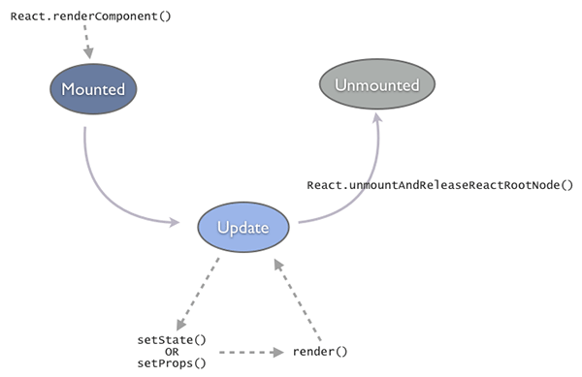
Component Life Cycle
Components in the React framework have a specific lifecycle and embody a state-machine that has three distinct states.
Mounte
Update
Unmounted

Slide 30
Component Life Cycle
Mounted() : The Component comes to life after being Mounted. Mounting results in going through a render-pass that generates the component-tree (intermediate-DOM). This tree is converted and placed into a container-node of the real DOM. This is a direct outcome of the call to React.renderComponent().
Update() : Once mounted, the component stays in the Update state. A component gets updated when you change state using setState() or change props using setProps(). This in turn results in calling render(), which brings the DOM in sync with the data (props + state). Between subsequent updates, React will calculate the delta between the previous component-tree and the newly generated tree. This is a highly optimized step (and a flagship feature) that minimizes the manipulation on the real DOM.

Slide 31
Component Life Cycle methods
componentWillMount () -> immediately before initial render occurs only once.
componentDidMount () -> after initial rendering
componentWillReceiveProps()->When component receives new props
shouldComponentUpdate()->before rendering , after receiving new props or state
componentWillUpdate()-> before rendering, after receiving new props or state
componentDidUpdate()->after component's updates are flushed to DOM
componentWillUnmount()->Immediately before removing component from DOM

Slide 32
Forms & Event Handling
In ReactJS the HTML tags are considered as forms tags below example show’s you how to handle the event using the form element.
  class FormExample extends React.Component{
  handleChange(event) {
  this.setState({value: event.target.value}); }
  render(){
  return(
  <div>
  <input type="text" value={this.state.value} onChange={this.handleChange} />
  </div> ); } }

Slide 33
ReactJS ref
The ref is used to return a reference to your element. Refs should be avoided in most cases but they can be useful when you need DOM measurements or to add methods to your components.
For Example :
var refExample = React.createClass({
clearInput() { this.setState({data: ''}); ReactDOM.findDOMNode(this.refs.myInput).focus(); }
render() { return ( <div> <input value = {this.state.data} onChange = {this.updateState} ref = "myInput"></input></div>
);
} });

Slide 34
Unidirectional Data Flow
In React, application data flows unidirectionally via the state and props objects
In a multi component heirachy, a common parent component should manage the state and pass it down the chain via props.
Your state should be updated using the setState method to ensure that a UI refresh will occur, if necessary.
The resulting values should be passed down to child components using attributes that are accessible in said children via this.props
See the example:

Slide 35
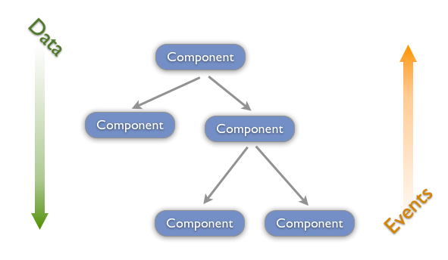
Unidirectional Flow of data
Within a component-tree, data should always flow down.
A parent-component should set the props of a child-component to pass any data from the parent to the child.
On the other hand user-events (mouse, keyboard, touches) will always bubble up from the child all the way to the root component, unless handled in between.

