Slide 1
REDUX INTRODUCTION :

Slide 2
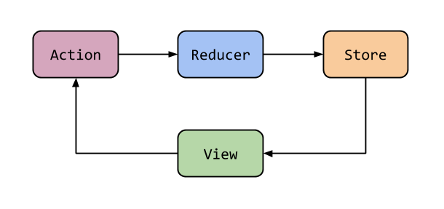
Redux flow of information
What is Redux : it’s makes the state manage very is in the ReactJs
It ‘s an open source you can use it for other JS lib.

Slide 3
What is Redux
  As the requirements for JavaScript single-page applications have become increasingly complicated, our code must manage more state than ever before.
  At some point, you no longer understand what happens in your app as you have lost control over the when, why, and how of its state.
  This is the very classic MVC that we all know about. But it actually looks like concepts of flux, just expressed in a slightly different way:
  - Models look like stores
  - user events, data modifications and their handlers look like
  "action creators" -> action -> dispatcher -> callback
  - Views look like React views (or anything else )

Slide 4
Redux Principles
1) Single source of truth : The state of your whole application is stored in an object tree within a single store.
2) State is read-only : The only way to mutate the state is to emit an action, an object describing what happened
3) Changes are made with pure functions : To specify how the state tree is transformed by actions, you write pure reducers.
reducer functions that will allow us to transform this state.
Difference between store and reducer :
A Store keeps your data in it while a Reducer doesn't. each time a reducer is called, it is passed the state that needs to be updated
"A reducer is just a function that receives the current state of your application, the action, and returns a new state modified (or reduced as they call it)

Slide 5
Redux Principle
Redux has three principles :
Actions are payloads of information that send data from your application to your store.
They are the only source of information for the store. You send them to the store using store.dispatch().
Reducers specify how the application's state changes in response to action sent to the store.
Remember that actions only describe what happened, but don't describe how the application's state changes.

Slide 6
Redux principles
Store : is the object that brings them together. The store has the following responsibilities.
Holds application state;
Allows access to state via getState();
Allows state to be updated via dispatch(action);
Registers listeners via subscribe();
Handles unregistering of listeners via the function returned by subscribe(listener).

Slide 7
Redux
  To sum up, Redux will provide you:
  1) a place to put your application state
  2) a mechanism to dispatch actions to modifiers of your application state
  3) a mechanism to subscribe to state updates
  The Redux instance is called a store and can be created like this:
  import { createStore } from 'redux'
  var store = createStore(() => {})

Slide 8
Steps to use redux
Use the below command to install the redux :
npm install redux –save
We need to create a store: the store is the responsible for changing the state of the component.
There will be only one store for whole application.
We can have many reducers .
Import {createStore} from ‘redux’;
createStore : will take two parameters.
  A. Reducer
  B. initial state
For Example :
const store= createStore(reducer,1);

Slide 9
Reducers :
Reducers are the pure functions :
reducer is a method from which the action will takes place reducer will take two parameter
  1) state
  2) action
one reducer will handle multiple actions switch is the best option. trigger the action using dispatch method:
For Example :
  const reducer =(state, action)=>{
  switch(action.type){
  case "ADD":
  state = state + action.payload
  Break; } return state; };

Slide 10
Call an action
Dispatch : it’s a method which is used to dispatch the action to the reducer to change the state.
store.dispatch({->expects a javascript object
type:"ADD",
payload:10
type:"SUB"
});
use the subscribe method to change the state of the object by calling the action.

Slide 11
Reducer in Redux
A reducer takes in current state as an argument and can only modify the state by returning new state:
// Reducer Function
var someReducer = function(state, action) {
... return state;
}
Reducers should be written as "pure“ functions :

Slide 12
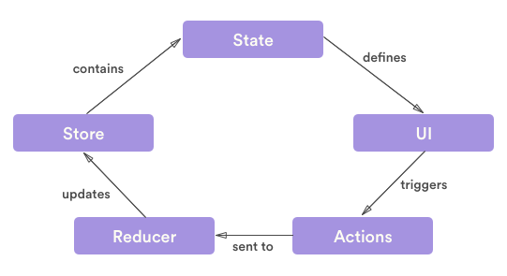
Redux flow
In the Redux ecosystem, UI updates and user options always follow the same workflow:
The state tree defines the UI and the action callbacks through props
User actions, such as clicks, are sent to an action creator that normalizes them
The resulting redux actions are passed to a reducer that implements the actual app logic
The reducer updates the state tree and dispatches it to a store that, well, stores it
The UI is updated accordingly to the new state tree in the store

Slide 13
Redux
Store : is an immutable object and stores the data for whole application.
It has following methods :
getState() : It retrieves the current state of the Redux store.
dispatch(action): It lets you dispatch actions to change the state of your application.
subscribe(listener) : It lets you register a callback that the Redux store will call any time an action has been dispatched, so that you can update the UI of your application.

Slide 14
How to use Multiple reducers
In reactjs their will be only single store. You can handle the multiple reducers.
To access the multiple reducers we have one method in redux
combineReducers (): which accepts the java script object pass the many reducers.
We can pass the key value pares also.
For Example
  const store= createStore(
  combineReducers({showreducer,userReducer}
  ));

Slide 15
ReactJS with Redux
To access the redux with react JS :
We need to install one more package is
npm install react-redux
two steps to connect Redux to react is :
connect the redux store to react app.
dispatch action is needed.

Slide 16
React & Redux
1) Provider is the class which will provide the redux lib to ReactJS application.
For Example :
<Provider> <name of the root component> </Provider>
2) the component need to be attached to the redux.
By two methods :
mapStateToProps() : which properties of my global application state do i want to use in this component and to which local props need to attach it.
, mapDispatchToProps() : which takes the action details of the redux element

Slide 17
mapToStateProps
Example of mapStateToProps() :
  const mapStateToProps=(state)=>{
  return{
  user:state.userReducer,
  show:state.showReducer
  };
  };

Slide 18
mapDispatchToProps
Example of mapDispatchToProps():
  const mapDispatchToProps=(dispatch)=>{
  return{
  setName:(name)=>{
  dispatch(setName(name));
  /* dispatch({
  type:"SET_NAME",
  payload:name
  });*/ } }; };
We need to use the connect method to connect the redux to reactjs.
connect(mapStateToProps,mapDispatchToProps)(App2)

