Slide 1

Agenda
Engineering Design of a Manually Actuated Lead-Screw Scissor Lift
This presentation aims to outline the design and fabrication of a manual lead-screw-driven scissor lift by combining strong mechanical design methods with accurate modeling and material-based performance assessment.

Slide 2
Agenda
Team members
This presentation aims to outline the design and fabrication of a manual lead-screw-driven scissor lift by combining strong mechanical design methods with accurate modeling and material-based performance assessment.
Mohammad Arshad
Mohit Raj Sutrave
Mohammed Khaja Ahmed

Slide 3
1
5
2
3
4
Agenda
FIVE
This presentation aims to outline the design and fabrication of a manual lead-screw-driven scissor lift by combining strong mechanical design methods with accurate modeling and material-based performance assessment.
STEPS
Modeling and Assembly
Calculations
Conclusion
Design Considerations
Project Overview & Problem Statement

Slide 4
5
1
4
2
3
Agenda
FIVE
This presentation aims to outline the design and fabrication of a manual lead-screw-driven scissor lift by combining strong mechanical design methods with accurate modeling and material-based performance assessment.
STEPS
Modeling and Assembly
Conclusion
Calculations
Design Considerations
Project Overview & Problem Statement

Slide 5
Project Overview & Problem Statement
1
2
3
4
5
FIVE
STEPS
Project Overview & Problem Statement
Design Considerations
Modeling and Assembly
Calculations
Conclusion

Slide 6
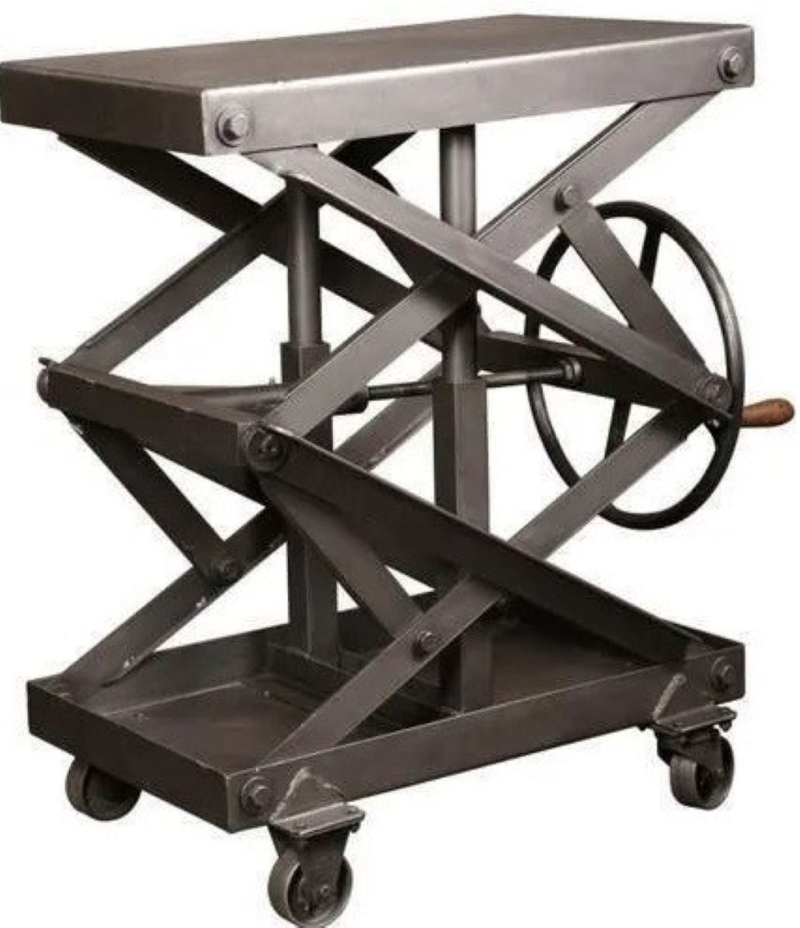
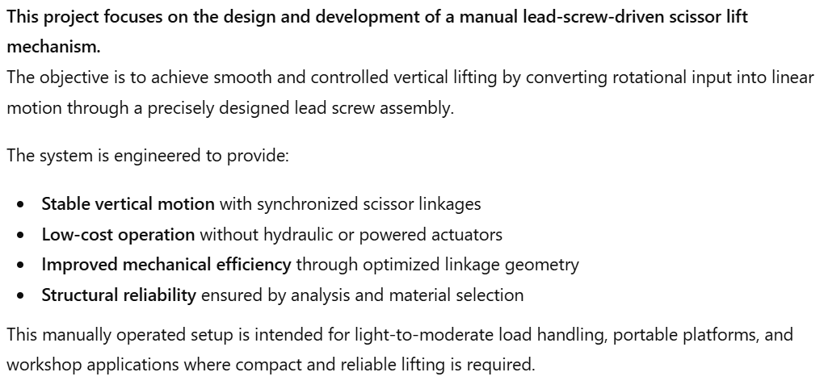
Project Overview & Problem Statement

Slide 7
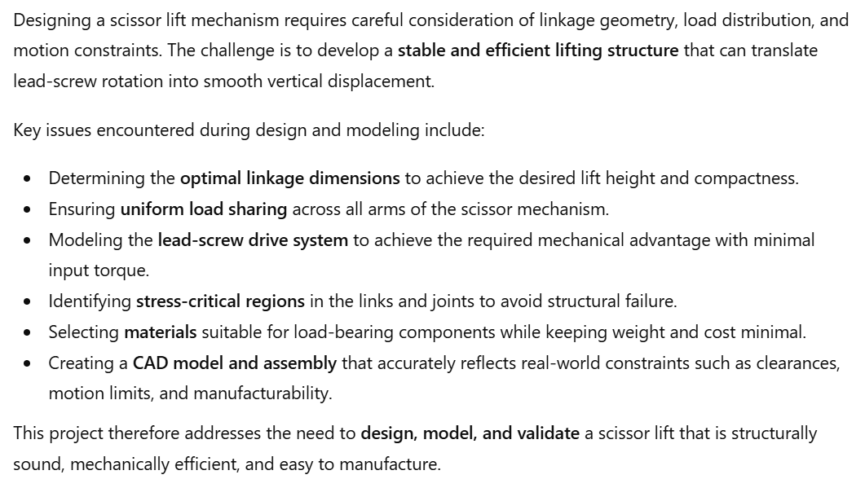
Project Overview & Problem Statement

Slide 8
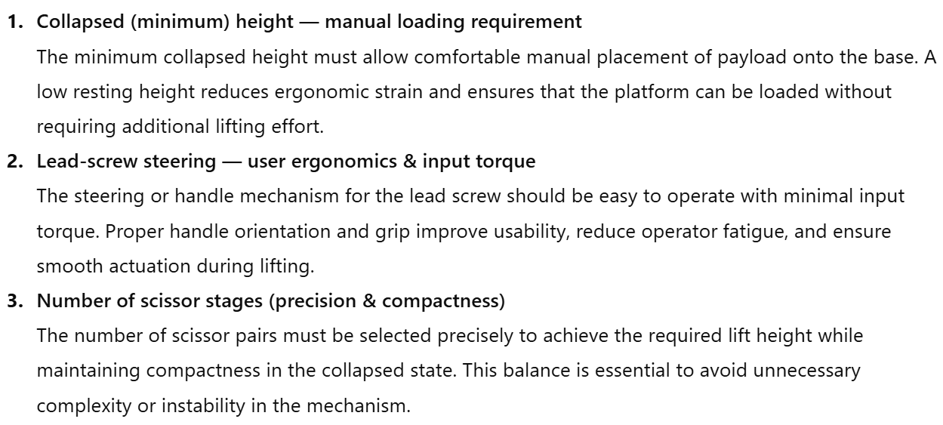
Design Considerations

Slide 9
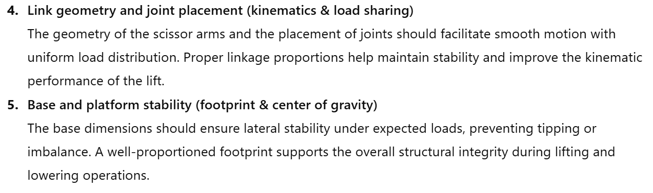
Design Considerations

Slide 10
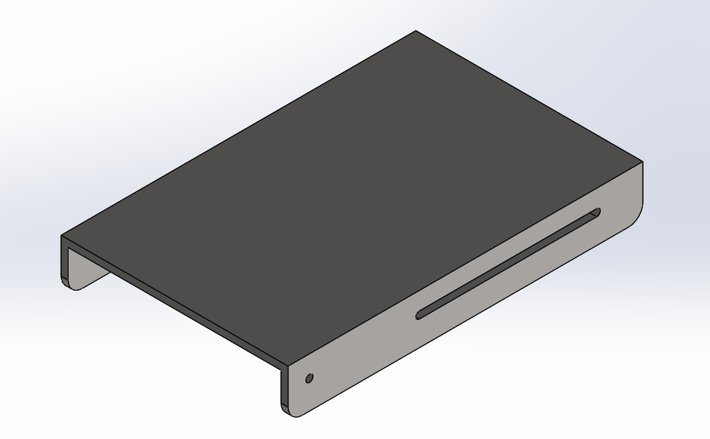
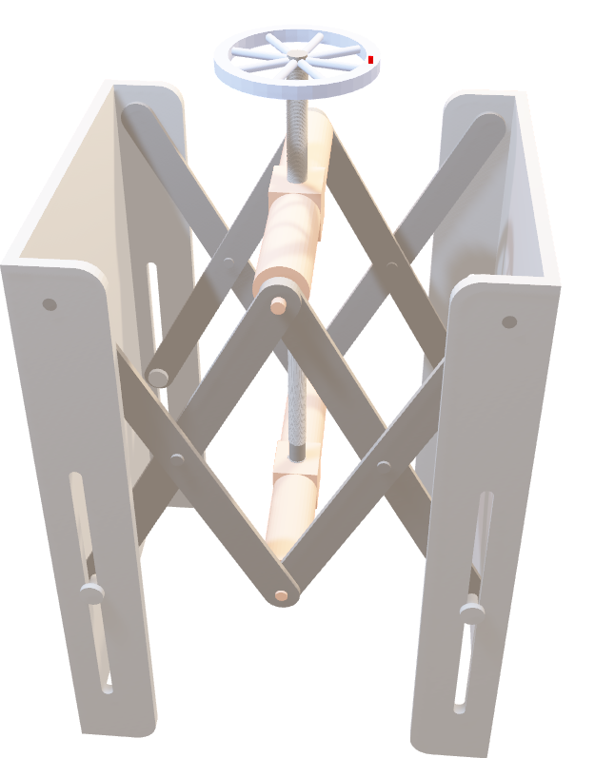
Modeling and assembly
Here are the CAD-modeled components that form the complete scissor lift mechanism.
These visuals help in understanding the structure, assembly process, and functional layout.
Base Top
Function
Provides stable top support for load distribution
by offering a rigid mounting interface for components
Material Selection
AISI 1020
Chosen for its good strength and excellent machinability.

Slide 11
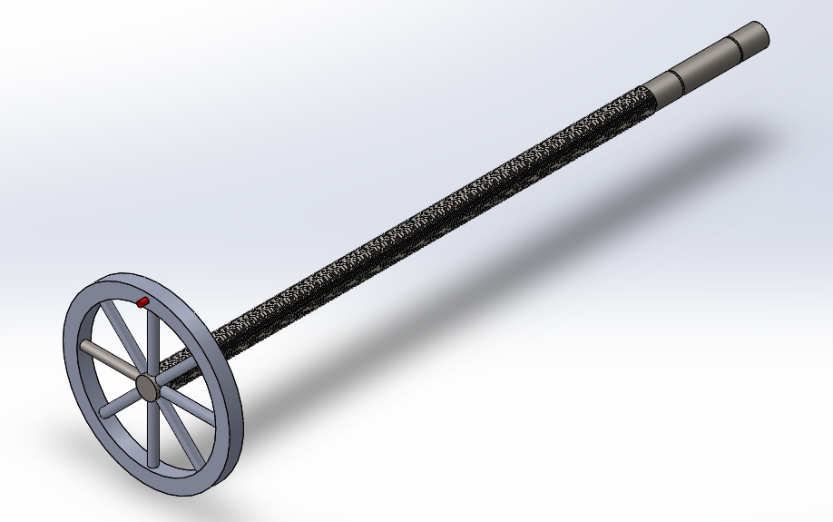
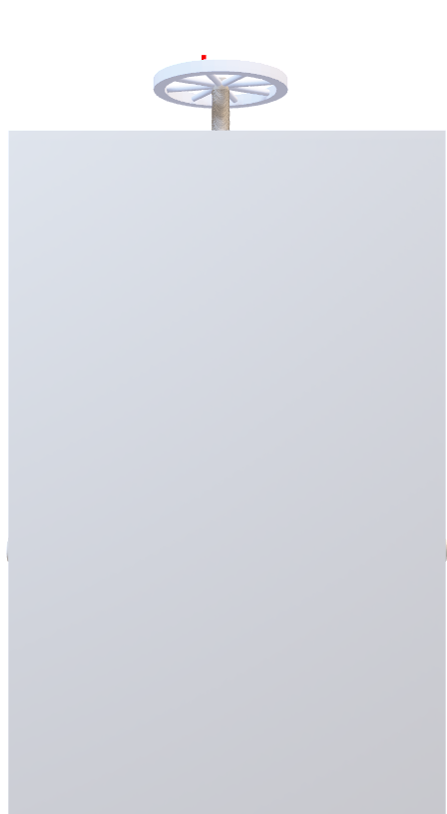
Modeling and assembly
Here are the CAD-modeled components that form the complete scissor lift mechanism.
These visuals help in understanding the structure, assembly process, and functional layout.
Base Top
Function
Provides stable top support for load distribution
by offering a rigid mounting interface for components
Material Selection
AISI 1020
Chosen for its good strength and excellent machinability.
Lead Screw
Function
Converts rotational motion into linear
lifting action delivering smooth and
controlled vertical displacement of
the scissor mechanism.
Material Selection
AISI 4340 Steel, annealed
Selected for its high toughness and superior strength ideal for load-bearing shaft applications.

Slide 12
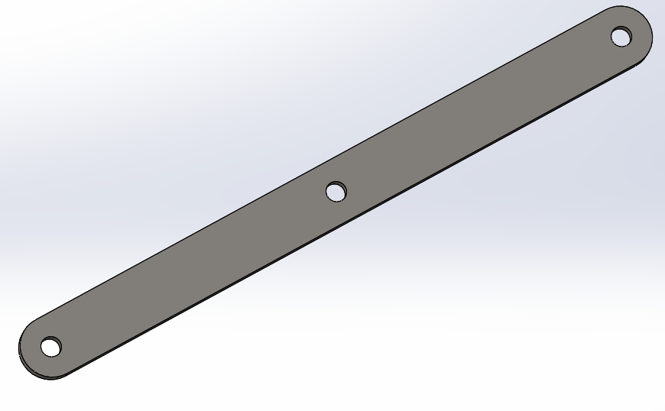
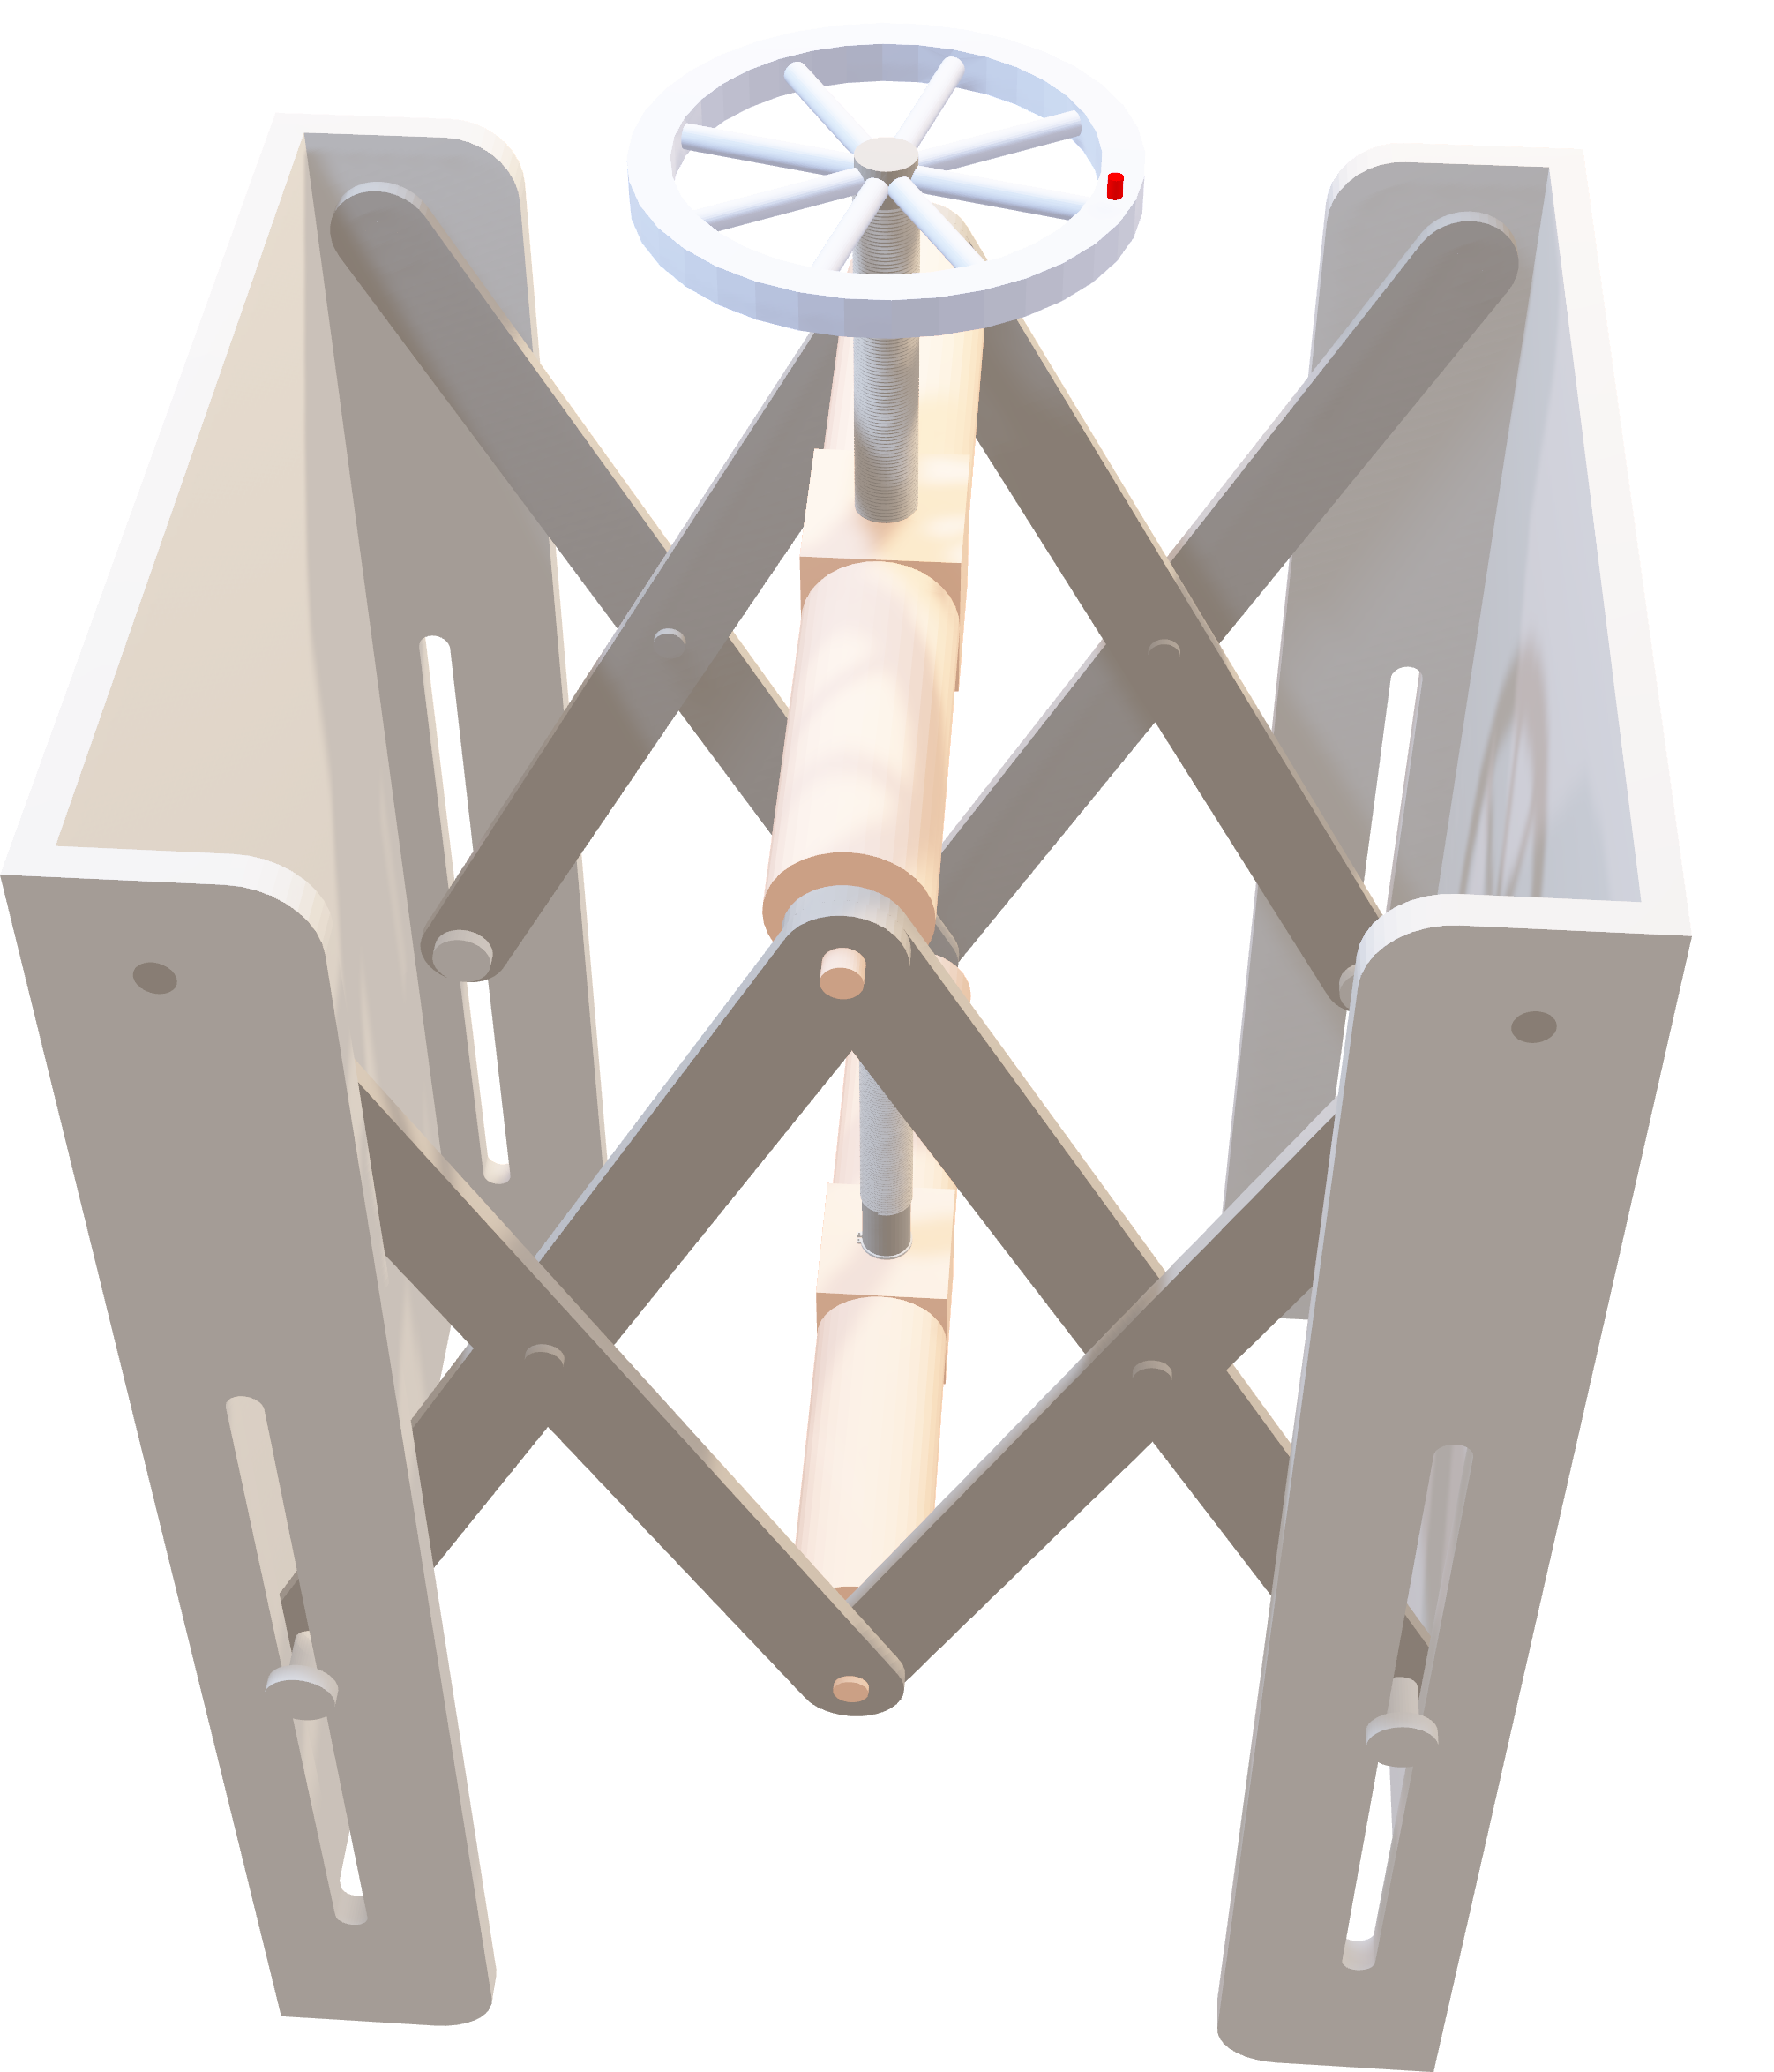
Base Top
Function
Provides stable top support for load distribution
by offering a rigid mounting interface for components
Material Selection
AISI 1020
Chosen for its good strength and excellent machinability.
Lead Screw
Function
Converts rotational motion into linear
lifting action delivering smooth and
controlled vertical displacement of
the scissor mechanism.
Material Selection
AISI 4340 Steel, annealed
Selected for its high toughness and superior strength ideal for load-bearing shaft applications.
Leg Support
Function
Supports the scissor mechanism vertically
by providing structural stability while resisting bending and operational stresses.
Material Selection
ASTM A36 steel
Selected for its high structural strength and good weldability.

Slide 13
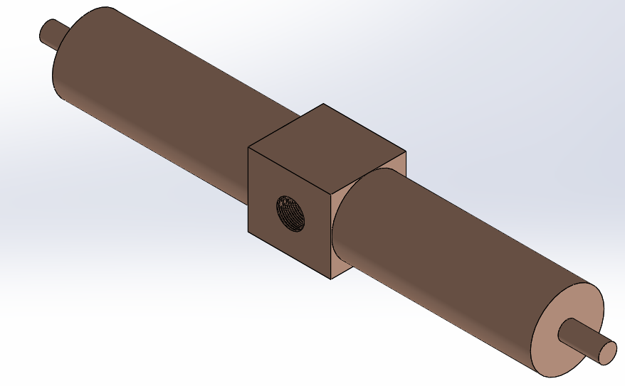
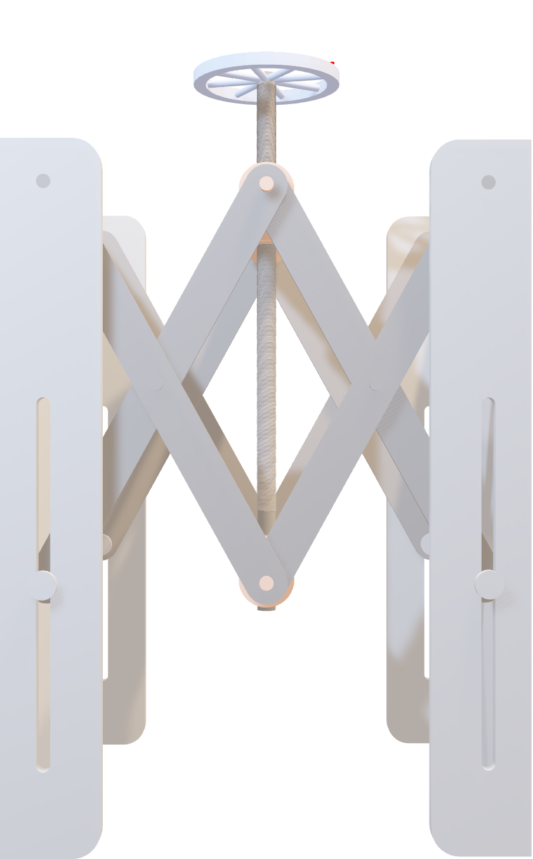
Lead Screw
Function
Converts rotational motion into linear
lifting action delivering smooth and
controlled vertical displacement of
the scissor mechanism.
Material Selection
AISI 4340 Steel, annealed
Selected for its high toughness and superior strength ideal for load-bearing shaft applications.
Leg Support
Function
Supports the scissor mechanism vertically
by providing structural stability while resisting bending and operational stresses.
Material Selection
ASTM A36 steel
Selected for its high structural strength and good weldability.
Cylindrical Support
Function
Holds and guides the lead screw securely
maintaining smooth rotational movement of the shaft.
Material Selection
Phosphor Bronze 10% D (UNS C52400)
Chosen for its excellent wear resistance and low friction properties.

Slide 14
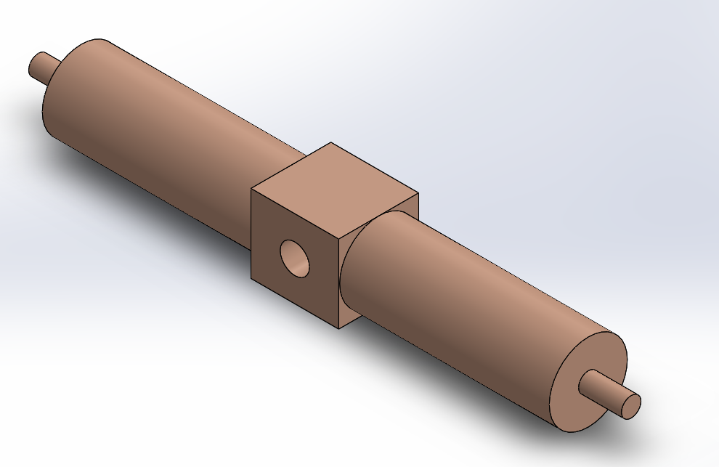
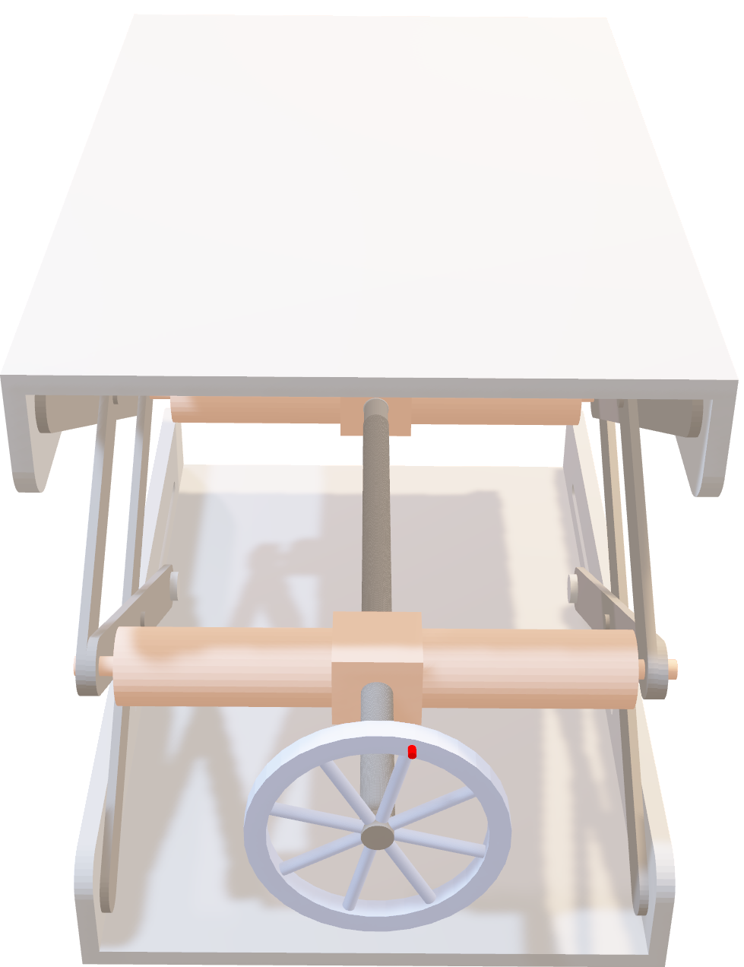
Leg Support
Function
Supports the scissor mechanism vertically
by providing structural stability while resisting bending and operational stresses.
Material Selection
ASTM A36 steel
Selected for its high structural strength and good weldability.
Cylindrical Support
Function
Holds and guides the lead screw securely
maintaining smooth rotational movement of the shaft.
Material Selection
Phosphor Bronze 10% D (UNS C52400)
Chosen for its excellent wear resistance and low friction properties.
Cylindrical Support Fixed
Function
Restricts axial movement between the support
and lead screw while permitting free rotation
ensuring stable transmission of motion
and maintaining alignment under load.
Material Selection
Phosphor Bronze 10% D (UNS C52400)
Chosen for its excellent wear resistance and low friction properties.

Slide 15
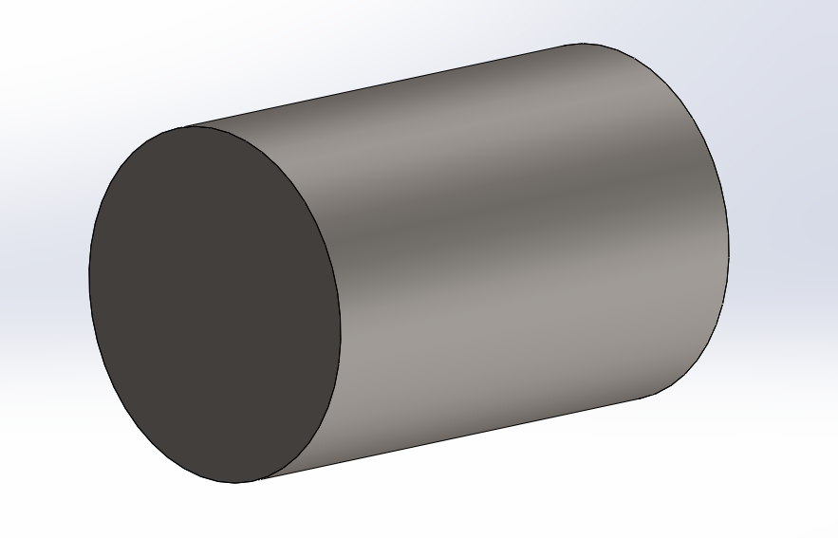
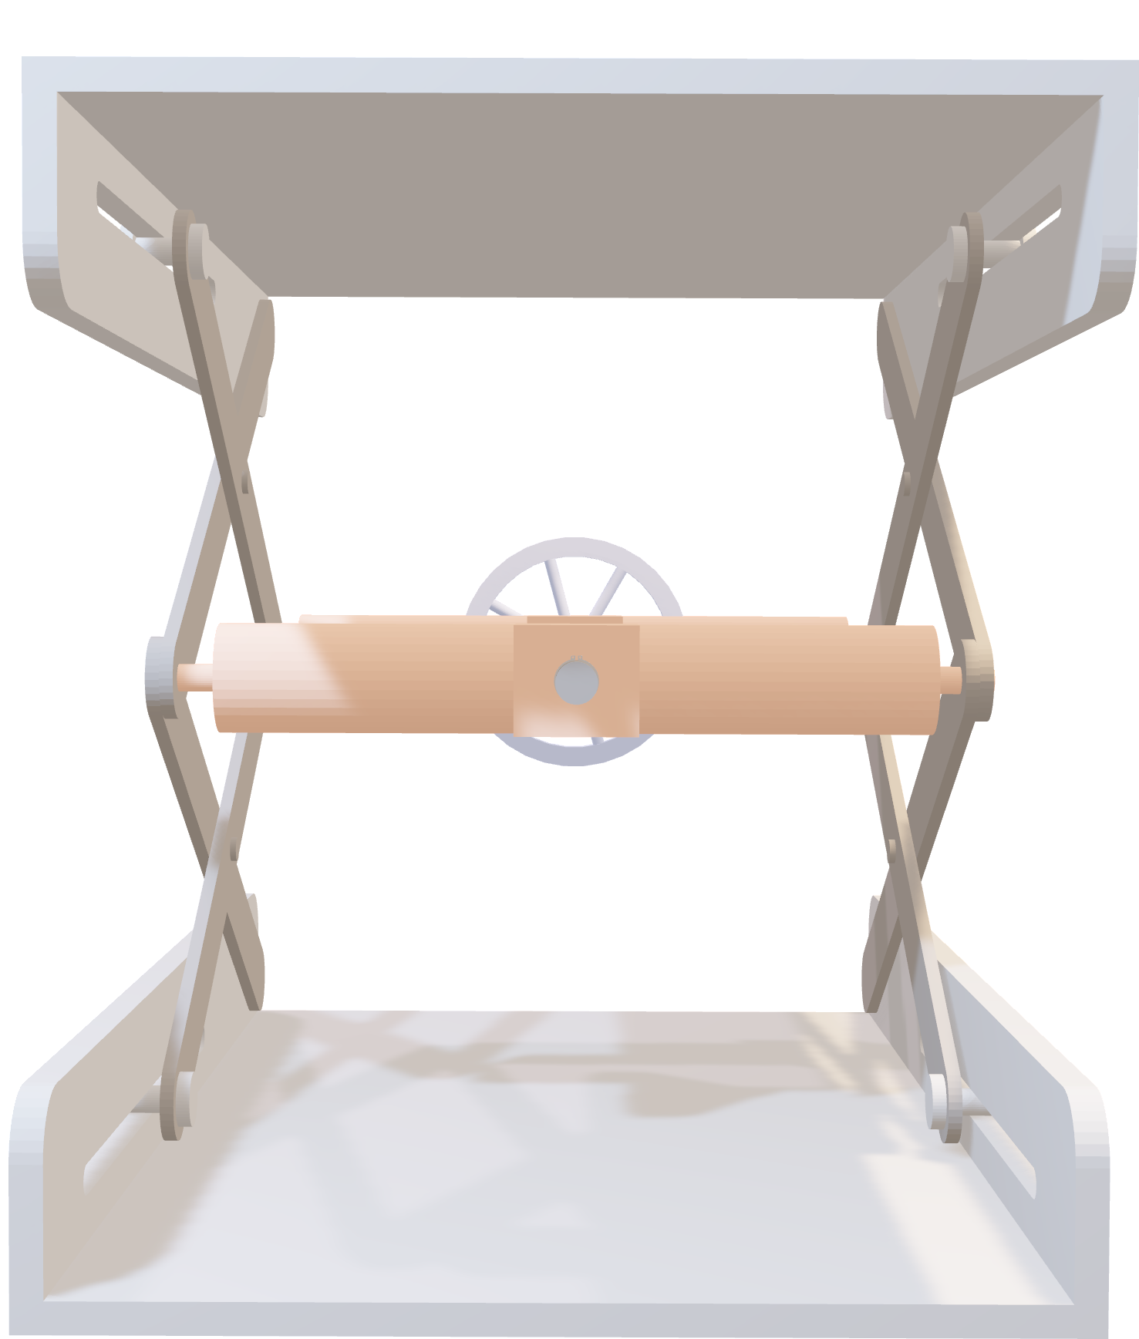
Cylindrical Support
Function
Holds and guides the lead screw securely
maintaining smooth rotational movement of the shaft.
Material Selection
Phosphor Bronze 10% D (UNS C52400)
Chosen for its excellent wear resistance and low friction properties.
Cylindrical Support Fixed
Function
Restricts axial movement between the support
and lead screw while permitting free rotation
ensuring stable transmission of motion
and maintaining alignment under load.
Material Selection
Phosphor Bronze 10% D (UNS C52400)
Chosen for its excellent wear resistance and low friction properties.
Pin
Function
Acts as a point joint connecting
the scissor leg supports enabling
smooth pivoting motion and stable
load transfer during operation.
Material Selection
Alloy Steel (SS)
Chosen for its high strength and wear resistance.

Slide 16
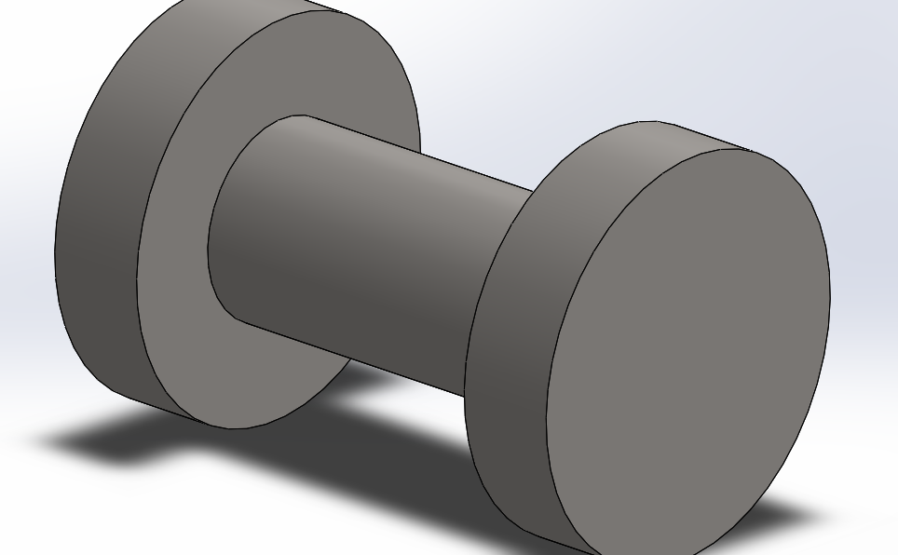
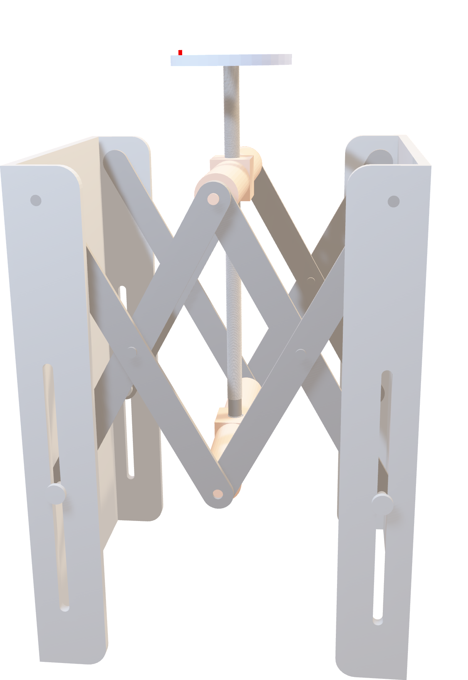
Cylindrical Support Fixed
Function
Restricts axial movement between the support
and lead screw while permitting free rotation
ensuring stable transmission of motion
and maintaining alignment under load.
Material Selection
Phosphor Bronze 10% D (UNS C52400)
Chosen for its excellent wear resistance and low friction properties.
Pin
Function
Acts as a point joint connecting
the scissor leg supports enabling
smooth pivoting motion and stable
load transfer during operation.
Material Selection
Alloy Steel (SS)
Chosen for its high strength and wear resistance.
Bush
Function
Provides a stable interface between
the scissor leg support and base
plate allowing smooth rotation
Material Selection
Cast Alloy Steel
Selected for its durability and ability to withstand cyclic loads.

Slide 17
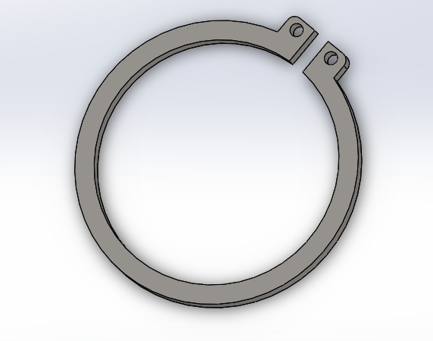

Pin
Function
Acts as a point joint connecting
the scissor leg supports enabling
smooth pivoting motion and stable
load transfer during operation.
Material Selection
Alloy Steel (SS)
Chosen for its high strength and wear resistance.
Bush
Function
Provides a stable interface between
the scissor leg support and base
plate allowing smooth rotation
Material Selection
Cast Alloy Steel
Selected for its durability and ability to withstand cyclic loads.
Circlip
Function
Secures axial position between the
lead screw and cylindrical support
preventing unwanted movement while
allowing smooth rotational action.
Material Selection
AISI 1020
Chosen for its strength and reliable performance in retaining applications.

Slide 18
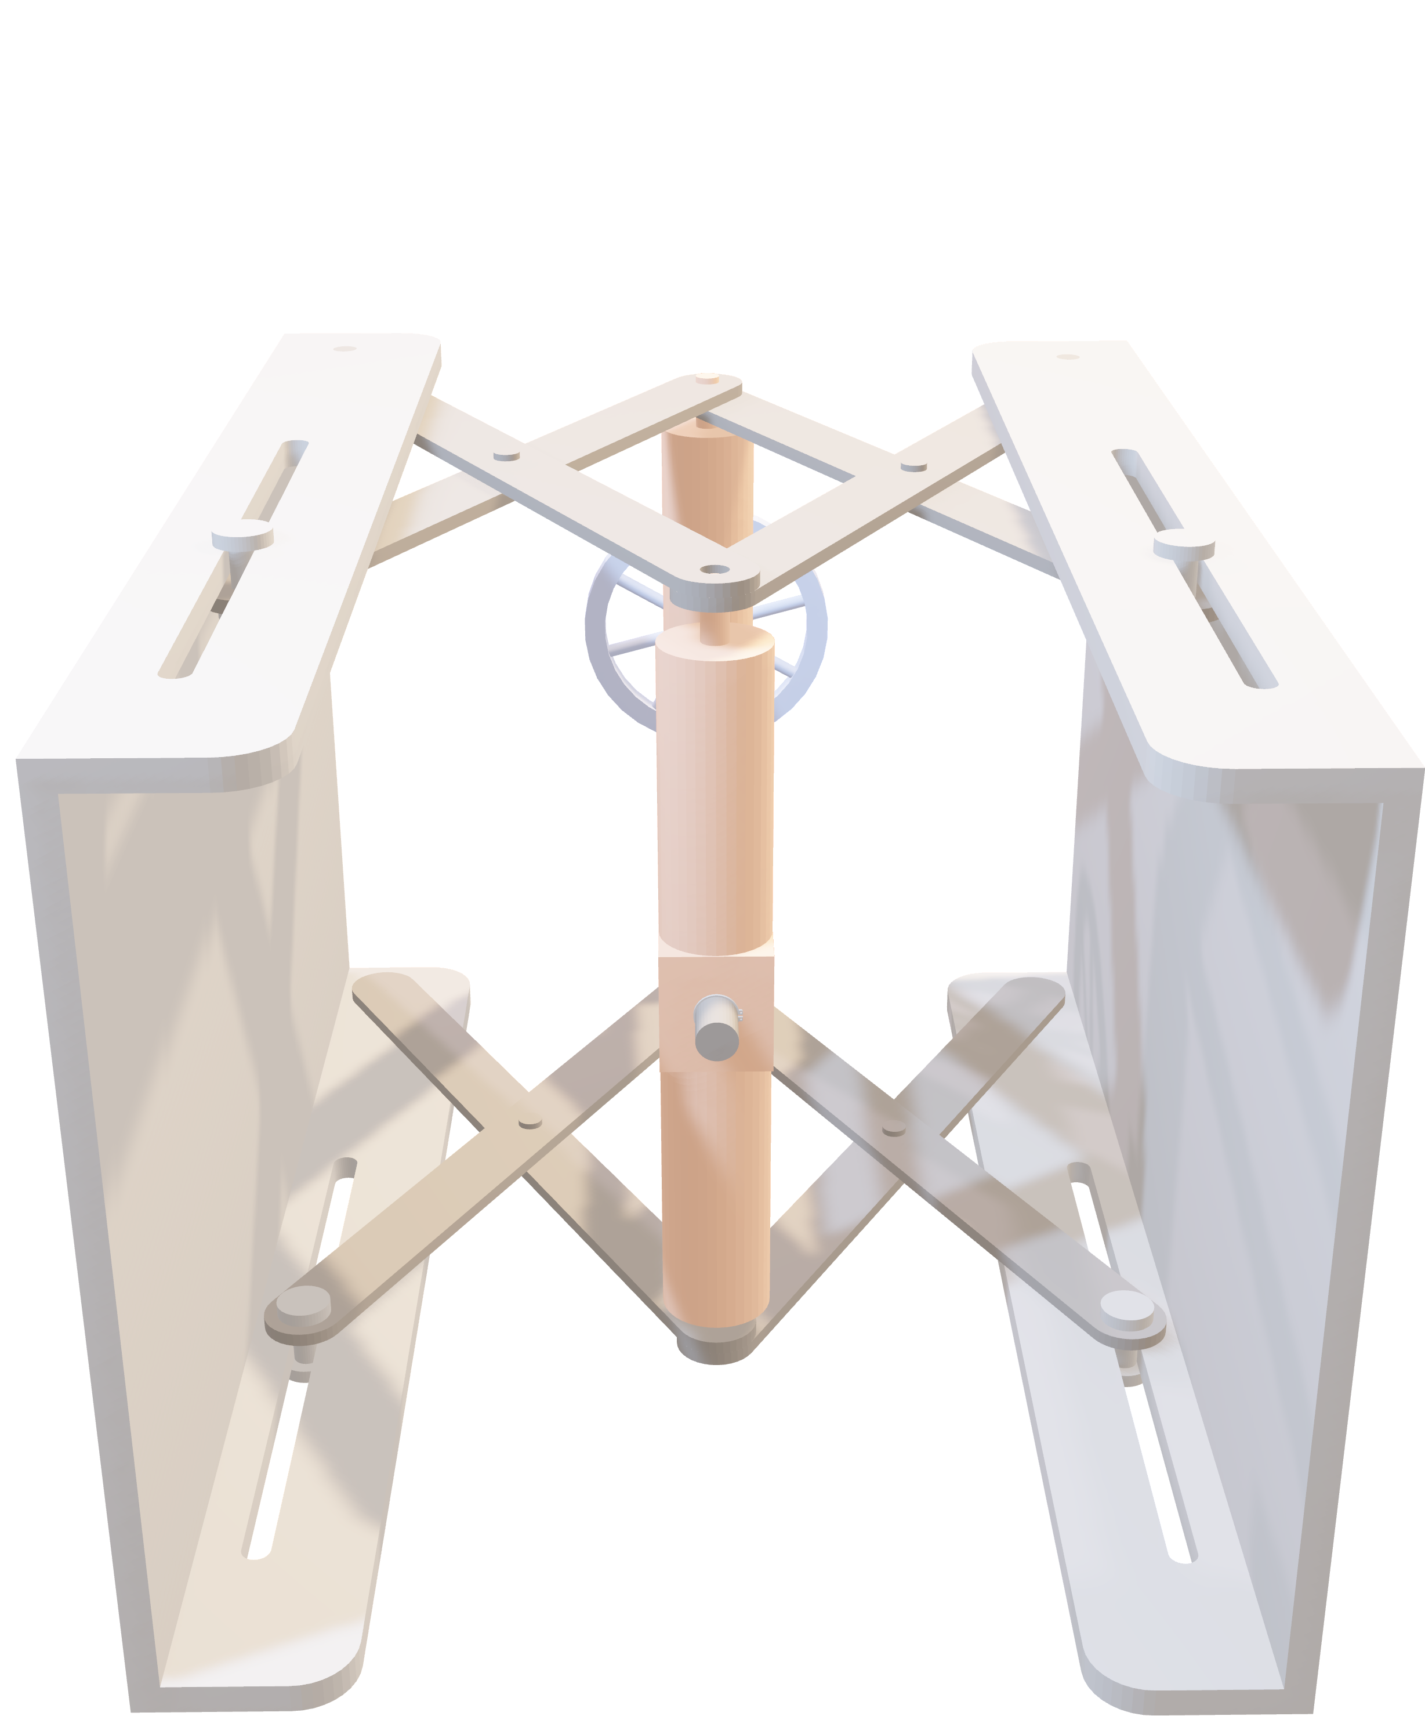
Bush
Function
Provides a stable interface between
the scissor leg support and base
plate allowing smooth rotation
Material Selection
Cast Alloy Steel
Selected for its durability and ability to withstand cyclic loads.
Circlip
Function
Secures axial position between the
lead screw and cylindrical support
preventing unwanted movement while
allowing smooth rotational action.
Material Selection
AISI 1020
Chosen for its strength and reliable performance in retaining applications.
Assembly
The assembly integrates all components into a coordinated scissor-lift mechanism that converts rotational input into stable vertical motion.
Each part is fitted with precise clearances and selected materials to ensure smooth operation, structural reliability, and long-term durability.

Slide 19
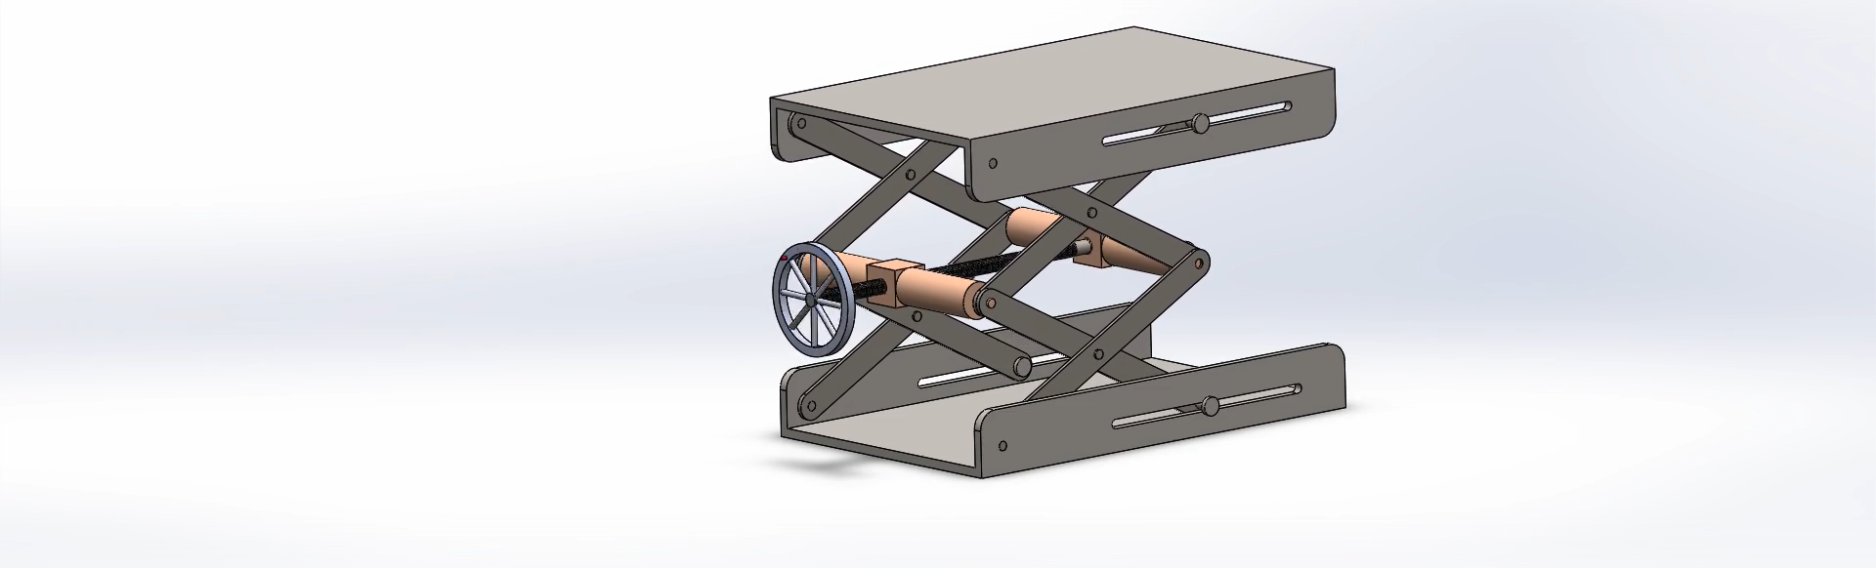
Circlip
Function
Secures axial position between the
lead screw and cylindrical support
preventing unwanted movement while
allowing smooth rotational action.
Material Selection
AISI 1020
Chosen for its strength and reliable performance in retaining applications.
Assembly
The assembly integrates all components into a coordinated scissor-lift mechanism that converts rotational input into stable vertical motion.
Each part is fitted with precise clearances and selected materials to ensure smooth operation, structural reliability, and long-term durability.

Slide 20
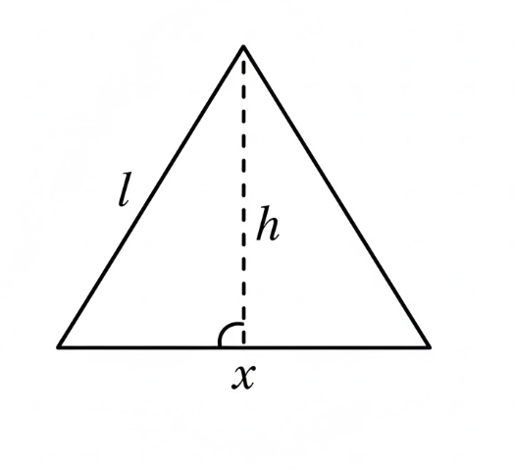
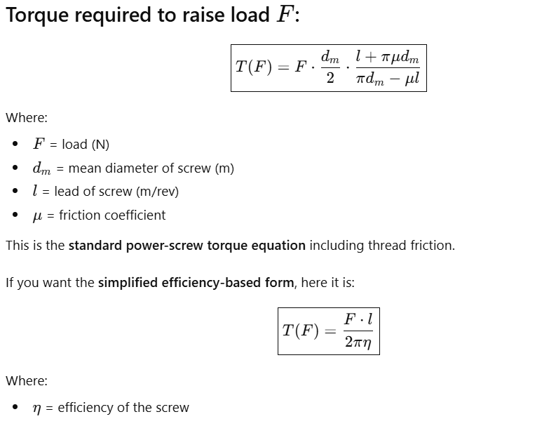
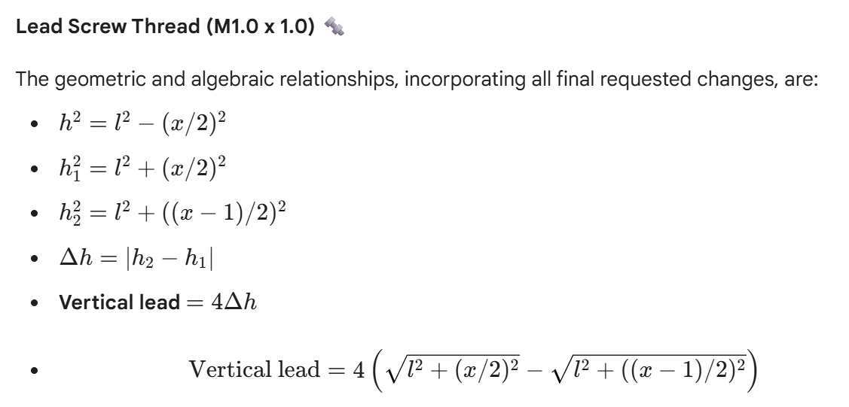
CALCULATIONs

Slide 21

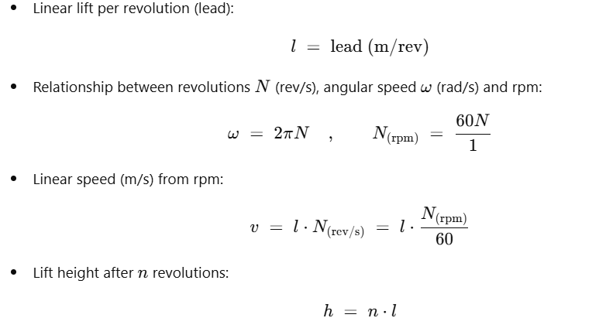
CALCULATIONs

Slide 22
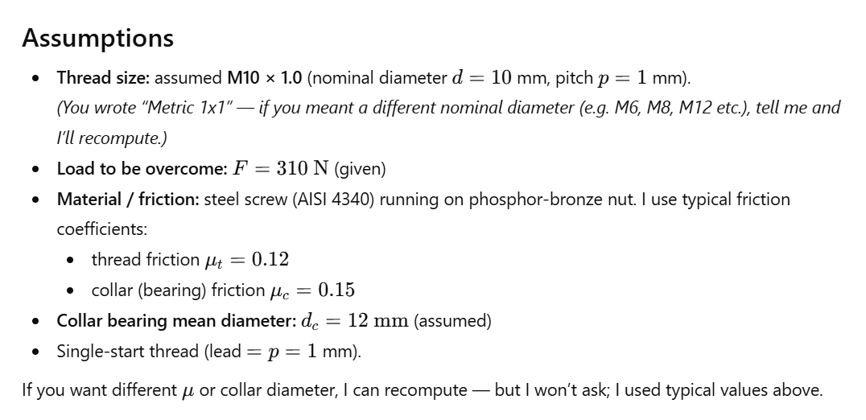
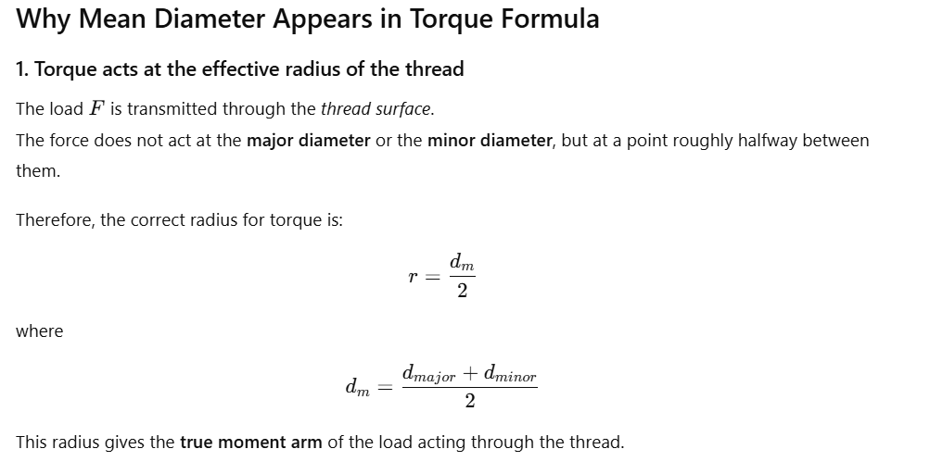
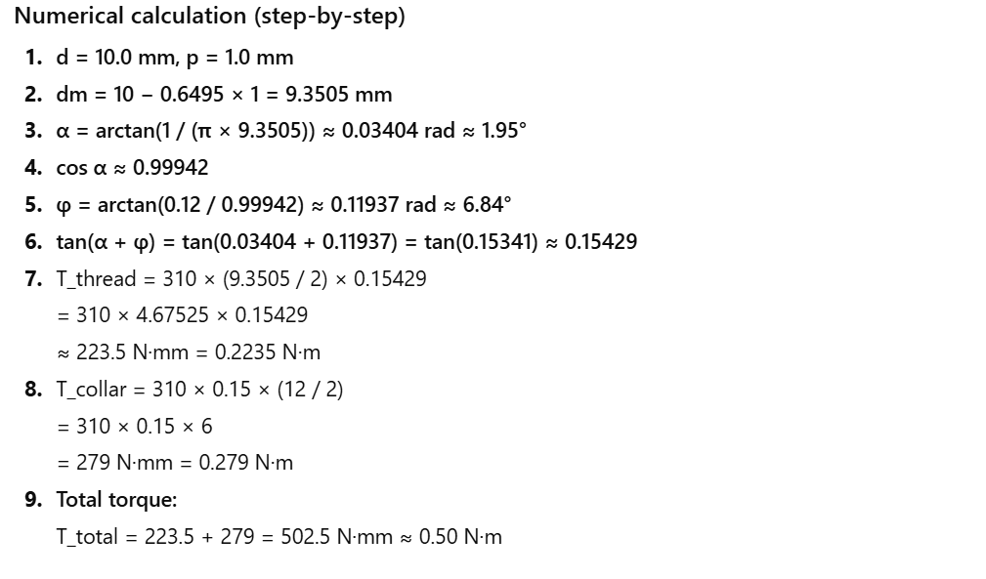
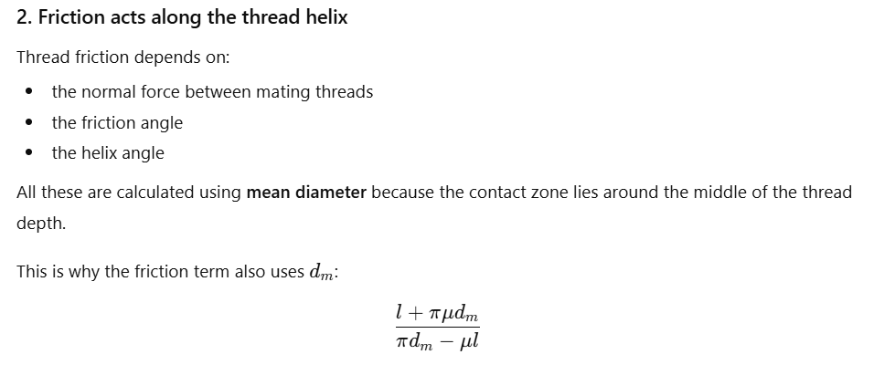
CALCULATIONs

Slide 23
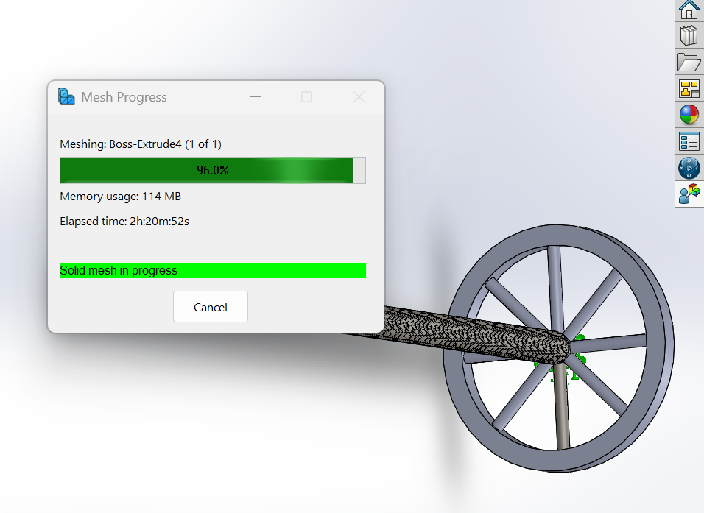
FEA

Slide 24
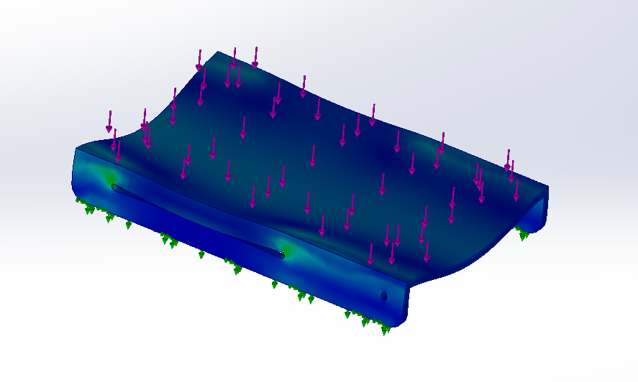
FEA

Slide 25
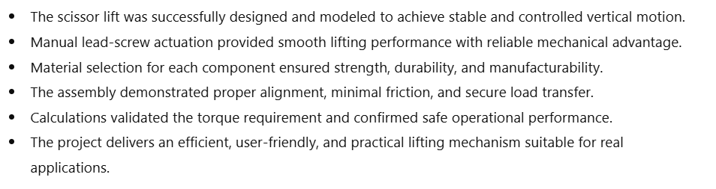
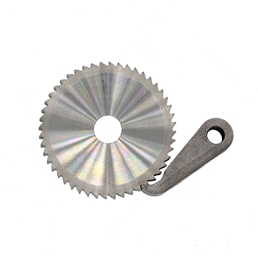
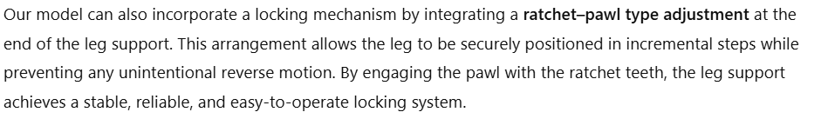
Conclusion

Slide 26


