Slide 1

Optimizing TV Program Scheduling
By Mohamad Knio

Slide 2
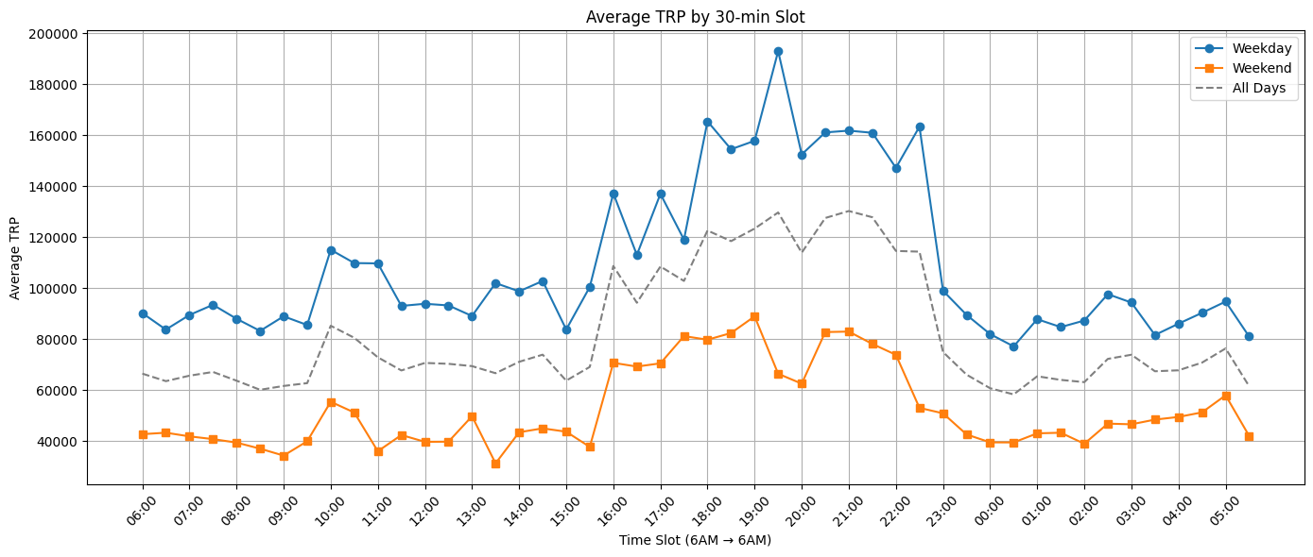
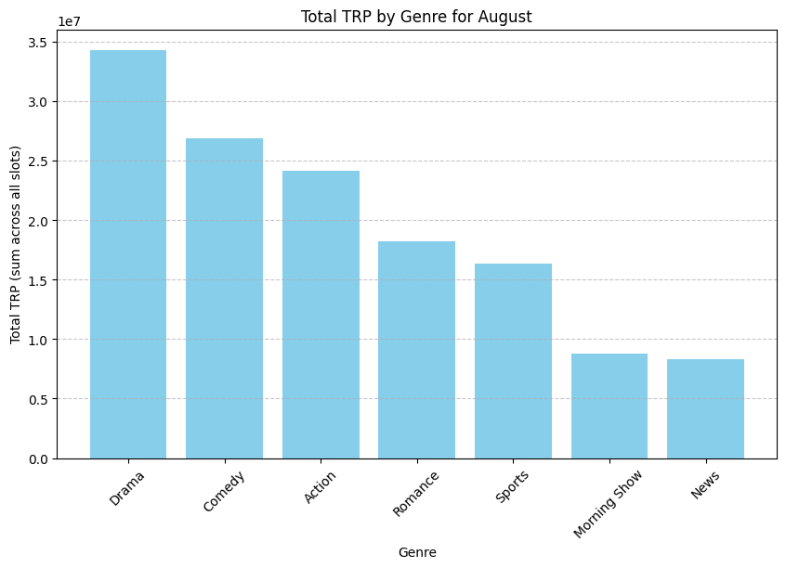
Problem Statement
Place 10 new programs optimally on the weekly TV grid
Manual scheduling is slow, error-prone, and biased
Many conflicting constraints: genre spacing, program duration, peak vs off-peak slots
TRP varies hourly and daily, making manual optimization difficult
Weekend vs weekday patterns differ

Slide 3

Objectives
Maximize
Maximize total TRP for the 10 new programs
Place
Place all programs exactly once on the grid
Respect
Respect constraints:
Duration rules (weekday = 1 hour, weekend = 2 hours)
Genre Spacing avoid same-genre consecutive programs)
Peak-hour TRP for maximum viewership
Weekend vs Weekday dynamics
Leverage
Leverage AI-generated metadata (subgenre, tone, violence, theme, age group)
Produce
Produce a clear, readable, optimized weekly schedule

Slide 4
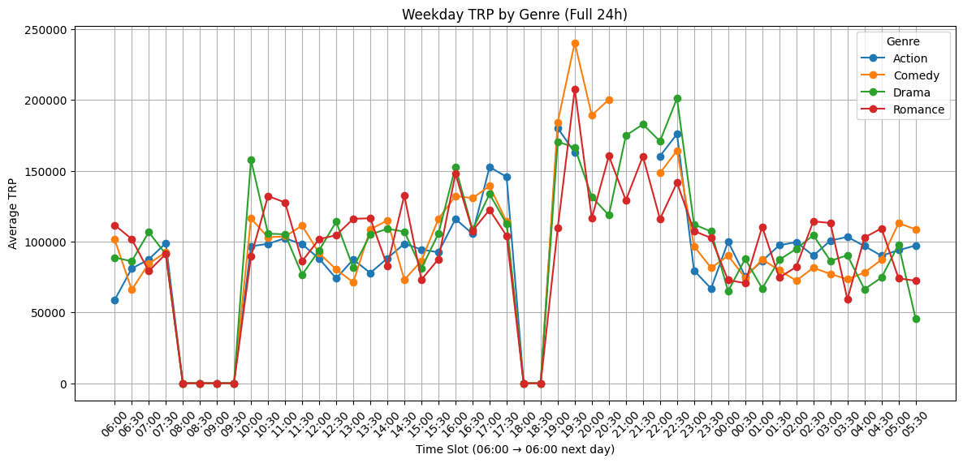
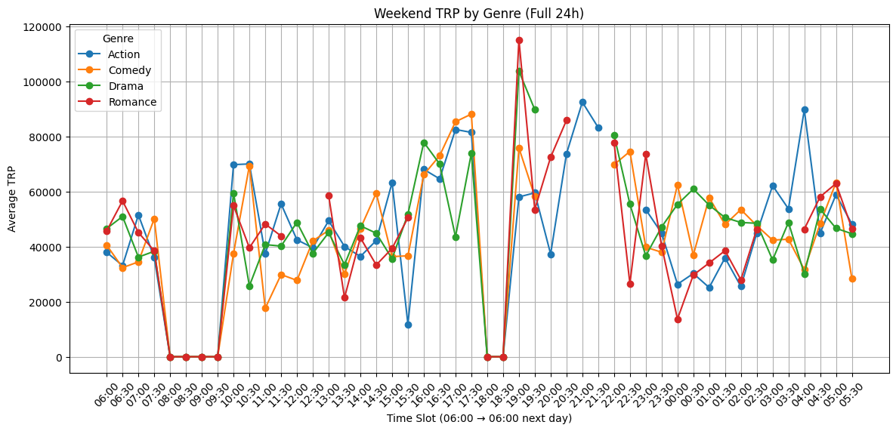
Data & Feature Engineering
Key engineered columns:
  Time slots indexed (0–47)
  TRP scaled 0-1
  Peak-Hour identified
  Genre Compatibility and duration blocks
LLM-generated metadata for all programs:
  Subgenre, Tone, Violence, Theme, Age group
  Used to improve CP-SAT optimization and meaningful program placement
Insights extracted from historical data:
  Weekend vs Weekday patterns differ between genres
  Empty vs Peak slots
  Pattern that guide optimal scheduling

Slide 5
CP-SAT: The Industry-Standard for TV Scheduling
Genetic Algorithm has high variance
  Not guaranteed to satisfy constraints
  Needs hundreds of generations
  Can place shows at nonsense times (e.g. Comedy at 5AM)
CP-SAT:
  Deterministic
  Perfect for scheduling
  Handles as many constraints as possible
  Guarantees an optimal or near-optimal solution
  CP-SAT is the industry-standard choice

Slide 6
CP-SAT Overview
CP-SAT is a modern optimization solver by Google
Designed for:
TV scheduling
Crew Scheduling
Manufacturing
Logistics
Works using:
Integer programming
Conflict-based search
Boolean Constraints
Perfect for timetables with many rules

Slide 7
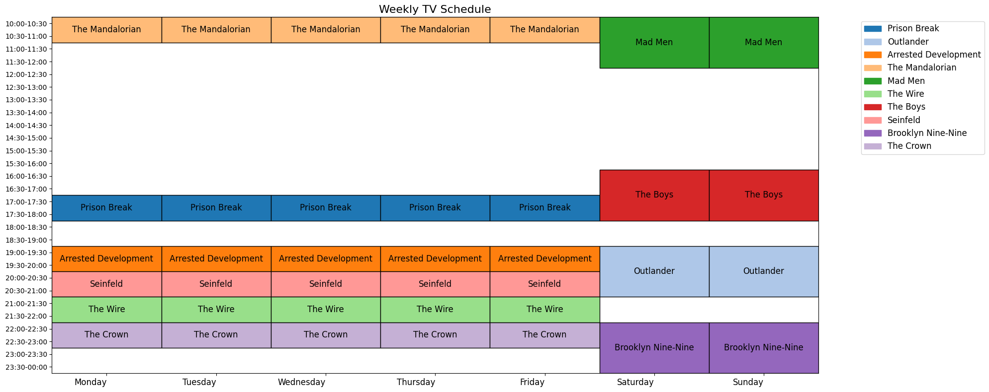
Result

